Slide 1
#Challenge-13
IoT Product - 1
Tank Water Management System(Dropium)
ADDANKI SRI ROHITH MANGESH
2020BCS0108

Slide 2
Generally, people use water tanks to store water
They face many problems with this tank water
Some of the common issues are:
1)Contamination of water
2)Green or black algae growing in the storage tank
3)Fire Damage to Storage Tanks
4)Checking of water level on a regular basis
Here comes the solution !

Slide 3
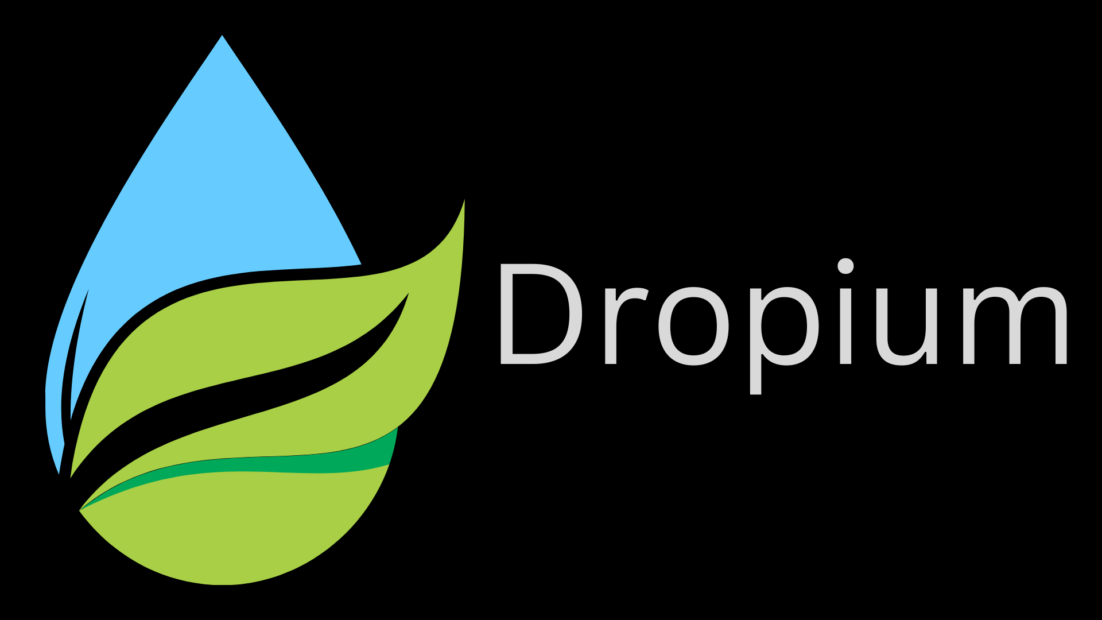

Slide 4
Dropium
Dropium is an IoT based one stop application where the users can know the
Temperature of the water
pH of the water
Water level
Turbidity of water

Slide 5
We measure them using different IoT based sensors
Such as
1)pH sensor
To measure the pH level of the water
2)Temperature sensor
To measure the temperature of the water
3)Ultrasonic sensor
To measure the water level using sound waves
4)Turbidity sensor
To measure the turbidity (the level of relative clarity of liquid)

Slide 6
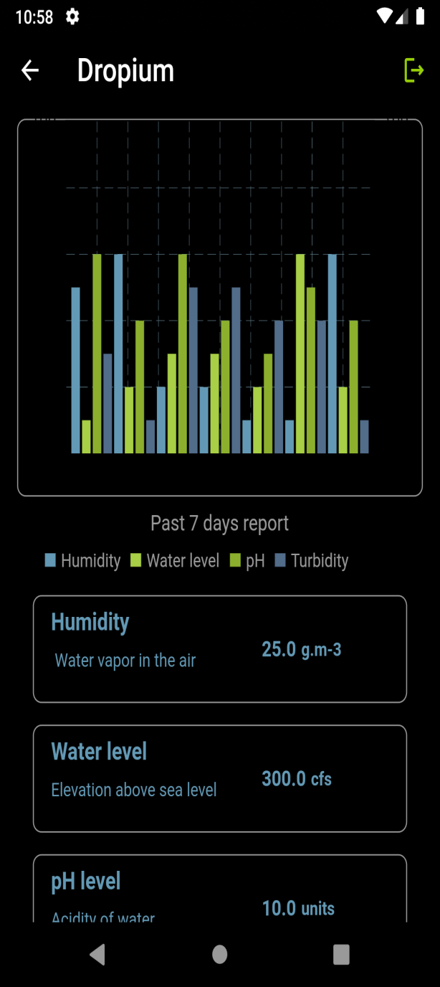
This real-time data is displayed in the app and notifying
user in dangerous/emergency situations
Tech stack used
1)Flutter
2)Firebase
Sensors used
1)pH sensor
2)Ultrasonic sensor
3)Turbidity sensor
4) Temperature sensor

Slide 7
Who are the end users?
This can be used for domestic purposes in which the users can install the sensor in their water tanks and can track the real-time data
Farmers can use this to track the pH levels of the ground water for the selection of suitable crops
Large water tanks in the city which store large amounts of water , are placed at high altitude’s, it takes a lot of effort to check and test the water regularly Where dropium makes it easy so that municipal workers can track the quality and quantity of water

