Slide 1
AI-Native Smart City Operating Platform
with Multi-Agent Decision Intelligence, Explainable AI, Digital Twin, and LLM-Based Decision Support
Mangesh Bandre | Roll No. 553 | M.Sc. Computer Science
Guide: Mrs. Megha Sawant | Ramnarain Ruia Autonomous College, Matunga, Mumbai | 2026-27

Slide 2
Problem & Objectives
The Problem
Objectives
Smart city dashboards only monitor; decisions stay manual and slow
AI models work in silos, no cross-department coordination
Black-box predictions reduce operator trust
No scenario simulation, no LLM support, no learning from outcomes
Unified AI-native architecture
Six collaborating agents: Traffic, Hospital, Police, Fire, Weather, Utility
Decision Intelligence for prioritisation and resource allocation
XAI for transparency
2D Digital Twin for scenarios
LLM City Assistant; compare with dashboard baseline
2

Slide 3
Literature Review & Research Gaps
Smart city platforms (IBM, Cisco, Siemens, Huawei) give dashboards and alerts, not decisions
AI, MAS, XAI, Digital Twins and LLMs are each well studied
Foundations: Batty 2012, Zanella 2014, Wooldridge 2009, Lundberg & Lee 2017 (SHAP), Brown 2020
Independent AI models
Dashboard-centric
Black-box AI
No cross-domain collaboration
No automated prioritisation
Little XAI in operations
Standalone twins
No unified LLM support
No unified architecture
Not linked to decisions
Few multi-agent explanations
Static models, no learning
3

Slide 4
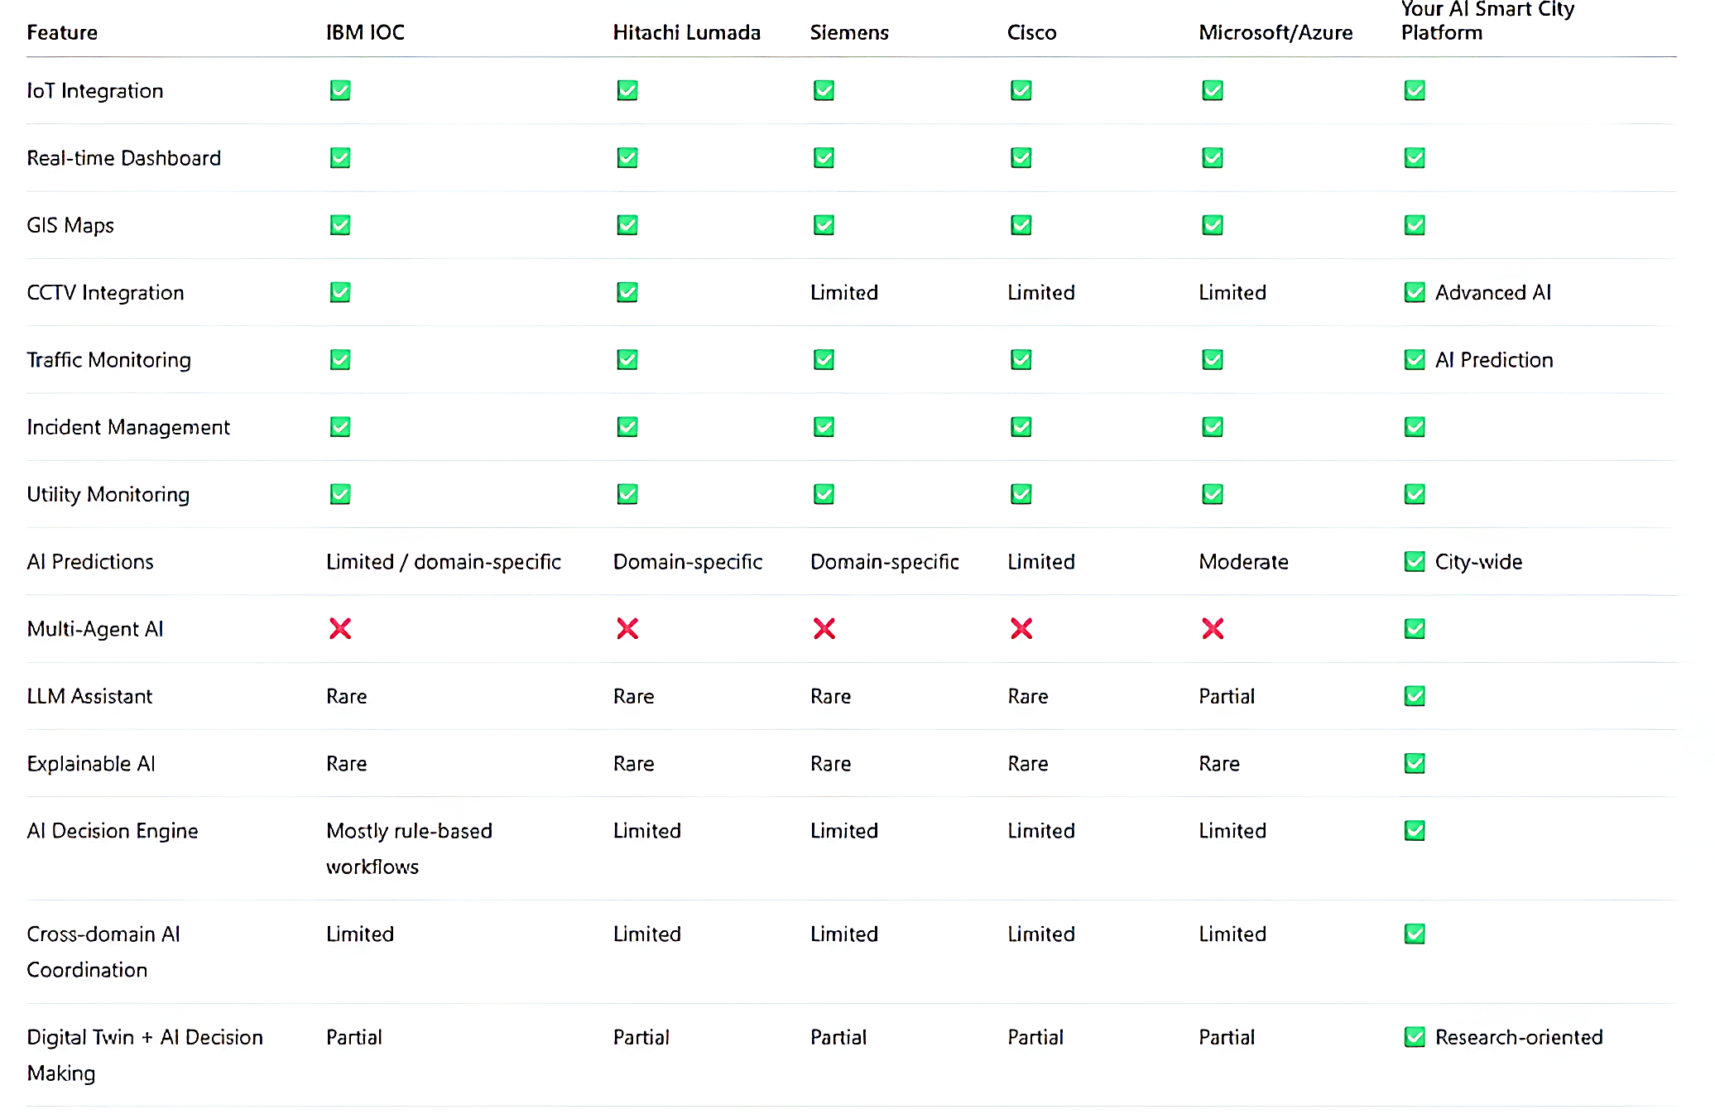

Slide 5
Methodology: Design Science Research
City data
Preprocess
AI prediction
Multi-agent
Decision intel.
XAI + Twin
LLM assistant
Dashboard
Continuous learning loop: record outcomes, compare predicted vs actual, retrain models
Data: public + simulated (traffic, weather, GPS, CCTV, hospital, fire, utility, citizen reports)
4

Slide 6
Core Components
Prediction layer
Multi-agent layer
Decision intelligence
Random Forest, XGBoost, Gradient Boosting for traffic, flood, hospital, fire, utility faults
Agents monitor, share info and request help across departments
Priority score from severity, affected citizens, traffic impact, resources; ranks incidents
Explainable AI
2D Digital Twin
LLM City Assistant
SHAP/LIME feature importance turned into plain-language reasons
Leaflet map simulating floods, fires, road closures, rerouting before action
Answers queries, summarises incidents, explains decisions in natural language
5

Slide 7
Implementation
Technology Stack
Frontend: React, Tailwind, Leaflet, Recharts
Backend: Node.js, Express, Socket.IO
Database: PostgreSQL
AI: Python, Scikit-learn, XGBoost, SHAP/LIME
LLM: OpenAI-compatible API
Deploy: Docker, Nginx, Linux/Cloud
6

Slide 8
Conclusion & Future Work
Findings
Future Enhancements
Main contribution is the integrated architecture, not a single model
Moves smart cities from monitoring to explainable decision support
Limits: simulated data, 2D twin, simulated learning, no autonomous control
Real-time IoT integration
3D Digital Twin and Edge AI
Federated learning and drones
Controlled autonomous dispatch
RAG-enhanced LLM assistant
Validation with real municipal data
7

