Slide 1


CMPE 280
Web UI Design and Development
September 28 Class Meeting
Department of Computer Engineering
San Jose State University
Fall 2017
Instructor: Ron Mak
www.cs.sjsu.edu/~mak

Slide 2
jQuery Object Effects
Method | Operation
show() | Make the object visible.
hide() | Make the object invisible.
toggle() | Toggle visible/invisible.
fadeIn() | Fade the object in.
fadeOut() | Fade the object out.
fadeToggle() | Toggle fade in/fade out.
slideDown() | Slide the object into view from top to bottom.
slideUp() | Slide the object out of view from bottom to top.
slideToggle() | Toggle slide down/slide up.

Slide 3
jQuery Object Effects, cont’d
<body>
<h1>Object Effects</h1>
<div id="buttons">
<h2 id="show">Show</h2>
<h2 id="hide">Hide</h2>
<h2 id="toggle">Toggle</h2>
<h2 id="slideDown">Slide Down</h2>
<h2 id="slideUp">Slide Up</h2>
<h2 id="fadeIn">Fade In</h2>
<h2 id="fadeOut">Fade Out</h2>
<h2 id="wrap">Wrap</h2>
<h2 id="unwrap">Unwrap</h2>
</div>
<p id="content">
<img src="images/Bristol.png" width="400" id="image"/>
</p>
</body>
effects.html

Slide 4
jQuery Object Effects, cont’d
#buttons {
float: left;
}
#content {
float: right;
}
h2 {
width: 10em;
border: 3px outset black;
background-color: lightgray;
text-align: center;
font-family: sans-serif;
border-radius: 5px;
box-shadow: 5px 5px 5px gray;
}
.wrapped {
border: 3px solid red;
padding: 2px;
}
effects.css

Slide 5
jQuery Object Effects, cont’d
$(init);
var showing = false;
var wrapped = false;
function init()
{
$("#content").hide();
$("#show").click(showContent);
$("#hide").click(hideContent);
$("#toggle").click(toggleContent);
$("#slideDown").click(slideDown);
$("#slideUp").click(slideUp);
$("#fadeIn").click(fadeIn);
$("#fadeOut").click(fadeOut);
$("#wrap").click(wrapImage);
$("#unwrap").click(unwrapImage);
}
effects.js

Slide 6
jQuery Object Effects, cont’d
effects.js
function showContent()
{
$("#content").show();
showing = true;
}
function hideContent()
{
$("#content").hide();
showing = false;
}
function toggleContent()
{
$("#content").toggle();
showing = !showing;
}

Slide 7
jQuery Object Effects, cont’d
effects.js
function slideDown()
{
$("#content").slideDown("medium");
showing = true;
}
function slideUp()
{
$("#content").slideUp(500);
showing = false;
}

Slide 8
jQuery Object Effects, cont’d
effects.js
function fadeIn()
{
$("#content").fadeIn(1000, meow);
showing = true;
}
function fadeOut()
{
$("#content").fadeOut("fast");
showing = false;
}
function meow()
{
alert("MEOW!");
}

Slide 9
jQuery Object Effects, cont’d
effects.js
function wrapImage()
{
if (showing) {
$("#image").wrap("<div class='wrapped'></div>");
wrapped = true;
}
}
function unwrapImage()
{
if (showing && wrapped) {
var image = $("#image").clone();
$(".wrapped").remove();
$("#content").append(image);
wrapped = false;
}
}
Demo

Slide 10
jQuery Object Animation
Use the css() method to change
an object’s position.
Use chaining:
Or use a JSON object:
$("#content").css("left", "10px").css("top", "120px");
$("#content").css( {"left": "10px",
"top": "120px"} );

Slide 11
jQuery Object Animation, cont’d
The jQuery animate() method changes
any DOM characteristics (such as position)
over time.
  Example:
  Change the left and top attribute values to 500px and 300px, respectively, over a span of 2 seconds.
var end = {"left": "500px",
"top": "300px"};
...
$("#content").animate(end, 2000);

Slide 12
jQuery Object Animation, cont’d
The animation can occur in two modes.
swing: The animation starts slowly, speeds up, and then ends slowly (like a child on a swing).
  This is the default mode.
linear: The animation occurs at a
constant speed.
$("#content").animate(end, 2000, "linear");

Slide 13
jQuery Object Animation, cont’d
<form action = "">
<fieldset>
<button type = "button" id = "home">
Home
</button>
<button type = "button" id = "swing">
Swing glide
</button>
<button type = "button" id = "linear">
Linear glide
</button>
<button type = "button" id = "left">
&lt;--
</button>
<button type = "button" id = "right">
-->
</button>
</fieldset>
</form>
<p id="content">
<img src="images/Bristol.png" width="200" id="image"/>
</p>
animate.html

Slide 14
jQuery Object Animation, cont’d
animate.js
$(init);
var start = {"left": "10px",
"top": "120px"};
var end = {"left": "500px",
"top": "300px"};
function init()
{
$("#home").click(home);
$("#swing").click(swingGlide);
$("#linear").click(linearGlide);
$("#left").click(left);
$("#right").click(right);
}
function home()
{
$("#content").css(start);
}

Slide 15
jQuery Object Animation, cont’d
animate.js
function swingGlide()
{
home();
$("#content").animate(end, 2000);
}
function linearGlide()
{
home();
$("#content").animate(end, 2000, "linear");
}
function left()
{
$("#content").animate({"left": "-=10px"}, 100);
}
function right()
{
$("#content").animate({"left": "+=10px"}, 100);
}
Demo

Slide 16
The jQuery User Interface Toolkit
The jQuery User Interface Toolkit
is built on top of the jQuery library.
New cross-platform UI features:
  UI elements: scrollbars
    tabs, date pickers, etc.
  Advanced user interaction
    drag and drop
    resize objects
  Theme templates
    control your application’s look and feel
  Icon library

Slide 17
The jQuery User Interface Toolkit, cont’d
Build a modern application.
  That just happens to run inside a web browser.
  Add visual effects.
Single-page application (SPA)
Open source
  Download from http://jqueryui.com

Slide 18
Themes
A jQuery theme is a visual rule set.
  Defines a particular look and feel.
  Implemented by a complex CSS document
  that you can download and link to your web pages.
Visit the jQuery Theme Roller at
http://jqueryui.com/themeroller/
  Widgets (tool objects) of jQuery UI.
  Select and download themes.
  Modify themes or create new themes.

Slide 19
Drag an Object
Call a jQuery object’s draggable() function
on an object to enable it to be dragged with a mouse.

Slide 20
Drag an Object, cont’d
<head>
<title>Drag</title>
<meta charset= "UTF-8" />
<script type="text/javascript"
src="js/jquery.js">
</script>
<script type="text/javascript"
src="js/jquery-ui-lightness/jquery-ui.min.js">
</script>
<script type="text/javascript"
src="js/drag.js">
</script>
</head>
<body>
<h1>Drag Demo</h1>
<div id="dragMe">
<img src="images/Bristol.png" width="200" />
</div>
</body>
drag.html
drag.js
$(init);
function init()
{
$("#dragMe").draggable();
}

Slide 21
UI Icons
Each UI Toolkit download includes an images folder that contains the icon files.
To insert an icon, create a span
where icon-name is obtained from the
Theme Roller.
Hover the mouse over the desired icon
to see its name.
<span class="ui-icon icon-name"></span>

Slide 22
Resize an Object
Call a jQuery object’s resizable() function
on an object to enable it to be resized with a mouse.
Add the following jQuery UI classes
to the object:
  ui-widget
  ui-widget-content
  ui-corner-all

Slide 23
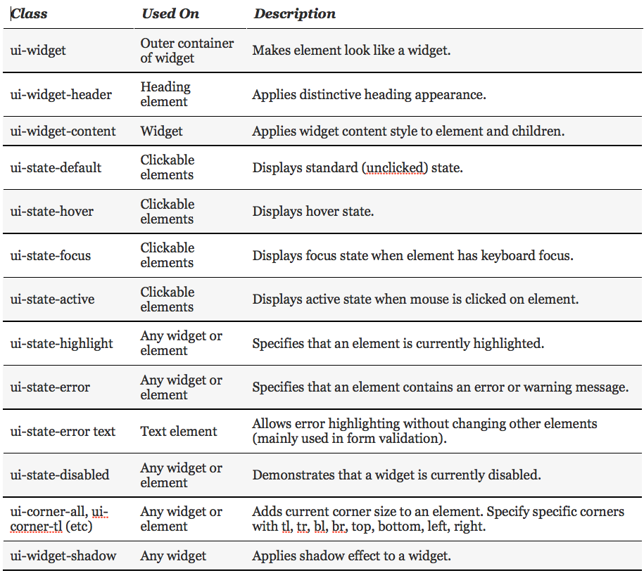
jQuery UI Toolkit Classes for CSS

Slide 24
Resize an Object, cont’d
<head>
<meta http-equiv="content-type"
content="text/xml; charset=utf-8" />
<link rel = "stylesheet"
type = "text/css"
href = "css/jquery-ui-lightness/jquery-ui.min.css" />
<link rel = "stylesheet"
type = "text/css"
href = "css/resize.css" />
<script type = "text/javascript"
src = "js/jquery.js">
</script>
<script type = "text/javascript"
src = "js/jquery-ui-lightness/jquery-ui.min.js">
</script>
<script type = "text/javascript"
src="js/resize.js">
</script>
<title>resize.html</title>
</head>
resize.html

Slide 25
Resize an Object, cont’d
<body>
<h1>Resize Demo</h1>
<div id = "resizeMe">
<h2>
<span class = "ui-icon ui-icon-heart"></span>
Resize me
<span class = "ui-icon ui-icon-star"></span>
</h2>
<p>
Drag a corner or side to resize.
</p>
</div>
</body>
resize.html

Slide 26
Resize an Object, cont’d
resize.js
$(init);
function init()
{
$("#resizeMe").resizable();
$("div").addClass("ui-widget")
.addClass("ui-widget-content")
.addClass("ui-corner-all");
$(":header").addClass("ui-widget-header")
.addClass("ui-corner-all");
}

Slide 27
Drag and Drop an Object
Call a jQuery object’s droppable() function
to an object to enable it to be a drop target.
Use the bind() function to bind drop-in
and drop-out events to the object.
  Attach a callback function to each event.
UI variable ui-draggable refers to the object that triggered the drop-in callback function.

Slide 28
Drag and Drop an Object, cont’d
dragdrop.html
<body>
<h1>Drag and Drop Demo</h1>
<div class="dragMe">
DRAG ME
</div>
<div id="target">
DROP HERE
</div>
</body>
</html>

Slide 29
Drag and Drop an Object, cont’d
.dragMe {
width: 100px;
height: 100px;
border: 1px solid blue;
text-align: center;
background-color: white;
position: absolute;
z-index: 100;
}
#target {
width: 200px;
height: 200px;
border: 1px solid red;
text-align: center;
position: absolute;
left: 300px;
top: 100px;
z-index: 0;
}
dragdrop.css

Slide 30
Drag and Drop an Object, cont’d
dragdrop.js
$(init);
function init()
{
cloneDragMe();
$(".dragMe").draggable();
$("#target").droppable();
$("#target").bind("drop", highlightTarget);
$("#target").bind("dropout", resetTarget);
}

Slide 31
Drag and Drop an Object, cont’d
dragdrop.js
function highlightTarget(event, ui)
{
$("#target").addClass("ui-state-highlight")
.html("Dropped ")
.append(ui.draggable.text());
}
function resetTarget(event, ui)
{
$("#target").removeClass("ui-state-highlight")
.html("Drop on me");
}

Slide 32
Drag and Drop an Object, cont’d
dragdrop.js
function cloneDragMe()
{
for (i = 1; i <= 4; i++){
zValue = 101 + i;
xPos = 20*i;
yPos = 80 + 20*i + "px";
$("div:first").clone()
.insertAfter("div:last")
.css("left", xPos)
.css("top", yPos)
.css("zIndex", zValue)
.append(" #" + i);
}
}

Slide 33
jQuery UI Widgets
Popular jQuery UI widgets include:
  accordion
  tabs
  date picker
  slider
  selectable elements
  sortable lists
  dialog boxes

Slide 34
Accordion Widget
Create an outer div to be the accordion widget.
Create a heading for each collapsible element of the accordion widget.
  The headings are contained in the outer div.
  Make all the headings at the same level.
Follow each heading with an inner div to contain the contents of the collapsible element.

Slide 35
Accordion Widget, cont’d
<body>
<h1>Accordion Demo</h1>
<div id="accordion">
<h2>CS 149 Operating Systems</h2>
<div>
<p>
Fundamentals: Contiguous and non-contiguous
...
</p>
<p>
<strong>Prerequisite:</strong> CS 146 or SE 146
(with a grade of "C-" or better).
</p>
</div>
<h2>CS 153 Compiler Design</h2>
<div> ... </div>
...
</div>
</body>
accordion.html

Slide 36
Accordion Widget, cont’d
accordion.js
$(init);
function init()
{
$("#accordion").accordion();
}

Slide 37
Tabs Widget
Create an outer div to be the tabs widget.
The first element contained in the div must be an ordered or unordered list to serve as the tabs directory.
Each list item is a local link to an inner div
that contains the tab contents.

Slide 38
Tabs Widget, cont’d
tabs.html
<body>
<h1 class="ui-state-default">Tabs Demo</h1>
<div id="tabs">
<ul>
<li><a href="#CS149">CS 149</a></li>
<li><a href="#CS153">CS 153</a></li>
<li><a href="#CS174">CS 174</a></li>
<li><a href="#CS235">CS 235</a></li>
</ul>
<div id="CS149">
...
</div>
<div id="CS153">
...
</div>
...
</div>
</body>
$(init);
function init()
{
$("#tabs").tabs();
}
tabs.js

Slide 39
AJAX Tabs
Use AJAX to obtain the contents of a tab.
Specify the file to be loaded from the server
as a link in the corresponding item in the
tabs directory list.

Slide 40
AJAX Tabs, cont’d
ajaxtabs.html
<body>
<h1 class="ui-state-default">AJAX Tabs Demo</h1>
<div id="tabs">
<ul>
<li><a href="courses/CS149.html">CS 149</a></li>
<li><a href="courses/CS153.html">CS 153</a></li>
<li><a href="courses/CS174.html">CS 174</a></li>
<li><a href="courses/CS235.html">CS 235</a></li>
</ul>
</div>
</body>

Slide 41
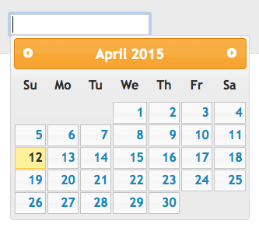
Date Picker Widget
<input type="text" id="datePicker" />
$("#datePicker").datepicker();

Slide 42
Slider Widget
<div id="slider"></div>
<div id="slideOutput">0</div>
$("#slider").slider().bind("slide", reportSlider);
...
function reportSlider()
{
var sliderVal = $("#slider").slider("value");
$("#slideOutput").html(sliderVal);
}

Slide 43

Selectable Widget
<ul id="selectable">
<li>alpha</li>
<li>beta</li>
<li>gamma</li>
<li>delta</li>
</ul>
$("#selectable").selectable();

Slide 44


Sortable Widget
<ul id="sortable">
<li>alpha</li>
<li>beta</li>
<li>gamma</li>
<li>delta</li>
</ul>
$("#sortable").sortable();

Slide 45
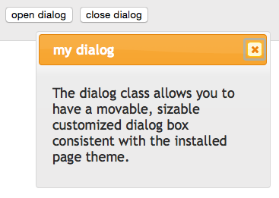
Dialog Widget
<div id="dialog" title="my dialog">
<p>
The dialog class allows you
to have a movable sizable
customized dialog box
consistent the installed
page theme.
</p>
</div>
<input type="button"
value="open dialog"
onclick="openDialog()" />
<input type="button"
value="close dialog"
onclick="closeDialog()" />

Slide 46
Dialog Widget, cont’d
$("#dialog").dialog();
$("#dialog").dialog("close");
...
function openDialog()
{
$("#dialog").dialog("open");
}
function closeDialog()
{
$("#dialog").dialog("close");
}

Slide 47
Assignment #3
Add jQuery functionality to your web app.
Perform AJAX.
Use jQuery and CSS to create
an interactive visual effect.

Slide 48
Assignment #3, cont’d
Add jQuery UI toolkit functionality.
  Pick and use a jQuery theme.
Have at least one on-screen object that is:
  resizable
  dragged and dropped
Use jQuery UI widgets:
  AJAX tabs
  at least two other interactive widgets

Slide 49
Assignment #3, cont’d
Include a short informal report that points out the jQuery and jQuery UI features of your app.
  The purpose of each feature.
  How it behaves (you can use screenshots).
  How you implemented it.
Due Friday, October 6.

