Slide 1
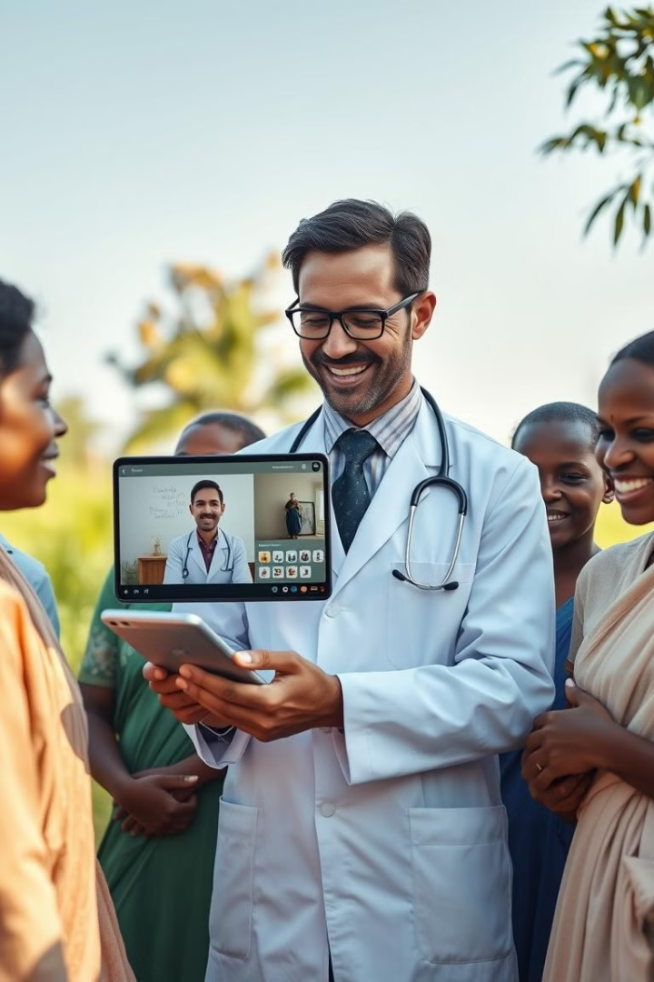
Swastha Sathi: Telemedicine for Rural India
Bridging the healthcare gap in rural communities. Swastha Sathi delivers accessible, affordable, and convenient telemedicine services.

Slide 2
Understanding the Challenge & Target User
The Challenge
Target User
Limited access to doctors and healthcare facilities in rural areas creates significant disparities in healthcare outcomes. Many rural patients lack convenient access to timely and quality care, leading to delayed diagnoses and treatment.
The primary user is a resident of a rural Indian community, often with limited mobility or financial resources, seeking access to medical advice and basic healthcare services. They also need convenient access to information about nearby pharmacies, diagnostic centers, and available medications.

Slide 3
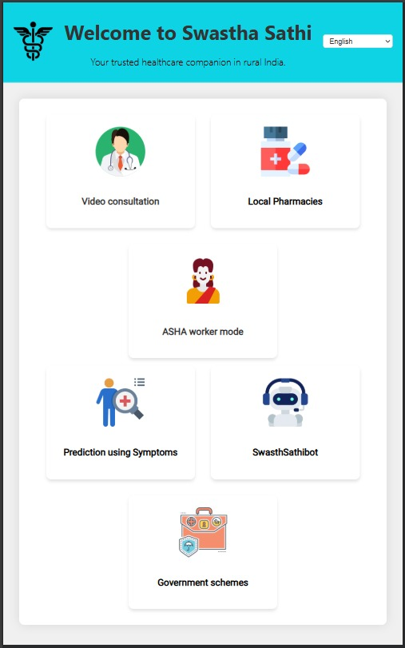
Our Solution: Swastha Sathi Features
Video Consultation
Direct video calls with qualified doctors, accessible via the app.
Local Pharmacies
Find nearby pharmacies and order medications with ease.
AI Symptom Checker
Preliminary symptom assessment for initial guidance.
ASHA Worker Mode
Simplified interface for ASHA workers to register patient data.

Slide 4
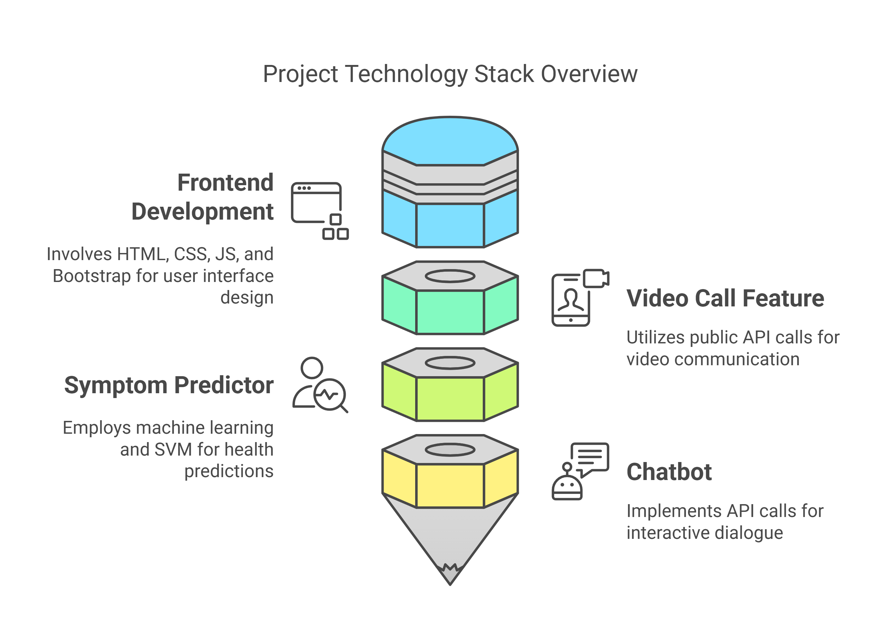




Technical Architecture & Implementation
Frontend
Lightweight, multilingual web app for ease of use.
Backend
Secure API for managing user data, consultations.
Database
Scalable to accommodate growing user base.
AI Integration
Reliable symptom assessment and chatbot assistance.

Slide 5




Measuring Impact: Key Metrics
Adoption Rate
Consultation Volume
User Satisfaction
Measure the increase in user adoption among rural populations.
Assess user satisfaction through feedback.
Track the number of video consultations conducted.
Integrate with government healthcare schemes for wider access and benefits.

Slide 6



Scaling for the Future: Growth
2
Tech
1
Partnerships
Data
3
Focus on strategic partnerships with local healthcare providers. Enhance platform tech with AI. Continuous improvements to our data.

