Slide 1
Printec
EXECUTIVE BRIEFING
Banking Market
Intelligence
An autonomous, multi-agent research system that infers what banks in Printec’s footprint will need — before they ask.
6 agents · 1 system
17 countries
Weekly cadence
100% claims cited
Prepared for the Printec Group leadership team · June 2026

Slide 2
THE CHALLENGE
Banks don’t publish their buying plans.
Our job is to know what every bank across 17 countries will need 6–12 months before they issue an RFP — without a single bank interview.
The problem
The opening
The discipline
Buying signals are scattered — investor decks, public tenders, regulators, job boards, vendor results — across 17 countries and a dozen languages. No single source tells you what is coming.
Banks hire, disclose, and get regulated before they buy. Read those tells early and you reach the decision-maker while there is still a deal to shape — not after the tender is public.
One rule above all: never invent a number. Every figure traces to a dated, named, re-checkable source — the system only classifies and counts values that already exist.
Printec Group · Banking Market Intelligence
02

Slide 3
THE SYSTEM
One autonomous system. Every week. Fully cited.
Six specialist research agents, a triangulating orchestrator, and an independent validator turn the open web into a board-grade brief and a live dashboard.
8
17
8
specialist agents
countries covered
dashboard views
Live now at printec-market-research.vercel.app — it refreshes automatically every week with no redeploy, and every figure, deadline and forecast is one click from its source.
Printec Group · Banking Market Intelligence
03

Slide 4
① THE COLLECTORS
Six specialists, six angles on the same question
Each fans out one subagent per unit — bank · portal · regulation · country · competitor — so depth scales with the week.
A1
Bank Disclosures
A2
Tenders & Procurement
A3
Regulation & Deadlines
Reads what banks tell investors.
Catches banks buying in the open.
Tracks the rules that force spend.
Where: IR & strategy-day decks, verbatim earnings-call transcripts
Where: TED (EU-wide API) + 15 national portals + bank-owned pages
Where: ECB / EBA / central banks: DORA, instant payments, accessibility
Monthly
Weekly
2× / month
A4
Market Statistics
A5
Early Intent — Jobs + Leadership
A6
Vendors & Competitors
Measures the structural backdrop.
Spots intent before the budget.
Watches where money already flows.
Where: ECB Data Portal + central banks + leading indicators (Trends, apps)
Where: Bank career pages, LinkedIn, senior-executive appointments
Where: 150+ rivals — giants to local peers; filings, tenders, footprint press
Monthly
Weekly
Weekly
Printec Group · Banking Market Intelligence
05

Slide 5
ARCHITECTURE
AI agent · LLM
How the system is organized
Python script · deterministic
Each collector fans out a subagent per bank, portal, market or competitor; the Orchestrator runs the engine and spawns the validator (now auditing the 2–5yr futures too). A8 · Future Outlook runs monthly.
MISSION infer what banks will need in the next 6–12 months
①
A1
A2
A3
A4
A5
A6
A8
Bank
Disclosures
Tenders &
Procurement
Regulation &
Deadlines
Market
Statistics
Early Intent
Jobs+Leaders
Vendors &
Competitors
Future
Outlook
findings
②
ORCHESTRATOR · 1 agent
reads findings · triangulates · writes outlooks · runs the engine · spawns the validator
runs
spawns
③ COMPUTE — Deterministic engine
④ AUDIT — Validator workflow
Python · scripts own the numbers (sum-verified) · no LLM
spawned by the Orchestrator · independent LLM fact-check · outlooks + futures
fetch_ecb · fetch_competitors pull ECB + SEC-EDGAR figures, sum-verified
spawns
claim checkers
+
Writer
ingest.py parse master table + workbook → score
× N
forecast.py project the trend lines
verify.py re-fetch & snapshot every source
build_dashboard.py assemble payload · merge verdicts
N = one per 6–12mth outlook + one per 2–5yr future; paywalled cites count if snapshotted / in the KB. Writer → outlook_validation.json + futures_validation.json; the engine merges (✓ / ⚠).
publish.py push to the live site
⑤
🖥 Live dashboard · 8 views
📄 Board brief · BLUF + Top-3
Printec Group · Banking Market Intelligence
04

Slide 6
HOW AN AGENT WORKS
Fan out, search deep — never quit at the first wall
Worked example — the Tenders agent (A2)
1
→
2
→
3
→
4
TRIAGE & FAN OUT
SEARCH DEEP
HIT A WALL? ESCALATE
REDUCE & OUTPUT
Enumerate the live set, then spawn one subagent per portal / country — each with a fresh context to own its niche.
TED API + national portals + bank-owned pages, in the local language — buyer, value, deadline, winner, dated & linked.
API → a Google cache → a real browser that renders JavaScript. Still gated (login/PDF)? Flag it for a human — never skip.
The parent dedups across niches, triangulates, and writes one cited findings file. “A gap is a prompt to try harder.”
The exhaustiveness standard
3+ search angles (keywords, languages, sources) · go one level deeper · use proxies. Only then declare a genuine gap — with the next-best alternative named.
In practice
PrivatBank’s tenders sit behind a JavaScript-rendered portal — read via a browser, it surfaced a live recycling-ATM prequalification in a 7,401-ATM fleet.
Printec Group · Banking Market Intelligence
06

Slide 7
② SYNTHESIS — THE ORCHESTRATOR
Confidence is earned by agreement
From six streams to one ranked view
By evidence
A2
How well-proven a signal is — confidence weight plus a bonus for each independent agent that confirms it.
A1
HIGH
By value
A5
The risk-adjusted prize — deal-size × win-probability × confidence. Threats & macro trends score zero, so noise can never outrank a concrete biddable deal.
One agent alone caps a signal at Medium. Two or more independent agents — different evidence types — on the same need makes it eligible for High. Only the orchestrator promotes it, after re-checking the key figure on the live source.
The brief leads with value; the dashboard lets you toggle between both lenses.
Printec Group · Banking Market Intelligence
07

Slide 8
TRUST
Four layers between a claim and your decision
1
CITE EVERYTHING
Every claim carries a named, dated, clickable source. The cardinal rule: never invent a number.
The engine fabricates nothing.
↓
2
RE-FETCH & SNAPSHOT
A deterministic trust pass re-opens every cited URL each week and saves a timestamped copy — 274 of 298 reachable, defending against link-rot.
↓
It only classifies and does arithmetic on values that already exist in a source. Every number on the dashboard can be opened, re-checked, and audited.
3
FIGURE RE-CHECK
Before any signal is “decision-grade”, the orchestrator re-opens a primary source and confirms the key number with a quoted snippet — or downgrades it.
↓
4
INDEPENDENT VALIDATOR
A separate, adversarial pass traces every forward-looking call back to its sources and flags anything that does not trace — visibly, never hidden.
Reachability is automatic. Figure accuracy is signed off.
Printec Group · Banking Market Intelligence
08

Slide 9
④ THE VALIDATOR
An independent fact-checker, by design
The weak point of any analysis is that the author proofreads their own work. So a separate set of agents re-checks the forward-looking calls — with one job: confirm every claim traces to its source, and flag the ones that don’t.
GROWTH
Ukraine · ATM modernization
What it is
Reasoned outlook with cited drivers, projected range, and an evidence trail.
Fresh agents, spawned with a blank slate and an adversarial mandate — one fact-checker per market.
✓ Independently validated
How it stays independent
⚠ 1 claim not yet linked to a source
They re-read each call against the primary documents it cites — a fresh, separate pass that checks the claims, not the author. Like a code reviewer who didn’t write the code: independence is fresh context, not a different schedule.
This week’s audit
What it produces
21
15
6
Each outlook is marked “✓ independently validated”; any claim it can’t trace shows as a visible “⚠ not yet linked to a source” caveat — shown to the reader, never hidden. Its verdict overrides the analyst’s self-assessment.
outlooks audited
fully grounded
honest caveat
Printec Group · Banking Market Intelligence
09

Slide 10
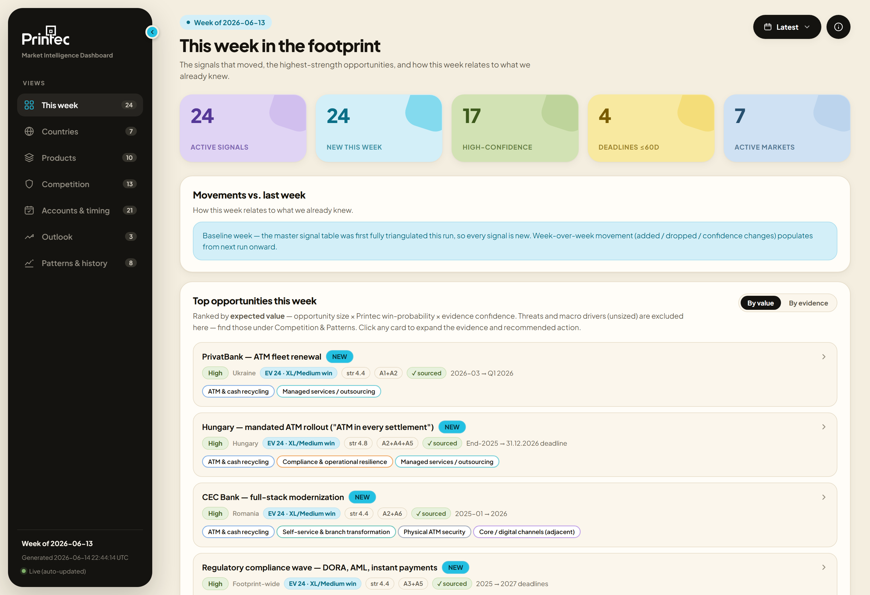
⑤ REPORT
One live dashboard, seven questions answered
printec-market-research.vercel.app
THE SEVEN VIEWS
1
This week
what changed — and what is hot now
2
Countries
where to focus
3
Products
demand by Printec solution
4
Competition
where rivals are strong vs. thin
5
Accounts & deadlines
who to approach, and by when
6
Outlook
where each market is heading, and why
7
Patterns & history
how it fits the long-run story
Live & self-updating — new week every Friday, no redeploy; time-travel to any past week; every figure one click from its source.
Actual live view — “This week”, week of 2026-06-13
Printec Group · Banking Market Intelligence
10

Slide 11
CADENCE
A standing weekly cycle
Agents run through the week on their own schedules; Friday synthesises, validates, and publishes — automatically.
MON
TUE
WED
FRI
Tenders &
Procurement
Jobs &
Leadership
Vendors &
Competitors
Orchestrate →
Validate → Publish
Plus periodic inputs: Bank Disclosures (monthly) · Regulation (twice-monthly) · Market Statistics (monthly).
Why a cadence matters
FRIDAY — synthesis & publish
Weekly tenders, jobs and vendor moves catch fast-moving windows; the monthly inputs add the structural backdrop. The result is a living picture, not a one-off report.
→ Triangulate the six streams → master table
→ Write the reasoned outlook + run the validator
→ Engine builds & publishes → dashboard + brief live
Printec Group · Banking Market Intelligence
11

Slide 12
THE PAYOFF
From signal to decision
✓
Early warning
✓
Named contacts
✓
A board-grade brief
Reach the bank before the RFP is written — while you can still shape the spec, not just respond to it.
A new CDO or Head of Channels handed to sales, with the 6–12-month decision window already flagged.
Bottom-line-up-front: the three highest-value moves with owner, by-when, and a deal-size band.
✓
Prioritised by value
✓
A defensible trail
Opportunities ranked by risk-adjusted prize — size × win × confidence — not by noise or recency.
Every claim re-checkable to a dated source. Nothing in front of the board is taken on faith.
Printec Group · Banking Market Intelligence
12

Slide 13
STATUS & ROADMAP
Live today — and designed to grow
LIVE NOW
ON THE HORIZON
✓
Expected-value ranking (value, not just visibility)
Beyond banking
✓
Foresight layer — reasoned Outlook per market
Extend to other Printec verticals — retail, fuel, postal, telco — once the method is proven.
✓
Trust pass: every source re-fetched & snapshotted
Deeper leading indicators
✓
Source links everywhere — figure → source in one click
Broaden the early-signal sweep (search trends, app adoption, web traffic) feeding the Outlook.
✓
Independent traceability validator
✓
Full-size-range competitor map — local peers to giants
Competitor depth
Segment revenue for the listed regionals + RFP-win tracking per competitor — who actually won which deal.
✓
Live dashboard auto-publishing every week
Banking-first by design: new verticals add collectors, not a rebuild.
Printec Group · Banking Market Intelligence
13

Slide 14
Printec
Every number on the screen
traces to a source you can open.
The system that knows what banks will need — before they ask.
printec-market-research.vercel.app
Printec Group · Banking Market Intelligence · June 2026

