Slide 1

G2M Case Study
Virtual Internship
21-Oct-2023

Slide 2
XYZ is a private firm in US. Due to remarkable growth in the Cab Industry in last few years and multiple key players in the market, it is planning for an investment in Cab industry and as per their Go-to-Market(G2M) strategy they want to understand the market before taking final decision.
Objective : Provide actionable insights to help XYZ firm in identifying the right company for making investment.
Background – Case Study

Slide 3
Cab analysis divided into four sections:
1. Data Understanding and Cleaning
2. Feature/Profit Analysis between the Cab companies
3. Finding the most profitable Cab company
4.Final Recommendations for investment
Agenda

Slide 4
Data Understanding and Cleaning
Data Features:
16 features in master_data
Timeframe of the data: 2016-01-31 to 2018-12-31
Total data points : 358879
Assumptions:
Outliers are present in Price_Charged feature but we did not remove this
data because there are customers that pay for higher quality vehicles/service.
Profit of rides are calculated keeping other factors constant where profit is
calculated by Price_Charged divided by the Cost_of_Trip.
Each record or row of data represents a unique transaction of cab so there
are multiple transactions of the same customer and of different companies.
Cab_Data.csv
Customer_ID.csv
Transaction_ID.csv
City.csv
master_data

Slide 5
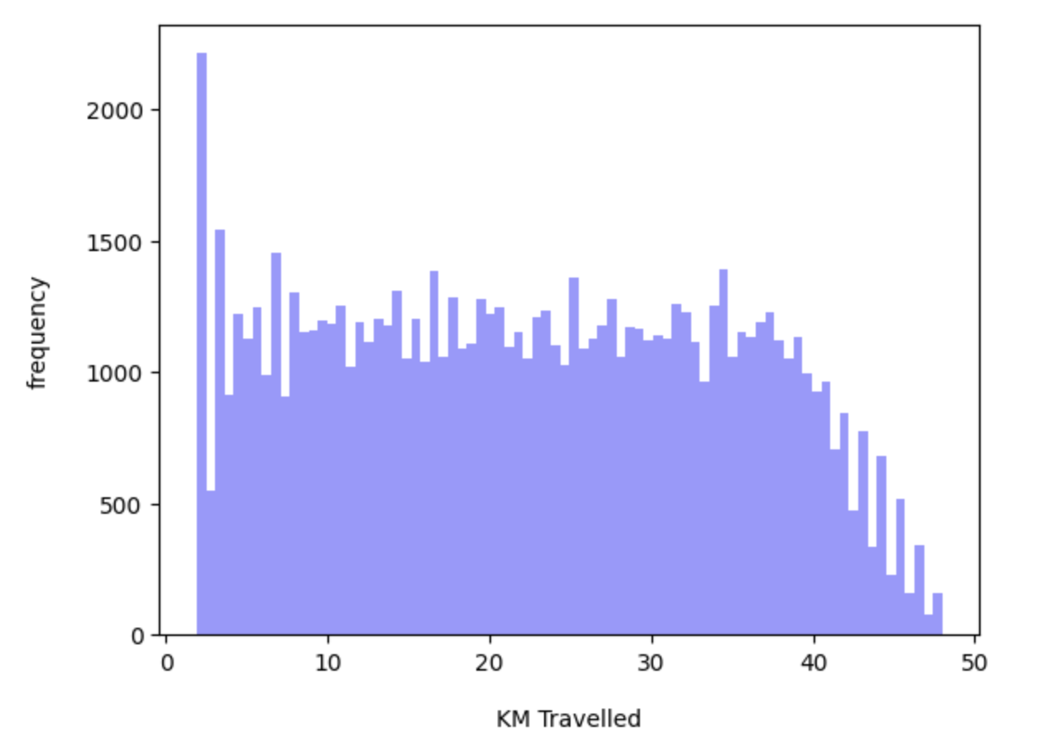
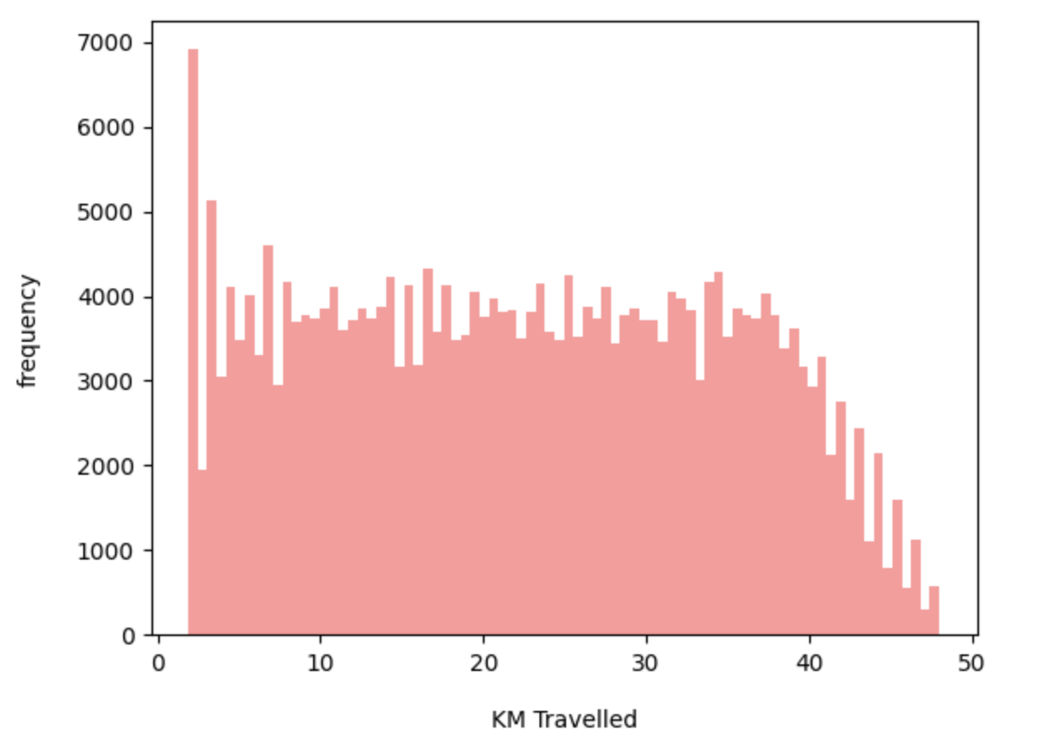
Profit Analysis
Distribution of KM Travelled
Distribution of KM Travelled (Pink Cab)
Distribution of KM Travelled (Yellow Cab)
Overall same distribution of distance travelled by the customers but the frequency of trips for Yellow Cab is around triple the frequency of Pink Cab.

Slide 6
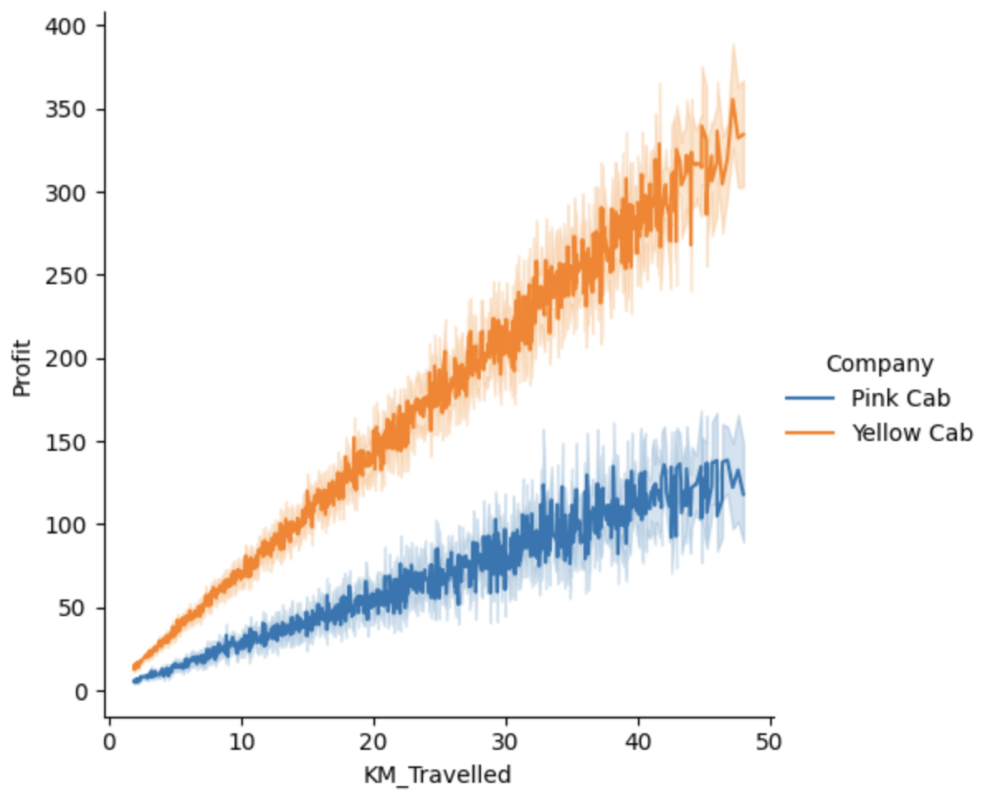
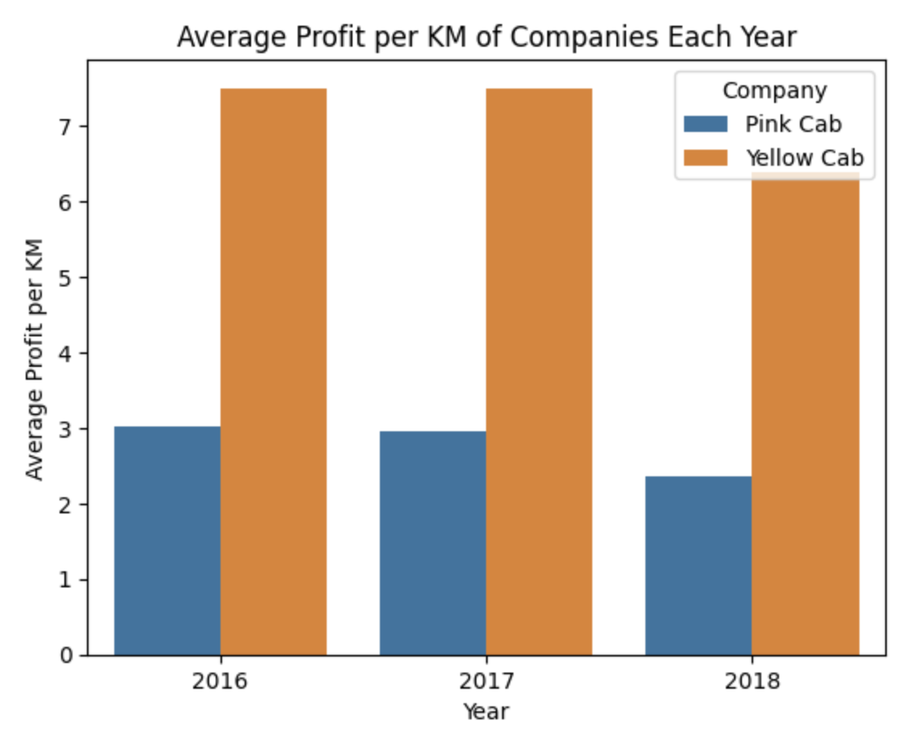
Profit Analysis
Profit and Distance Travelled(KM)
The left graph presents all transactions of our dataset and compare the KM travelled versus the profit for each transaction.
Both companies have positive correlation but the Yellow Cab company has a stronger increase in profit per KM travelled and higher average of profit per KM each year.

Slide 7
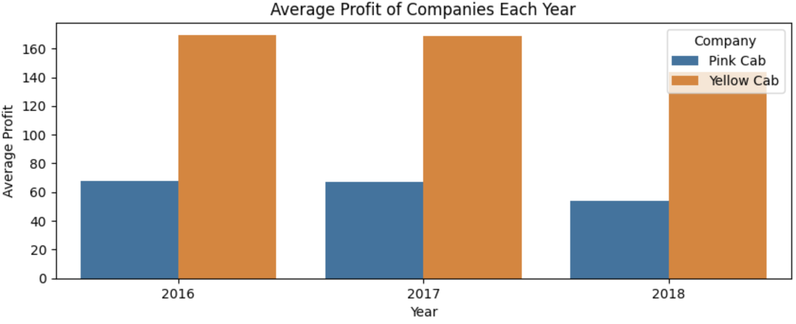
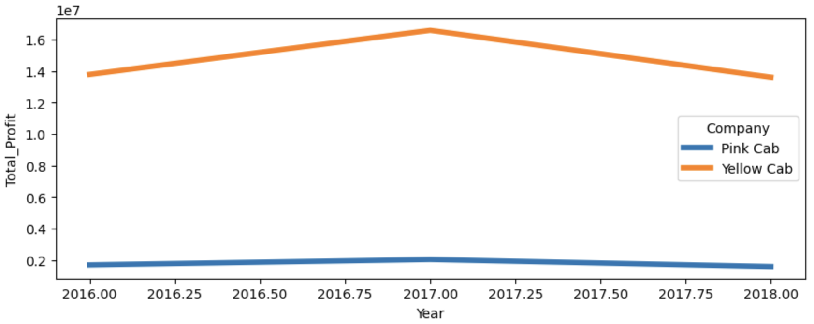
Profit Analysis
Overall Profit Analysis
Overall percent difference in average profit of companies is 156.45%. Yellow Cab’s highest total profit year was in 2017 with profit 16.58 million dollars whereas Pink Cab’s highest total profit was 2.03 million dollars in 2017 as well.
$16,586,610
$13,786,940
$13,609,460
difference % = 149.50
difference % = 151.66
difference % = 168.18
$1,686,458
$2,033,435
$1,578,972

Slide 8
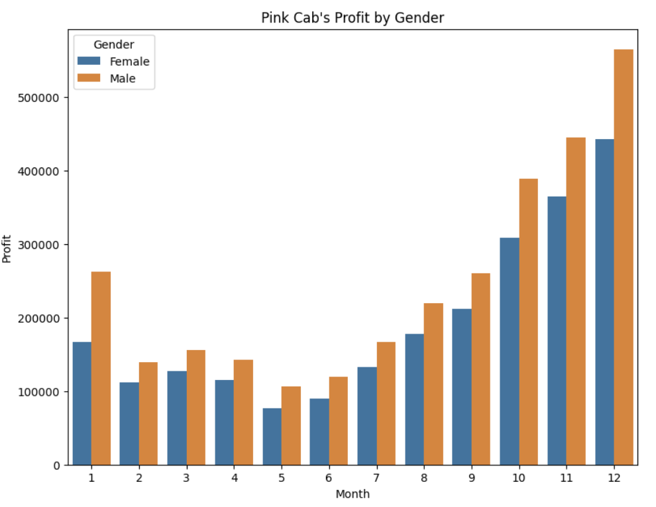
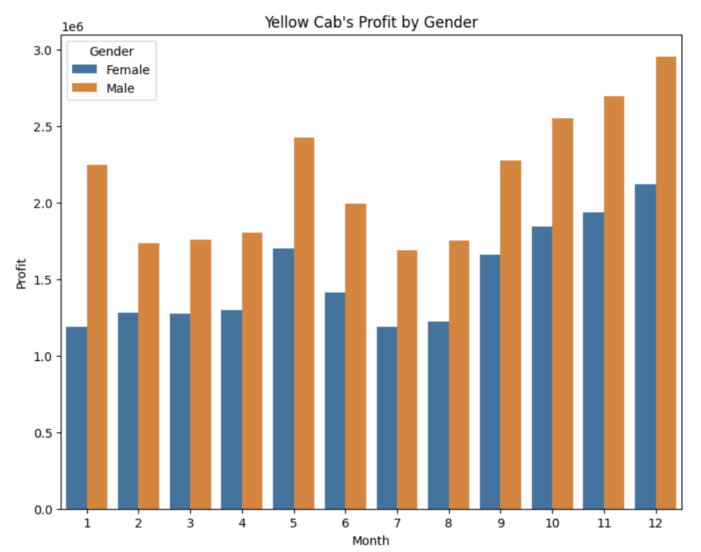
Profit and customer base Analysis Gender wise
Monthly profit by
gender for both
companies show that male customers
typically generate
more profit and is
especially true for the Yellow Cab company.

Slide 9
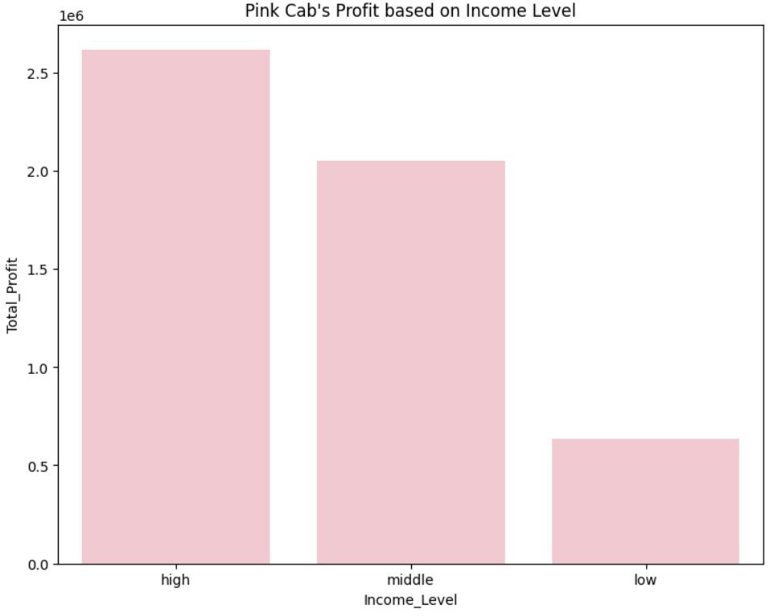
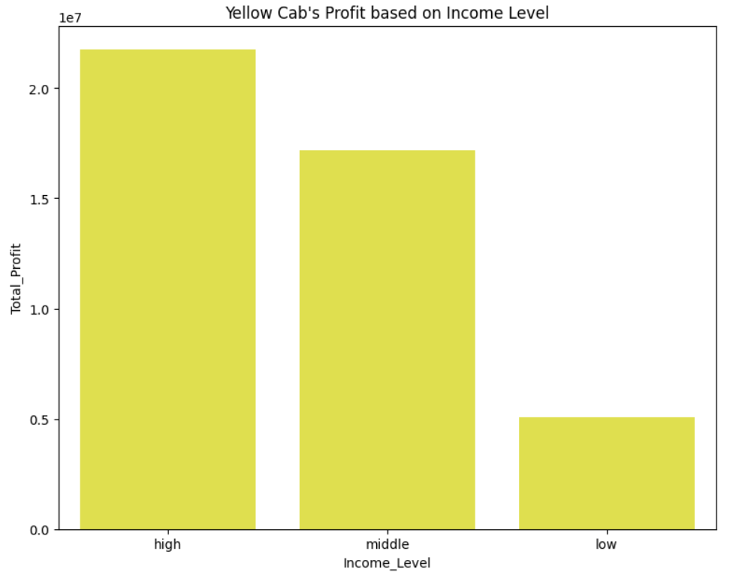
Profit based on Income Class Analysis
High and middle class income level generate significantly more to the total profit of both the cabs.
Income level based on USD per Month
High: >= 15,000
Middle:
5000 – 15000
Low : <= 5000

Slide 10
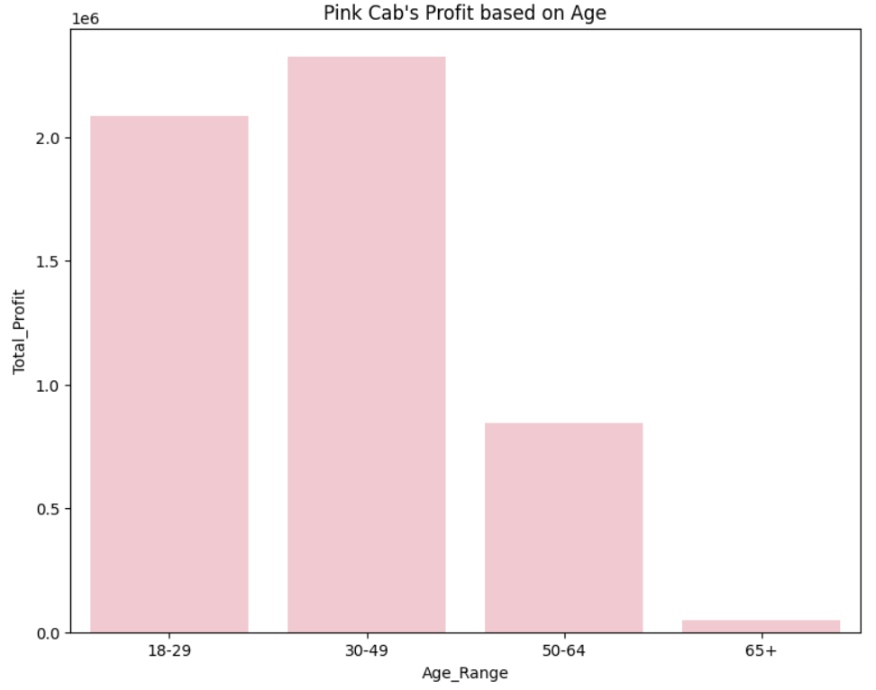
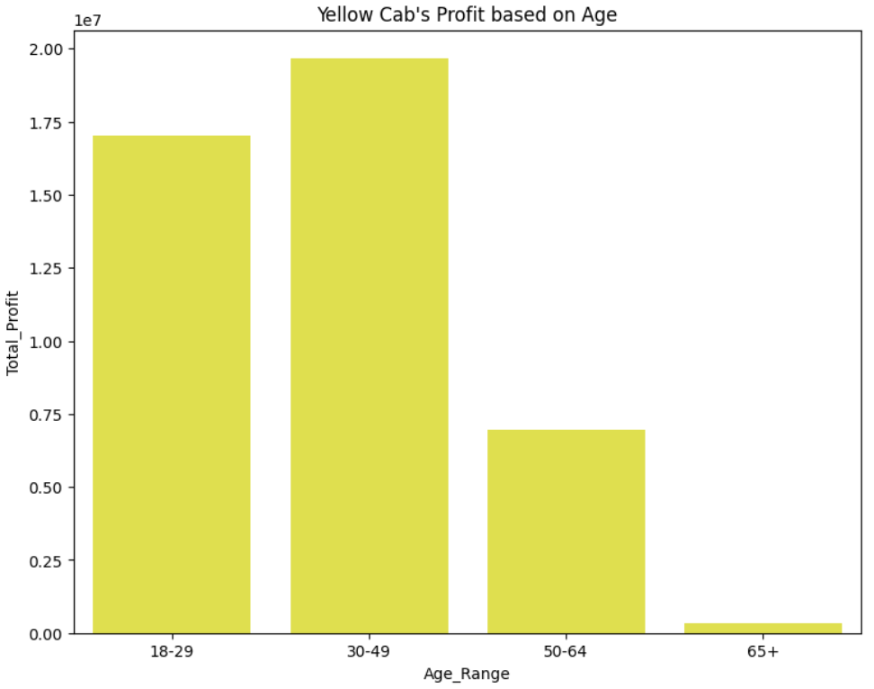
Age Group Profit Analysis
Cab customers
from both
companies of the ages under 50 years old generate the most amount
of profit. More
specifically, the age group from 30 to 49 have the highest total profit.

Slide 11
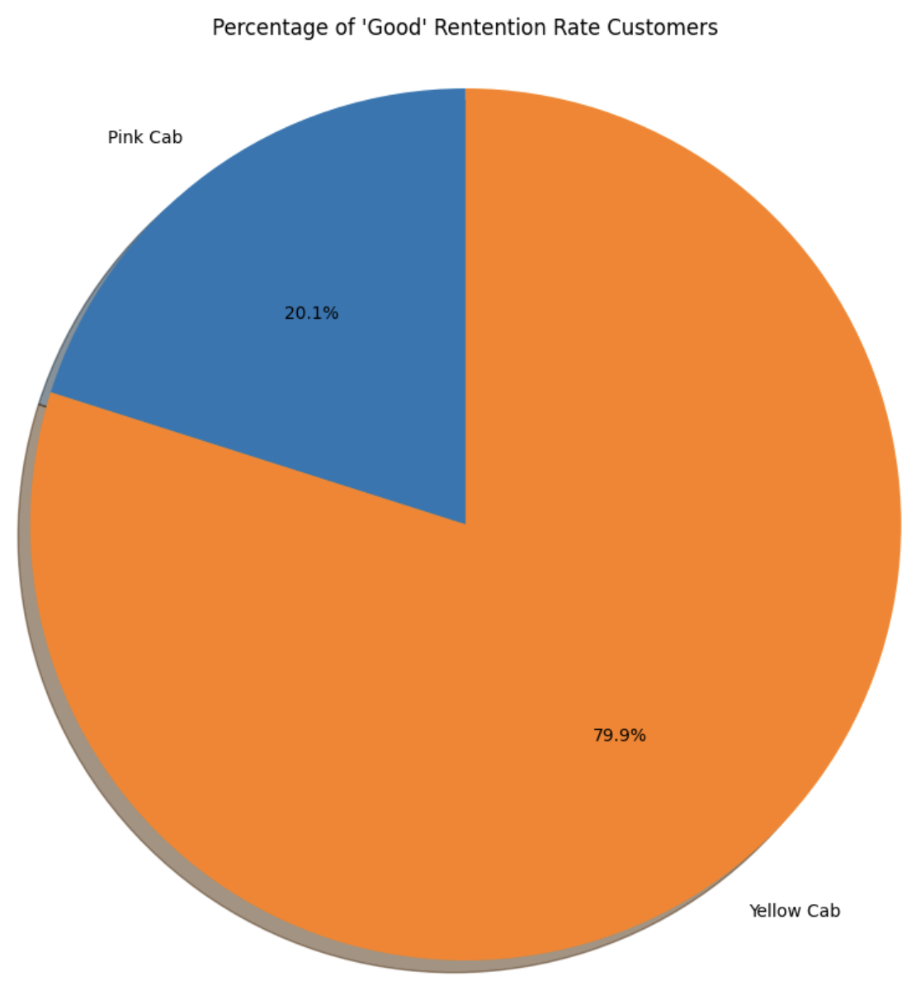
Customer Retention Analysis
Customers who have taken at least 5 rides of the same cab company are considered to be a ”good” retention rate customer
Pie graph shows the percent of “good” retention customers from both companies.
Clearly in the pie graph Yellow cab has a far better retention rate than Pink cab. Which shows Yellow cab is able to retain their customers well with Yellow cab having nearly four times the amount of “good” retention customers than Pink cab

Slide 12
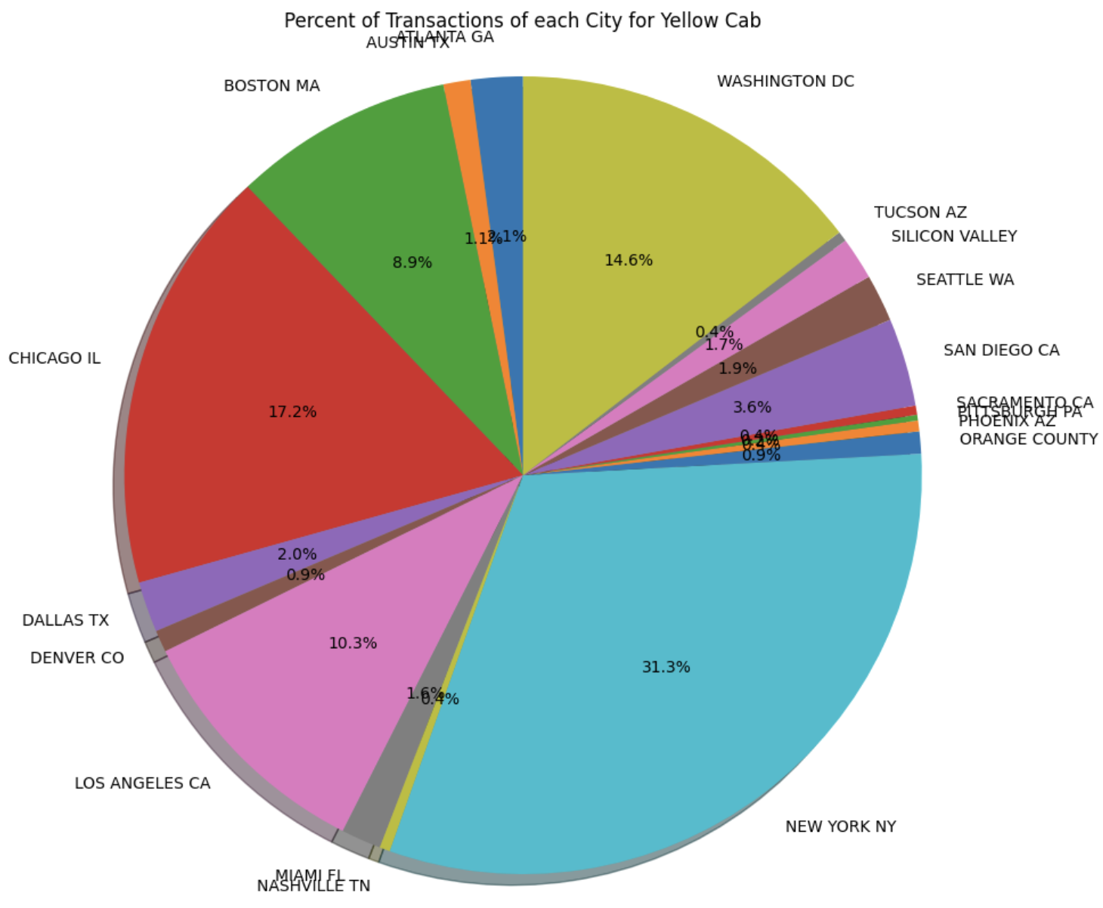
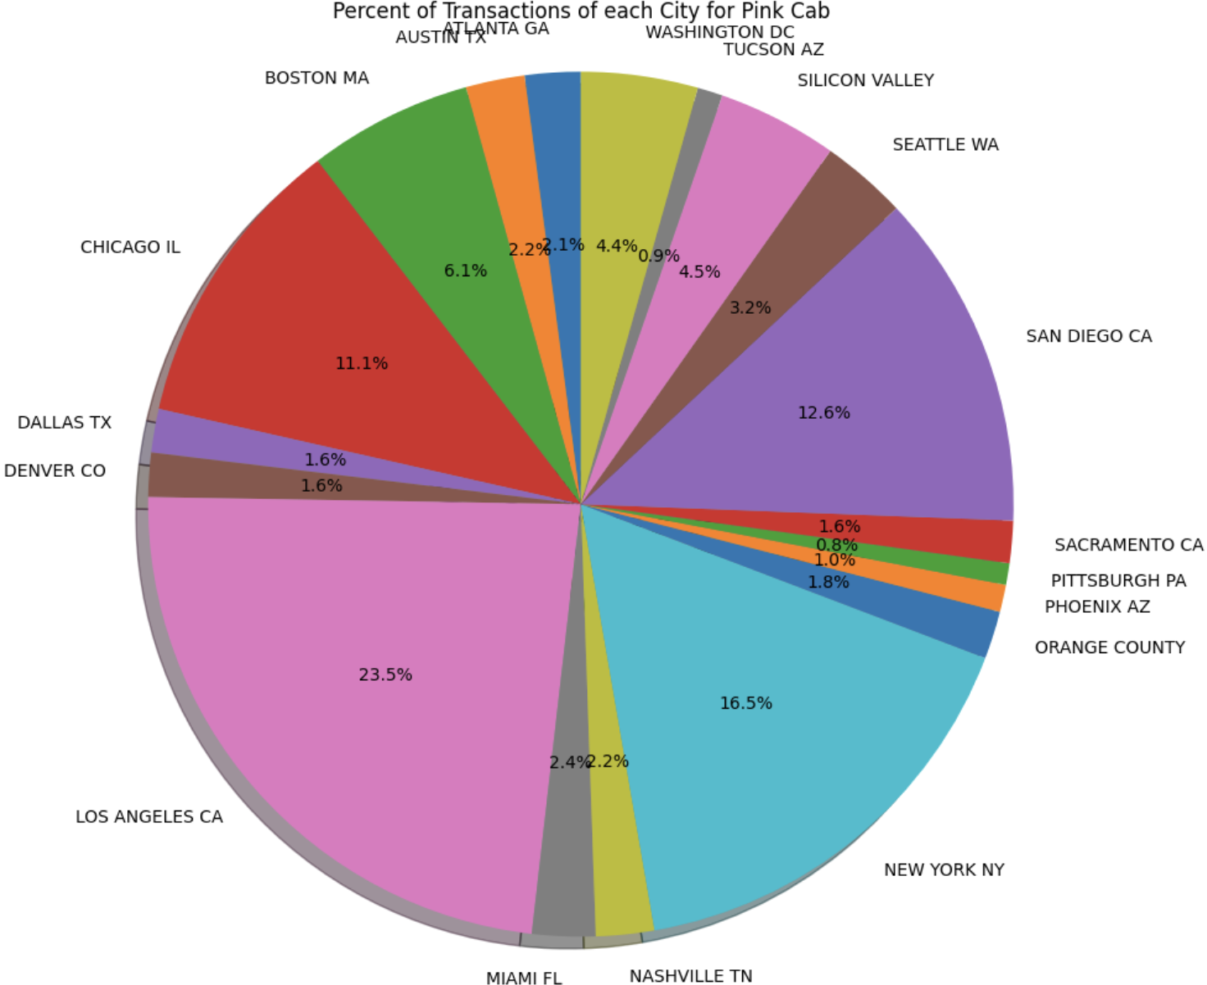
Percent of Transactions of each City

Slide 13
Number of Trips in Each City for Both Companies
The Yellow cab company have more trips in 15 out of 19 cities than the Pink cab.

Slide 14
Recommendations
We have analyzed both the cab companies with many different features and found Yellow cab produces more profit in most categories than Pink cab which is why we are going to recommend Yellow Cab for these reasons:
Customer Reach by City: Yellow cab has higher customer reach in 15 cities while Pink cab has higher customer reach in 4 cities.
Customer Retention: We have analyzed this with customers that have a “good” retention rate have used the same cab company 5 or more times. We found that Yellow cab is doing far better than Pink cab with almost four times the amount of “good” retention customers.
Age wise Reach : Both cab companies have customers in all age groups especially from the ages between 18 to 49, but Yellow Cab still shows to produce more total profit in all age groups than Pink cab.
Average Profit per KM: Yellow cab’s average profit per KM is more than double the average profit per KM of the Pink cab.
Income wise Reach: Both the cabs are very popular in high and middle income class but Yellow cab is still performing better than Pink cab in producing more total profit in all classes.
Based on the findings above, we will recommend Yellow cab for investment.

Slide 15
Thank You

