Slide 1
CAPSTONE PROJECT · CS495 · 2026
Running LLMs without a GPU
BitNet b1.58 2B4T vs Qwen2.5-1.5B (Q8 / Q4 / Q2) and Llama-3.2-1B on commodity CPU
THE HEADLINE
On a six-year-old desktop CPU, BitNet b1.58 matches the paper's published throughput and memory.
Three Qwen quantizations and a smaller Llama trace a clean speed-vs-accuracy frontier -- with Q2 marking where compression stops paying off.
Sean Michael · Supervisor: Prof. Dr. Pedro Albuquerque

Slide 2
01 · MOTIVATION
Who gets to run a modern LLM?
Running a capable language model today usually means renting a GPU in the cloud or paying per token to a provider like OpenAI or Anthropic.
That excludes a lot of people. Students without lab access. Researchers on a budget. Anyone in a region where cloud is expensive or unreliable. Edge devices. Privacy-sensitive workloads. Hobbyists with an old desktop.
$0
offline
private
No-cost inference
No internet needed
Data stays local
If you already own a computer, running the model costs only electricity
Edge devices, air-gapped environments, regions with unreliable connectivity
Any workload where information can't leave the building -- self-hosted by construction
This project asks whether new model designs can actually make capable LLMs run usefully on hardware most people already own.
CS495 Capstone · Non-GPU LLM Inference · Sean Michael
2 / 15

Slide 3
02 · BACKGROUND
BitNet's pitch -- and where it stands today
Normal language models store each weight as a 16-bit decimal number. BitNet stores it as one of just three values: -1, 0, or +1.
That's the trick. About one bit per weight instead of sixteen. Matrix multiplication becomes integer addition plus table lookup -- something a regular CPU is good at, with no special hardware required.
THE STORY SO FAR
Feb 2024
Apr 2025
Jan 2026
Today
The idea
First real model
It got faster
Live ecosystem
Microsoft Research paper introduces ternary weights
BitNet b1.58 2B4T released -- 2 billion parameters, fully open
CPU optimization update delivers another 1.15--2.1× speedup
38k+ GitHub stars, Falcon released its own 1.58-bit variants, phone NPU support next
CS495 Capstone · Non-GPU LLM Inference · Sean Michael
3 / 15

Slide 4
03 · METHODOLOGY
What I measured
BitNet b1.58 2B4T
Qwen2.5-1.5B Q8
Qwen2.5-1.5B Q4
Qwen2.5-1.5B Q2
Llama-3.2-1B Q4
THE MODEL UNDER TEST
QUALITY REFERENCE
SPEED CHAMPION
CAUTIONARY TALE
SMALLER-MODEL FLOOR
2 billion params, ternary weights
8-bit compression, near-original accuracy
4-bit compression, mainstream choice
2-bit compression, accuracy cliff
1 billion params at 4-bit
FOUR METRICS PER MODEL
SPEED
MEMORY
ACCURACY
ENERGY
tokens generated per second
peak RAM used while running
score on 5 standard benchmarks
watt-hours per 1,000 tokens
All measurements on one machine: Intel i5-9400F (6 cores, no GPU, no AVX-512) -- a six-year-old desktop chip.
CS495 Capstone · Non-GPU LLM Inference · Sean Michael
4 / 15

Slide 5
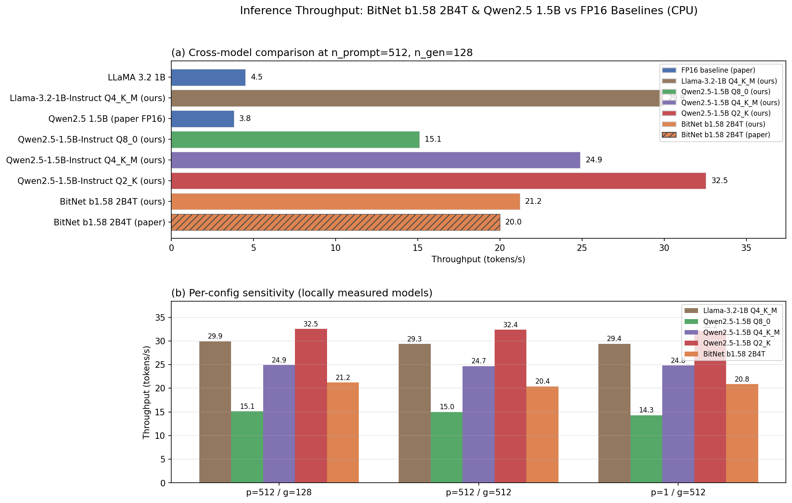
04 · RESULTS
Speed -- how many tokens per second?
BitNet reproduces the paper. 21.2 vs 20.0 tok/s. Every Qwen quant beats the paper's FP16 number by 4--8× -- quantization alone, not the BitNet kernel. Q2 is fastest, but watch the accuracy slide.
CS495 Capstone · Non-GPU LLM Inference · Sean Michael
5 / 15

Slide 6
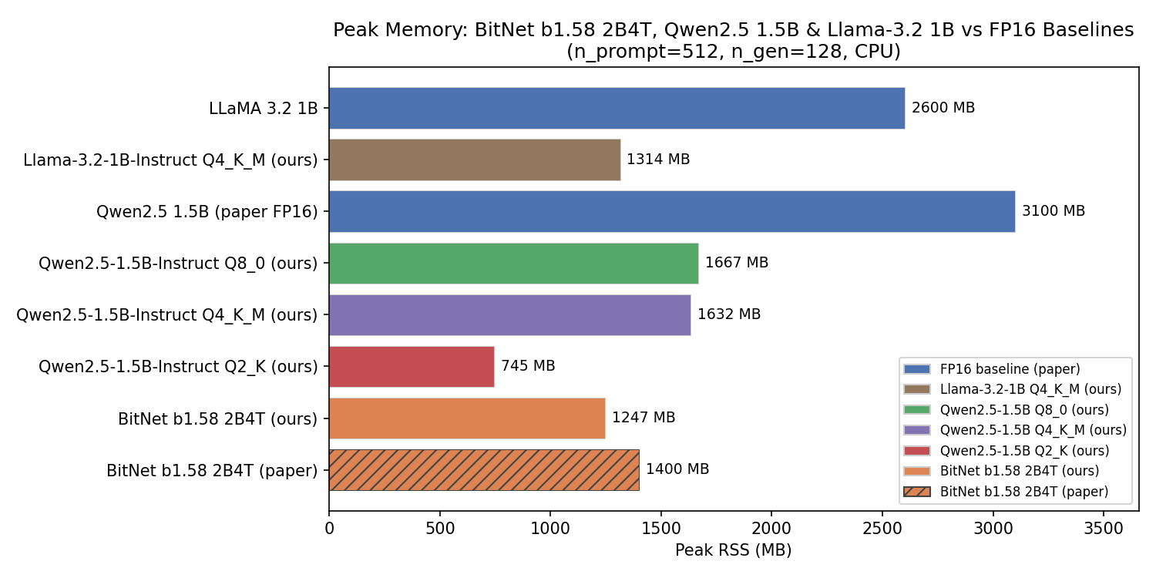
05 · RESULTS
Memory -- how much RAM does it actually use?
BitNet wins memory among 2-billion-parameter models. 1,247 MB -- well under half the paper's FP16 baselines (3.1 GB). Q2 goes lower still (745 MB) -- the absolute floor if accuracy doesn't matter.
CS495 Capstone · Non-GPU LLM Inference · Sean Michael
6 / 15

Slide 7
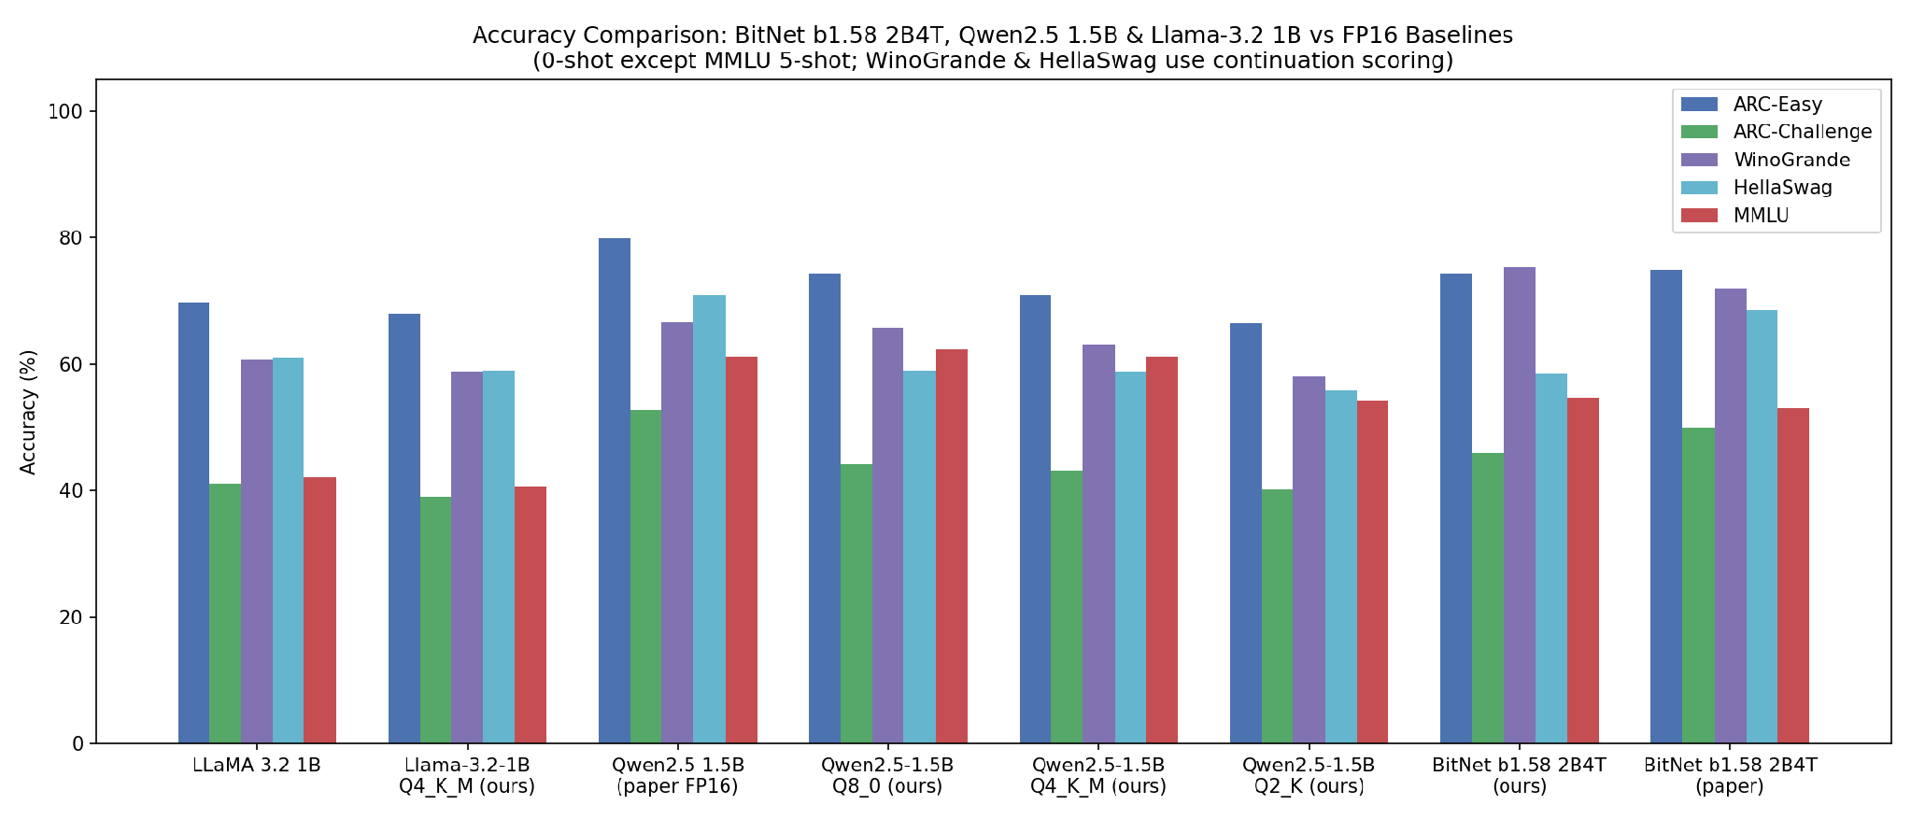
06 · RESULTS
Accuracy -- how well does it answer the test?
BitNet wins reasoning (WinoGrande, ARC-Challenge). Qwen Q8 wins knowledge (MMLU). Q2 collapses on every benchmark. Llama trails Qwen by 6--8 points -- the smaller-model penalty.
CS495 Capstone · Non-GPU LLM Inference · Sean Michael
7 / 15

Slide 8
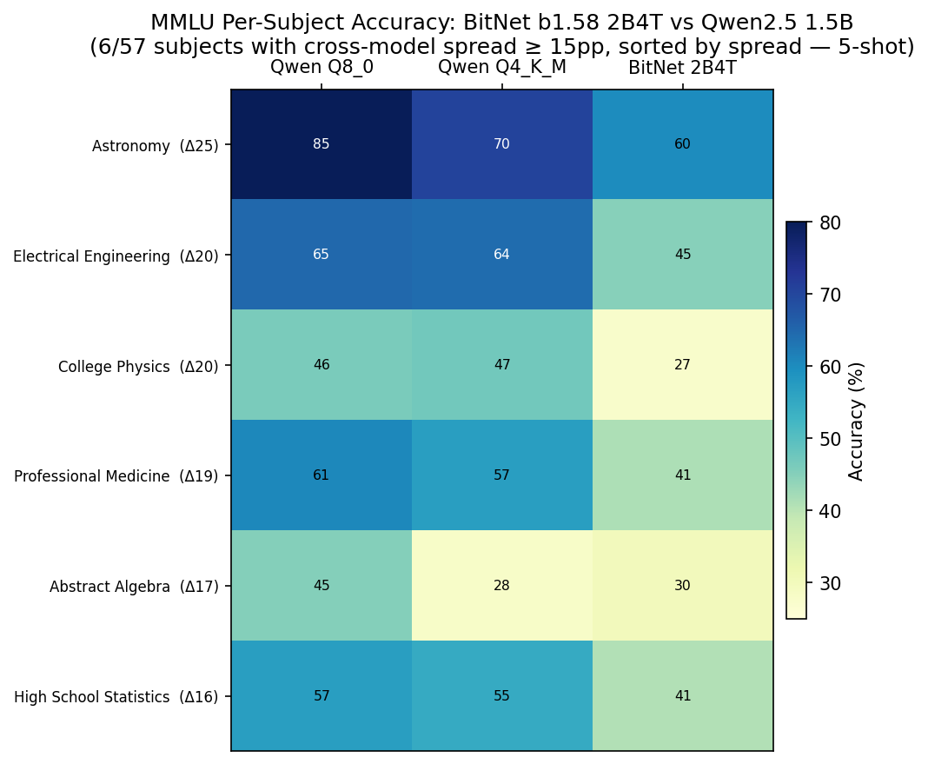
07 · RESULTS
Where the knowledge gap lives -- 6 subjects with the biggest spread
READING THIS CHART
Out of 57 MMLU subjects, these 6 show the biggest cross-model spread (at least 15 percentage points between best and worst).
WHAT IT SHOWS
Qwen's knowledge advantage lives in factual recall:
astronomy, electrical engineering, professional medicine.
BitNet collapses on technical math:
college physics (27 vs 46), abstract algebra (30 vs 45).
CS495 Capstone · Non-GPU LLM Inference · Sean Michael
8 / 15

Slide 9
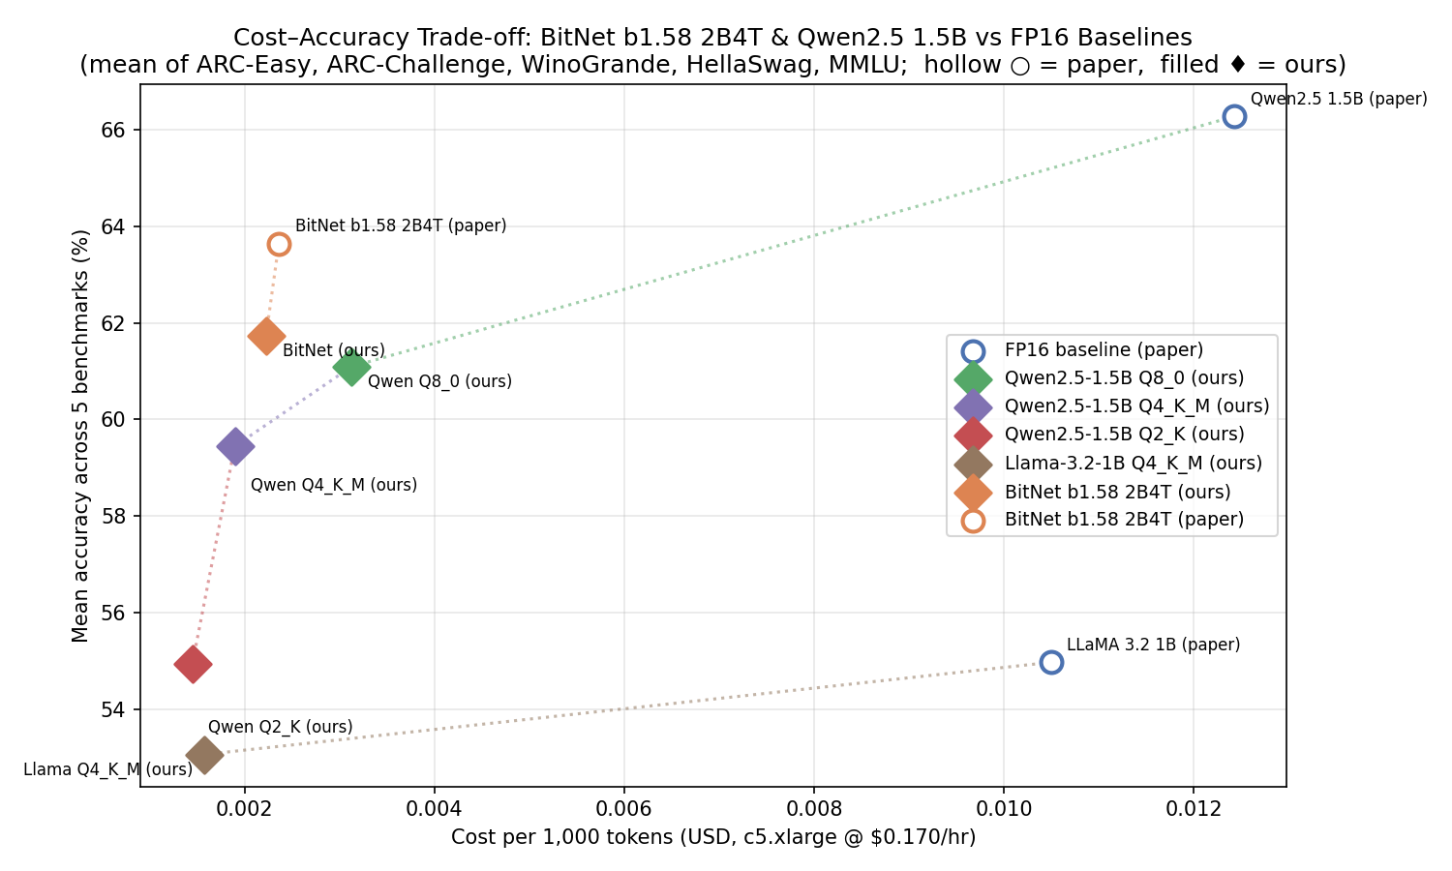
08 · ANALYSIS
The trade-off -- cost vs accuracy
THE FRONTIER
Diamonds = our measurements.
Circles = the paper's published numbers, on much faster hardware.
BitNet is the cheapest path
to ~62% mean accuracy.
Q8 -- Q4 -- Q2
shows the quantization curve: cheaper at the cost of accuracy, with a steep drop at Q2.
Pick BitNet for accuracy. Pick Q4 for cost. Avoid Q2 unless the accuracy cliff is acceptable for your use case.
CS495 Capstone · Non-GPU LLM Inference · Sean Michael
9 / 15

Slide 10
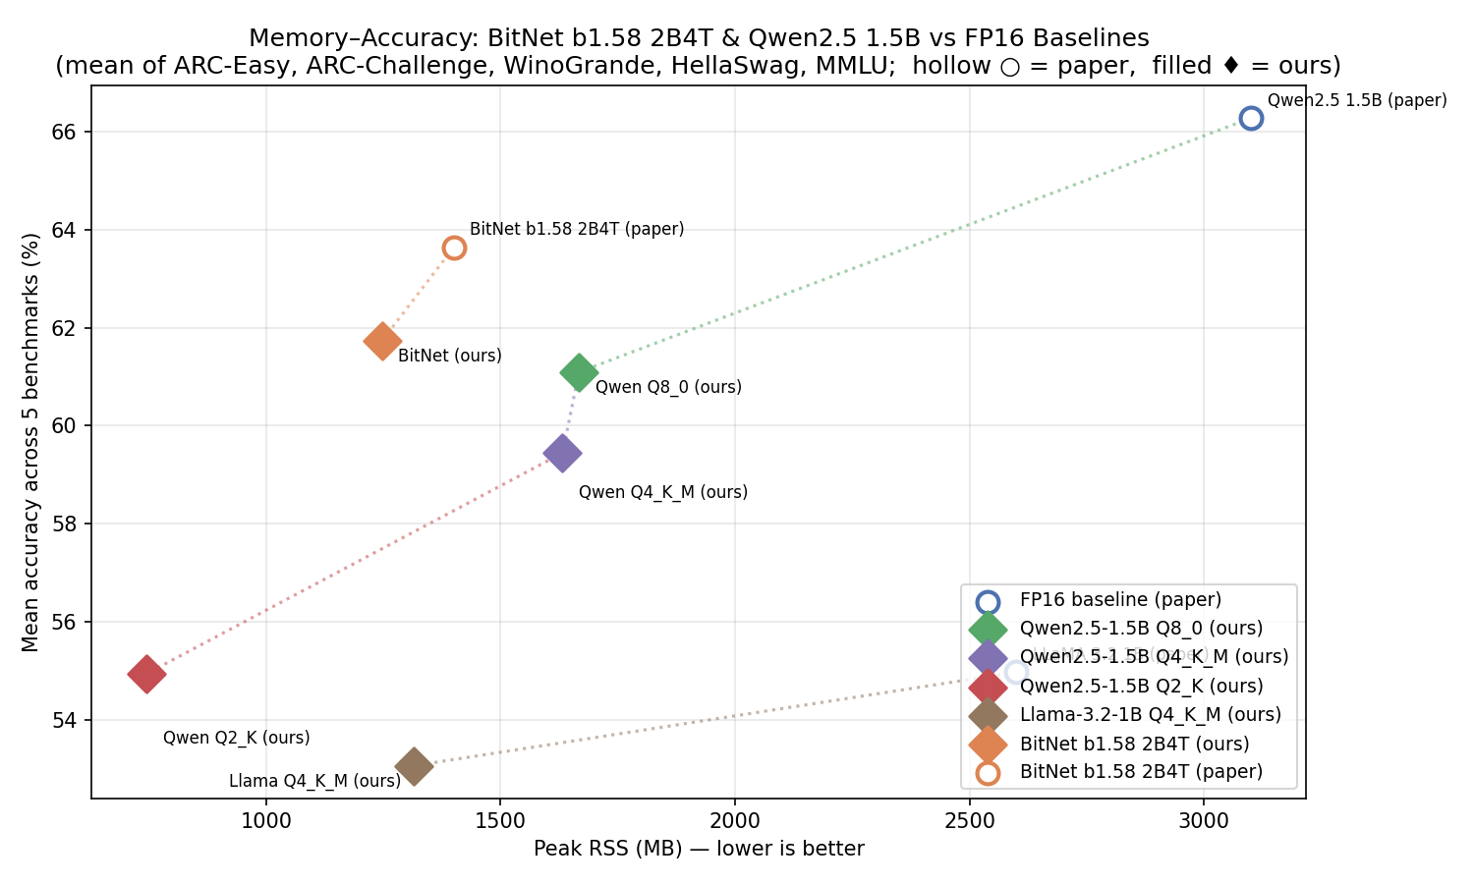
09 · ANALYSIS
The trade-off -- memory vs accuracy
THE FRONTIER
Lower-left is better
(less memory, more accurate).
BitNet is on the Pareto frontier
-- nothing dominates it on both axes.
The paper's published FP16 baselines
use 2.5--3 GB of memory -- our quantized models use roughly half that, at almost the same accuracy.
BitNet is the only model that gets near-Q8 accuracy at near-Q4 memory -- that's its real contribution.
CS495 Capstone · Non-GPU LLM Inference · Sean Michael
10 / 15

Slide 11
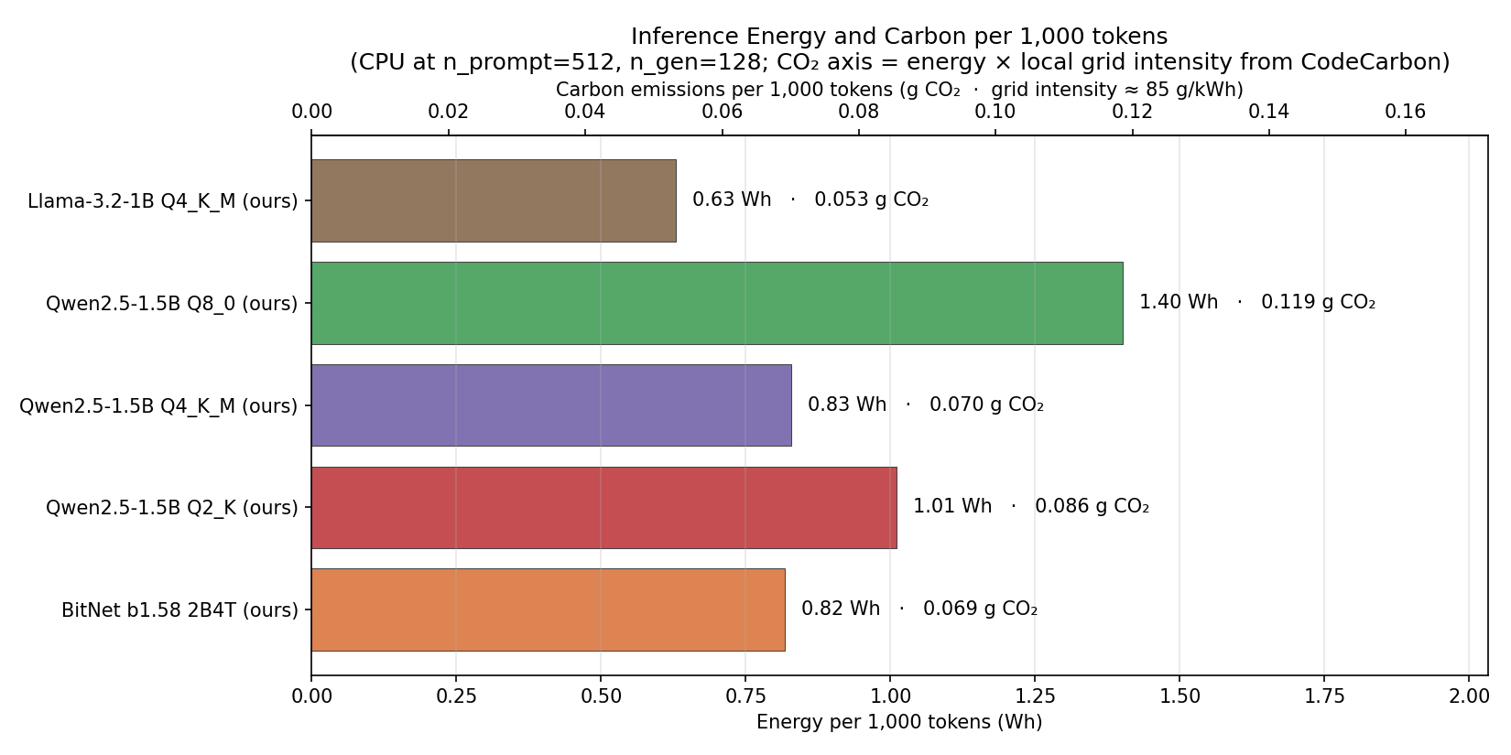
10 · RESULTS
Energy & carbon -- how much does inference actually cost?
Generating 1,000 tokens uses about 1 watt-hour -- roughly what a phone charger draws in five minutes. BitNet and Q4 essentially tie on energy per token; Q8 uses about 70% more because it's slower per result.
CS495 Capstone · Non-GPU LLM Inference · Sean Michael
11 / 15

Slide 12
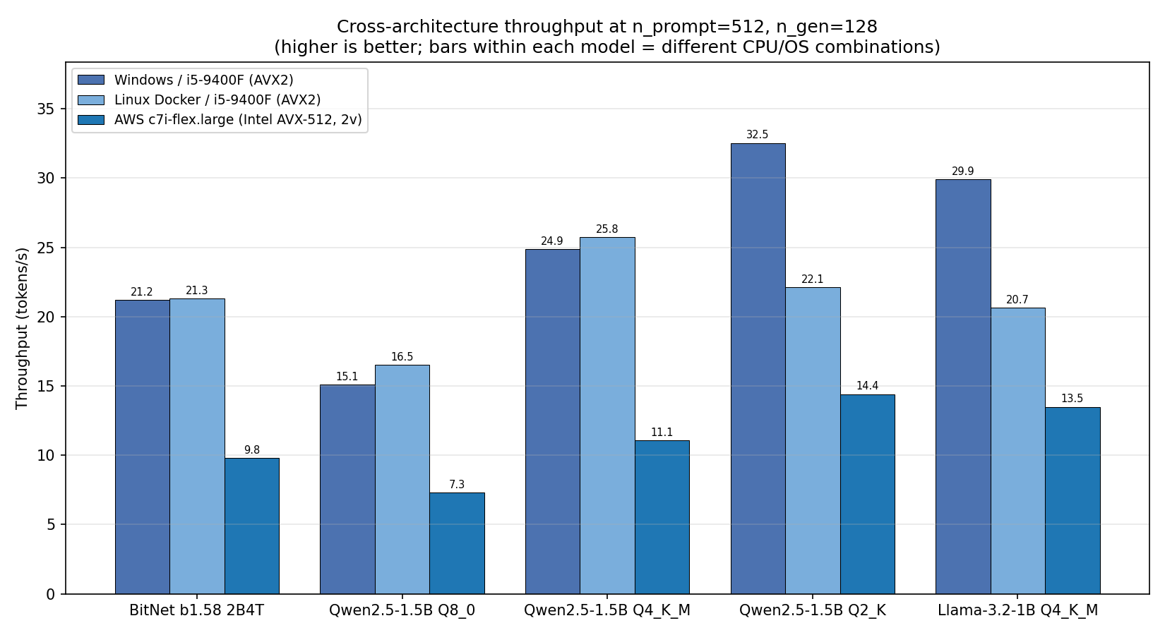
12 · PORTABILITY
Does it work on other machines?
THREE MACHINES TESTED
Windows / i5-9400F: the primary test machine.
Linux Docker / same chip: essentially identical -- the OS doesn't matter much.
AWS c7i-flex (newer Intel, 2 vCPUs): roughly half the throughput -- because core count beats SIMD width at this size.
Pareto ordering holds across every machine tested. Q2 > Q4 > BitNet > Q8 on speed, everywhere. The model-selection guidance from this study generalizes beyond the test hardware.
CS495 Capstone · Non-GPU LLM Inference · Sean Michael
13 / 15

Slide 13
CONCLUSIONS
What we now know -- and what to do with it
CONFIRMED
BitNet's published targets (~20 tok/s, ~1.4 GB) reproduce on six-year-old consumer hardware.
REFINED
BitNet's speed isn't unique to 1.58-bit -- aggressive Qwen quantization on stock llama.cpp is just as fast or faster. BitNet's real edge is the Pareto position: best accuracy per MB.
CAUTIONED
Q2 quantization is the cliff -- it goes fastest and smallest but accuracy collapses across every benchmark.
CAVEATED
Self-hosted CPU inference is dramatically cheaper than cloud APIs, but only when a 2-billion-parameter model is actually good enough for the task.
Deployment guidance: BitNet → accuracy + memory. Q4 → cost / speed. Q8 → quality reference. Q2 → don't.

