Slide 1


Introduction to UNIX command-line
Serghei Mangul, Ph.D.
University of California, Los Angeles
@serghei_mangul

Slide 2
Introduction to UNIX command-line
Day 1
Unix - Learning the essentials
Unix fundamentals , syntax and usage
Day 2
Unix commands
Useful tools for processing text files
Day 3
Useful shell commands
UNIX Shell Scripting

Slide 3
Learning Objectives
By the end of this module, students will be able to:
List the attributes of Unix that make it ideal for addressing complicated biological questions using computers
Compare and contrast the Command Line Interface (CLI) vs the Graphical User Interface (GUI)
Identify the uses of the multiple UNIX commands
pwd, mkdir, and cd and use them to navigate within the UNIX file system

Slide 4
Introduction to UNIX Command Line: Learning Objectives
By the end of this module, students will be able to:
Perform the following tasks within the UNIX environment:
Create a text file
List and reorder files
Display, copy, move, and delete directories and files
Use grep command to search text in the txt files
Use awk to process tab delimited files
Use sed to edit text in the txt files

Slide 5
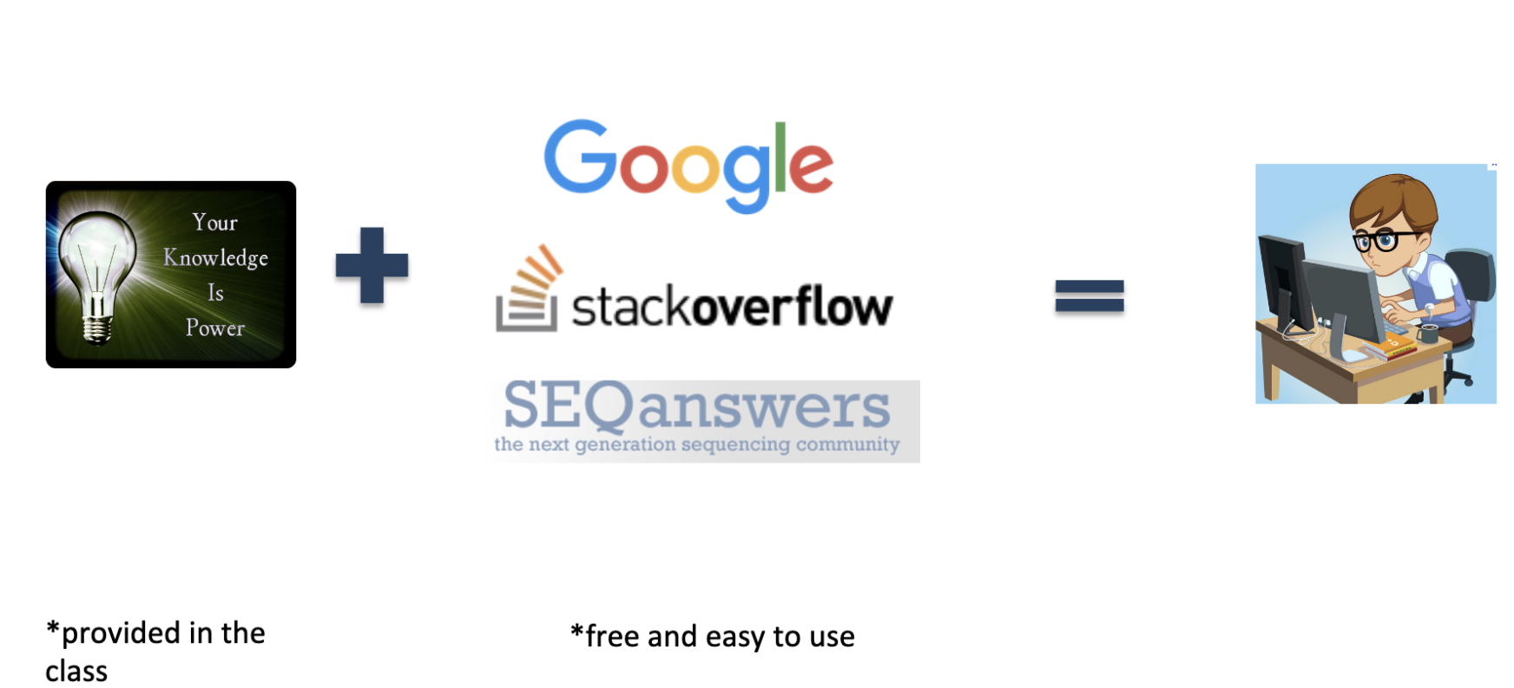
Do biomedical researchers have to become programmers?

Slide 6
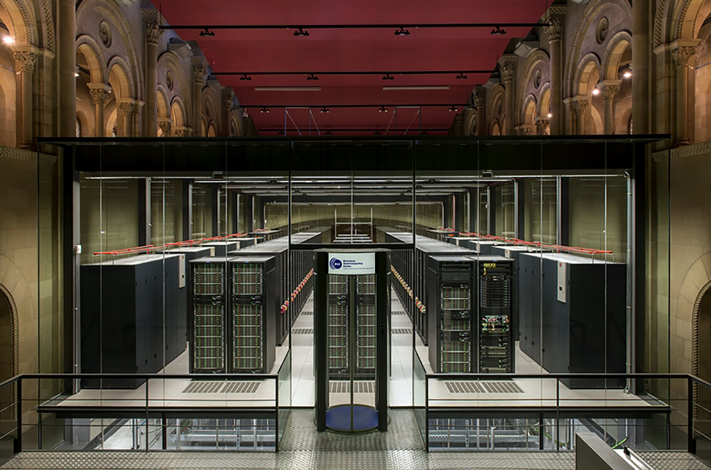
Why Learn Unix?
As biological data sets have grown larger and biological problems have become more complex, the requirements for computing power have also grown.
Computers that can provide this power generally use the Unix operating system
BSC-CNS | Barcelona Supercomputing Center

Slide 7
Why Learn Unix?
Most new bioinformatics software is created for Unix
Unix is very efficient
manage extremely huge amounts of data
It is very popular, so it is easy to find information and get help
Unix is very stable - computers running Unix almost never crash
Notes:
Unix is used by most large, powerful computers
Graphical User Interface at Mac and Windows
Unix – command line interface, called shell

Slide 8
Why not MS Excel?
Excel is good for simple tasks and small datasets
Excel is not eble to handle large datasets above 1,048,576 rows and 16,384 columns
Excel is not suitable for large number of datasets.

Slide 9
What is Unix?
UNIX-like system (e.g Linux, Ubuntu) is a type of operating system that lack a graphical interface and require inputting code.
UNIX environment is often is referred as command line interface opposed to graphical interface, which is common for Windows and MacOS.

Slide 10
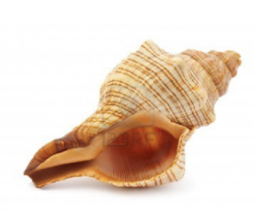
The Unix Shell
A shell is a program that waits for you to type a command and then executes it.
type the command, then “return”
Notes:
Try to type anything

Slide 11
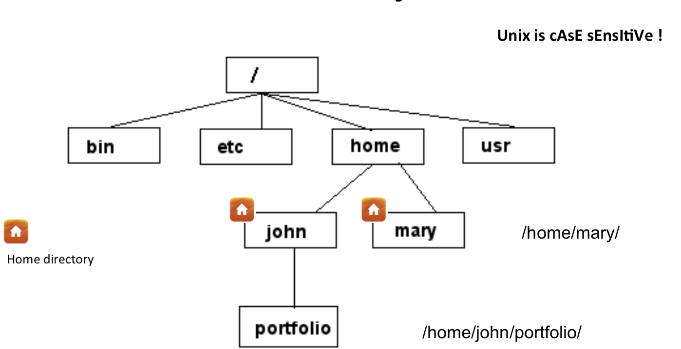
Unix File System
my home directory
path
My laptop : /Users/serghei
Notes:
Folders - >dir
Type pwd

Slide 12

Home directory
When you open terminal, you always start in your Home directory.
Create sub-directories in your home or other directory to store specific projects or groups of information
Do not accumulate thousands of files with cryptic names in your Home directory

Slide 13
Command: pwd
To display current directory
[serghei@login3 ~]$ pwd
/u/home/s/serghei
Notes:
Since it is command line interface let’s learn few commands

Slide 14

Command: mkdir
To create a new directory use “mkdir”
[serghei@login3 ~]$ mkdir test
If no error message is displayed means the command was run successfully

Slide 15
Command: cd
cd changes your current working directory
cd test
pwd
/u/home/s/serghei/test
Notes:
cd t “tab”, to auto-complete file names, use the tab key

Slide 16
Command: cd
“~” is the location of your home directory
“..” is the location of the directory above the current one
/Users/serghei
my home directory
/Users/serghei/test
/Users/serghei/test

Slide 17

Let’s practice
[serghei@login3 test]$ cd ~
[serghei@login3 ~]$ pwd
/u/home/s/serghei
[serghei@login3 ~]$ cd ..
[serghei@login3 s]$ pwd
/u/home/s
[serghei@login3 s]$ cd
/u/home/s/serghei

Slide 18


to go back to previously entered commands, use the up and down arrows
to auto-complete file names, use the tab key
if you are stuck within a command/process/program, try ctrl-z to terminate it

Slide 19
Let’s practice
mkdir jdkhfkjdsfhkjsdhfkjsdhfkjhs
cd jdkhfkjdsfhkjsdhfkjsdhfkjhs

Slide 20
Create a text file
[serghei@login3 ~]$ vi test.txt
On-screen, you will see blank lines, each with a tilde (~) at the left, and a line at the bottom giving the name and status of the new file:
Press “i” to edit the file
Press
“ESC” (insert mode is gone)
“SHIFT” + ”;” (you should see on the screen :wq)
“wq” (w – save file, q- quit) OR “q!” (discard changes and quit file)
“ENTER”
~
"test.txt" [New File]
~
-- INSERT --
~
:wq
~
:q!

Slide 21
Command : ls
to list the files in the current directory
ls has many options
-l long list (displays lots of info)
-t sort by modification time
-S sort by size
-h list file sizes in human readable format
-r reverse the order
Options can be combined: “ls -lh”
Notes:
Whenever you need help with a command type “man” and the command name

Slide 22
Let’s practice!
[serghei@login3 test]$ ls
jdkhfkjdsfhkjsdhfkjsdhfkjhsdjfk test.txt
[serghei@login3 test]$ ls -l
total 8
drwxr-xr-x 2 serghei eeskin 4096 Sep 8 09:35 jdkhfkjdsfhkjsdhfkjsdhfkjhsdjfk
-rw-r--r-- 1 serghei eeskin 80 Sep 8 09:50 test.txt
[serghei@login3 test]$ ls -lh
total 8.0K
drwxr-xr-x 2 serghei eeskin 4.0K Sep 8 09:35 jdkhfkjdsfhkjsdhfkjsdhfkjhsdjfk
-rw-r--r-- 1 serghei eeskin 80 Sep 8 09:50 test.txt
Notes:
Many option might be confusing, how to get help!

Slide 23
How to know more?
Manual
Google

Slide 24

Command : man
displays manual pages
[serghei@login3 test]$ man ls
LS(1) BSD General Commands Manual LS(1)
NAME
ls -- list directory contents
press q to

Slide 25
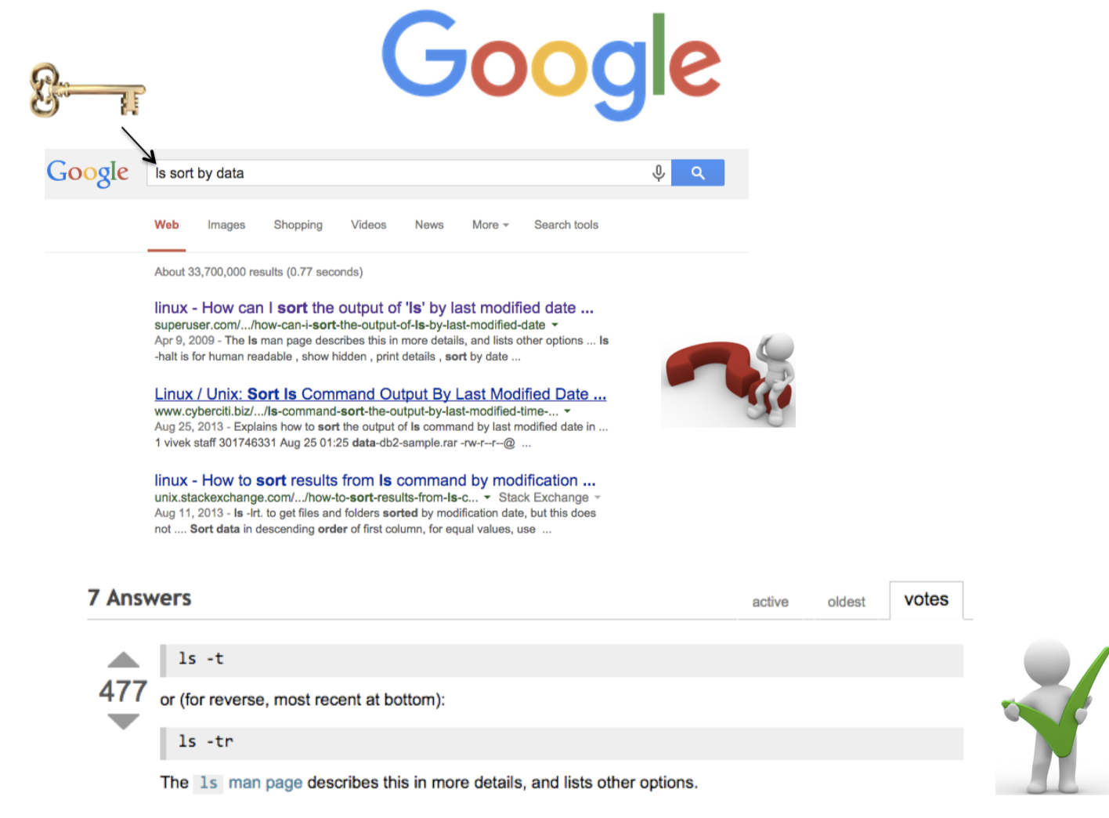

Slide 26
General Syntax: *
“*” can be used as a wildcard in Unix
[serghei@login3 test]$ ls *txt
test.txt
[serghei@login3 test]$ ls t*g
test.log
[serghei@login3 test]$ ls t*
test.log
test.txt

Slide 27
Displaying a file
Various ways to display a file in Unix
cat
less
head
tail

Slide 28
Command: cat
dumps an entire file to standard output
good for displaying short, simple files
[serghei@login3 test]$ cat test.txt
My first txt file!

Slide 29
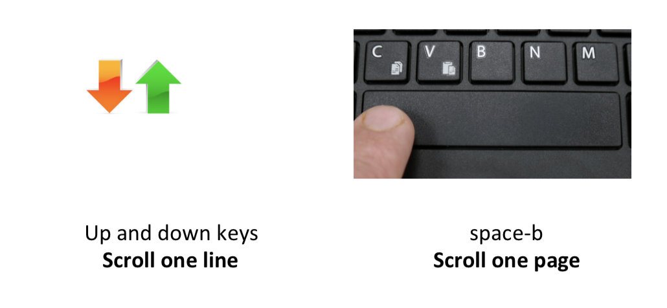
Command: less
Scrolling through a file without a mouse
press q to

Slide 30

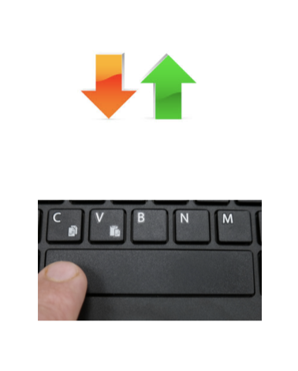
Let’s practice!
[serghei@login3 test]$ less large.txt
1
2
3
4
5
6
7
…
30
Try to scroll forward/back one line/page!

Slide 31
Command: head
displays the top part of a file
by default it shows the first 10 lines
-n option allows you to change that

Slide 32
Command: tail
Same as head, but shows the last lines

Slide 33
Let’s practice!
head large.txt
1
2
…
9
10
tail large.txt
21
22
…
30
tail -n 3 large.txt
28
29
30

Slide 34



File Commands
Copying a file: cp
Move or rename a file: mv
Remove a file: rm
Notes:
Like so many Linux features, you have a variety of options from which to choose when you want to manipulate files and directories. You can also use wildcards when you're copying, moving, or deleting files and directories.

Slide 35
Copy
cp <source> <destination>
to copy a file use cp
to copy a directory use cp -r

Slide 36
Let’s practice
[serghei@login3 test]$ cp test.txt test1.txt
[serghei@login3 test]$ ls
large.txt test1.txt test.log test.txt
[serghei@login3 test]$ mkdir new
[serghei@login3 test]$ cp -r new new2
[serghei@login3 test]$ ls
large.txt new new2 test1.txt test.log test.txt
[serghei@login3 test]$ cp test.txt new/
[serghei@login3 test]$ cp test.txt new/test_new.txt
[serghei@login3 test]$ cd new
[serghei@login3 new]$ ls
test_new.txt test.txt
Notes:
Creating a copy of a file in the current directory

Slide 37

Command: mv
mv <source> <destination>
moves a file/directory to a different location
renames a file/directory
[serghei@login3 new]$ cd ..
[serghei@login3 test]$ pwd
/u/home/s/serghei/test
[serghei@login3 test]$ mv test1.txt new/
[serghei@login3 test]$ mv test.txt test_rename.txt
[serghei@login3 test]$ ls
large.txt new new2 test.log test_rename.txt
[serghei@login3 test]$ mv test.txt new/test2.txt

Slide 38
Symbolic Links
is a special kind of file that points to another file
existing file for which you want to create the symbolic link
name of the symbolic link
ln -s <ORIGINAL_FILE> <LINK_NAME>
Original file
Link
Data on the hard disc

Slide 39


Good to know
You can perform an operation on LINK_NAME, just as you could with the ORIGINAL_FILE
You can use normal file management commands (e.g., cp, rm) on the symbolic link.
Don’t modify the original file through the link

Slide 40


Command: rm
to remove a file use rm
to remove a directory use rm -r
[serghei@login3 test]$ rm test.log
[serghei@login3 test]$ rm -r new2
[serghei@login3 test]$ ls
large.txt new test_rename.txt
Files and directories deleted with rm are gone forever and cannot be recovered!!!

Slide 41
Good to know
cp/mv/rm can work on many files at once:
cp file1 file2 new/
rm file1 file2 file27
cp/mv/rm can work with *:
mv f* new/
rm f*
rm l*s
rm *txt

Slide 42
Intro to Read Alignment
Reads are short (~100bp) stretches of DNA produces by sequencing machine
Reference genome – a known DNA sequence of an organism
Read aliment – a process of finding the position in the reference genome from there the read originated

Slide 43
Our Data
In this tutorial, we provide:
1. HIV reference genome - the known DNA sequence of HIV virus
2. Sequencing data - reads generated from the HIV genome by sequencing mashine

Slide 44
Our goal
Align reads to the reference genome

Slide 45
Read Alignment with BWA
Bwa is one of most popular read alignment tools

Slide 46
Download BWA software tool and sequencing data
Download zip file from the link provided by professor, then unzip the file:
unzip BWA_Tutorial.zip

Slide 47
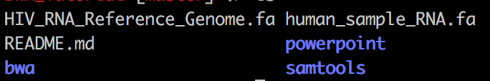
What’s inside
Tool for viewing Sam and Bam Files
BWA tool
HIV reference genome
Sequencing data (reads)

Slide 48
1. Create an index of HIV reference
BWA requires to specify which sequence will serve as the reference. In our case, we use the HIV virus. The -p option allows us to name the reference something shorter than the full file.
Run this command to create an index:
bwa/bwa index -p HIV_ref HIV_ref.fasta

Slide 49
2. Align reads to the reference genome
Now that we have created our reference index, we are ready to align reads to the HIV reference genome. We save the output to a .sam file called reads.sam
Run this command to align reads to reference genome:
bwa/bwa mem HIV_ref reads.fasta > reads.sam

Slide 50
3. View alignment results
We can view the samfile directly as a regular .txt file
For example we can use less command

Slide 51
Interpreting BWA alignment file
Run this command to view aligned reads:
less alignments.sam
human_read1 0 HIV_complete_genome 150 18M1I52M MCCCTTTTAGTCAGTGTGGAAAAATCT....
human_read2 0 HIV_complete_genome 1702 3M1D68M CAGCCCACCAGAAGAGAGCGGCAGGTCT....
human_read3 0 HIV_complete_genome 5902 48M1I46M GTGGAAGGAAGCAACCACCACTCTATTT....
Sequence of the read
Reads
CIGAR
Position in the refence genome where reads is aligned
Name of of the reference genome

Slide 52
Understanding the CIGAR
CIGAR (Concise Idiosyncratic Gapped Alignment Report) is a way to represent additional bases of the read that are not in the reference or may be missing bases of the read that are in the reference.

Slide 53
Interpreting alignment of read1
Line from reads.sam file:
read1 0 HIV_complete_genome 150 18M1I52M …
Interpretation:
Read1 was aligned to HIV_complete_genome as follows: 18 matches (18M) then 1 insertion (1I) and then 52 matches (52M)

Slide 54
Interpreting alignment of read2
Line from reads.sam file:
read2 0 HIV_complete_genome 1702 3M1D68M
Interpretation:
Read2 was aligned to HIV_complete_genome as follows: 3 matches, then 1 deletion then 68 matches

Slide 55
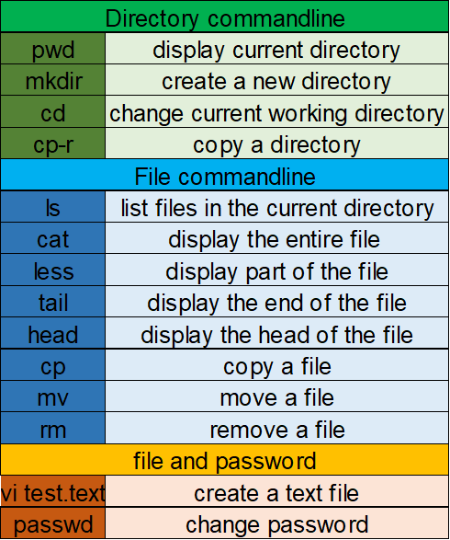
Summary
Sequence Alignment
create index from reference genome
bwa index
align reads to a reference
bwa mem

