Slide 1
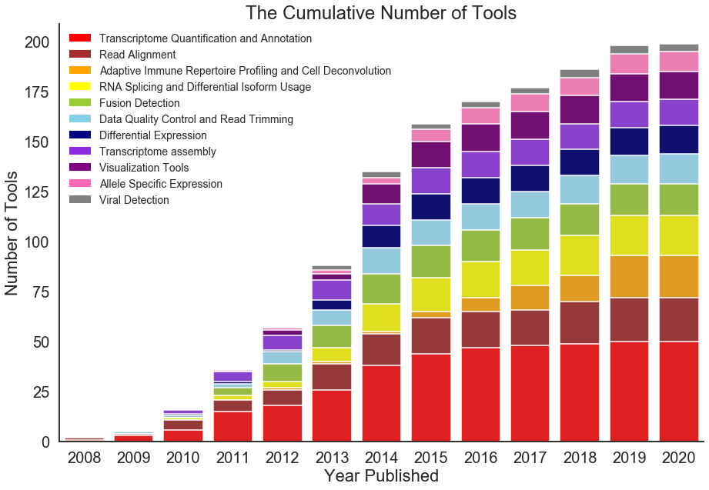
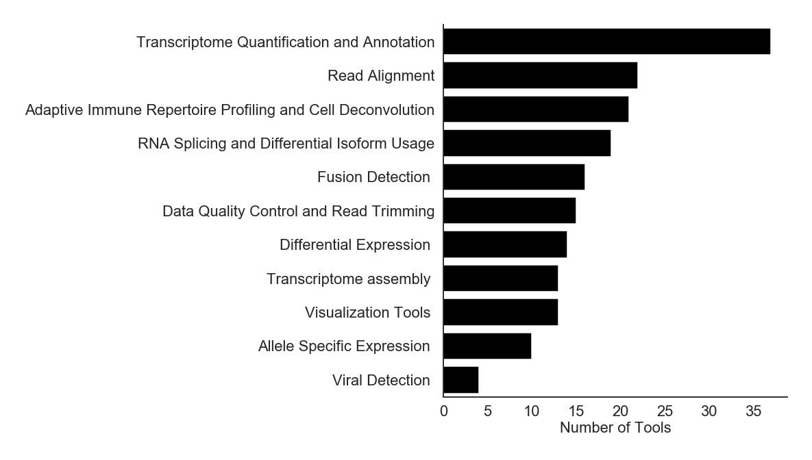
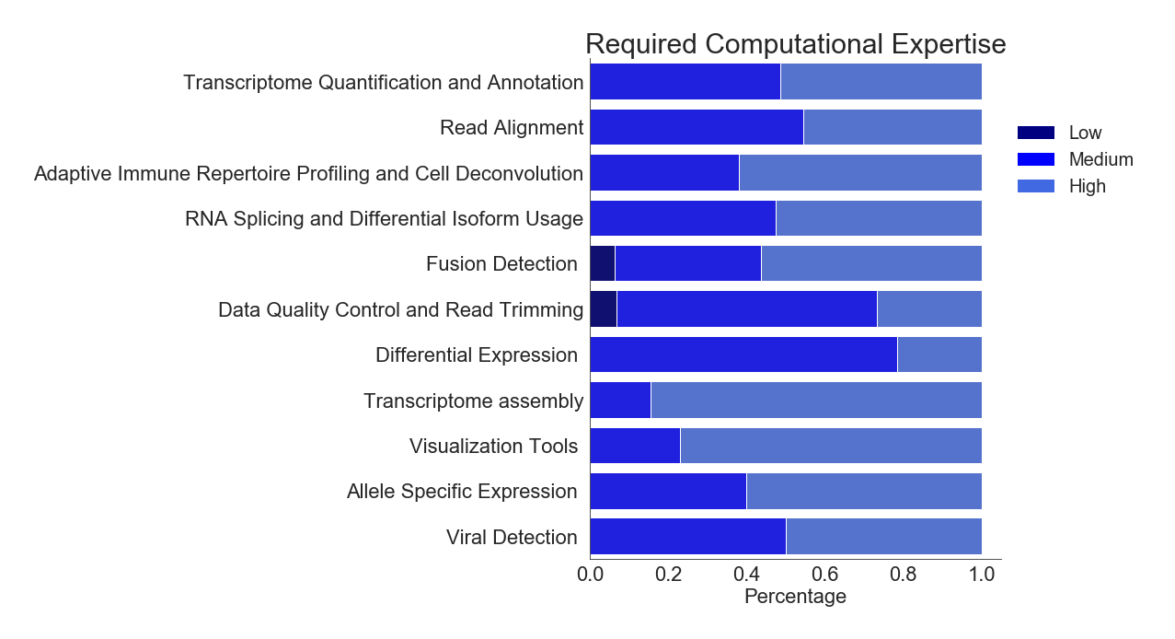
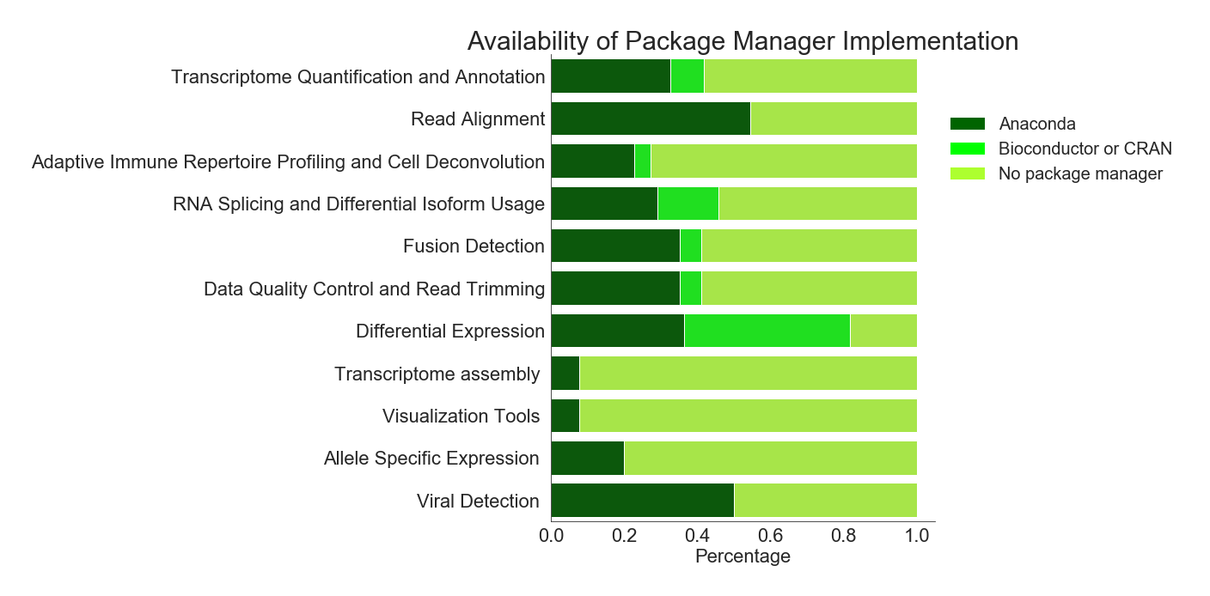
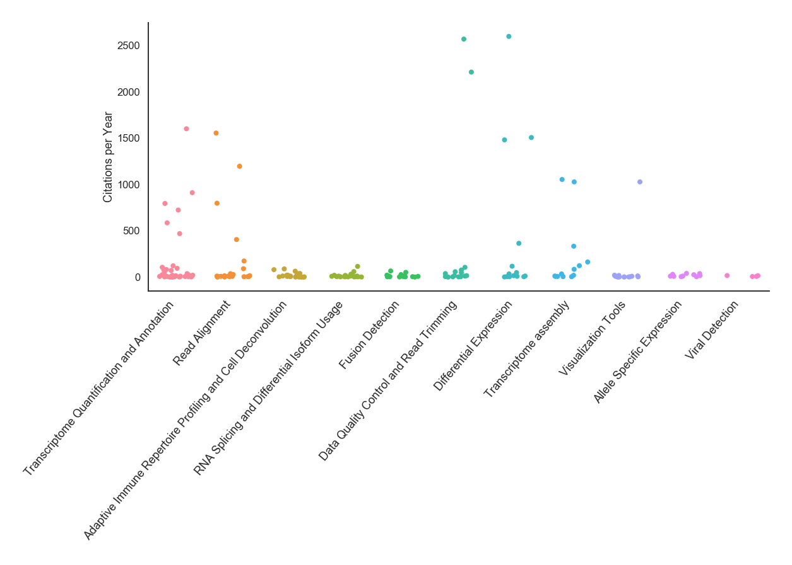
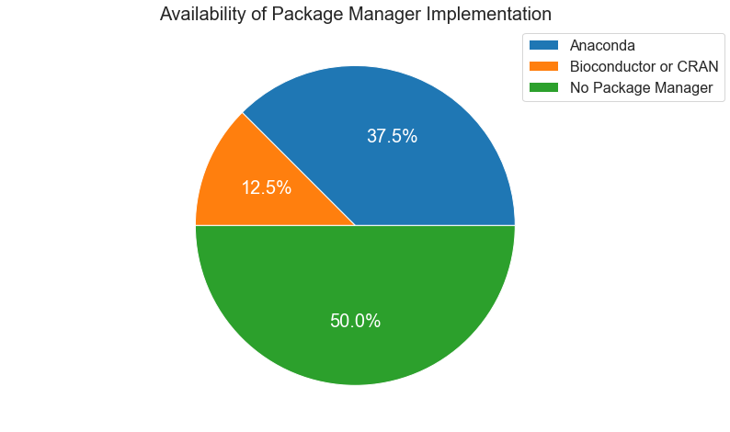
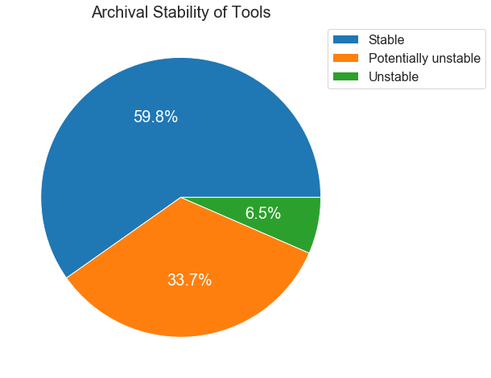
a
b
c
d
e
Trimmomatic
DESeq-2
f
Ht-seq-count
STAR
Trinity
CummeRbund
g

Slide 2
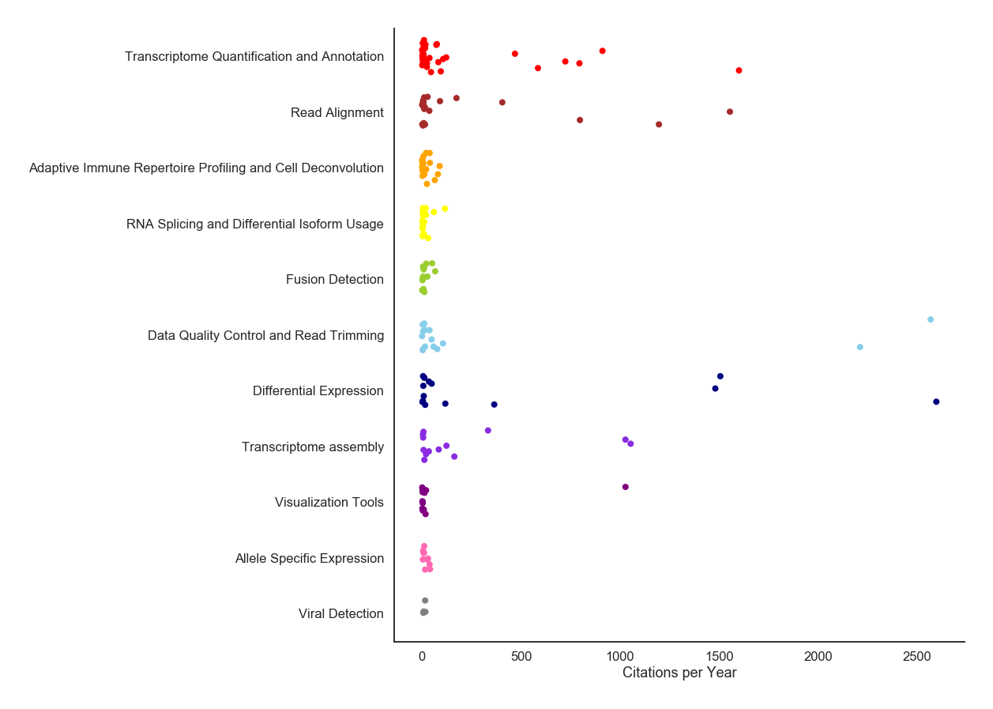
a
b
c
d
Ht-seq-count
f
e
STAR
TopHat2
Trimmomatic
Samtools
Cufflinks
g
Trinity
DESeq-2
CummeRbund

Slide 3
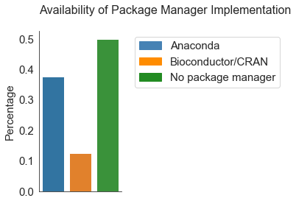
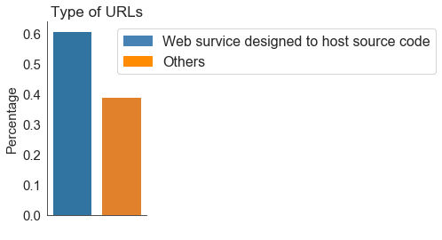
a
b
c
d
Ht-seq-count
f
e
STAR
TopHat2
Trimmomatic
Samtools
Cufflinks
g
Trinity
DESeq-2
CummeRbund

Slide 4
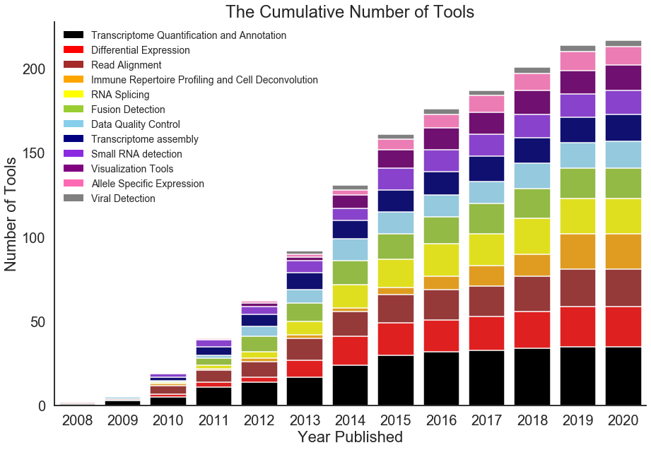
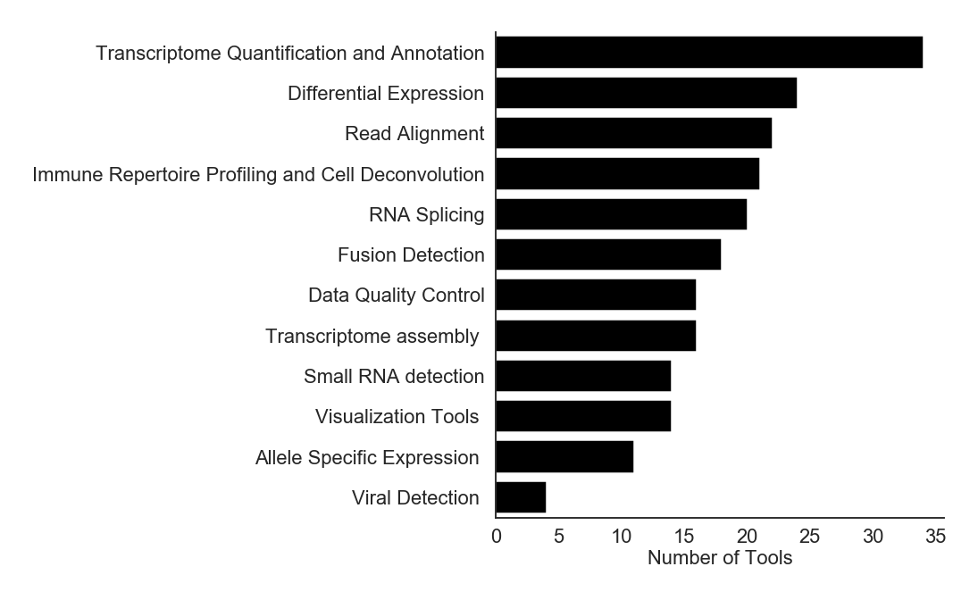
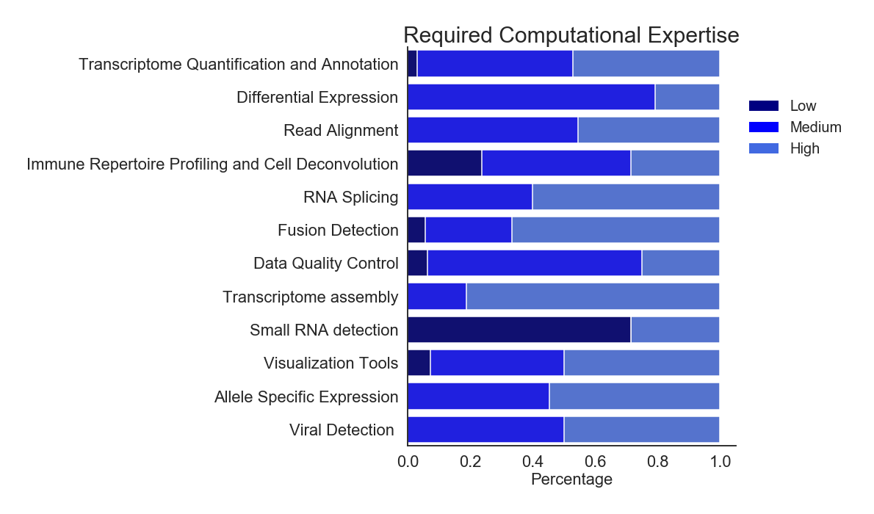
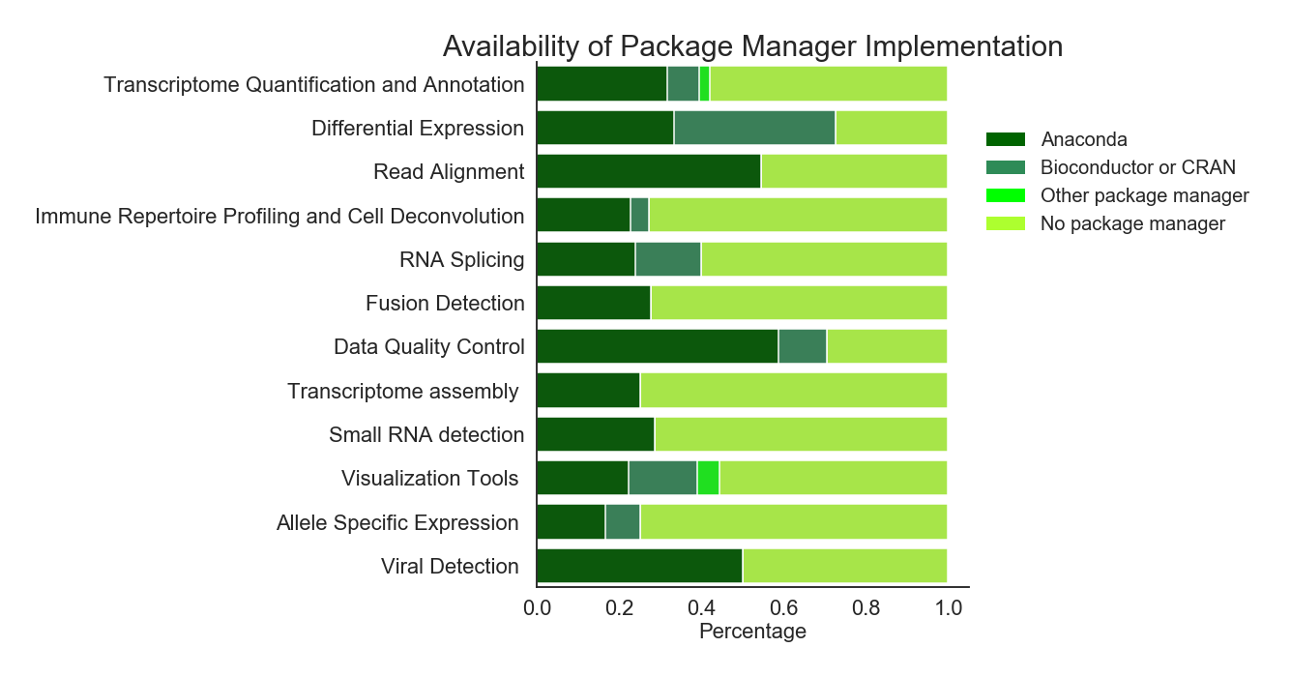
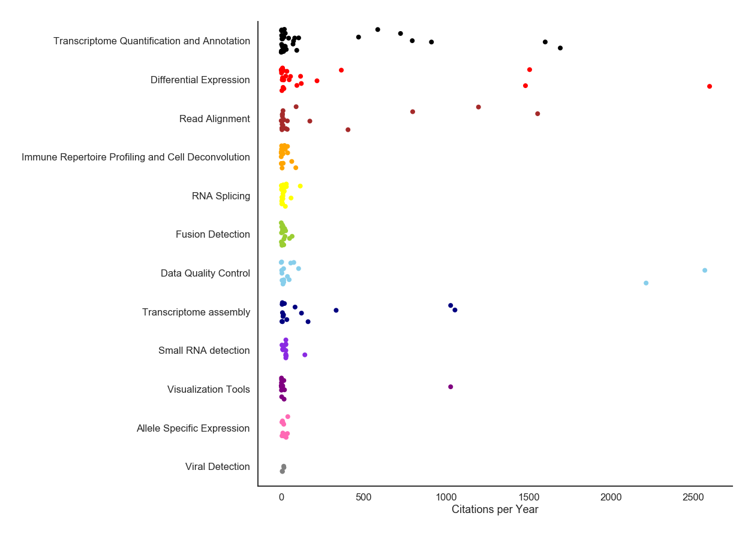
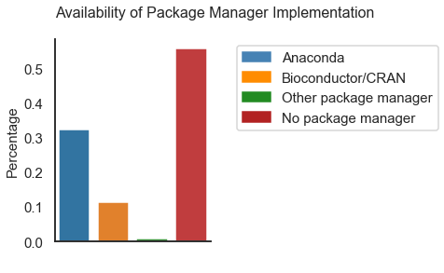
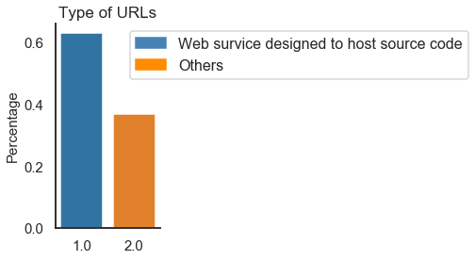
a
b
c
d
e
Ht-seq-count
f
Ht-seq
Limma/Voom
DESeq2
EdgeR
STAR
Trimmomatic
Cufflinks
Samtools
g
Trinity
CummeRbund

Slide 5
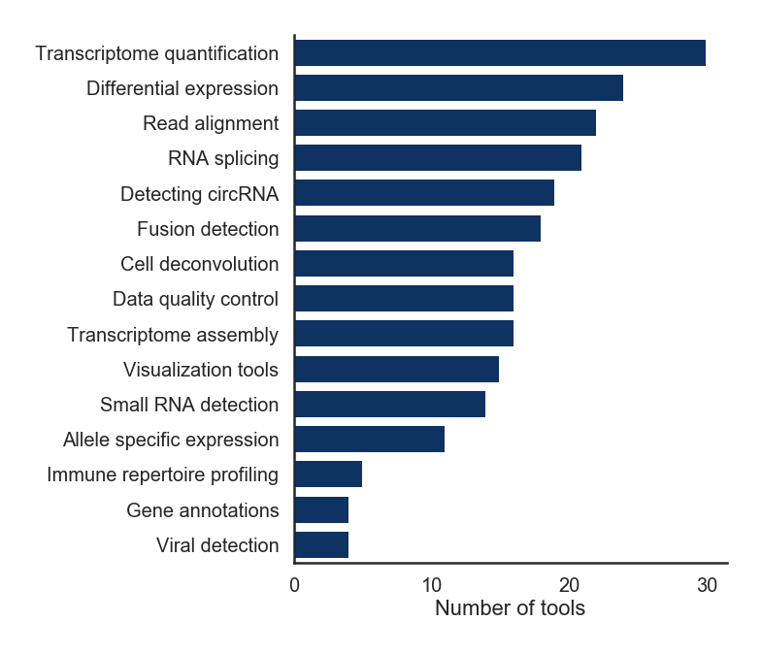
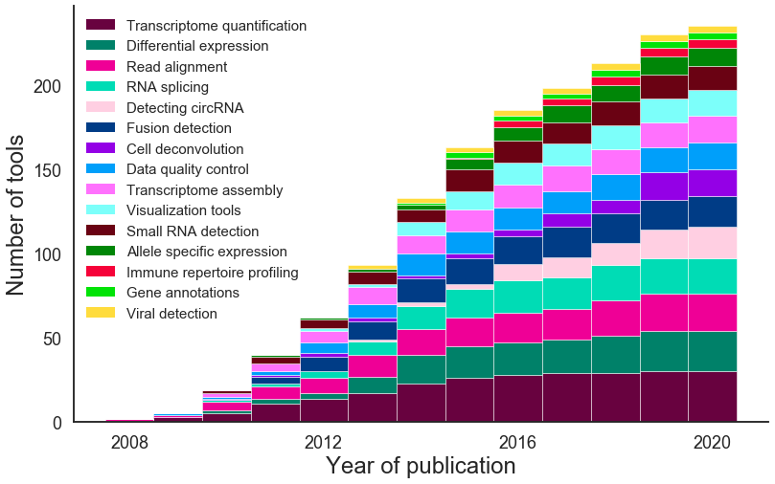
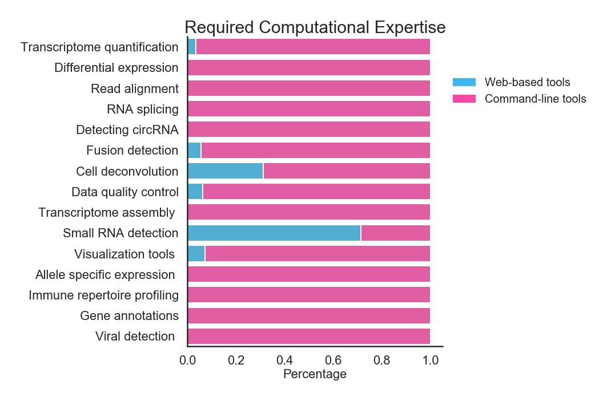
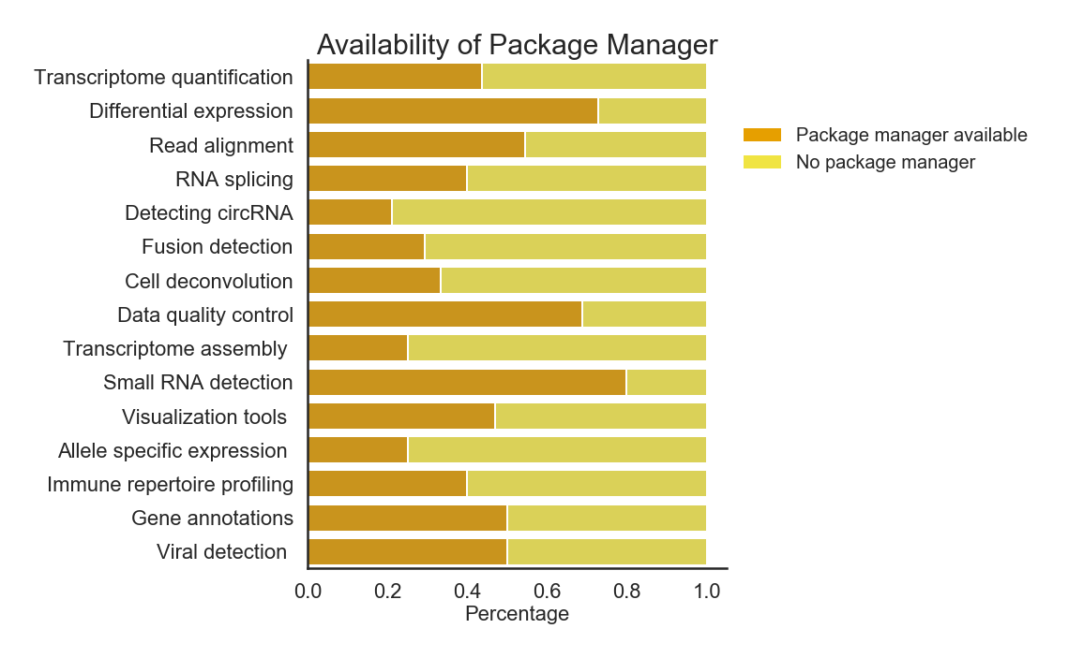
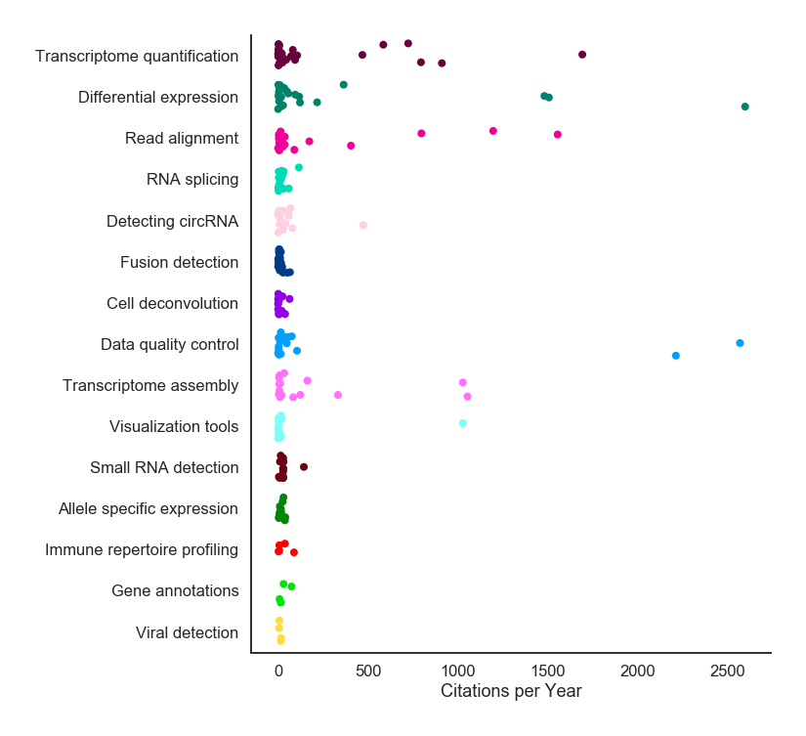
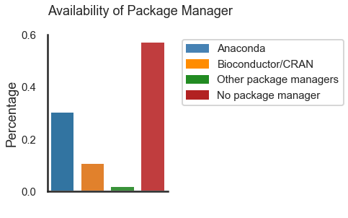
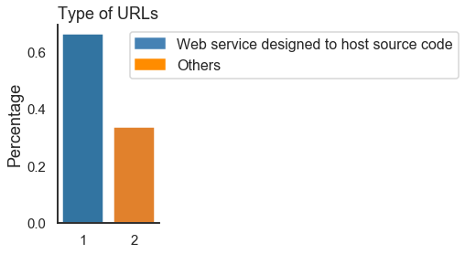
a
b
c
d
e
Ht-seq
f
EdgeR
Limma/Voom
DESeq2
TopHat2
STAR
Samtools
Trimmomatic
Cufflinks
Trinity
g
CummeRbund

Slide 6
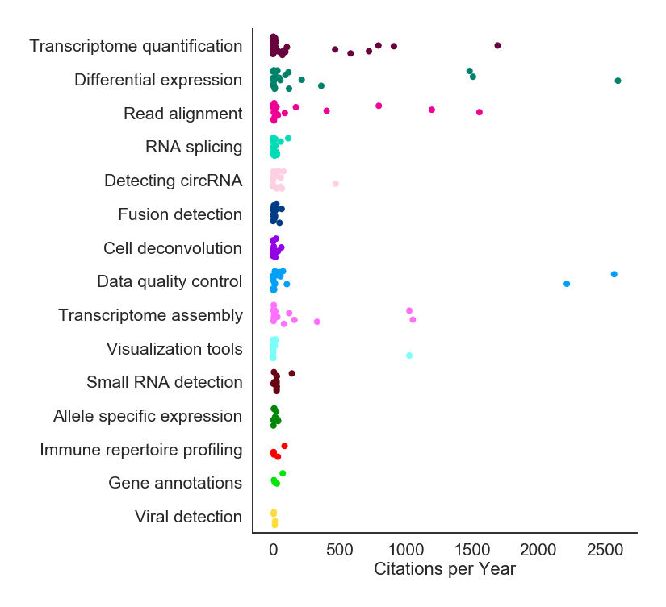
a
b
c
EdgeR
Ht-seq
Limma/Voom
DESeq2
TopHat2
STAR
Samtools
Trimmomatic
Cufflinks
Trinity
CummeRbund

Slide 7
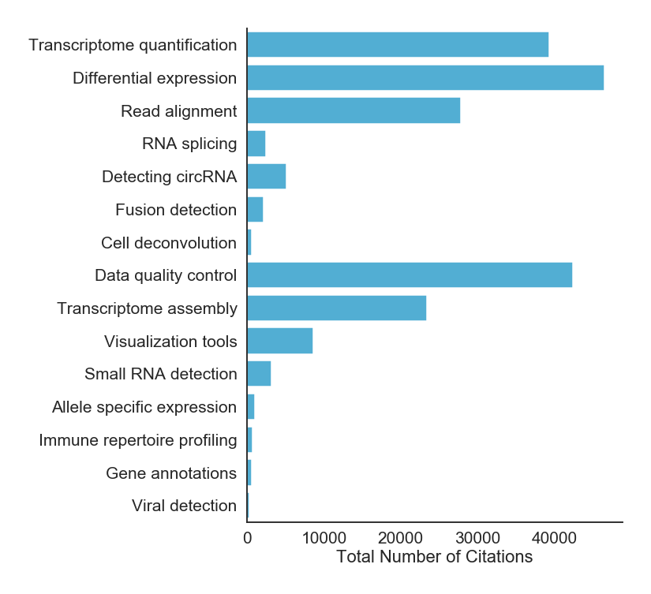
a
b
c
d
EdgeR
Ht-seq
Limma/Voom
DESeq2
TopHat2
STAR
Samtools
Trimmomatic
Cufflinks
Trinity
CummeRbund

Slide 8
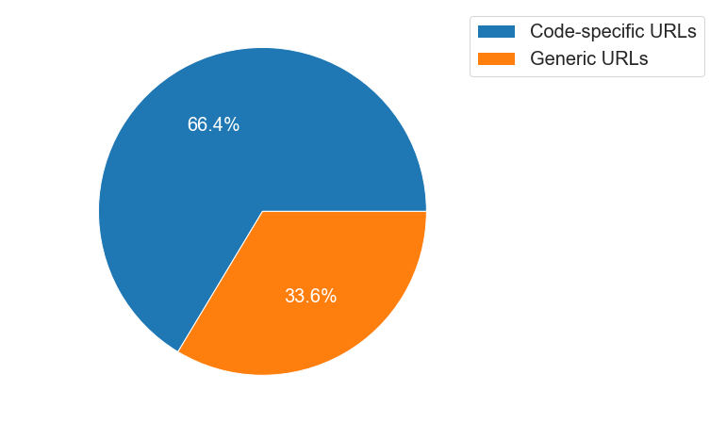
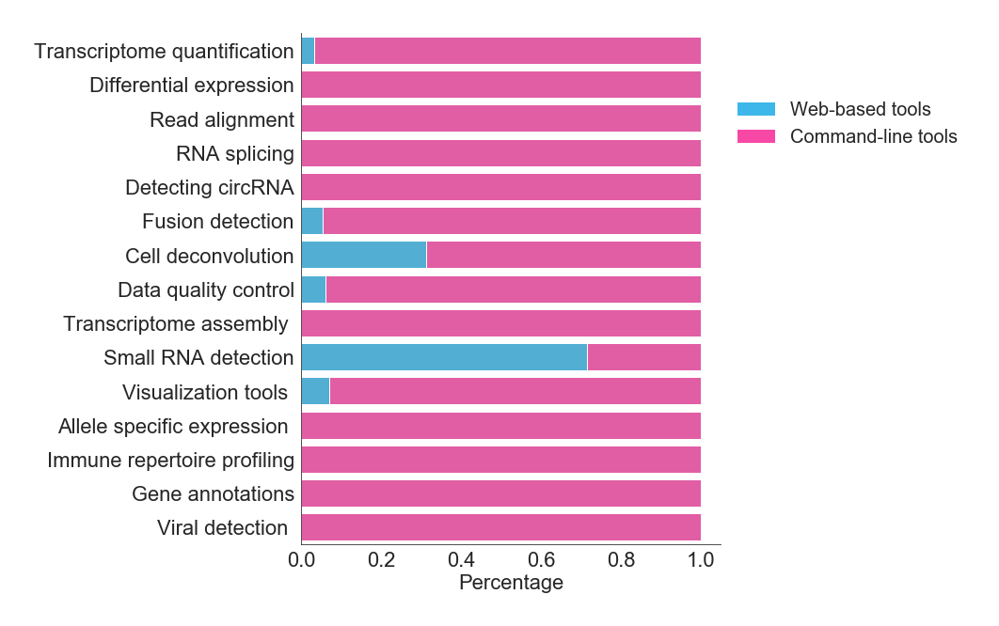
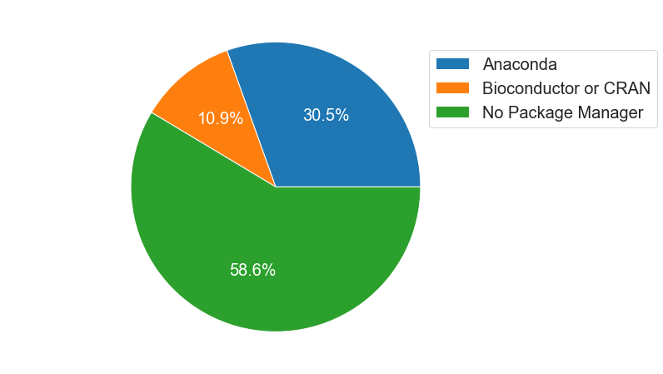
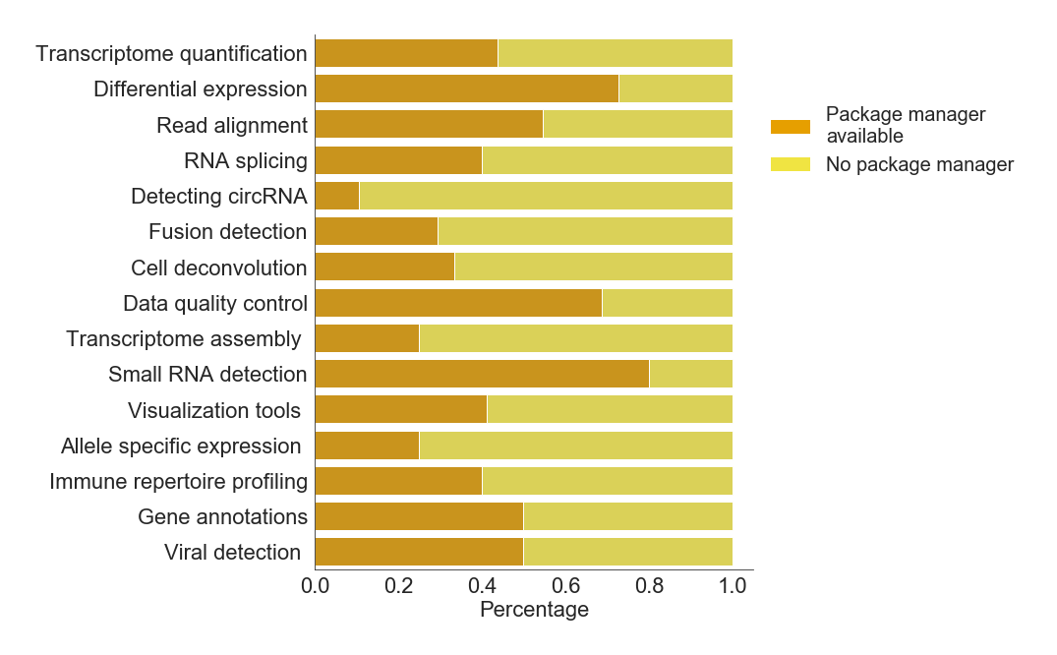
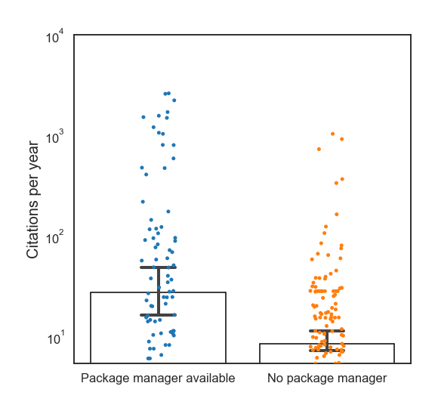
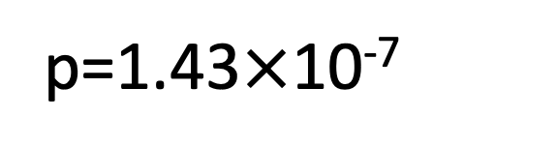
b
Type of URLs
a
Required Computational Expertise
c
Availability of Package Manager
d
Availability of Package Manager
e
p=1.43$×$10⁻⁷

Slide 9
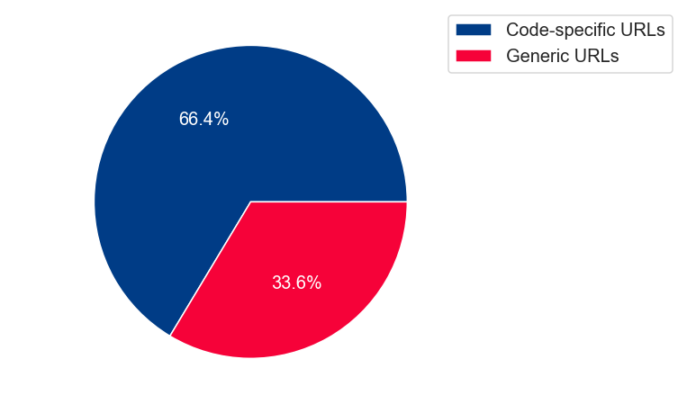
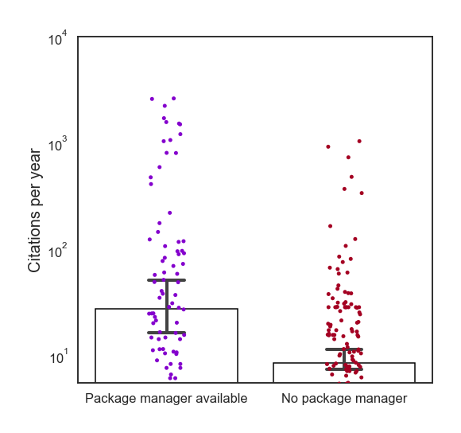
b
Type of URLs
a
Required Computational Expertise
c
Availability of Package Manager
d
Availability of Package Manager
e
p=1.43$×$10⁻⁷

