Slide 1
FAT12

Slide 2
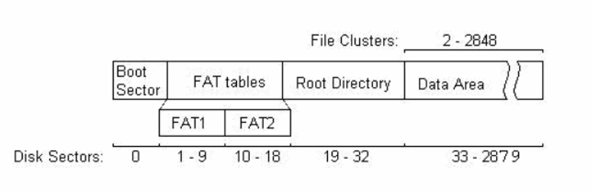

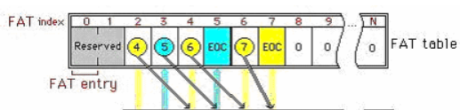

AN OVERVIEW OF FAT12
Disk organization
FAT table
FAT? is a table indicating status and location of all data clusters.(considered as an array)
“Cluster” definition refers to data area.( 1 cluster has a size of 1 sector.)
“12?” indicates that the FAT consists of 12 bit entries.
The storage space is divided in units called sectors.
1 sector has a size of 512 bytes.
NOTE

Slide 3
Disk organization
Find out some information on each sections :
Purpose of this section.
Size.
Address(where is the sections).
What does the section contain.
NOTE

Slide 4
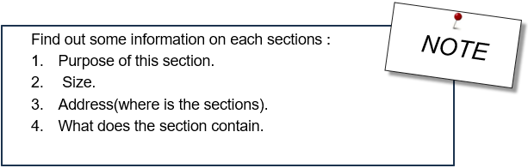
THE DATA SECTION
1. Contains content of files and directory.
Clusters(a cluster
is a group of sector)
are indexed from 2.
3.Start after Root directory.
4. Contain :
content of file or directories.

Slide 5
THE BOOT SECTOR
1. Needed information is
extracted to use the disk
correctly.(an instruction)
2. ONE Sector (512 bytes)
3.Start at zero sector.
4. Contain :
how many of FAT copys ?
how many sectors in a cluster ?
how big a sector is ?
An instruction to find other sections

Slide 6
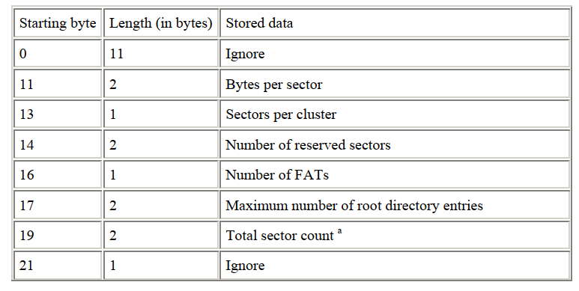
Main point

Slide 7
THE ROOT DIRECTORY
The root is the primary directory same as other directory stored in data area.
1. Main purpose : to store starting address of files or other directory (first cluster).
2. Size : Store in boot sector.
3. Address: Start after FAT section.
4. Contain entries?.

Slide 8
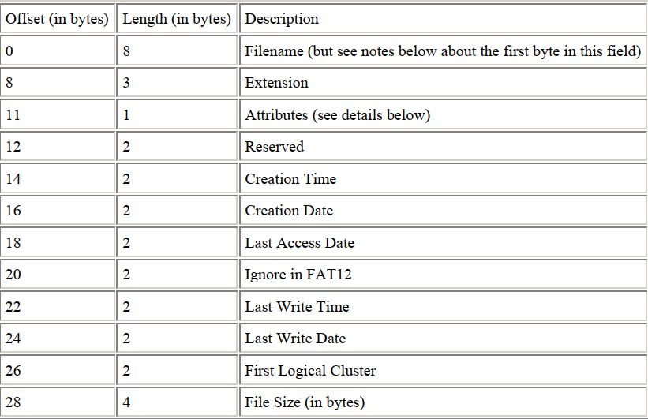

Slide 9
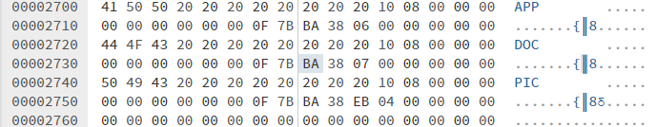
THE ROOT DIRECTORY ENTRY
1. Main purpose : to find content of files or other directory (first cluster).
2. Each entry has a size of 32 bytes
3. Start after the last copy of FAT section.
4. Contain: next page.

Slide 10
THE FAT SECTION -> WHY FAT IS NEEDED ?
An Array whose element is the next data cluster store information of the current file.
1. Main purpose : to keep track of content of a file.
2. Size : Store in boot sector.
3. Address: Start after FAT section.
4. Contain entries?.(12bit in FAT12).
the next address of content of file.
Each FAT entry refers to a cluster.

Slide 11
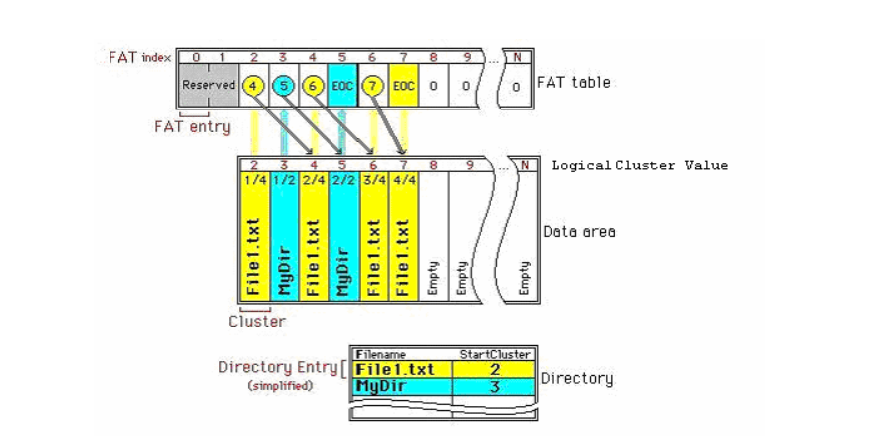
IDEA
NOTE :
1. The next address of content of file.
2. Each FAT entry refers to a cluster

Slide 12
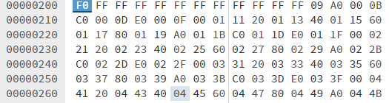
RESERVED ENTRY

Slide 13
Program Overview
Main
FAT
HAL
FAT_Print
User Interface
FAT
File Interface

Slide 14
HAL_Return_Type HAL_Open_Disk(uint8_t* userPath);
HAL_Return_Type HAL_Read_One_Sector(uint32_t sectorIndex, uint8_t *pData)
HAL
HAL_Return_Type HAL_Read_Multi_Sector(uint32_t sectorIndex, uint32_t sectorNum ,uint8_t *pData);
void HAL_Close_Disk();

Slide 15
void FAT_Initialize(uint8_t* diskPath);
FAT
void FAT_Read_File(uint32_t FirstCluster);
void FAT_Read_All_Entry (uint64_t dirAddr);

Slide 16
void FAT_Read_Boot()
void FAT_Initialize(uint8_t* diskPath)
void FAT_Read_All_Entry (uint64_t dirAddr)
FAT
static inline uint64_t FAT_Convert_L2B_Edian (uint8_t* firstByte, uint8_t dataLen)
uint16_t FAT_Find_Next_Cluster(uint32_t n)
void FAT_Read_File(uint32_t Firtclusterindex)

Slide 17
void FAT_Print_Boot();
FAT_Print
void FAT_Print_One_Entry (FAT_Entry_t* entryAddr,
uint32_t entryNum);
void FAT_Print_Folder_Opening();

Slide 18
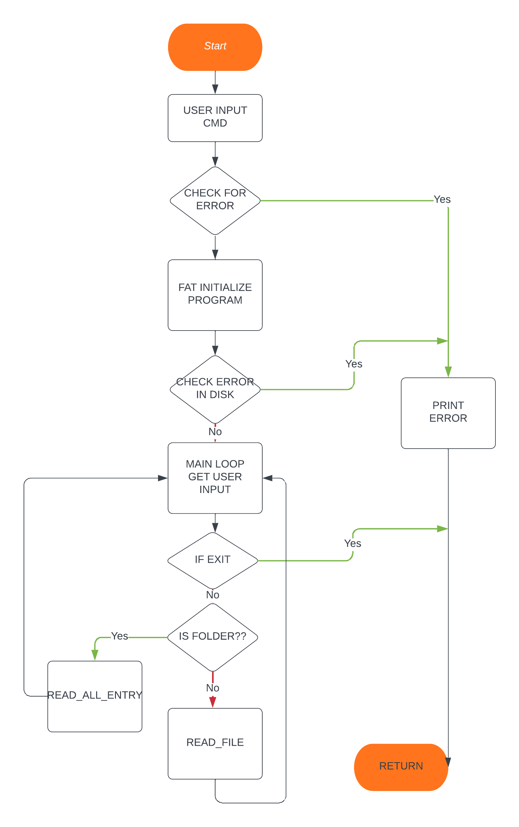

Slide 19
Initialize the program
Boot
FAT
Read FAT and store in a global
ROOT
Read all entry in root and print
Open Disk and read boot Sector

Slide 20
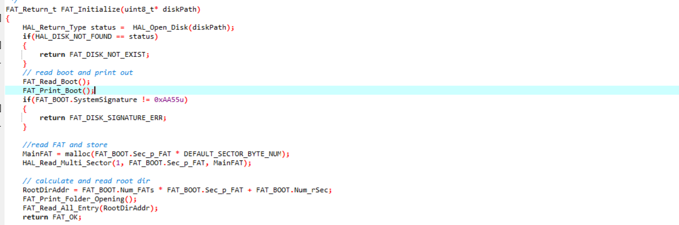
Initialize the program

Slide 21
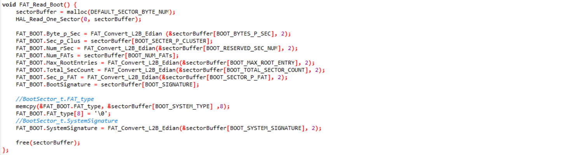
Read Boot

Slide 22
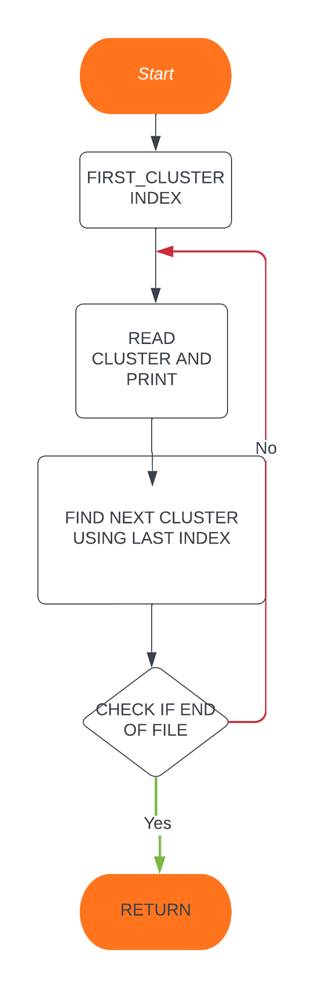
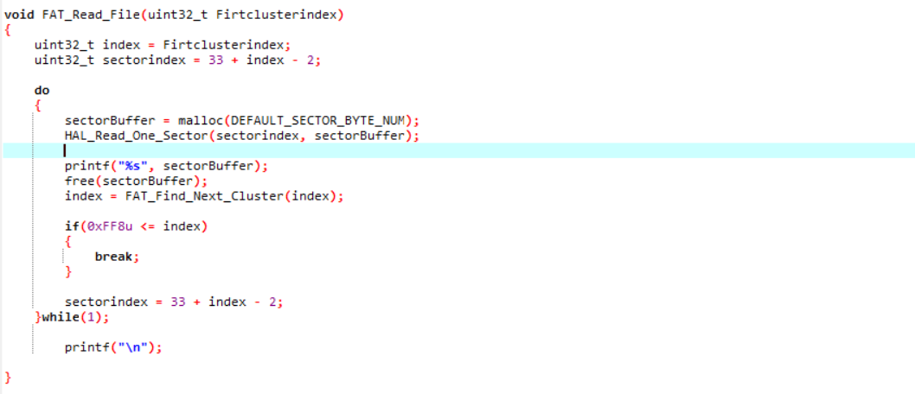
Read file

Slide 23
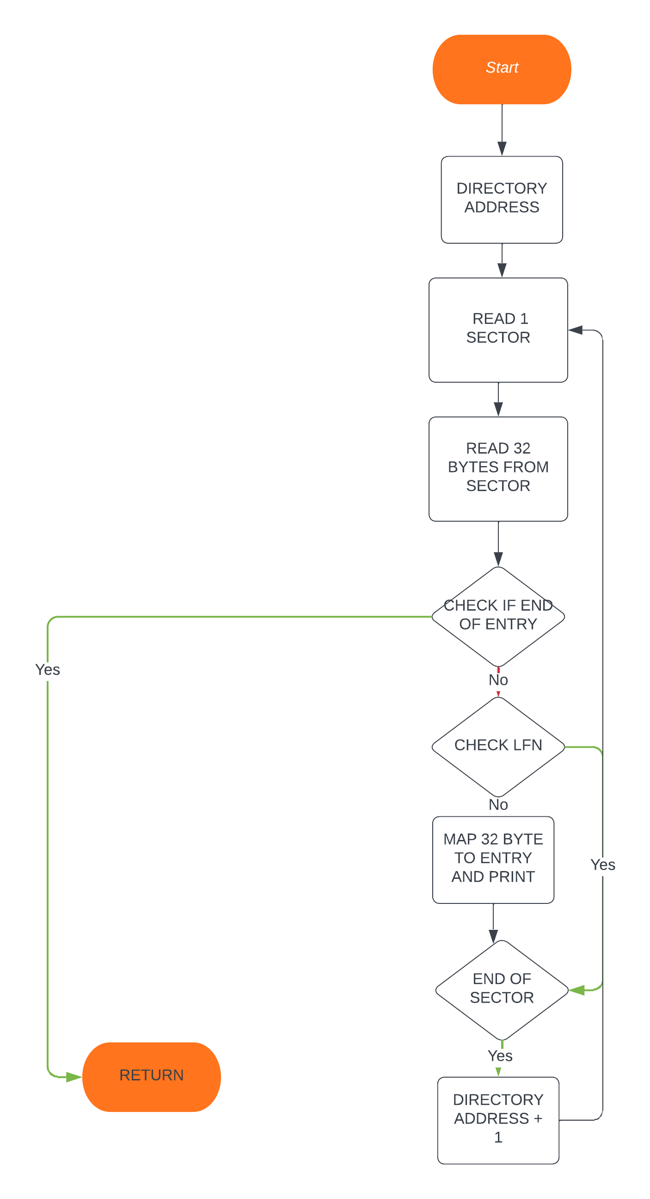
Read All entry

Slide 24

THANKS FOR LISTENING

