Slide 1
SENTIMENT ANALYSIS
Luong Khac Manh

Slide 2

CONTENT
Introduce to Sentiment Analysis
Build Sentiment Analysis Model
Conclusion

Slide 3
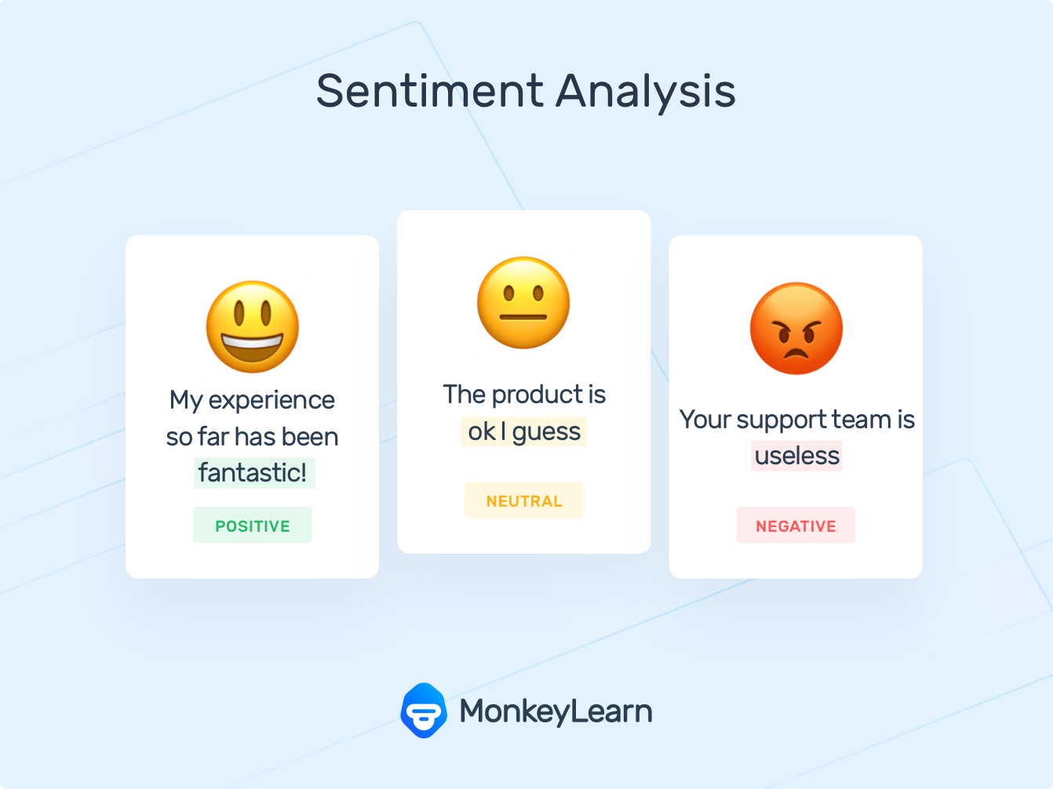
Introduction to sentiment analysis
2 Approaches:
User
Machine learning

Slide 4
Application
Businesses and Organization:
Brand analysis
New product perception
Product and Service benchmarking
Business spends a huge amount of money to find consumer sentiments and opinions.
Individuals: Interested in other’s opinions when….
Purchasing a product or using a service
Finding opinions on political topics, movies, etc.

Slide 5
Build sentiment analysis model
Flowchart of Sentiment Analysis
Input data pre-processing
Model for predicting
Result

Slide 6
Flowchar of Sentiment analysis
Training data
Vectorizer
Model
Positive
Negative
Neutral

Slide 7
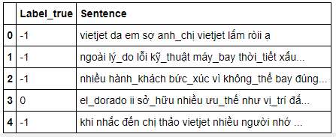
Training data
4930 records

Slide 8
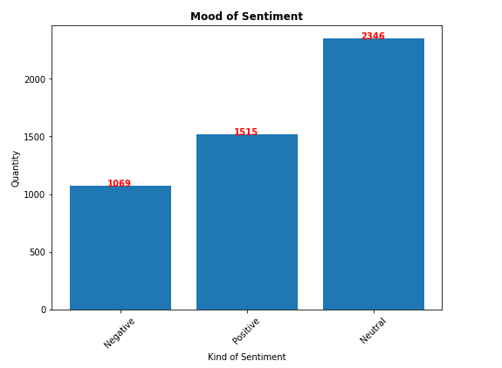
Training data

Slide 9
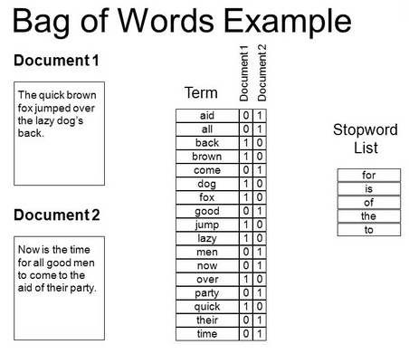
Vectorizer – Bag of Words

Slide 10
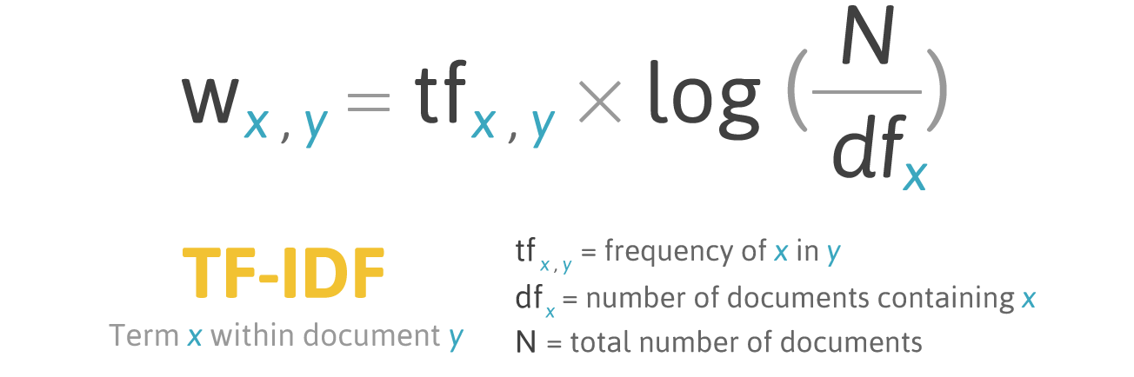
Vectorizer – TF-IDF

Slide 11
Model for predicting
Multinomial Naïve Bayes
Support vector machine – kernel = ‘linear’

Slide 12

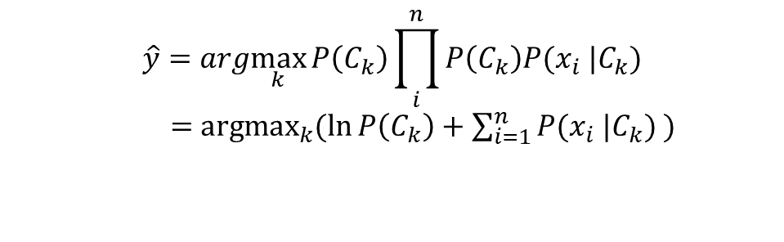
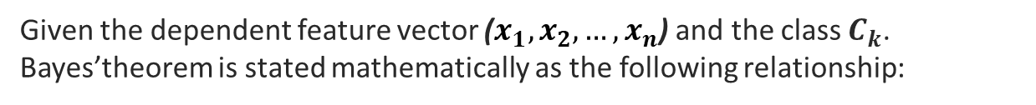
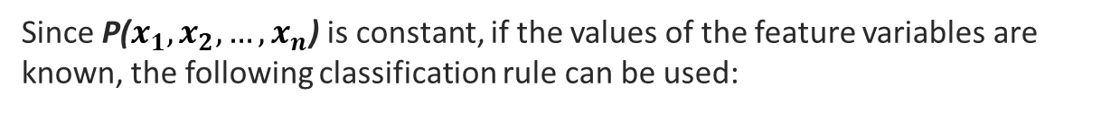

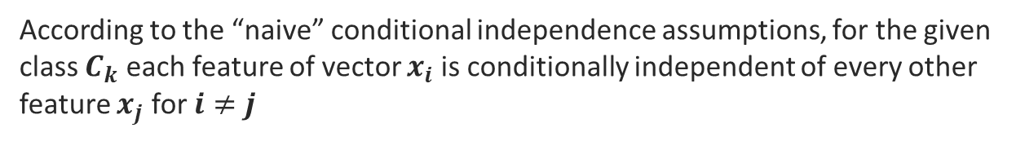
Naïve Bayes Classifier
Given the dependent feature vector ($x_{1},x_{2}, …,x_{n}$) and the class $C_{k}$. Bayes’theorem is stated mathematically as the following relationship:
$$P\left(C_{k} | x_{1},…,x_{n}\right)=\frac{P\left(C_{k}\right)P(x_{1},…,x_{n}|C_{k})}{P(x_{1},…,x_{n})}$$
According to the “naive” conditional independence assumptions, for the given class $C_{k}$ each feature of vector $x_{i}$ is conditionally independent of every other feature $x_{j}$ for $i≠j$
$$P\left(C_{k} | x_{1},…,x_{n}\right)=\frac{P\left(C_{k}\right)\prod_{i}^{n}{P\left(C_{k}\right)P(x_{i} |C_{k})}}{P(x_{1},…,x_{n})}$$
Since P($x_{1},x_{2}, …,x_{n}$) is constant, if the values of the feature variables are known, the following classification rule can be used:
$$\hat{y}=arg\max_{k}{P\left(C_{k}\right)\prod_{i}^{n}{P\left(C_{k}\right)P(x_{i} |C_{k})}}$$
$=$ $\underset{k}{argmax}{(\ln{P\left(C_{k}\right)}+\sum_{i=1}^{n}{P(x_{i} |C_{k})} )}$

Slide 13

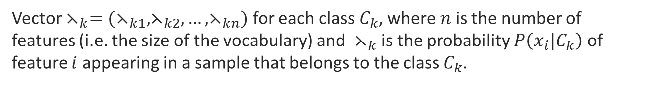
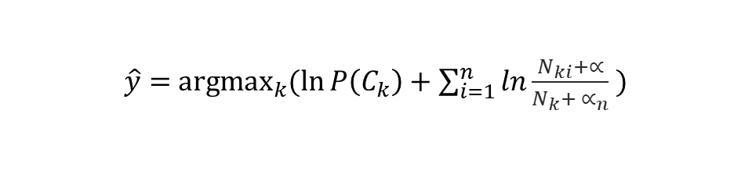
2.3.2 Multinomial Naïve Bayes
Vector $⋋_{k}=(⋋_{k1},⋋_{k2},…,⋋_{kn})$ for each class $C_{k}$, where $n$ is the number of features (i.e. the size of the vocabulary) and $⋋_{k}$ is the probability $P\left(x_{i}|C_{k}\right)$ of feature $i$ appearing in a sample that belongs to the class $C_{k}$.
$$⋋_{k}=\frac{N_{ki}+∝}{N_{k}+ ∝_{n}}$$
Thus, the final decision rule is defined as follows:
$\hat{y}=$ $\underset{k}{argmax}{(\ln{P\left(C_{k}\right)}+\sum_{i=1}^{n}{ln\frac{N_{ki}+∝}{N_{k}+ ∝_{n}}} )}$

Slide 14
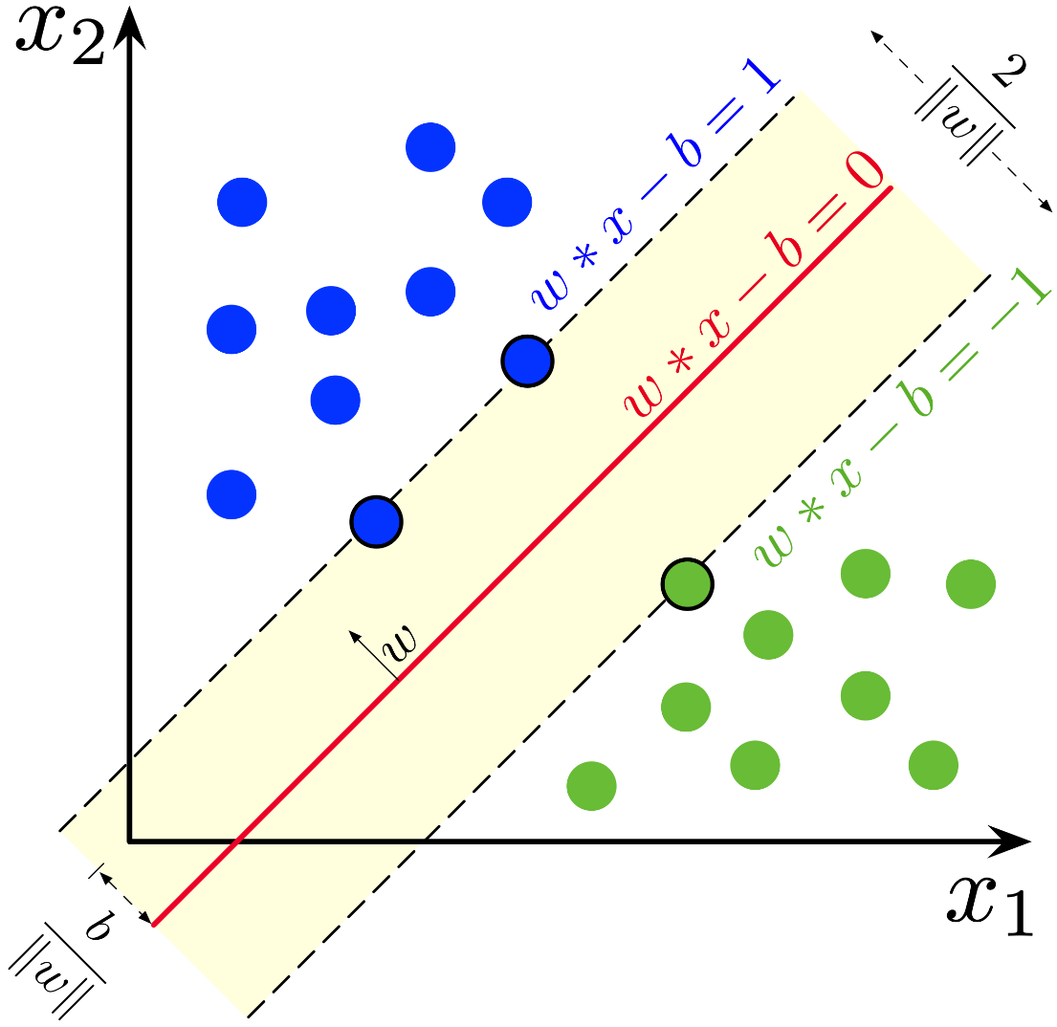


Support vector machine
Construct a hyperplane or set of hyperplanes in a hight or infinite dimensional space
Finding w,b satisfy max margin

Slide 15
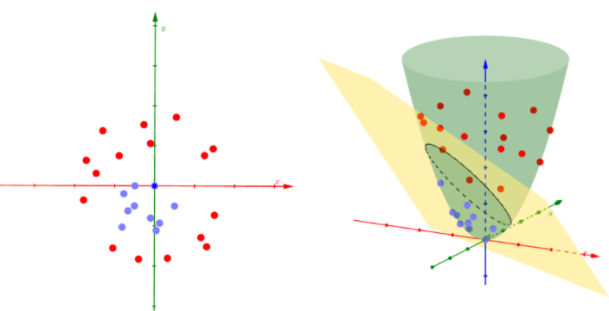
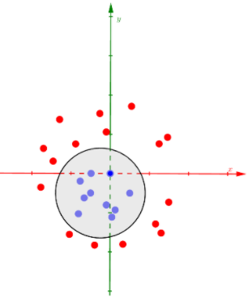
Kernel Support vector machine

Slide 16
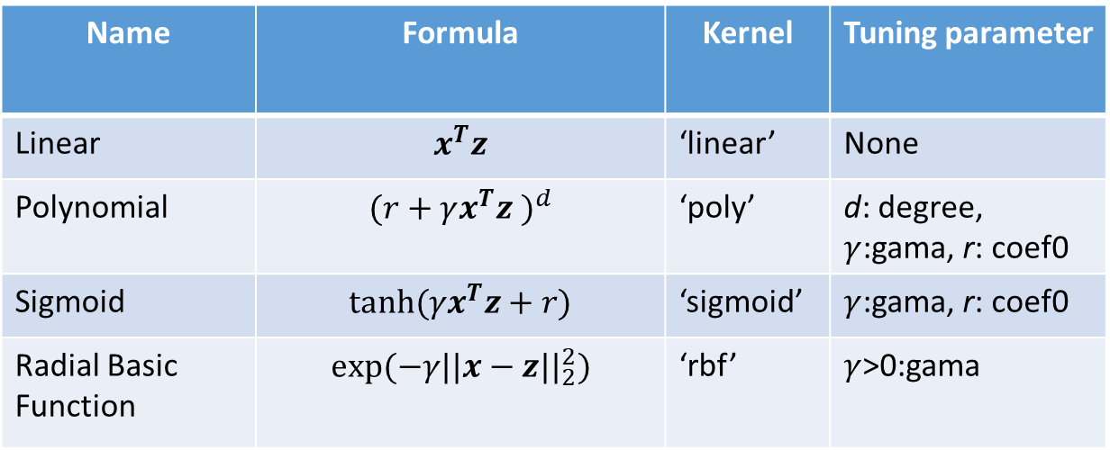
Kernel Support vector machine
Name | Formula | Kernel | Tuning parameter
Linear | $$x^{T}z$$ | ‘linear’ | None
Polynomial | $${(r+γx^{T}z )}^{d}$$ | ‘poly’ | d: degree, $γ$:gama, r: coef0
Sigmoid | $$tanh⁡(γx^{T}z+r)$$ | ‘sigmoid’ | $γ$:gama, r: coef0
Radial Basic Function | $$exp⁡(−γ{||x−z||}_{2}^{2})$$ | ‘rbf’ | $γ$>0:gama

Slide 17
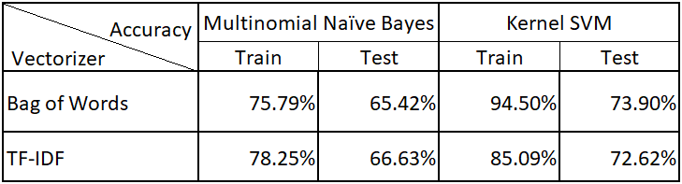
Result
Vetorizer: TF-IDF
Train model: Kernel SVM

Slide 18


Conclusion
Vectorizer by TF-IDF vs train model by Kernel SVM for result better than Bag of Word vs Naïve Bayes

Slide 19


