Slide 1
Session 2
Chapter 2 - Relational Data Model - Part 1
Database Systems

Slide 2
Objectives
1
Understand what is a Data Model
2
Understand what belong to a Data Model
3
Understand what are Relations, Attributes, Tuples, Domains
4
Understand what are Relation instances, Schema, DB schema
5
5
Understand how to use SQL to define relation schemas

Slide 3
Contents
1
An Overview of Data Models
2
Basics of the Relational Model
3
Defining a Relation Schema in SQL

Slide 4
2.1. An Overview of Data Models

Slide 5
2.1.1. What is a Data Model?
A Data Model is a notation for describing data or information. The description generally consists of 3 parts:
  Structure of the data
  Operations on data.
  Constraints.

Slide 6
2.1.2.Important Data Models
Today, two important data models are:
The relational model, including object-relational extensions
The semi-structured data model, including XML and related standards

Slide 7
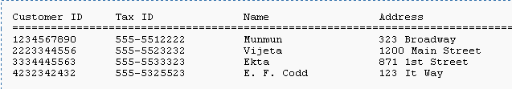
2.1.3. Overview of Relational Model

Slide 8
2.1.4. Overview of Semi-structured Data
Another data model, based on trees rather than tables or arrays.
The point-of-view today is XML: a way to represent data by hierarchically nested tagged elements.

Slide 9
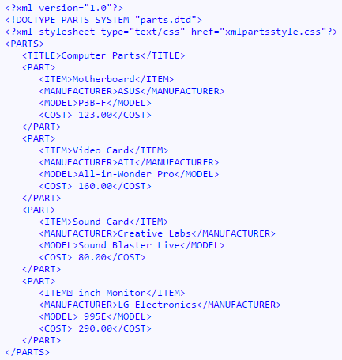
XML file example

Slide 10
2.2. Basics of Relational Model

Slide 11
2.2.1. Attributes
The relational model represents data as a 2-dimensional table (called a relation)
Each row represents a CUSTOMER
Each column represent a property of CUSTOMER and also called a “attribute”

Slide 12
2.2.2. Schemas
The name of a relation and the set of attributes for that relation is called the schema for that relation, exp:
CUSTOMER (Customer ID, Tax ID, Name, Address)

Slide 13
2.2.3. Tuples
A row of a relation is called a tuple (or record)
When we want to write a tuple in isolation, not as part of a relation, we normally use commas to separate components
Exp: (1234567890,555-5512222, Munmun, 323 Broadway)

Slide 14
2.2.4. Domains
The relational model requires that each component of each tuple must be atomic, that is, it must be of some elementary type such as INTEGER or STRING
It is not permitted for a value to be a record structure, set, list, array or any type that can have its values broken into smaller components
A Domain is a particular elementary type of a attribute

Slide 15
2.2.5. Equivalent representation of a relation
Relations are sets of tuples, not lists of tuples
So, the order in which the tuples of a relation are presented is not important

Slide 16
2.2.6. Relation instances
A relation about CUSTOMER is not static but changing over time:
  We want to insert tuples for new CUSTOMER as these appear
  We want to edit existing tuples if we get corrected information about a CUSTOMER
  We want to delete a tuple from the database
A set of tuples for a given relation is called an instance of that relation

Slide 17
2.2.7. Keys of relations
A set of attributes forms a key for a relation if we don’t allow 2 tuples in a relation instance to have the same values in all the attributes of the key
Exp: The key of relation
CUSTOMER (Customer ID, Tax ID, Name, Address)
is CustomerID or TaxID

Slide 18
2.3. Defining a Relation Schema in SQL
2.3.1. Relations in SQL
2.3.2. Data Types
2.3.3. Database
2.3.4. Simple Table Declarations
2.3.5. Modifying Relation Schemas
2.3.6. Default Values
2.3.7. Declaring Keys

Slide 19
2.3.1 Relations in SQL Server
3 kinds of relations
Stored relations (tables): a relation that exist in the database and that can be modified by changing its tuples, as well as queried
Views: defined by a computation. They are not stored, but are constructed when needed.
Temporary tables: constructed by the SQL language processor when it performs queries executions or data modifications.

Slide 20
2.3.2 Data Types in SQL Server
Data type | Explication
CHAR(n) | Fixed-length string of up to n characters (n<=8000) (‘foo’ string will be stored as ‘foo ’ for an attribute of CHAR(5))
VARCHAR(n) | Variable length string of up to n characters (n<=8000)
Text | Variable length string of up to 2GB text data
NCHAR(n) | Fixed-length Unicode string of up to n characters (n<=4000)
NVARCHAR(n) | Variable length Unicode string of up to n characters (n<=4000)
Ntext | Variable length Unicode string of up to 2GB text data
BOOLEAN | Logical value (TRUE (1), FALSE (0))
Datetime | From January 1, 1753 to December 31, 9999
Datetime2 | From January 1, 0001 to December 31, 9999
smalldatetime | From January 1, 1900 to June 6, 2079
Date | Store a date only. From January 1, 0001 to December 31, 9999
Time | Store a time only

Slide 21
2.3.2 Data Types in SQL Server
Data type | Explication
bit | Integer that can be 0, 1, or NULL
tinyint | Allows whole numbers from 0 to 255 (1 byte)
smallint | Allows whole numbers between -32,768 and 32,767 (2 bytes)
int | Allows whole numbers between -2,147,483,648 and 2,147,483,647 (4 bytes)
bigint | Allows whole numbers between -9,223,372,036,854,775,808 and 9,223,372,036,854,775,807 (8 bytes)
float | Floating precision number data from -1.79E + 308 to 1.79E + 308.
real | Floating precision number data from -3.40E + 38 to 3.40E + 38
Decimal(p,s) or Numeric(p,s) | Fixed precision and scale number from -10^38 +1 to 10^38 –1 (p decimal digits and maximum s digits stored to the right of the decimal point)

Slide 22
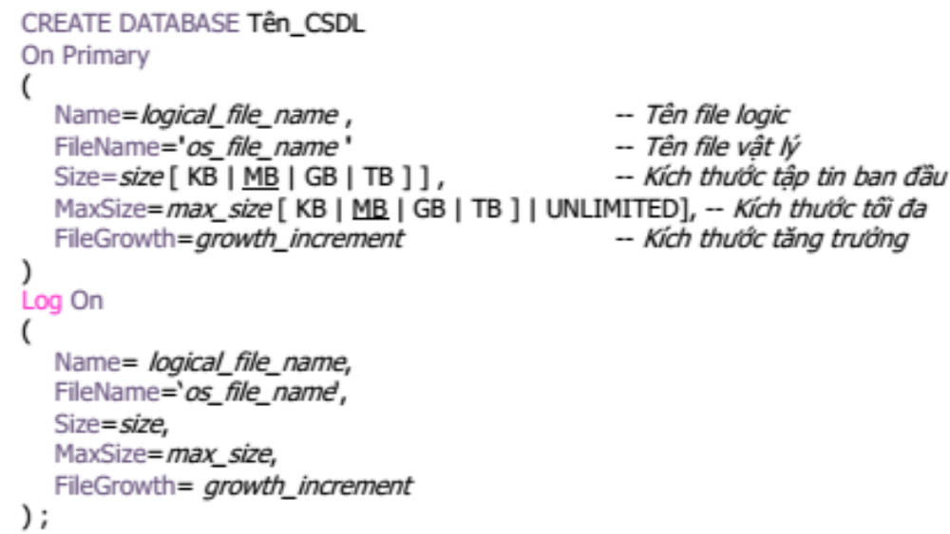
2.3.3a Create Database

Slide 23
2.3.3a Create Database
Example:
Create a database named QLSV with 10MB at the beginning for the primary file and 5MB at the beginning for the log file. Size of primary file and log file can be up to 50 MB and 25 MB. The files are stored in D:\DBI202.

Slide 24
2.3.3a Create Database
CREATE DATABASE QLSV
On Primary
(Name=QLSV_Data,
Filename= 'D:\DBI202\QLSV_dat.mdf',
Size=10 MB,
MaxSize=50MB)
Log On
(Name = QLSVLog,
FileName='D:\DBI202\QLSV_log.ldf',
Size=5MB,
MaxSize=25MB)

Slide 25
2.3.3b Delete Database
DROP DATABASE DB_Name
Example:
  DROP DATABASE QLSV

Slide 26
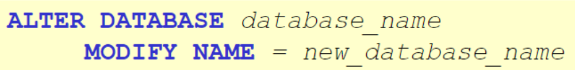
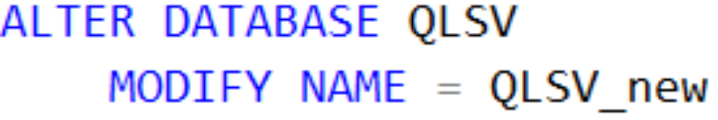
2.3.3b Modify Database Name
Example

Slide 27
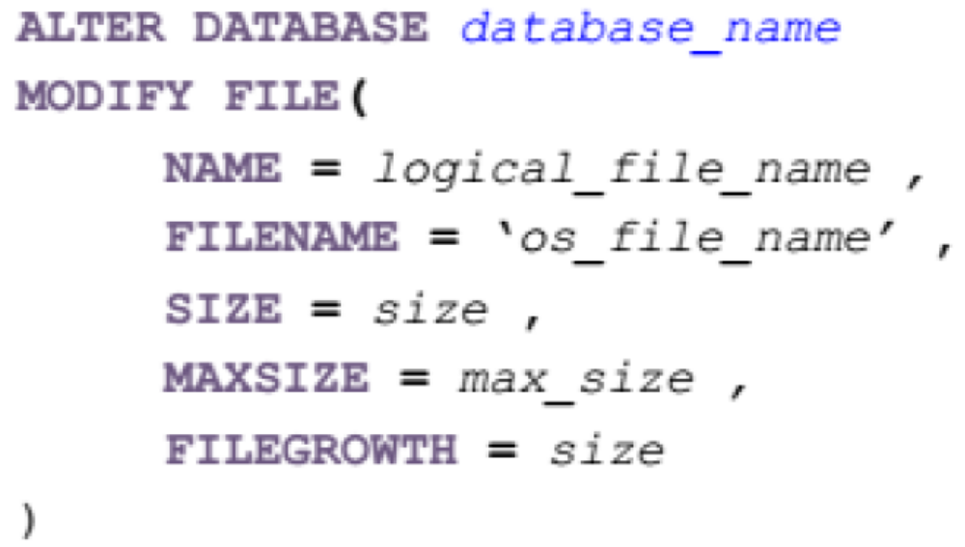
2.3.3b Modify Database File
Note: Give only information that you want to modify

Slide 28
2.3.4. Simple Table Declarations
[USE Database_Name]
CREATE TABLE Table_Name(
Attribute1_Name Datatype [Options],
Attribute2_Name Datatype [Options],
…
AttributeN_Name Datatype [Options]
);

Slide 29
Exercises
Write SQL queries to create the following Schemas in SQL Server:
  Address(House#, StreetName, City, Province, Country)
  Salaries(ID, IDPerson, PersonName, SalaryValue, Month, Year)
  Contacts(ID, ContactName, Address, Tel, eMail)

Slide 30
2.3.5. Modifying Relation Schemas
Delete table:
  [USE Database_Name]
  DROP TABLE TableName;
Add attribute:
  [USE Database_Name]
  ALTER TABLE TableName
  ADD
  Attribute1_Name Datatype [Options],
  Attribute1_Name Datatype [Options],
  …;

Slide 31
2.3.5. Modifying Relation Schemas
Modify attribute:
  [USE Database_Name]
  ALTER TABLE TableName
  ALTER COLUMN Attribute_Name Datatype [Options];
Delete attribute:
  [USE Database_Name]
  ALTER TABLE TableName
  DROP COLUMN Attribute_Name1,…;

Slide 32
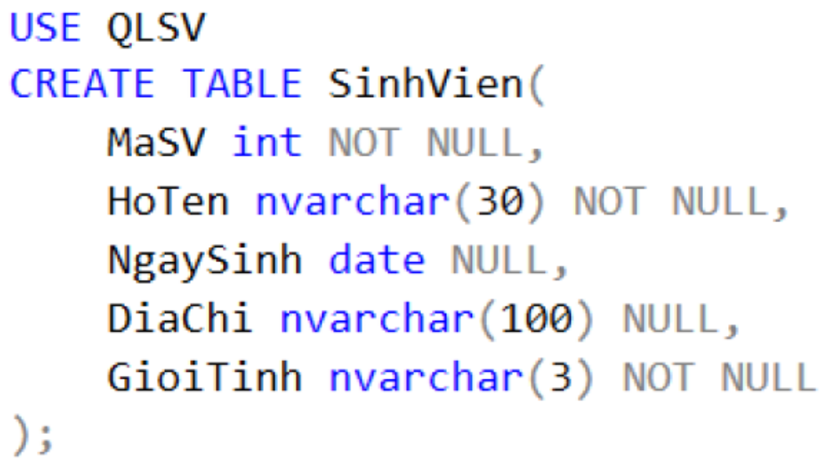
2.3.6. NULL Option
NULL option: attribute could have null value
NOT NULL option: attribute could not have null value
Defined when creating or modifying table

Slide 33
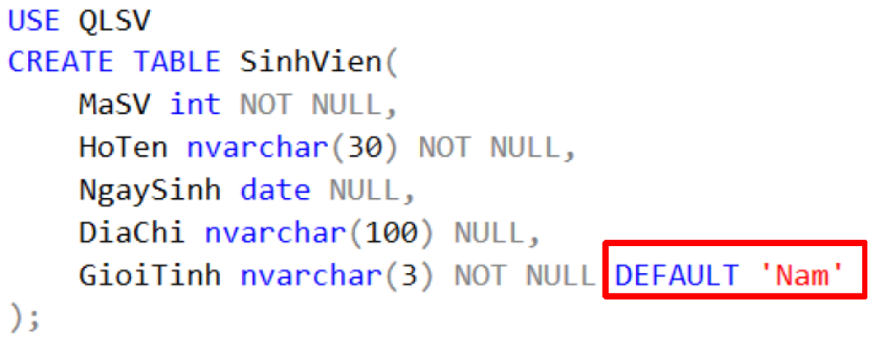
2.3.7. Default values
DEFAULT option: specify a default value for an attribute when no value is provided
DEFAULT could be defined when creating or modifying table

Slide 34
2.3.8. Declaring Keys
PRIMARY KEY:
  [USE DatabaseName]
  CREATE TABLE Table_Name(
  Attribute1_Name Datatype PRIMARY KEY,
  Attrbute2_Name DataType [OPTIONS],
  …
  );
Or
  [USE DatabaseName]
  CREATE TABLE Table_Name(
  Attribute1_Name Datatype [OPTIONS],
  Attrbute2_Name DataType [OPTIONS],
  …
  PRIMARY KEY(AttributeKey1, AttributeKey2,…)
  );

Slide 35
2.3.8. Declaring Keys
PRIMARY KEY:
  [USE DatabaseName]
  CREATE TABLE Table_Name(
  Attribute1_Name Datatype [OPTIONS],
  Attrbute2_Name DataType [OPTIONS],
  …
  CONSTRAINT Constraint_Name PRIMARY KEY(AttributeKey1, AttributeKey2,…)
  );
Or
  [USE DatabaseName]
  ALTER TABLE Table_Name ADD PRIMARY KEY(AttributeKey1, AttributeKey2,…);
Or
  [USE DatabaseName]
  ALTER TABLE Table_Name ADD CONSTRAINT ConstraintName PRIMARY KEY(AttributeKey1, AttributeKey2,…);

Slide 36
2.3.8. Declaring Keys
UNIQUE KEY:
  [USE DatabaseName]
  CREATE TABLE Table_Name(
  Attribute1_Name Datatype [OPTIONS],
  Attrbute2_Name DataType [OPTIONS] UNIQUE, …);
Or
  [USE DatabaseName]
  CREATE TABLE Table_Name(
  Attribute1_Name Datatype [OPTIONS],
  Attrbute2_Name DataType [OPTIONS],
  …
  UNIQUE(UniqueAttribute1, UniqueAttributeKey2,…)
  );

Slide 37
2.3.8. Declaring Keys
UNIQUE KEY:
  [USE DatabaseName]
  CREATE TABLE Table_Name(
  Attribute1_Name Datatype [OPTIONS],
  Attrbute2_Name DataType [OPTIONS],
  …
  CONSTRAINT Constraint_Name UNIQUE(UniqueAttribute1, UniqueAttributeKey2,…));
Or
  [USE DatabaseName]
  ALTER TABLE Table_Name ADD UNIQUE(UniqueAttribute1, UniqueAttributeKey2,…));
Or
  [USE DatabaseName]
  ALTER TABLE Table_Name ADD CONSTRAINT Constraint_Name UNIQUE(UniqueAttribute1, UniqueAttributeKey2,…));

Slide 38
Exercises
Following Schemas in SQL Server:
  Address(House#, StreetName, City, Province, Country)
  Salaries(ID, IDPerson, PersonName, SalaryValue, Month, Year)
  Contacts(ID, ContactName, Address, Tel, eMail)
Modify tables so that:
  Email and Tel are unique.
  Default value of country is ‘Việt Nam’
  House# is Primary key of Address
  ID is Primary key of Salaries
  ID is Primary key of Contacts
  ID of Salaries and Contacts are set to begin at 1 and automatically increased by 1 (Use IDENTITY)

Slide 39
Summary 1: Relational Model
Table = relation.
Column headers = attributes.
Row = tuple
Relation schema = name(attributes) + other structure info.,
e.g., keys, other constraints. Example: Beers(name, manf)
  Order of attributes is arbitrary, but in practice we need to assume the order given in the relation schema.
Relation instance is current set of rows for a relation schema.
Database schema = collection of relation schemas.

Slide 40
Summary 2: Why Relations?
Very simple model.
Often a good match for the way we think about our data.
Abstract model that underlies SQL, the most important language in DBMS’s today.
  But SQL uses “bags” while the abstract relational model is set-oriented.

Slide 41
Thank You !

