Slide 1
Session 7
Chapter 3 – Design of Relational Database Schema
Database Systems

Slide 2
Objectives
1
Understand what are anomalies
2
Understand why must decompose a relation
3
Understand what are normal forms (1NF, 2NF, 3NF, BCNF)
4
Understand the good, bad and ugly of decomposition

Slide 3
Contents
1
Anomalies
2
What are decomposition?
3
Decomposition: The good, bad and the ugly
4
1NF, 2NF, 3NF, BCNF definition
5
Algorithms to decompose a relation into BCNF, 3NF

Slide 4
1. Anomalies introduction
Careless selection of a relational database schema can lead to redundancy and related anomalies
So in this session we shall tackle the problems of relational database designing
Problems such as redundancy that occur when we try to cram too much into a single relation are called anomalies

Slide 5
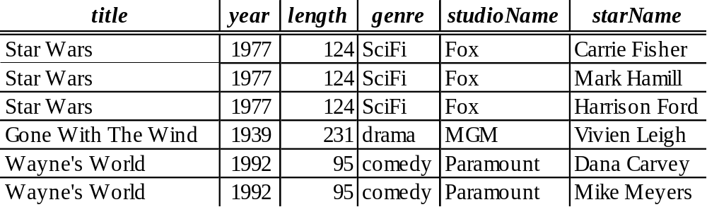
1. Anomalies
The principal kinds of anomalies that we encounter are:
Redundancy: information maybe repeated unnecessarily in several tuples (exp: the length and genre)
Update Anomalies: We may change information in one tuple but leave the same information unchanged in another (exp: if we found that Star Wars is 125 minutes long, we may change the length in the first tuple but not in the second and third tuples)
Deletion Anomalies: If a set of values becomes empty, we may lose other information as a side effect (exp: if we delete “Fox” from the set of studios, then we have no more studios for the movie “Star Wars”

Slide 6
2. Decomposition
The accepted way to eliminate anomalies is the decomposition of relations
Decomposition of a relation R involves splitting the attributes of R to make the schemas of 2 new relations
Definition: Given a relation R(A₁,..,A_{n}), we say R is decomposed into S(B₁,..,B_{m}) and T(C₁,..,C_{k}) if:
+ {A₁,..,A_{n}} = {B₁,..,B_{m}} U {C₁,..,C_{k}}
+ S = ∏_{B1,..Bm}(R)
+ T = ∏_{C1,..,Ck}(R)

Slide 7
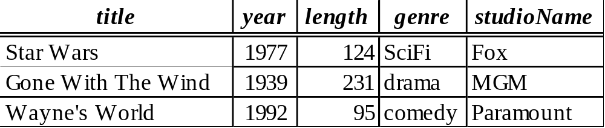
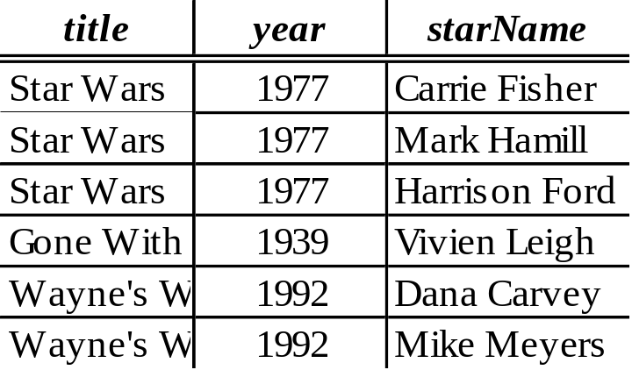
Example: Decomposition

Slide 8
Discuss
The redundancy is eliminated (the length of each film appears only once)
The risk of an update anomaly is gone (we only have to change the length of Star Wars in one tuple)
The risk of a deletion anomaly is gone (if we delete all the stars for Gone with the wind, that deletion makes the movie disappear from the right but still be found in the left)

Slide 9
3. Decomposition: The Good, Bad and Ugly
We observed that before we decompose a relation schema into BCNF, it can exhibit anomalies; That’s the “Good”
But, decomposition can also have some bad:
  Maybe we can’t recovery the original information; OR
  After reconstruction, the FDs maybe not hold

Slide 10
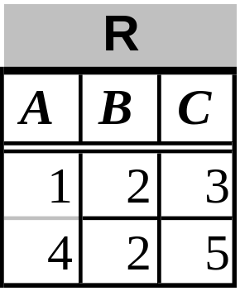
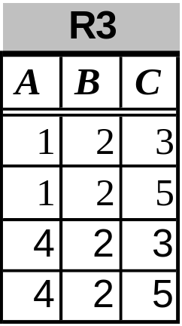
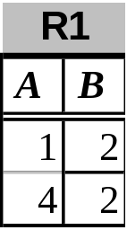
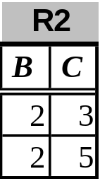
Example: Loss of information after decomposition
Suppose we have R(A,B,C) but neither of the FD’s B->A nor B->C holds.
R is decomposed into R1 and R2 as above
When we try to re-construct R by Natural Join of R1 and R2, we have: R3 = R1 X R2 (but R3 <> R1 => We lost information)

Slide 11
Example: Dependency Loss
If we check the projected FD’s in the relations of the decomposition, can we can be sure that when we reconstruct the original relation from the decomposition by joining, the result will satisfy the original FD’s?

Slide 12
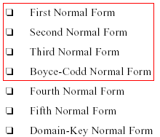

4. Normal Forms

Slide 13
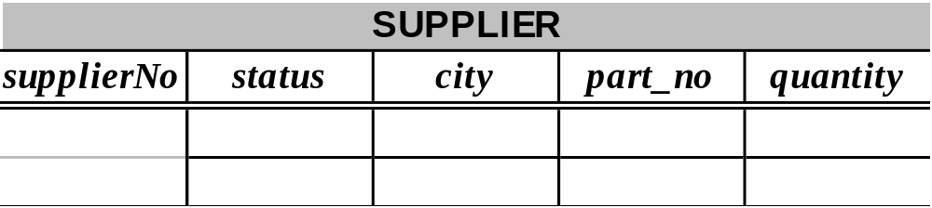
1NF
1NF A relation R is in first normal form (1NF) if and only if all underlying domains contain atomic values only
Example: 1NF but not 2NF

Slide 14
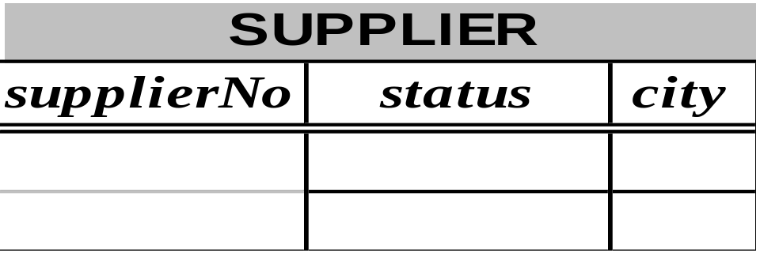
2NF
A relation R is in second normal form (2NF) if and only if it is in 1NF and every non-key attribute is fully dependent on the primary key
Example (2NF but not 3NF):
Mutual dependence is reflected in the transitive dependencies:
supplier_no->city AND city->status

Slide 15
3NF
A relation R is in third normal form (3NF) if and only if it is in 2NF and every non-key attribute is non-transitively dependent on the primary key.
An attribute C is transitively dependent on attribute A if there exists an attribute B such that: A->B and B->C
Note that 3NF is concerned with transitive dependencies which do not involve candidate keys. A relation with more than one candidate key will clearly have transitive dependencies of the form: primary_key -> other_candidate_key -> any_non-key_column

Slide 16
BCNF
A relation R is in BCNF if and only if: Whenever there is a Non-Trivial FD
A₁A₂..A_{n} -> B₁B₂..B_{m} for R, it is the case that:
{A₁,..,A_{n}} is a super-key for R
That is: the left side of every Non-Trivial FD must be a super-key

Slide 17
Example: BCNF or not
The above relation is not in BCNF because:
Consider the FD:
{title,year} -> {length, genre, studioName}
We know that {title, year} is not a super-key

Slide 18
Example: BCNF or not
The above relation is in BCNF because:
{title,year} -> {length, genre, studioName}
And: neither title nor year by itself functionally determines any of the other attributes

Slide 19
Example: BCNF or not
The above relation is in BCNF because: it has no Non-Trivial FD

Slide 20
Differences between BCNF and 3NF
3NF | Boyce-Codd
a nontrivial functional dependency: X => A holds in R, either X is a superkey of R, or (b) A is a prime attribute of R. | a nontrivial functional dependency X => A holds in R, then: X is a superkey of R
Note:A functional dependency X => Y is a full functional dependency if removal of any attribute A from X means that the dependency does not hold any more; A partial functional dependency is not a full functional dependency

Slide 21
5. Decompose a relation into BCNF, 3NF
The goal of decomposition is to replace a relation by several relations that do not exhibit anomalies
So, it turns out, a simple condition under which the anomalies can be guaranteed not to exist. This condition is called Boyce-Codd Normal Form, or BCNF

Slide 22
5. Decompose a relation into BCNF, 3NF
BCNF is a solution for eliminating Anomalies
But, BCNF can lead to the loss of information and functional dependencies (in some cases, after decomposition into BCNF, we can’t keep both the lossless-join and dependency-preservation properties)
So, 3NF is the solution that have both the lossless-join and dependency-preservation properties

Slide 23
BCNF decomposition algorithm
Input: A relation R with a set of FD’s F
Output: A BCNF decomposition of R with lossless join Method:
  At each step compute the key for the sub-relation R
  if not in BCNF, pick any FD X->Y which violates
  break the relation into 2 sub-relations
    R1(XY)
    R2(S - Y)
    this has a lossless join
    project FD's onto each sub-relation
  continue until no more offending FD's

Slide 24
3NF decomposition algorithm
Input: A relation R with a set of FD’s F
Output: A decomposition of R into a collection of relations, all of which are in 3NF. This decomposition has a lossless join and dependency-preservation.
Method:
  Find minimal basic for F, say G.
  ∀ X-A ∈ G, use XA as the schema of one relations in the decomposition.
  If none of the sets of relations from Step 2 is a super key for R, add another relation whose schema is a key for R.

Slide 25
3NF decomposition example
Example: Consider r(ABCDEF) subject to the following FDs:
F = {A →BCE, B →DE, ABD →CF, AC →DE }
Find a 3NF database for r under F.
Solution: Find a canonical cover for (R,F):
F= { A →B, B → DE, A →CF } same as
F= { A →BCF, B →DE }
Final decomposition: r = ( ABCF, BDE )

Slide 26
Exercise
Are the following relations in BCNF? 3NF? (if R is not in BCNF, decompose it to BCNF)
  S(A,B,C,D): A->B, A->C, D->A
  T(A,B,C,D): A->B, B->C, C->D, BD->A
  U(A,B,C,D): AD->B, AB->C, BC->D, CD->A
  R(A,B,C,D,E): A->C, C->B, B->D, D->E, E->A
  R(A,B,C,D,E): BC->DE, A->E, D->A, E->B
  R(A,B,C,D,E): C->D, AD->E, BC->E, DE->A
  R(A,B,C,D,E):
  AB->E, AC->D, BC->E, E->A, D->B
  R(A,B,C,D): B->A, C->B, D->C, A->D

Slide 27
Exercises
Are the following relations in BCNF? 3NF? (if R is not in BCNF, decompose it to BCNF; if R is not in 3NF, decompose it to 3NF)
  R(X,Y, Z,T,V): XY->Z, Y->T, Z->V
  R(X,Y,Z,T): X->Y, Y->Z, Z->T
  R(A,B,C): AB->C, B->A, C->B
  R(ABCD): BD->C, AB->D, AC->B, BD->A
  R(ABCD): AD->C, CD->B, BD->C
  R(ABCD): A->C, B->A, A->D, AD->C
  R(ABCD): A->D, C->A, D->B, AC->B
  R(XYZT): XYT->Z, ZT->X, XZ->Y, XZ->T
  R(XYZT): XY->Z, XYT->Z, XYZ->T, XZ->T
  R(XYZT): YT->Z, XY->T, XZ->Y, YT->X
  R(XYZT): YZ->X, XT->Z, ZT->Y, YT->Z

Slide 28
Summary 1
Decompose a relation into BCNF is a solution for eliminating anomalies
But BCNF can cause information loss and dependency loss
3NF is a relax solution of BCNF that keep loss-less join and dependency-preservation properties

Slide 29
Summary 2:
2NF | 3NF | Boyce-Codd
every nonprime attribute A in R is not partially dependent on any key of R | a nontrivial functional dependency: X => A holds in R, either X is a superkey of R, or (b) A is a prime attribute of R. | a nontrivial functional dependency X => A holds in R, then: X is a superkey of R
Note:A functional dependency X => Y is a full functional dependency if removal of any attribute A from X means that the dependency does not hold any more; A partial functional dependency is not a full functional dependency

Slide 30
Thank You !

