Slide 1
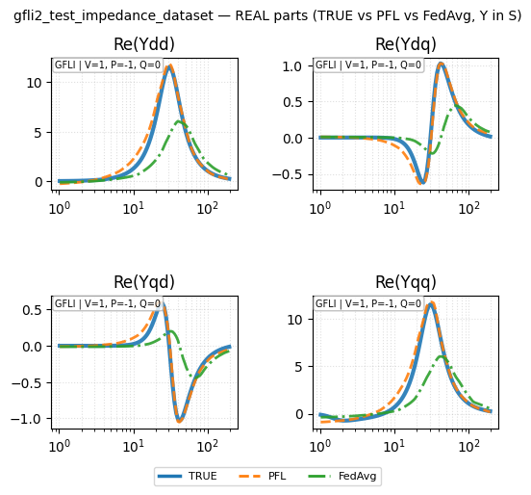
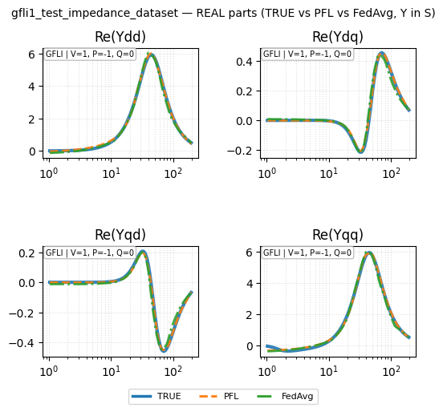
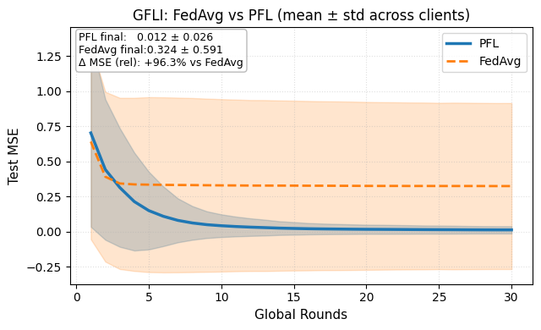
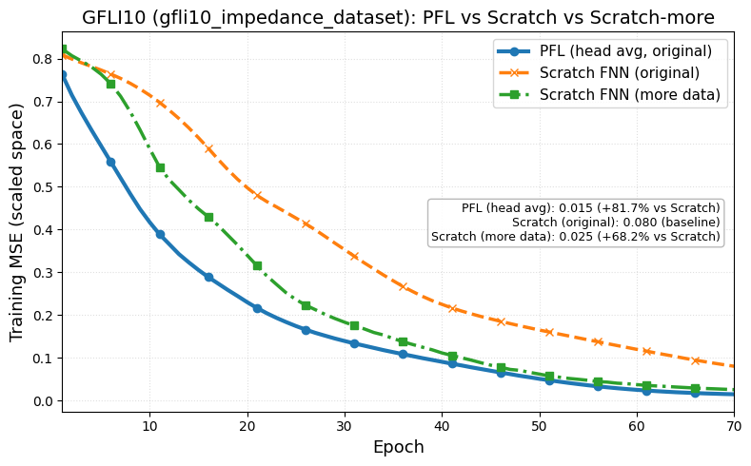
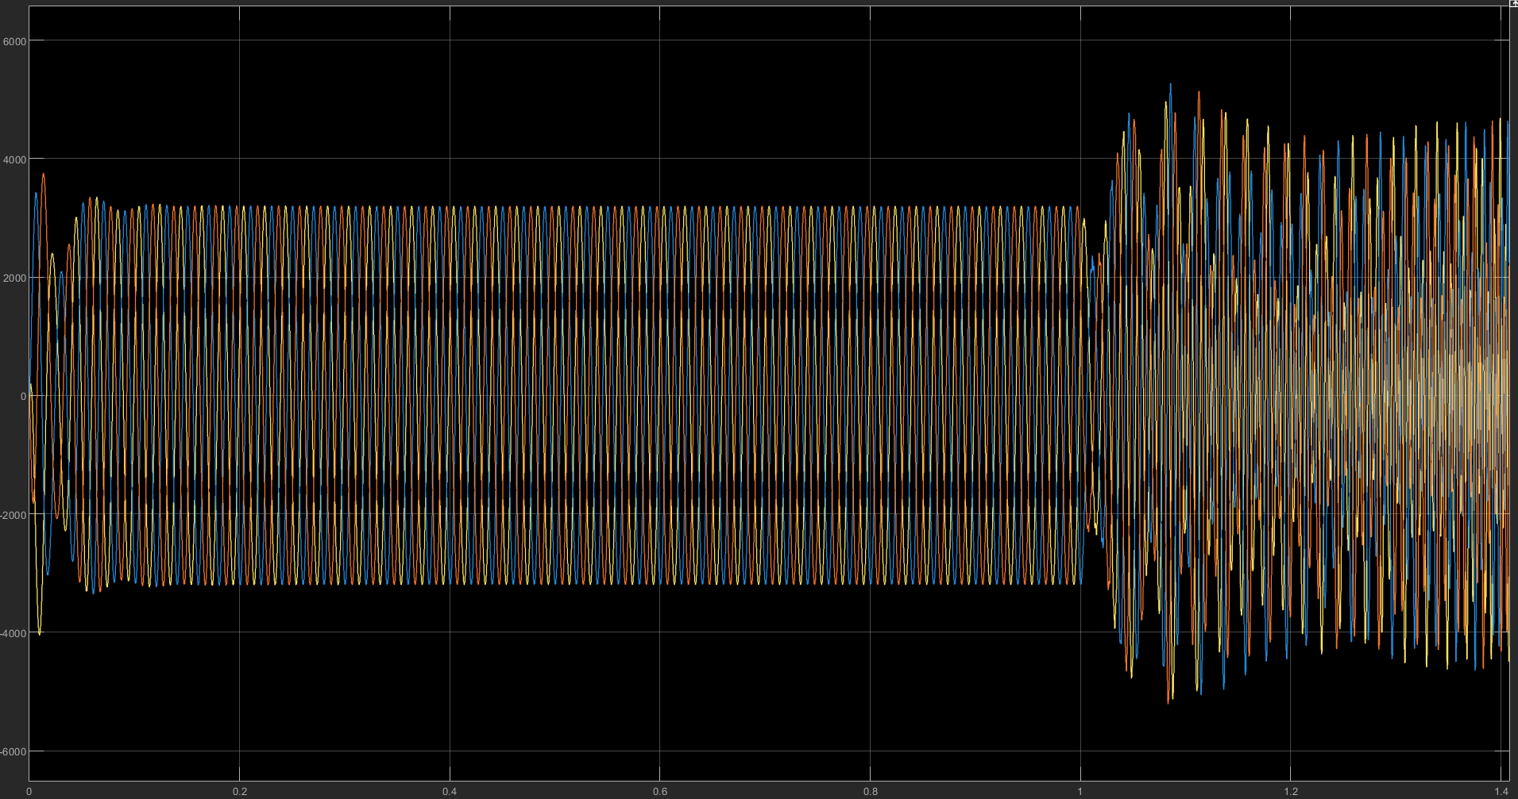
Paper outline
I – Introduction
II – Federated Learning Algorithm for Multi-Inverter Impedance Identification
II-A. Data Acquisition
II-B. Data Structure
III-C. FedAvg Algorithm
III – Personalized Federated Learning
III-A. FedAvg Drawbacks
III-B. FedPer Framework
IV – Validation
IV-A. New client with less data
IV-B. Application in stability analysis
V – Conclusion

Slide 2
Federated learning

Slide 3
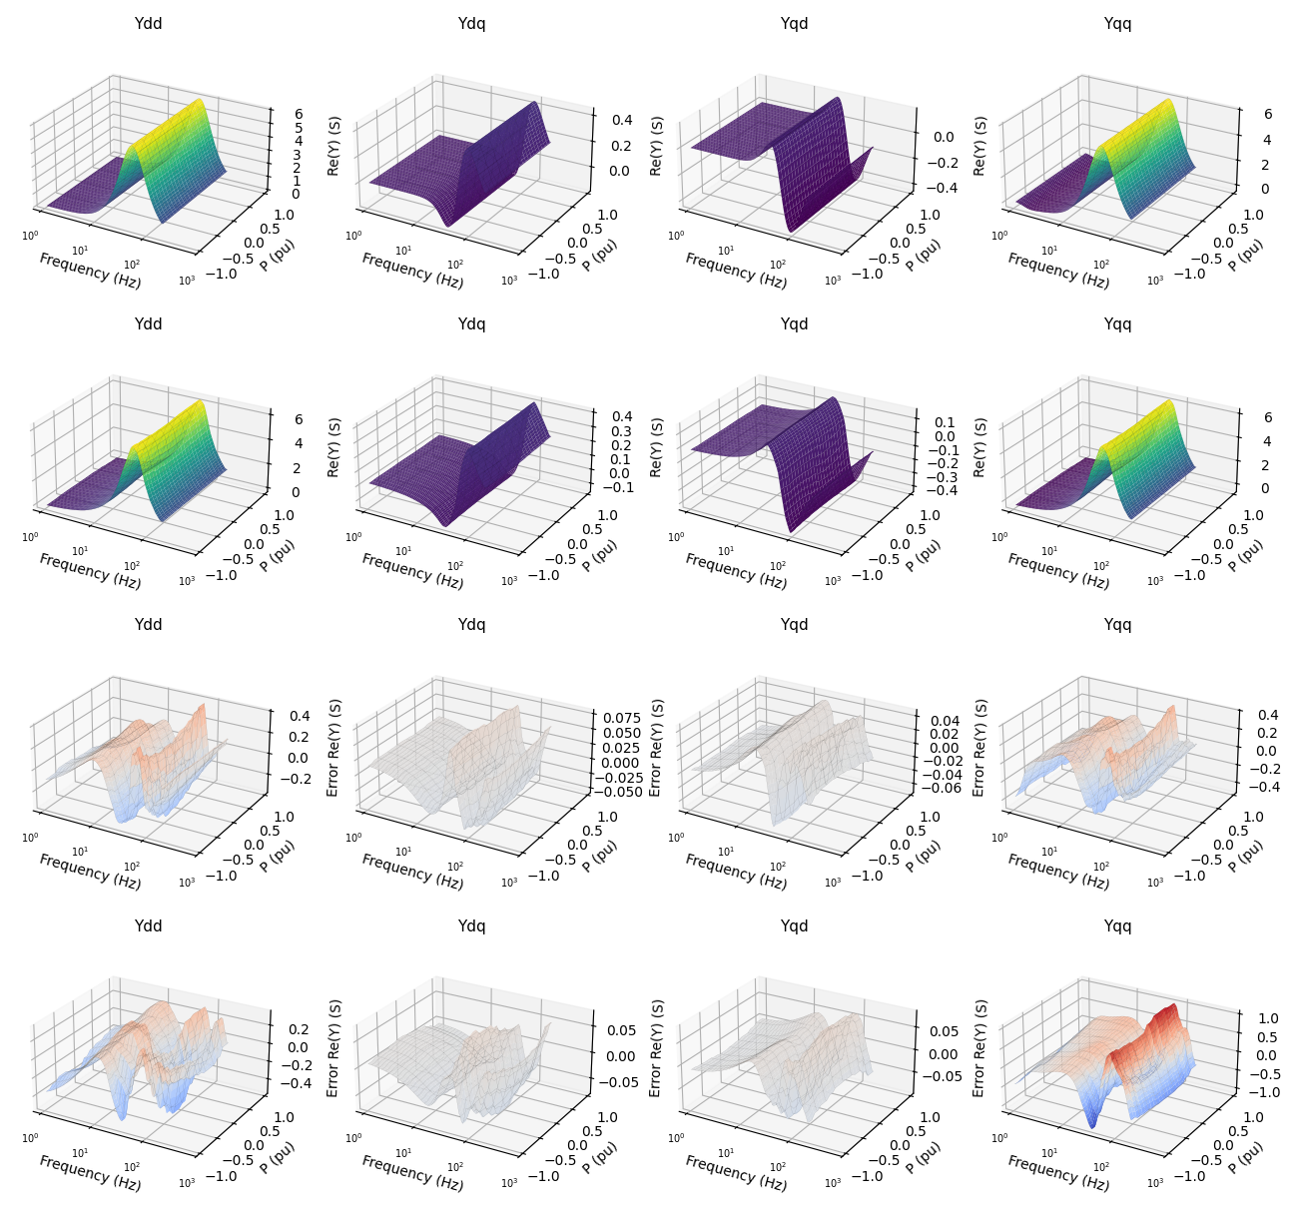

Slide 4
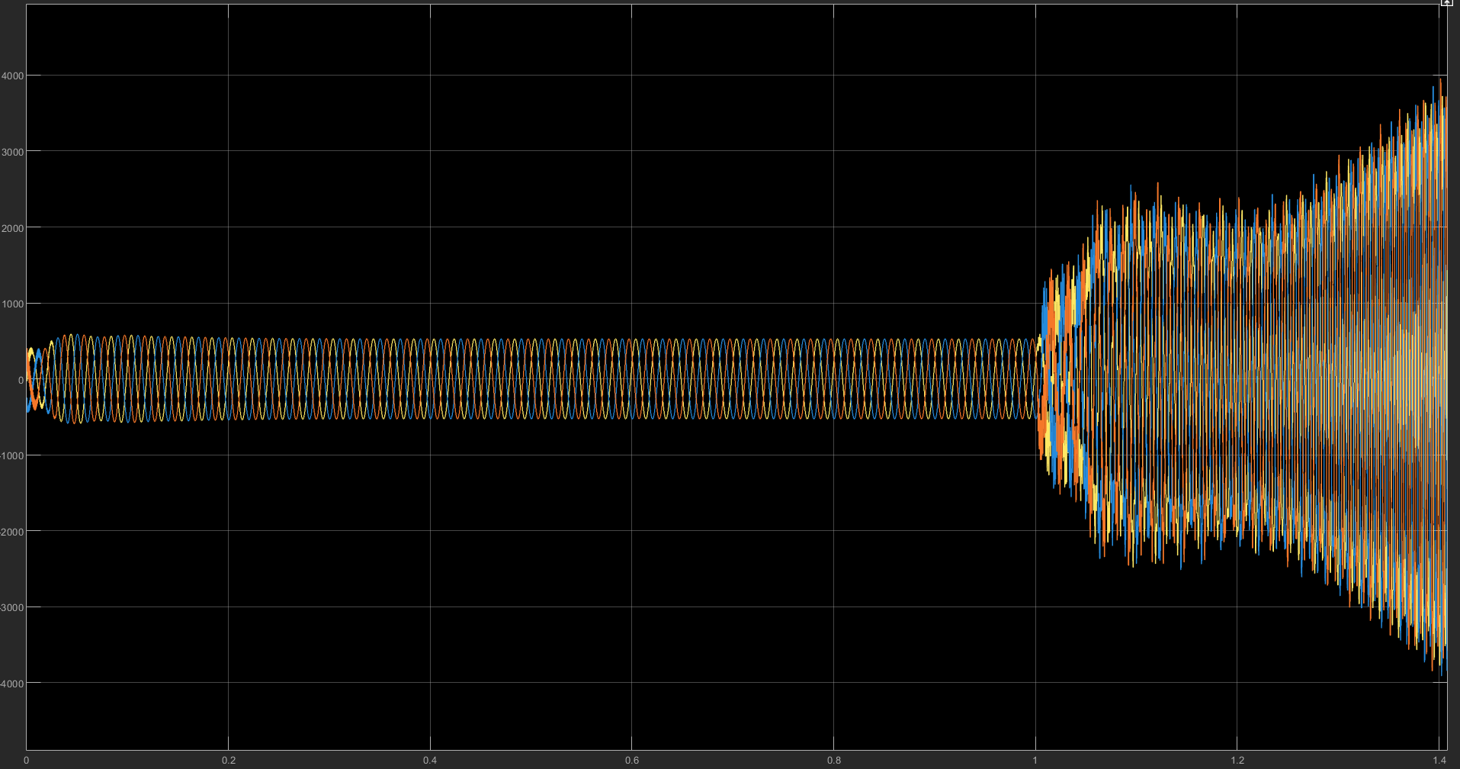




Validation for 3-phase inverter on dq frame
Strong grid
Weak grid
$$Z_{g}={2(R}_{g}+ωL_{g})$$
$$Z_{g}′={3(R}_{g}+ωL_{g})$$
Strong grid
Weak grid
Strong grid
Weak grid
$$i_{pcc}$$
$$v_{pcc}$$

