Slide 1
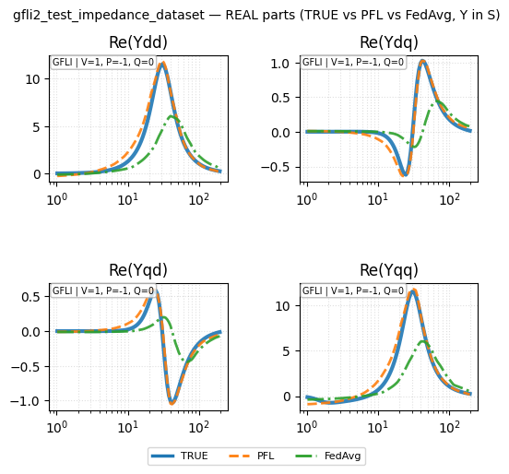
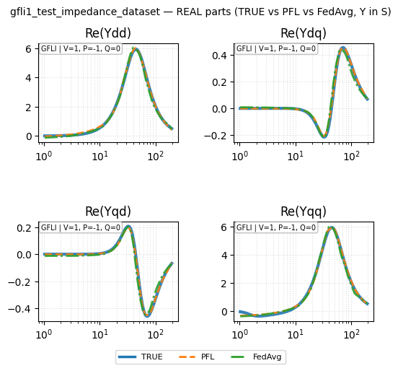
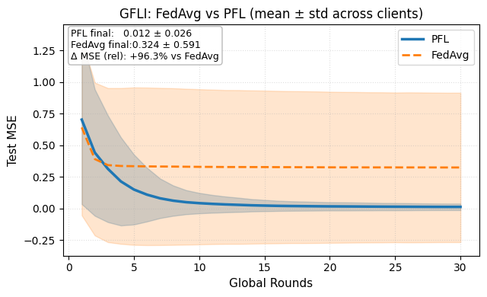
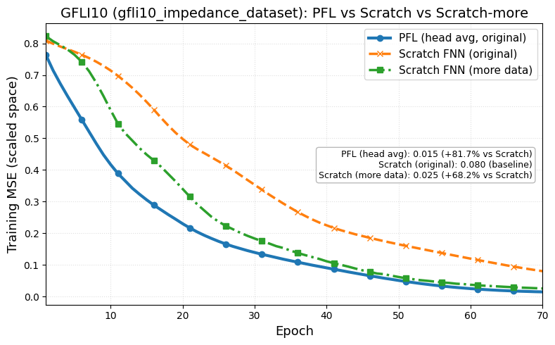
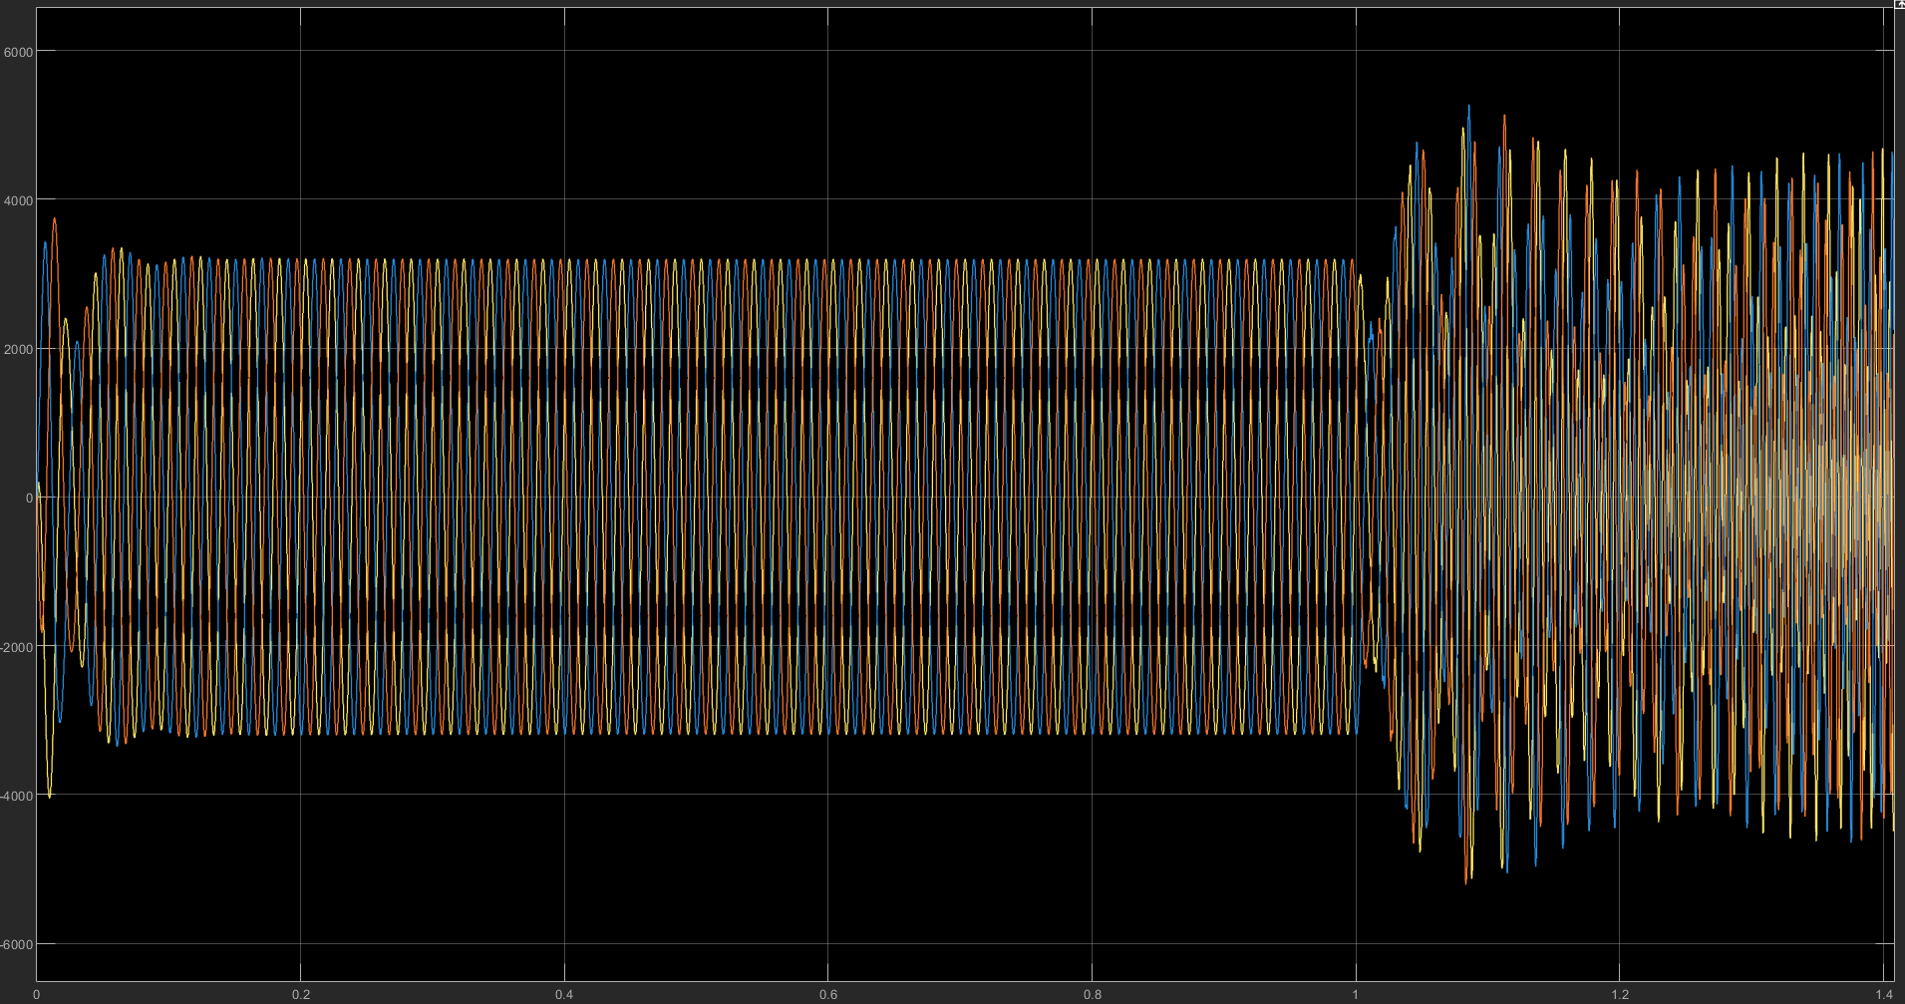
Paper outline
I – Introduction
II – Federated Learning Algorithm for Multi-Inverter Impedance Identification
II-A. Data Acquisition
II-B. Data Structure
III-C. FedAvg Algorithm
III – Personalized Federated Learning
III-A. FedAvg Drawbacks
III-B. FedPer Framework
IV – Validation
IV-A. New client with less data
IV-B. Application in stability analysis
V – Conclusion

Slide 2
Federated learning

Slide 3
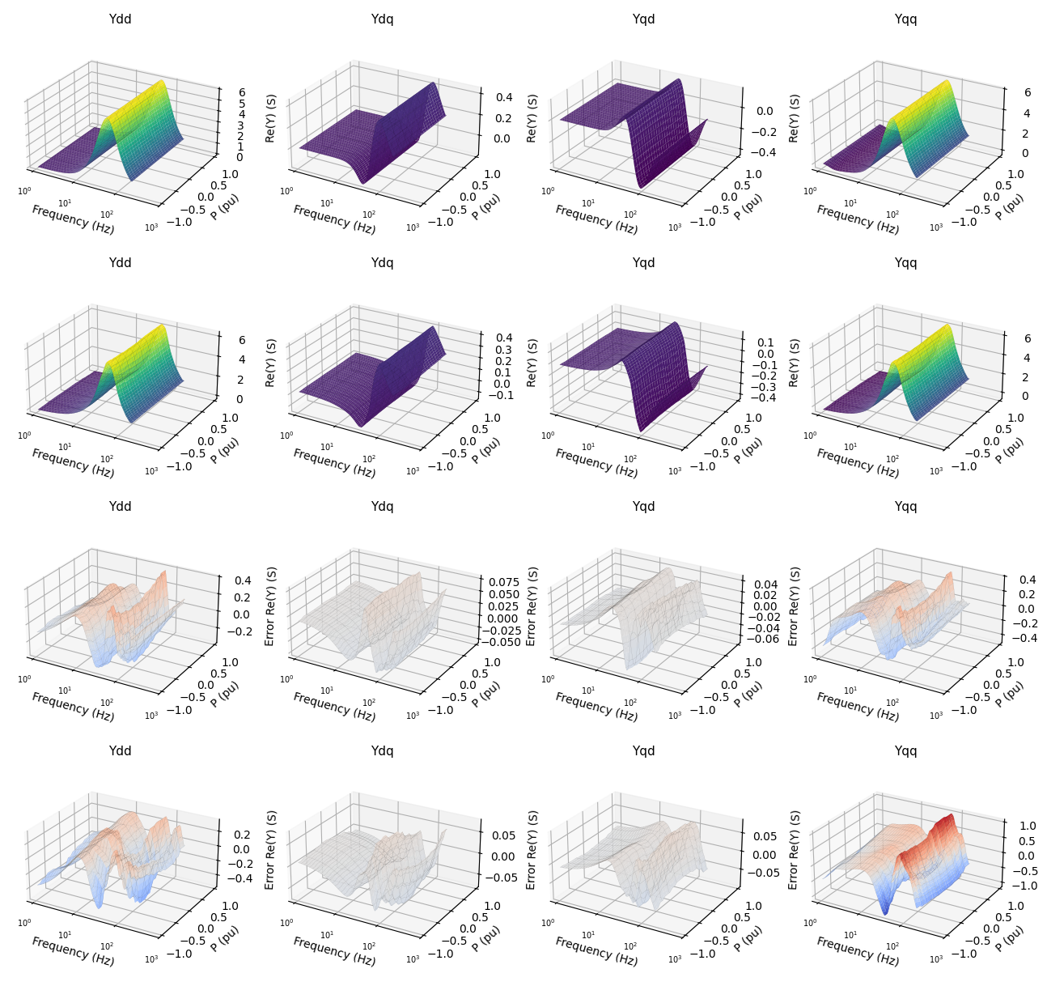

Slide 4
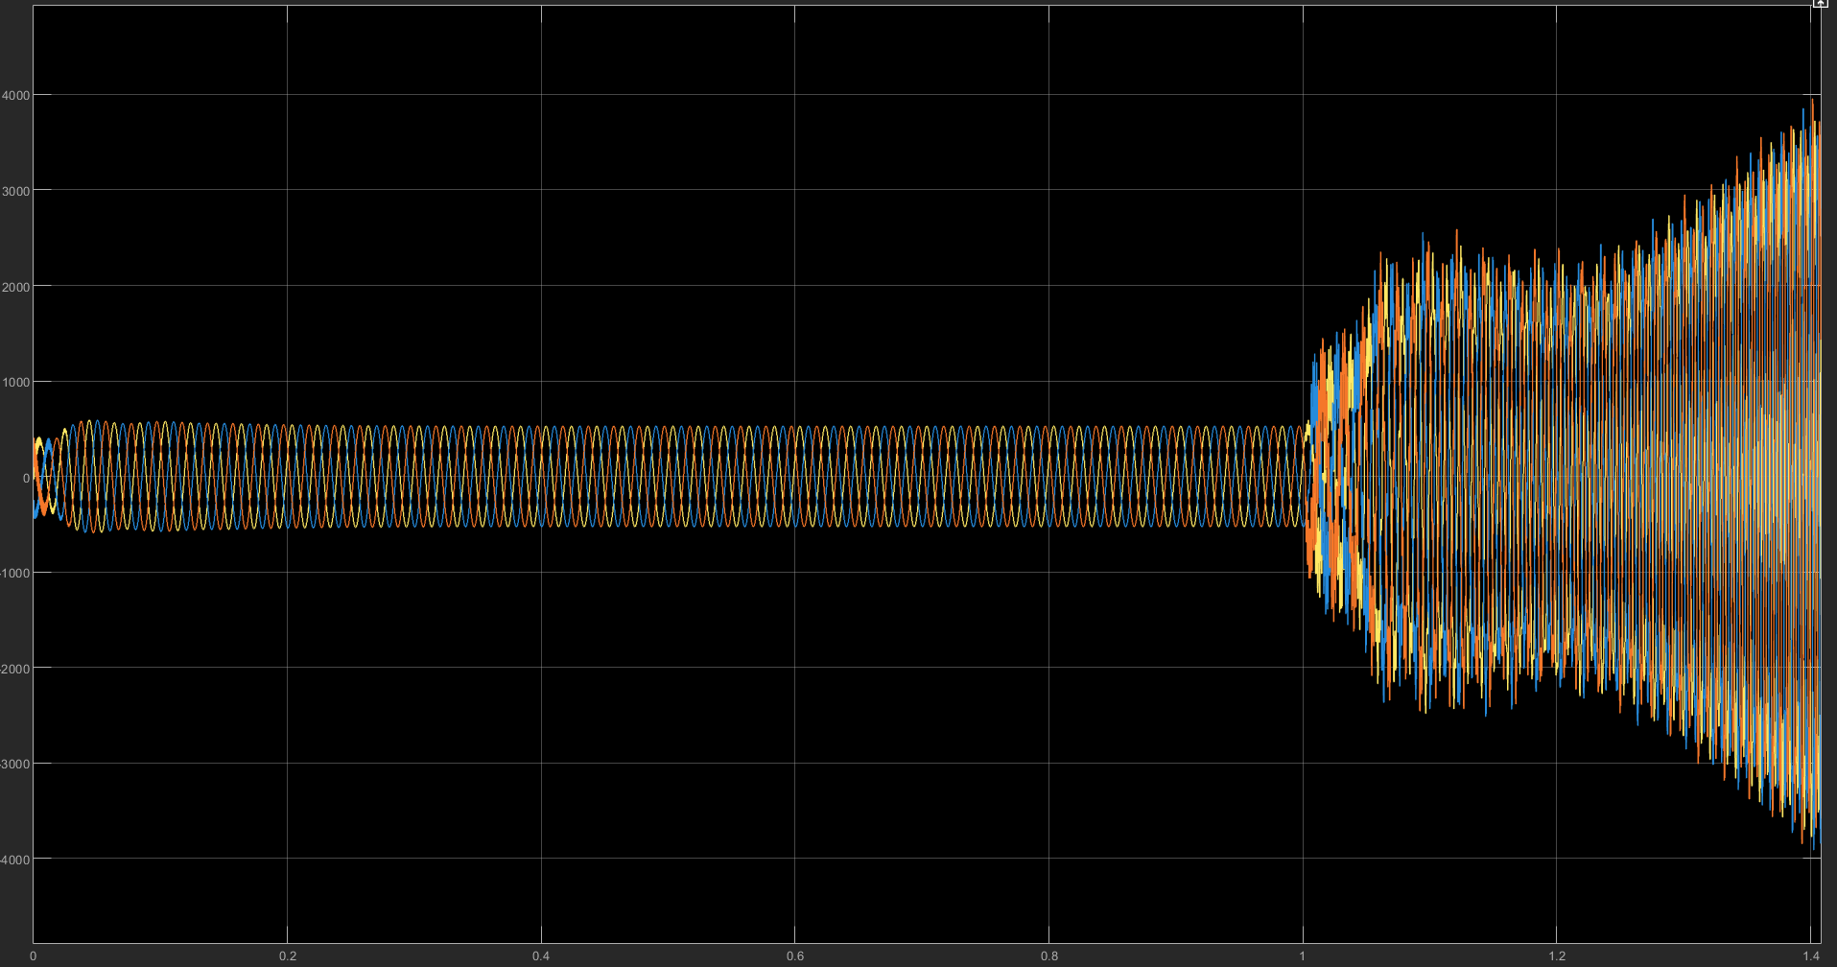




Validation for 3-phase inverter on dq frame
Strong grid
Weak grid
$$Z_{g}={2(R}_{g}+ωL_{g})$$
$$Z_{g}′={3(R}_{g}+ωL_{g})$$
Strong grid
Weak grid
Strong grid
Weak grid
$$i_{pcc}$$
$$v_{pcc}$$

Slide 5
Meeting Dec 8 2025
Outline
Paper outline
Results

Slide 6
Paper outline
I – Introduction
II – Problem Formulation
III – Federated Learning
III-A. Data Aquistion
III-B. Data structure
III-C. FedAvg Algorithm
IV – Validation
IV-A. FL vs Centralized
IV-B. FL vs Local
IV-C. Integrated a new IBR
IV-D. Transfer learning (Compared FL-TL vs Local FNN-TL)
IV-E. Application in stability analysis
V – Conclusion

Slide 7
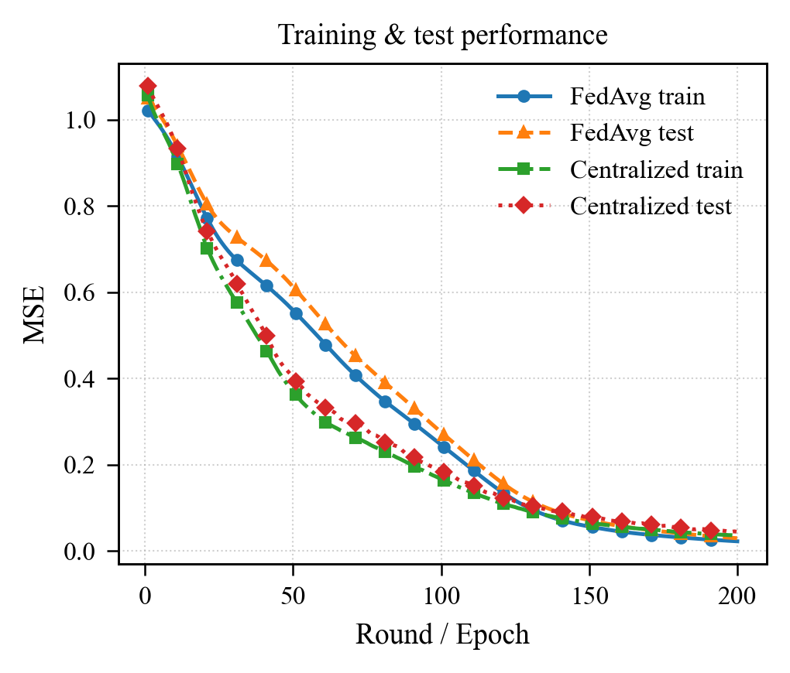
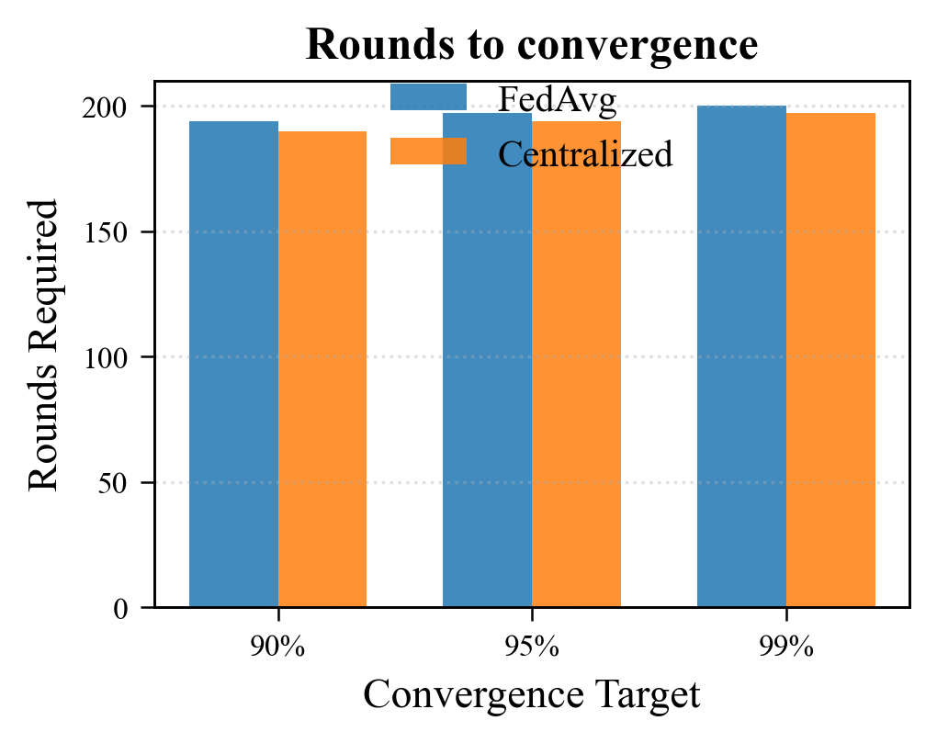
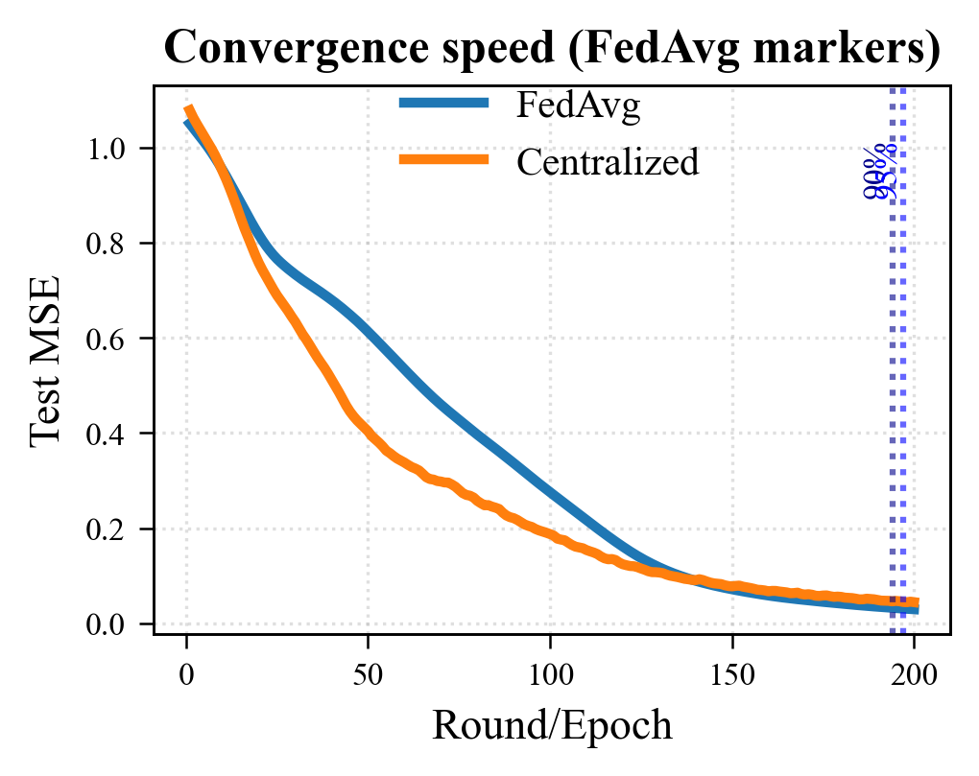
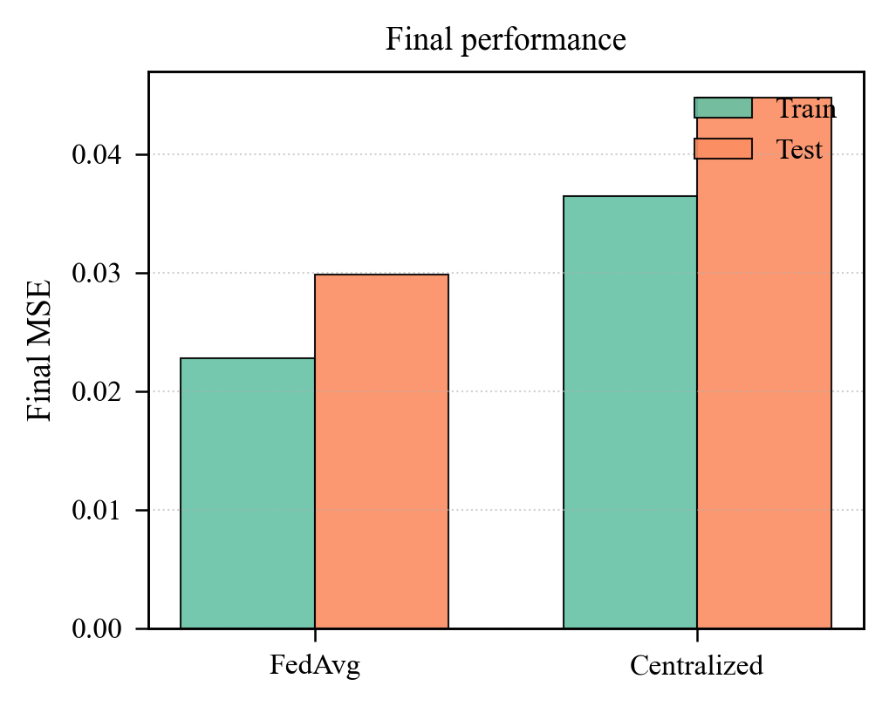
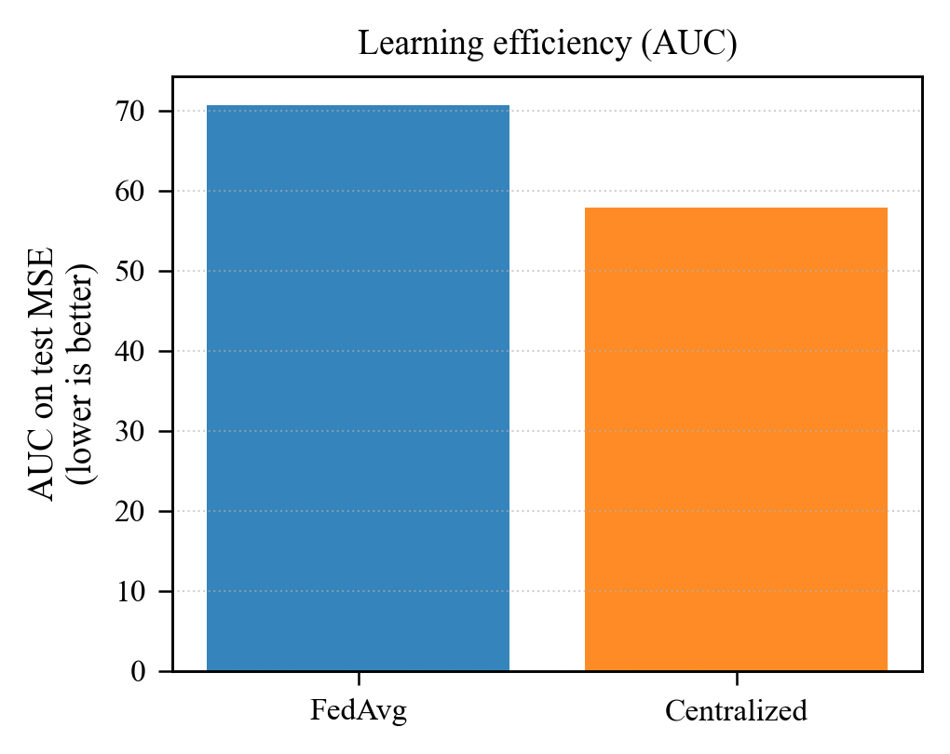
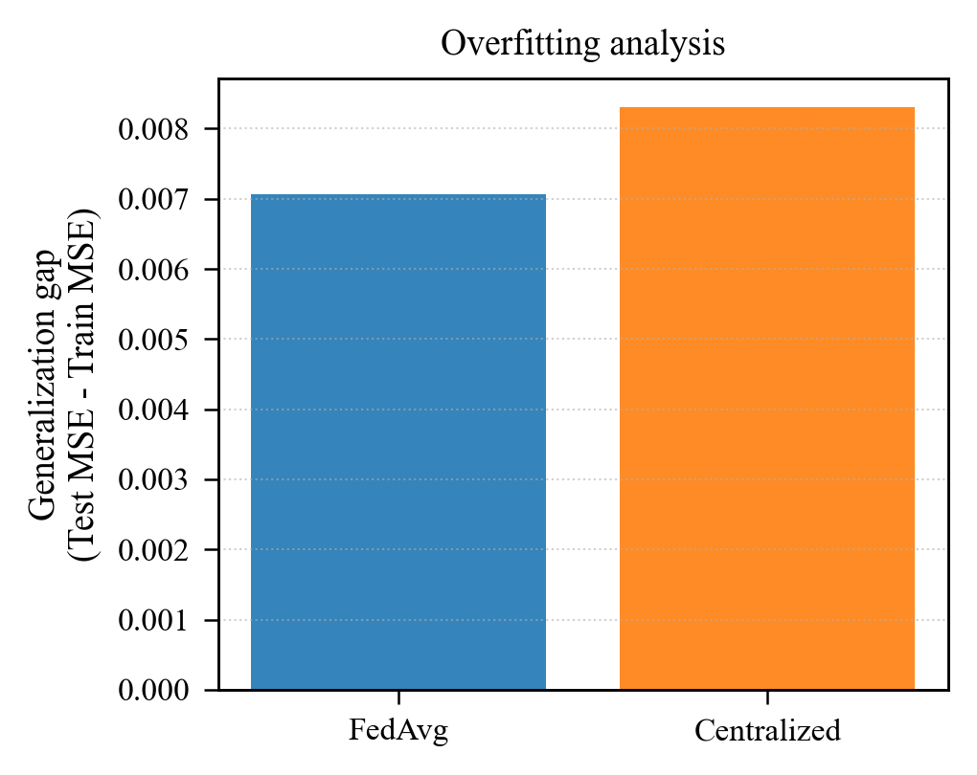
A. FL vs Centralized

Slide 8
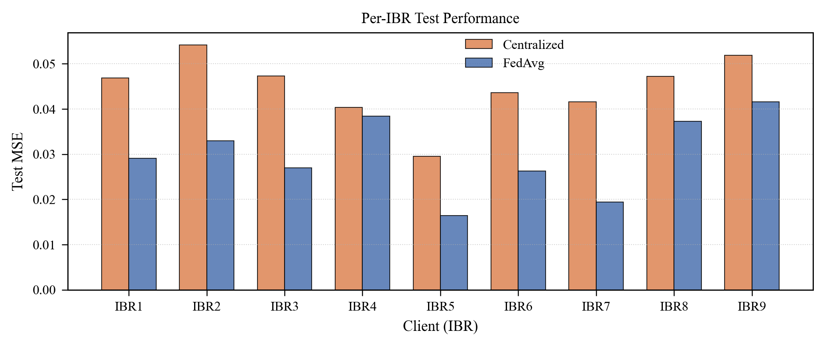
A. FL vs Centralized

Slide 9
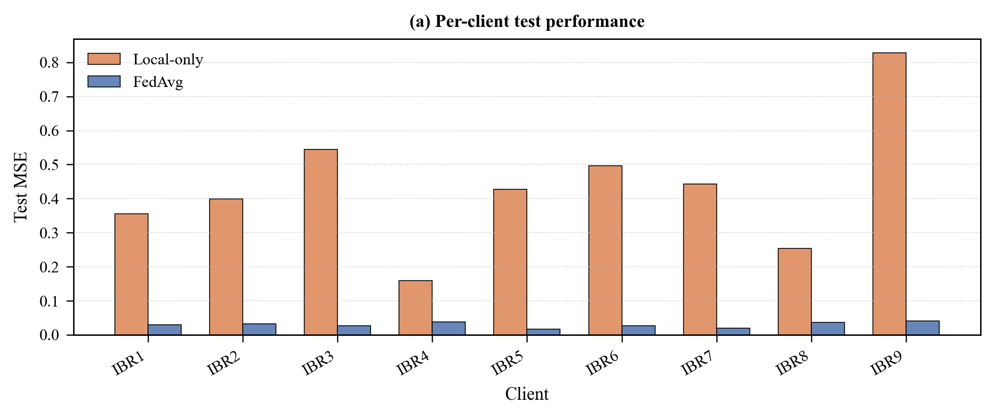
B. FL vs Local FNN

Slide 10
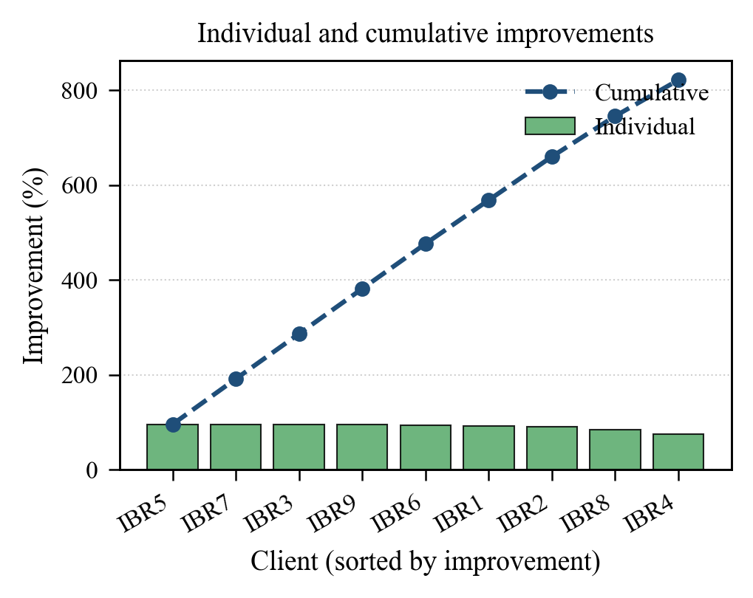
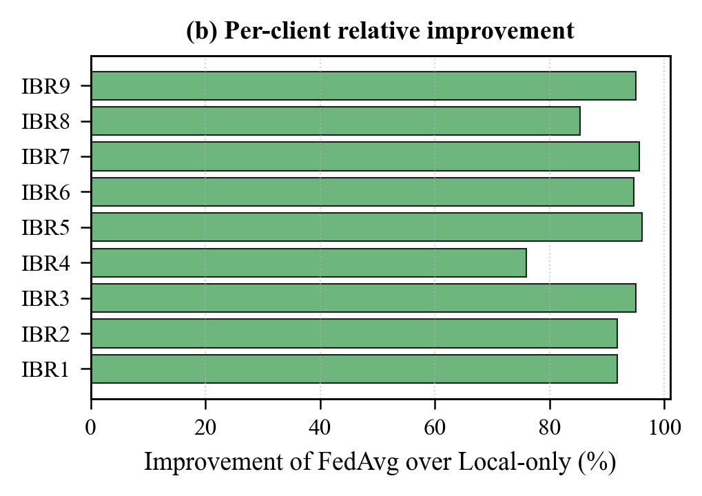
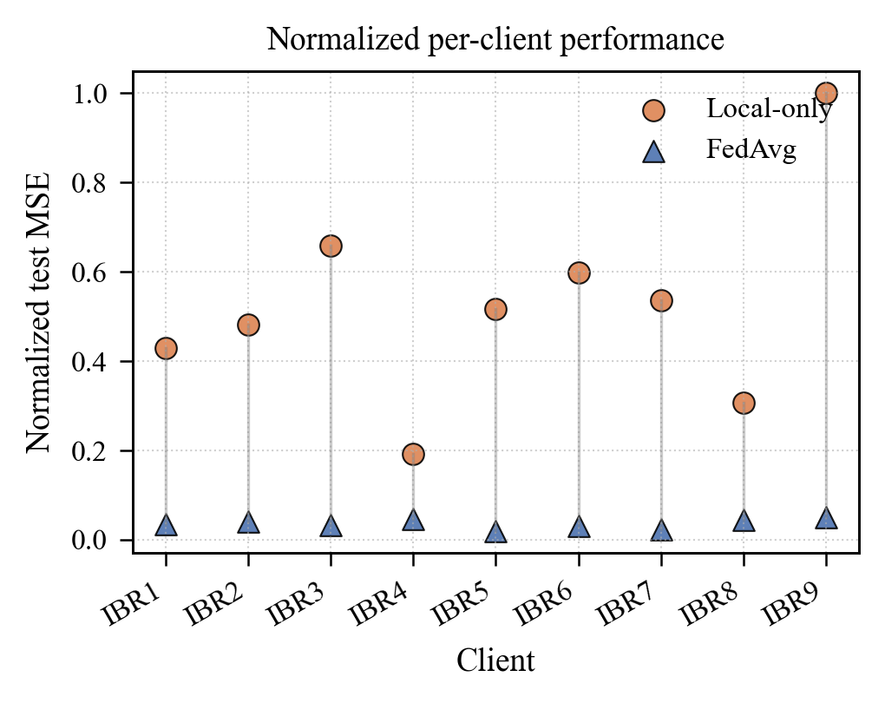
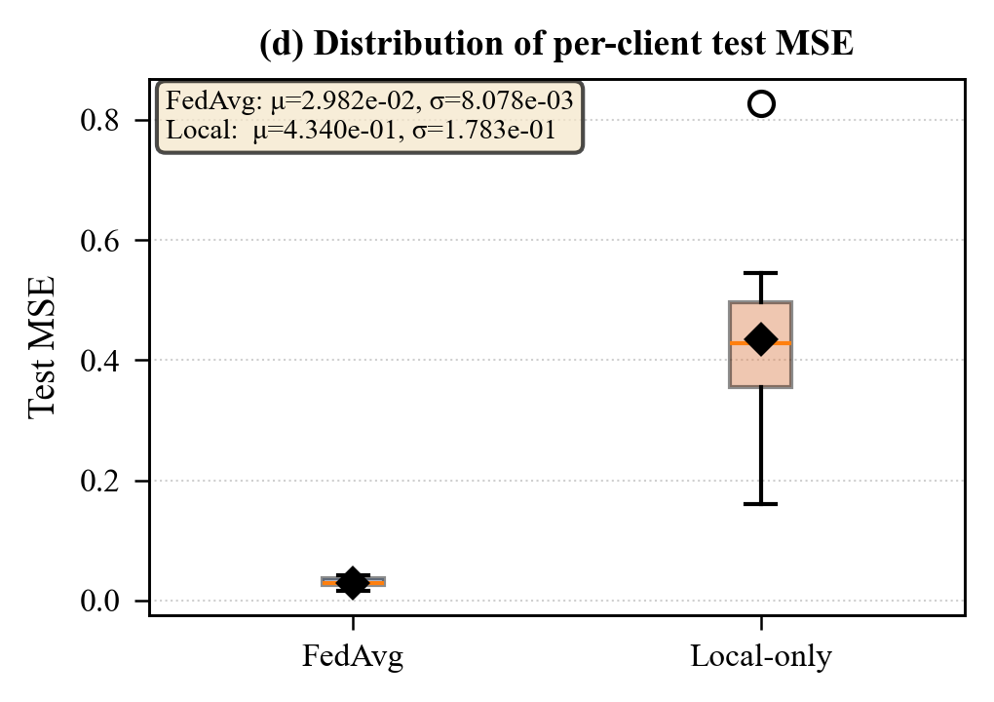
B. FL vs Local FNN

Slide 11
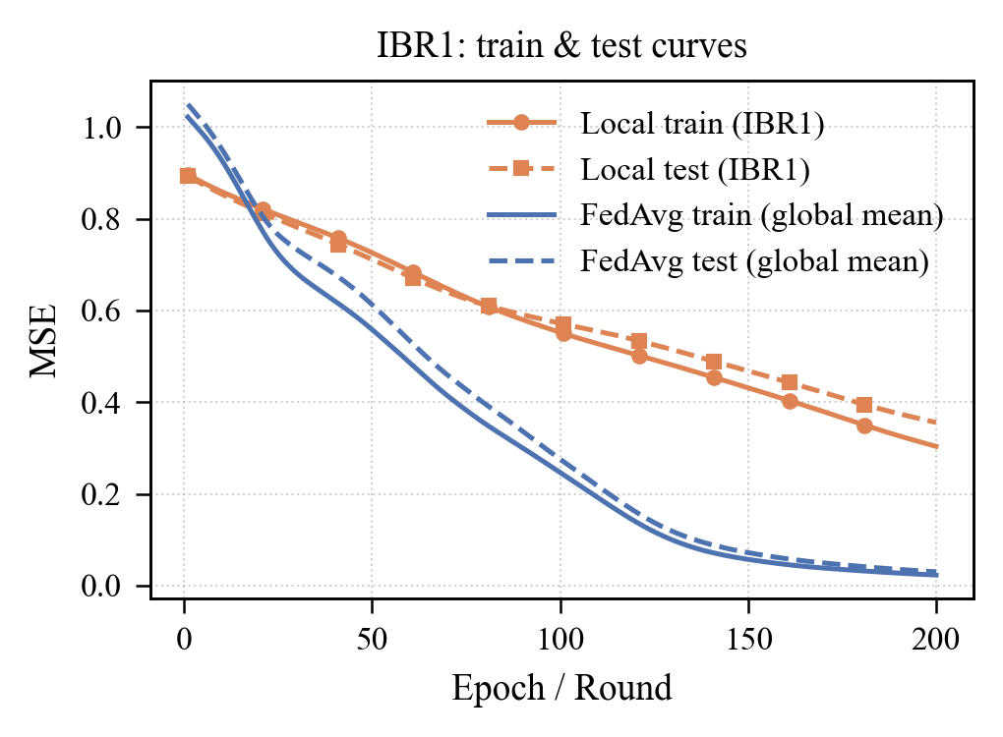
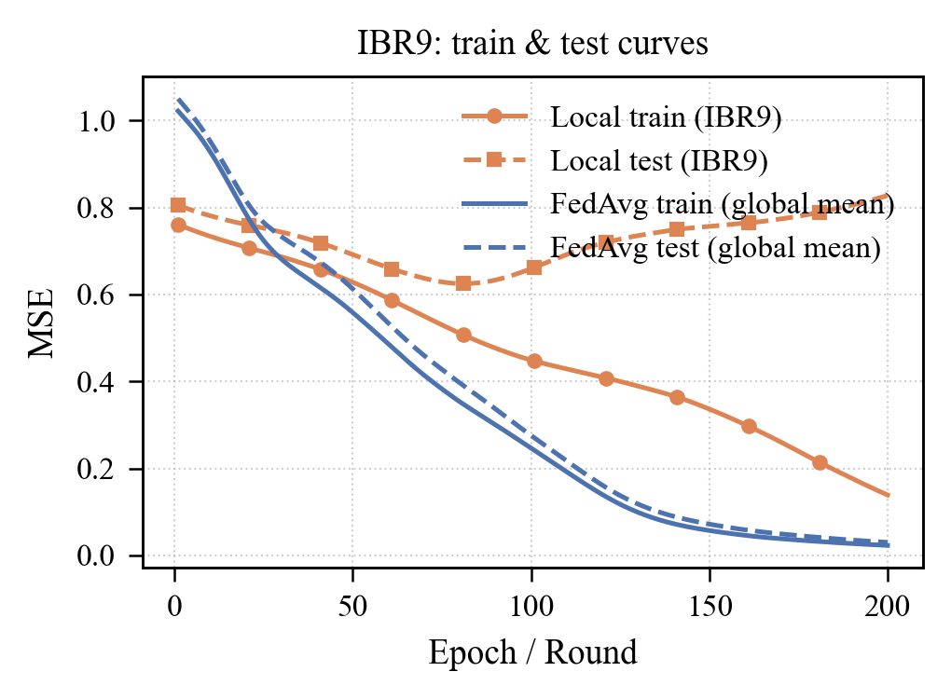
B. FL vs Local FNN

Slide 12
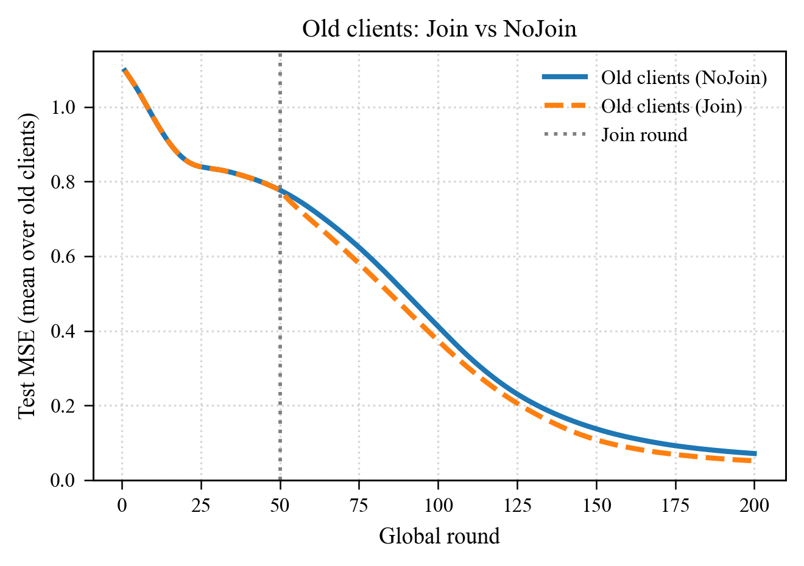
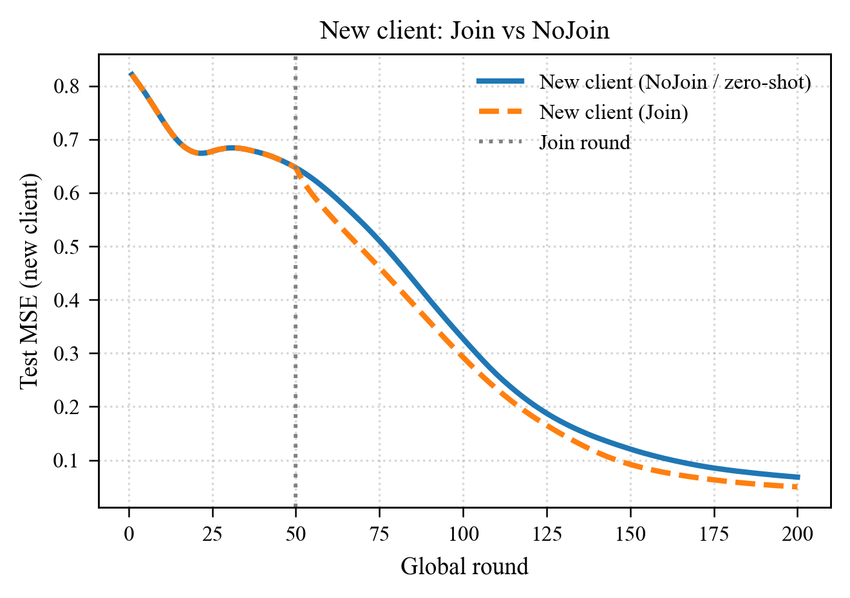
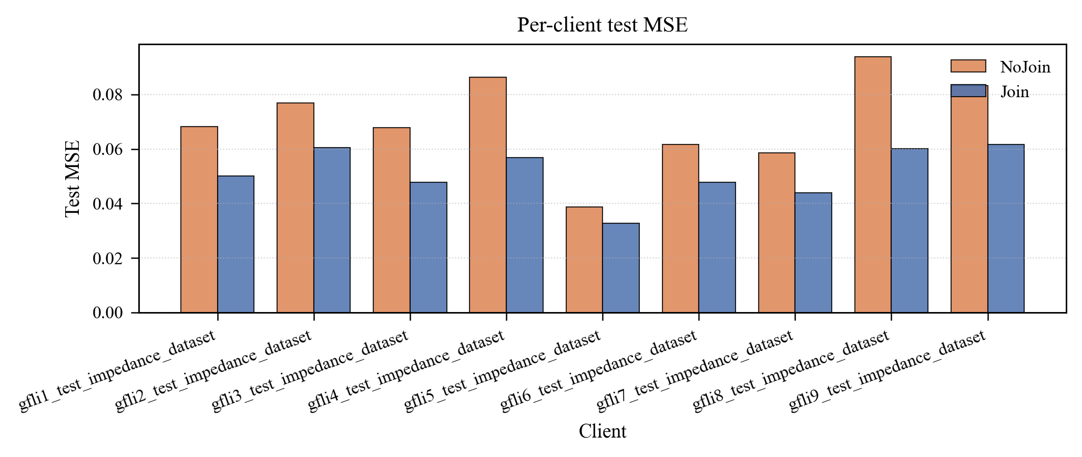
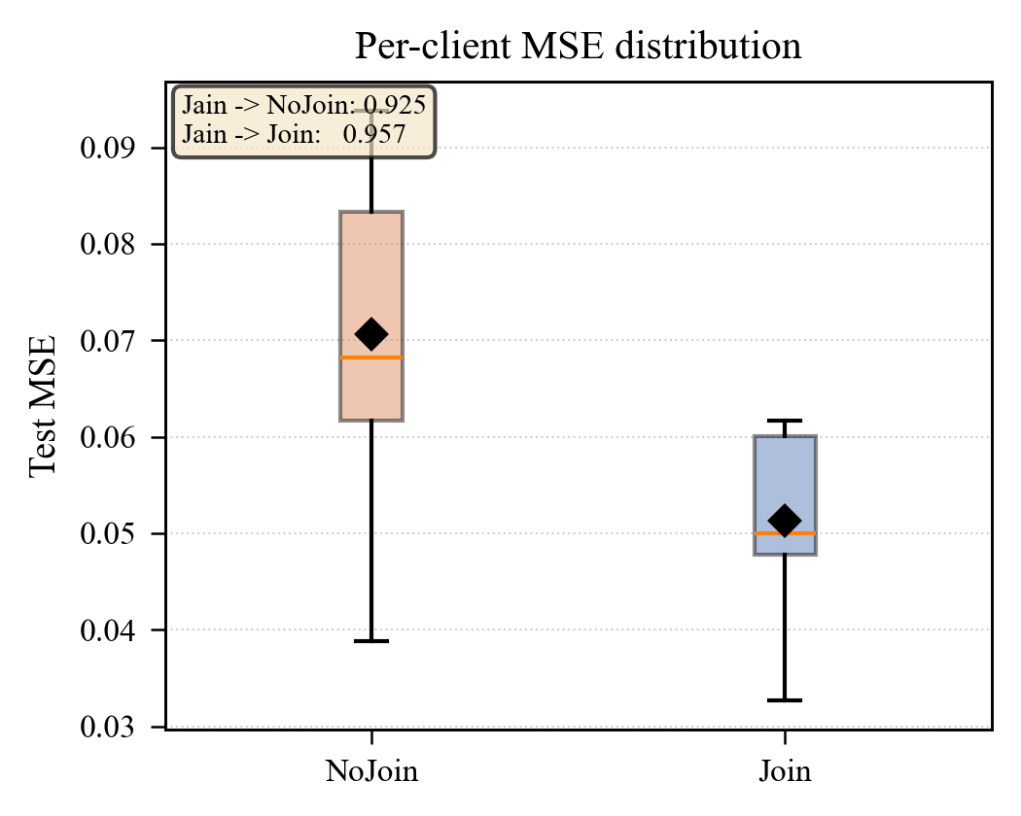
C. Integrate a new IBR

Slide 13
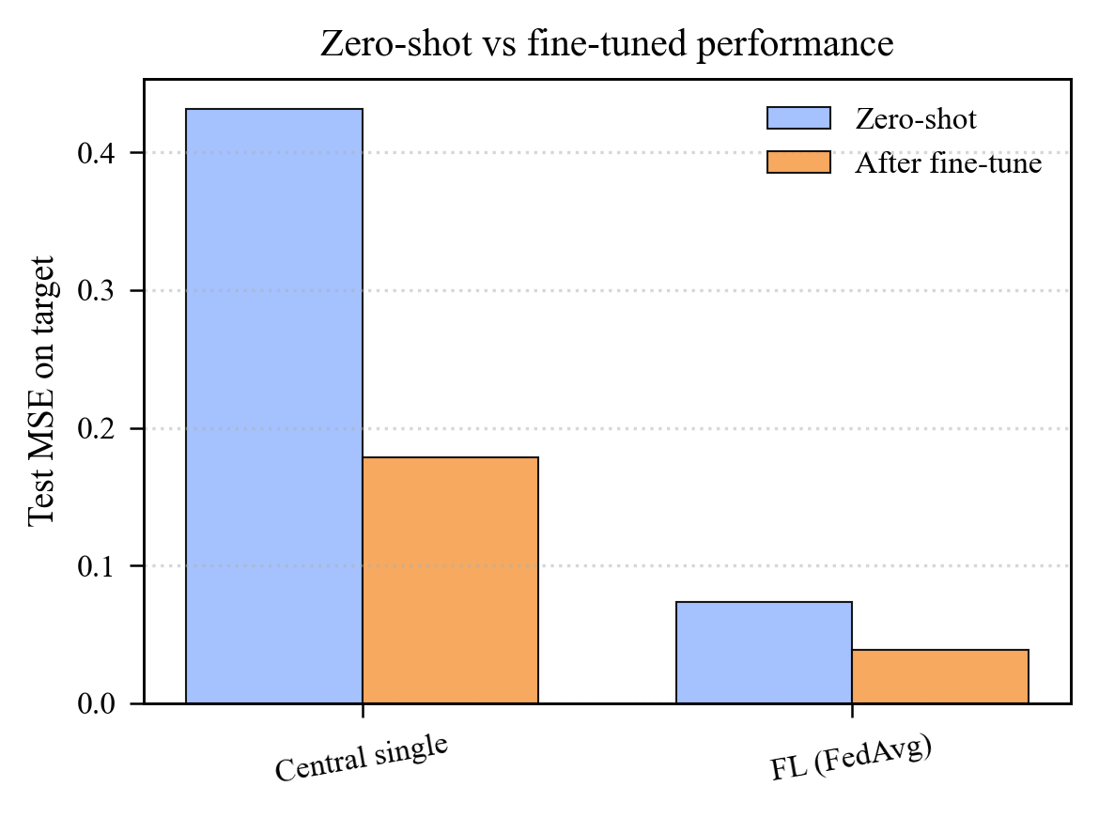
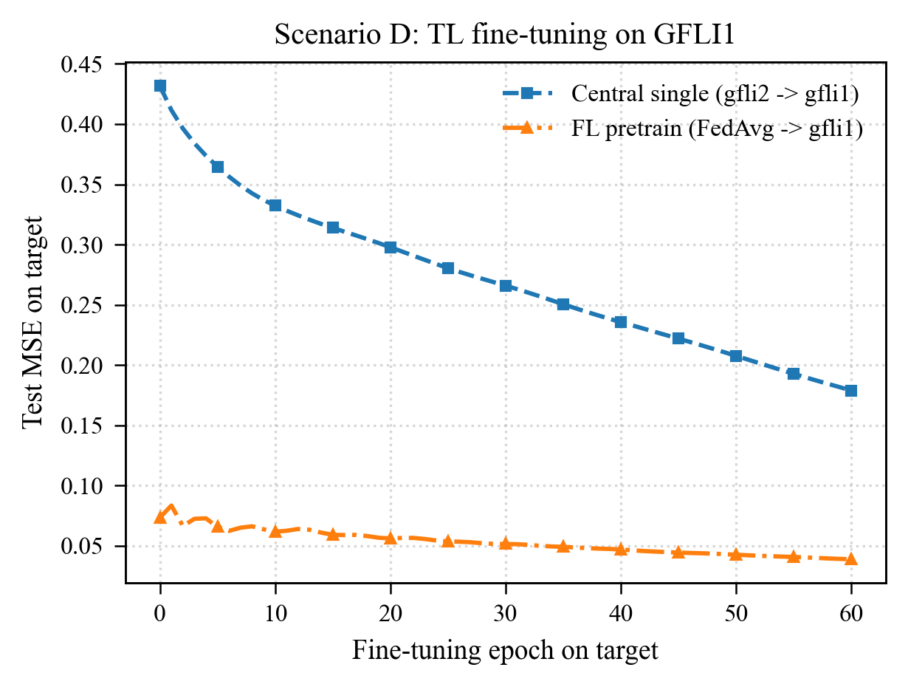
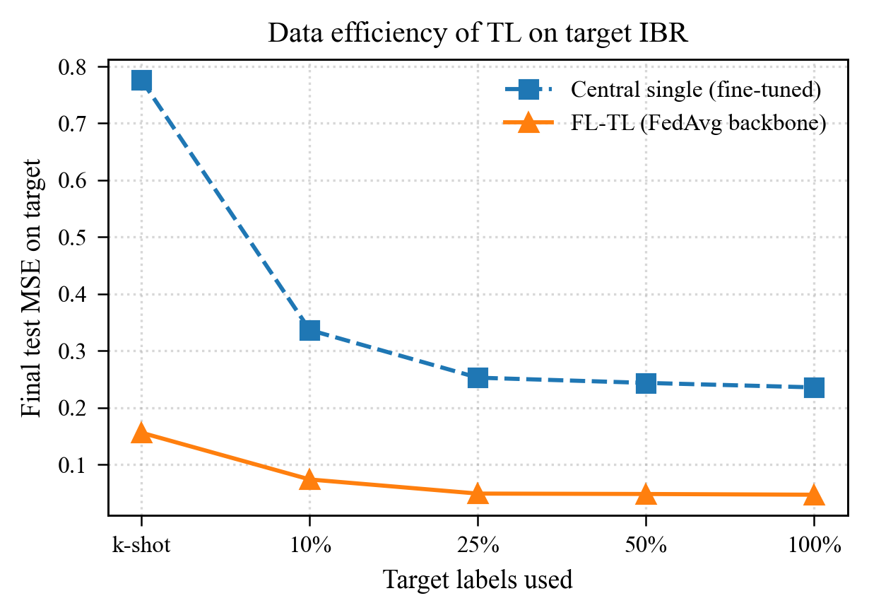
D. Offline Transfer Learning

Slide 14
E. Application in stability analysis

