Slide 1
Paper idea
Federated learning for multiple GFLIs with different control parameters (current control, PLL), LCL filters parameters.
Emphasize on :
Data privacy, confidential
Backbone model for new GFLIs
In the case we have a new GFLI, we can compare training efficiency of 3 scenarios:
FNN_From_Scratch
FedAvg
PerFedAvg
- Application in stability analysis of Single GFLI connected with strong/weak grid.
Offline simulation on Simulink
And CHIL validation on Typhoon/OPAL-RT

Slide 2
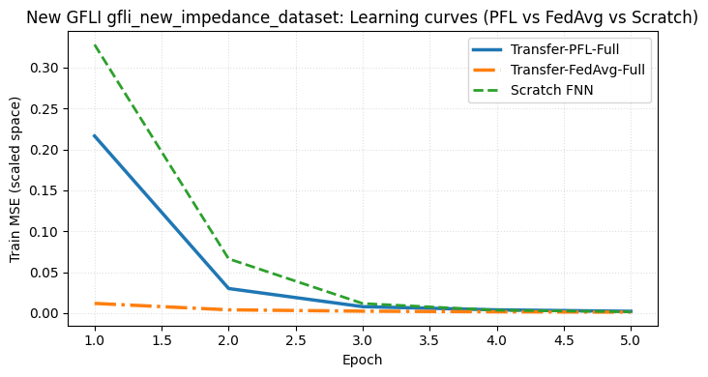
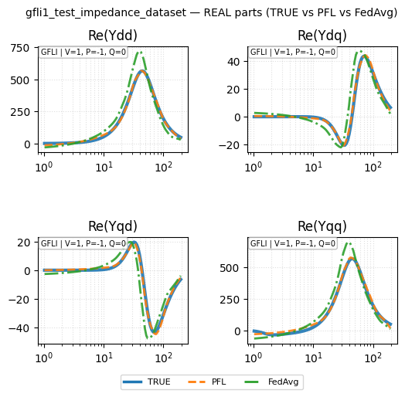
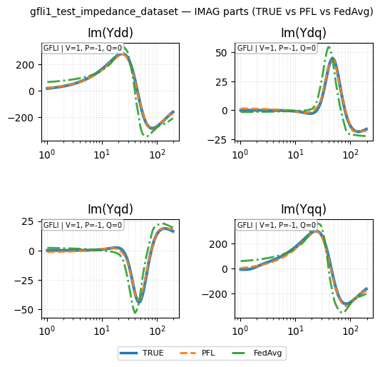
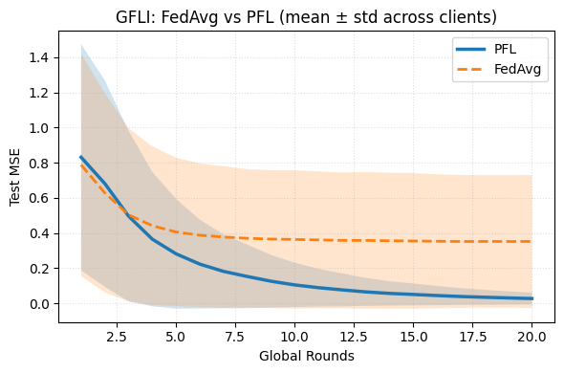
Federated learning

Slide 3
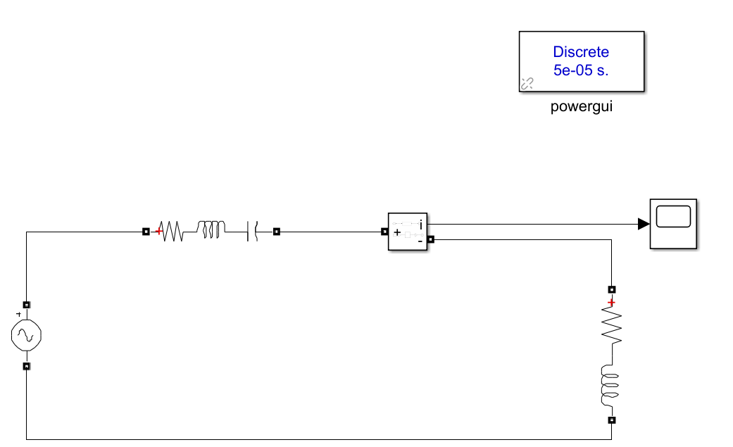
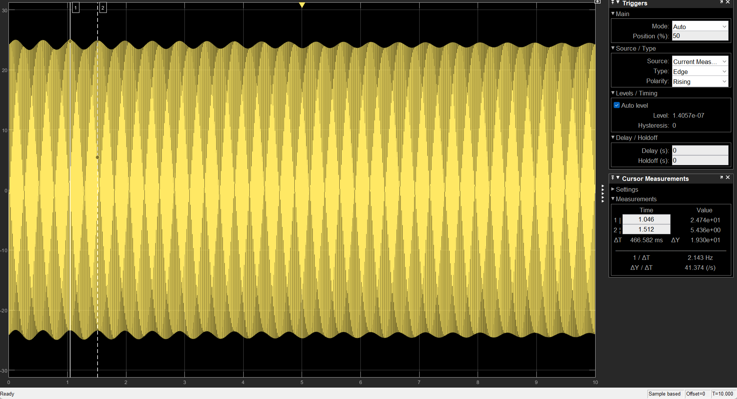
Validation
Passive components

Slide 4


Validation for 3-phase inverter on dq frame
Coupling in dq transformation -> using Bode plot can make a mistake
So, after got impedance model of IBR -> Plot Nyquist curve to investigate stability
Strong grid
Weak grid
$$Z_{g}=R_{g}+ωL_{g}$$
$$Z_{g}′={4(R}_{g}+ωL_{g})$$

Slide 5
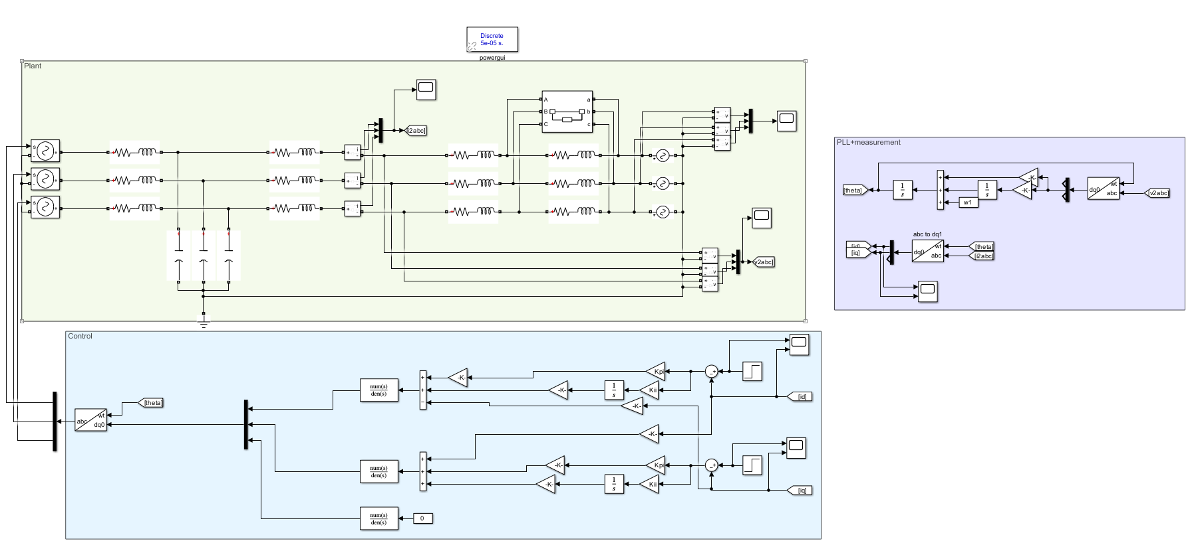
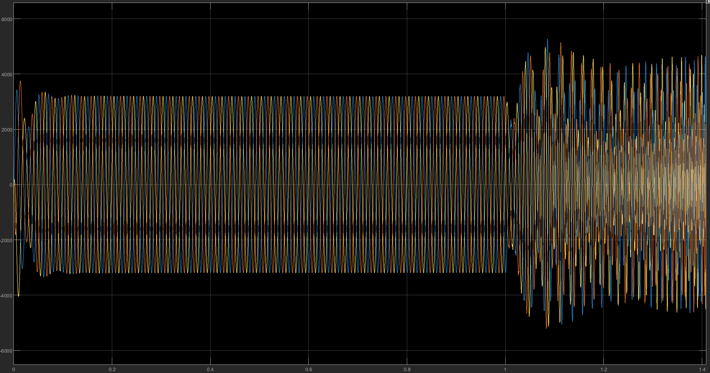
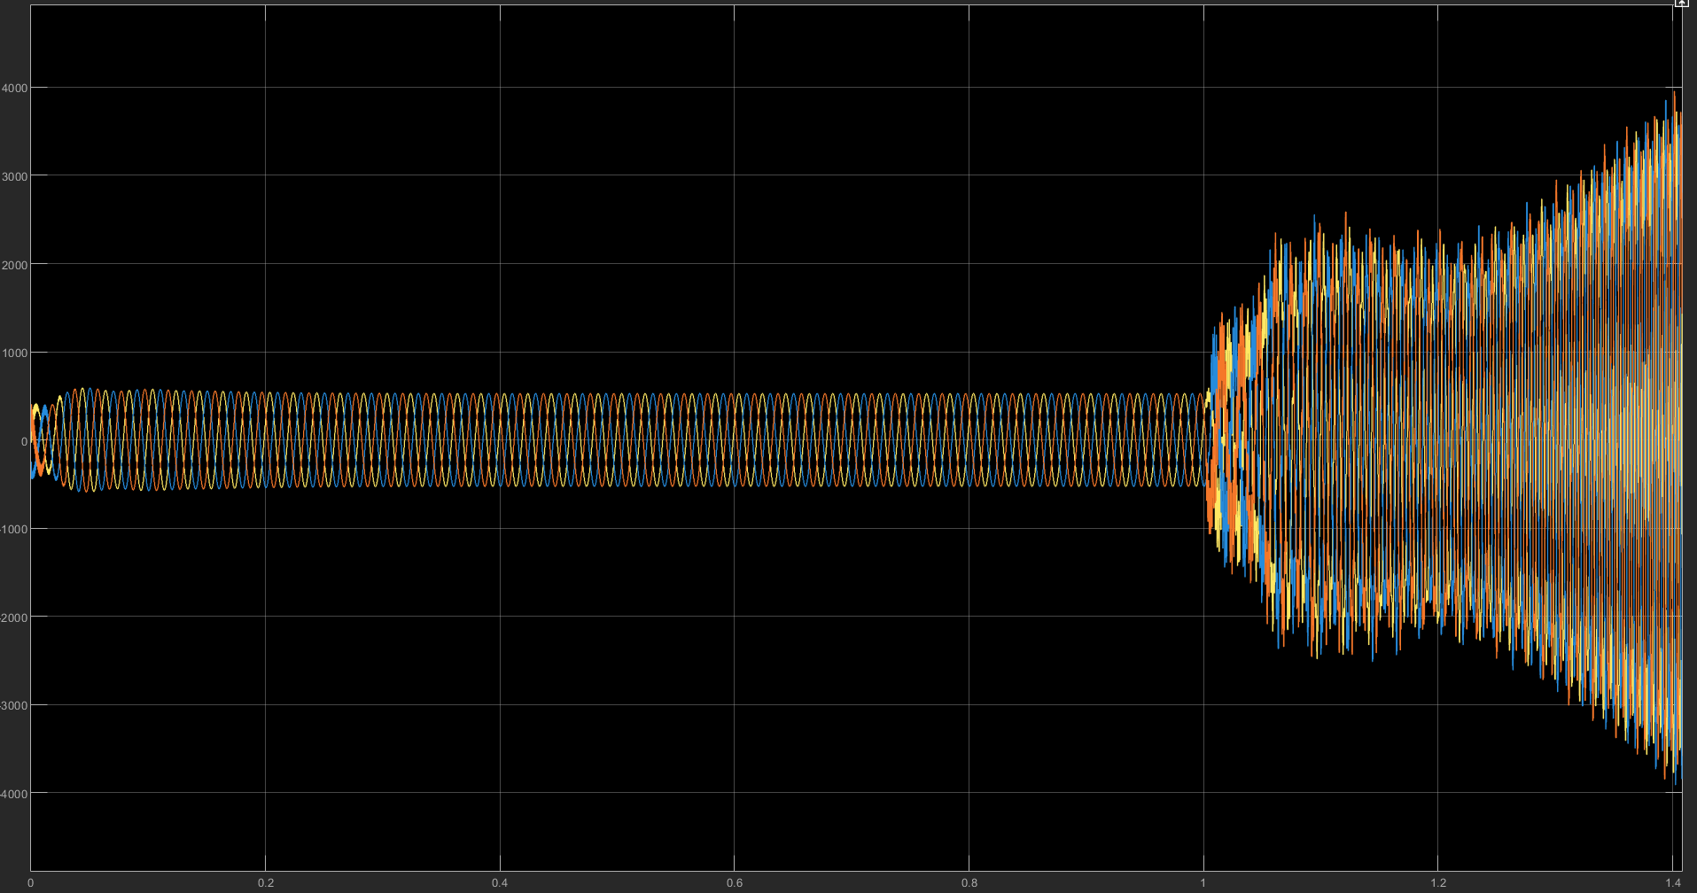


Validation for 3-phase inverter on dq frame
Strong grid
Weak grid
Strong grid
Weak grid
$$i_{pcc}$$
$$v_{pcc}$$

