Slide 1
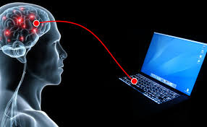
Telekenesis via Brain Computer Interface Control objects using electroencephalogram (EEG)

Slide 2
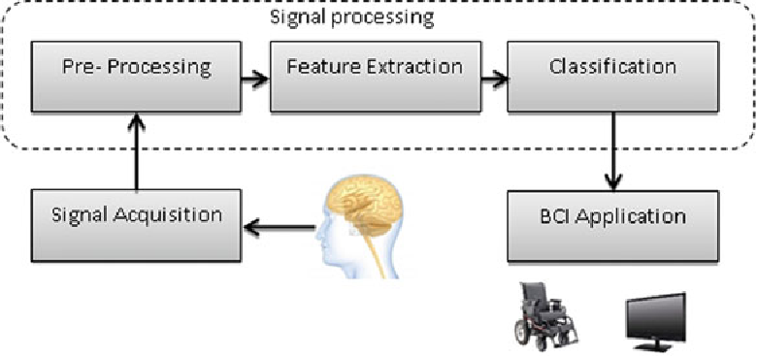
OBJECTIVE
PURPOSE OF THE PROJECT
Person with severe impairment or spinal cord injury has loss of ability to do anything. The target populations for the mind controlled wheelchair are the patients who are paralyzed below the neck and are unable to use conventional wheelchair interfaces. This project is about the EEG signals classification for wheelchair control application.
THE MAIN OBJECTIVE
The OBJECTIVE of this project is to classify the EEG signal to control the wheelchair’s movement. The specific objectives are:
i) To acquire EEG through ADS1292R and visualize using Grahical user interface(BrainBay).
ii) To analyze the EEG signal using FFT and calculating average Power of alpha waves using Python.
iii) To classify the EEG signal into two basic movements based on power of alpha waves.
iv) To transfer data from Python to Arduino and control the test object.

Slide 3
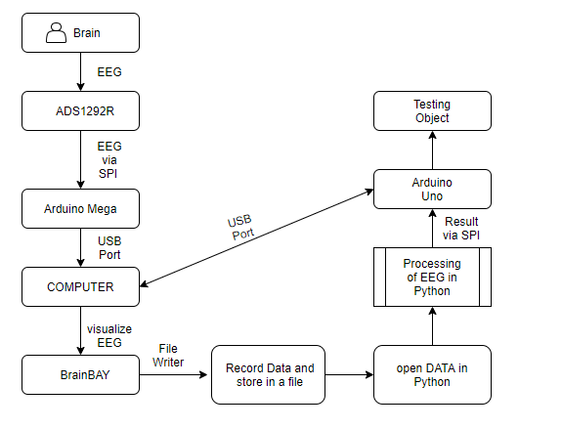
METHODOLOGY
Block-Diagram

Slide 4
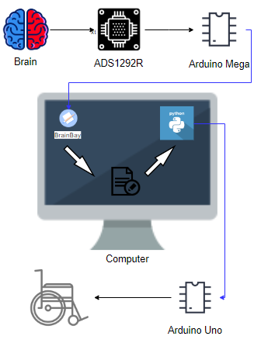
Detailed Work-flow
.
Metal Electrodes are used to extract EEG near visual cortex of the brain(alpha waves are strong here),electrodes are then connected to ADS1292R(via 3.5mm jack) which is connected to Arduino Mega(via SPI Protocol) because ADS1292R cannot commmunicate with computer directly,Arduino acts like a Bridge.
After connecting to computer we can store raw eeg signal using a software called BrainBay,it can be also used for visualizing the signal.This raw signal is opened in Python, using Welch's algorithm it calculates power spectral density of EEG,if the value of power in alpha region is greater than the threshold,it means the person has changed his status of mind,so the wheelchair should moves,else it stops
Once,the processing is done in python,data is sent back to Arduino which controls the motor.

Slide 5
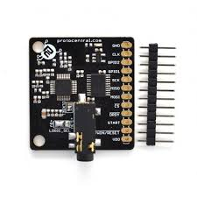
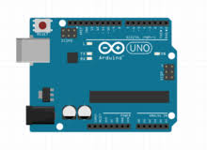
NOVELTY
1.Hardware Used
1) ADS1292R : This is a breakout board for the TI ADS1292R Analog front-end IC for ECG and respiration measurement. This is a simple board to add ECG/Respiration measurement capability to your Arduino, Raspberry Pi or other microcontroller of choice.
2) Arduino is an open-source electronics platform based on easy-to-use hardware and software. Arduino boards are able to read inputs - light on a sensor, a finger on a button, or a Twitter message - and turn it into an output - activating a motor, turning on an LED, publishing something online. You can tell your board what to do by sending a set of instructions to the microcontroller on the board. To do so you use the Arduino programming language (based on Wiring), and the Arduino Software (IDE), based on Processing.

Slide 6
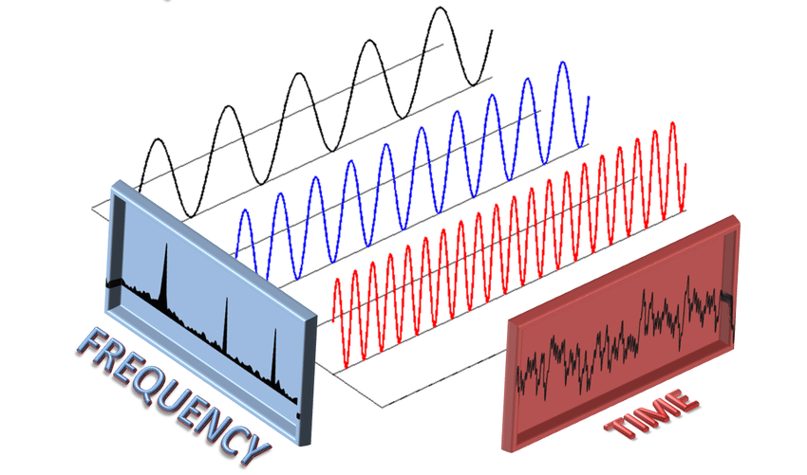
2. SIGNAL PROCESSING TECHNIQUES USED:
1. FFT : A fast Fourier transform (FFT) is an algorithm that computes the discrete Fourier transform (DFT) of a sequence, or its inverse (IDFT). Fourier analysis converts a signal from its original domain (often time or space) to a representation in the frequency domain and vice versa. The DFT is obtained by decomposing a sequence of values into components of different frequencies.
2. Power Spectral Density using Welch Algorithm: Welch's method is an approach for spectral density estimation. It is used for estimating the power of a signal at different frequencies. The method is based on the concept of using periodogram spectrum estimates, which are the result of converting a signal from the time domain to the frequency domain. Welch's method is an improvement on the standard periodogram spectrum estimating method and on Bartlett's method

Slide 7
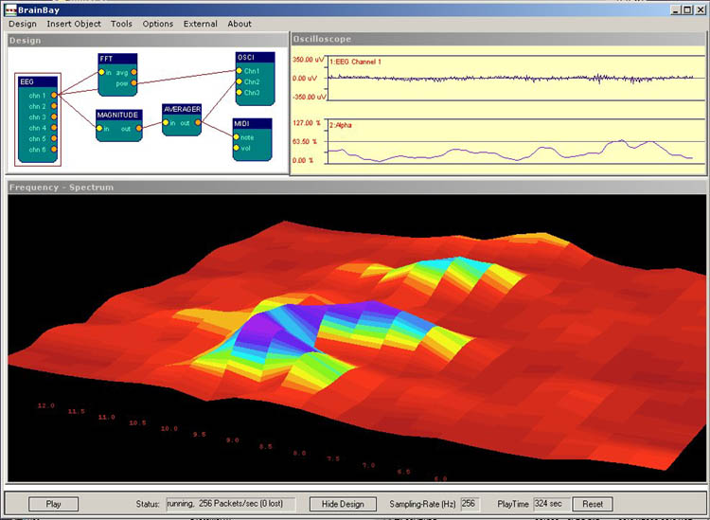
3.Software Used : BrainBay
BrainBay - an OpenSource Biosignal project :
BrainBay is a Bio- and Neurofeedback Application, designed to work with various EEG amplifiers(including the open hardware OpenEEG and OpenBCI amplifiers). It supports Human-Computer-Interface functions and the NeuroServer Software Framework to transmit live recordings via Internet / LAN. BrainBay is a part of the OpenEEG project and provides graphical + musical feedback
and feedback-games.
We used this software for
our project to visualize and
store the EEG signal.

Slide 8
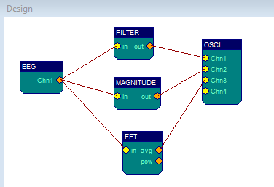
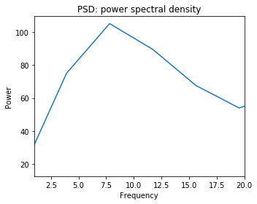
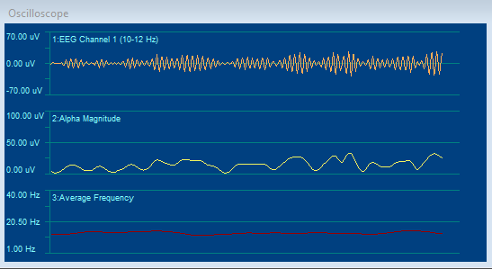
RESULT (BrainBay,Python)
PSD Plotted in Python
Results obtained in BrainBay

Slide 9
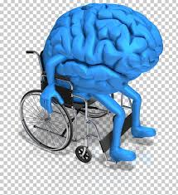
Conclusion
The raw EEG signal was captured using electrodes and other hardware and stored in computer
Python, using the raw data stored in file calculates the power spectral density, if it exceeds threshold value in alpha region wheelchair moves else stops.
Hence, controlling wheelchair with mental commands from human brain.
In similar way we can also control our home appliances,car,play games and many more.......

