Slide 1
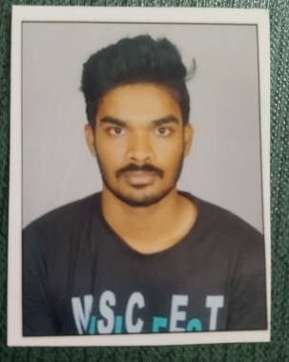


K H N S MANIKANTA BOLLAM
Education and certificates
Bachelor of Technology
Mechanical Engineering : 2017 - 2021
Analyst/Software Engineer
Skills Java 8 Spring Boot Spring Core
Base Location:
Mumbai
Email ID: Mobile No:
Khns-manikanta.bollam@capgemini.com
+91 9866449046
Grade:
A4
Backend Spring Boot Spring Core Rest API Node Js
Strengths
Software Engineer who is Strong in design and integration with intuitive problem-solving skills. Passionate about implementing and launching new projects.
Currently Improving skill on itransform-platform.
Ready to learn new technologies and implement them to further improve of my knowledge.
Eager to work in a team of dedicated people and serve a key role in the enhancement and development of the project.
Has working knowledge on React and Java Development using Spring framework on an intermediate level.
Achivement
Multiplex Ticket Booking System
Created a Multiplex ticket booking Application with spring boot as backend along with Postman for testing .
React as frontend, used HTML5 ,CSS ,JavaScript and bootstrap for designing responsive web pages .
Database
Oracle SQL PostgreSQL
MongoDB
Web Technologies
React Js
HTML5
CSS3
Javascript,ES6 Bootstrap
AddOns Github Gradle
Eclipse
https://github.com/mani-2210
Additional Details
Leadership
Team management

