Slide 1
🍹
MixBot
AI-Powered Cocktail Mixologist
Google Gemini 2.0 Flash · FastAPI · OpenRouter · Google OAuth
AI Essentials Capstone Project | April 2026

Slide 2
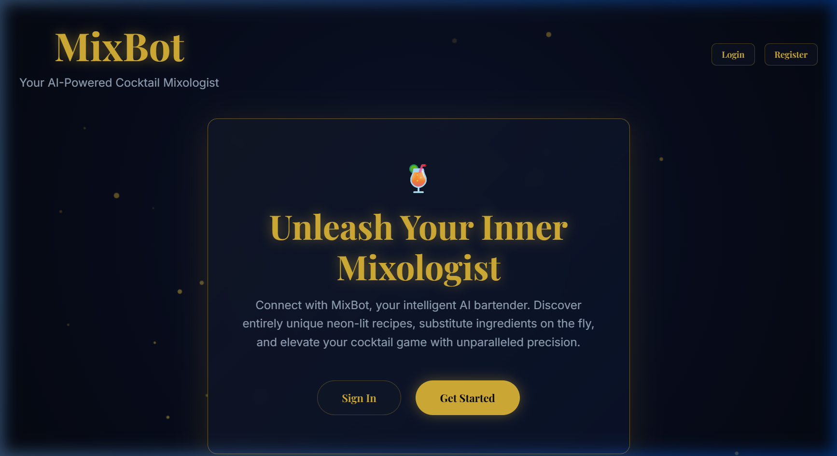
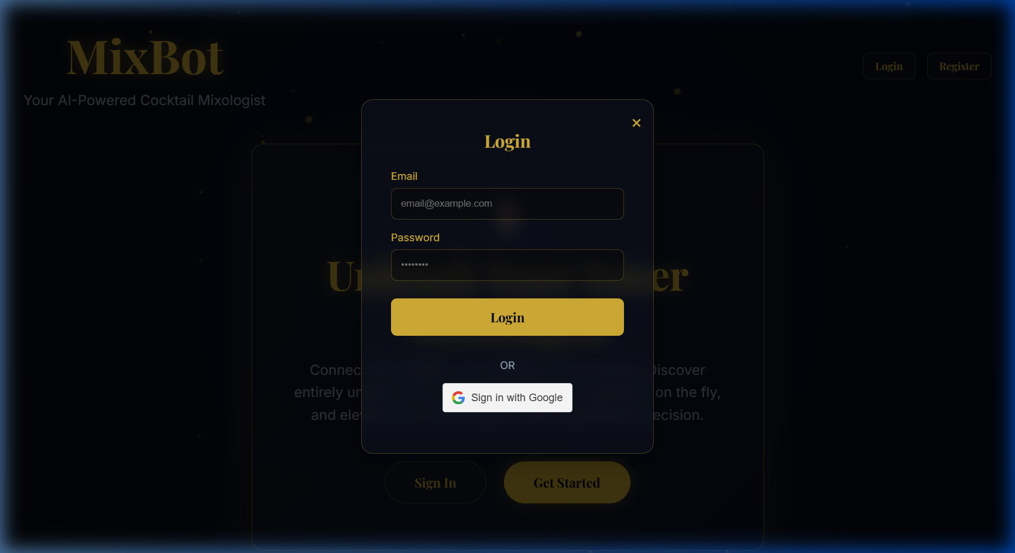
Project Overview
What is MixBot and why was it built?
About the Project
MixBot is a full-stack AI web app that acts as your personal bartender. It uses Gemini 2.0 Flash to understand natural language and craft unique cocktail recipes, substitutions and party plans in real time — all personalised per user.
🌐 Web-based chat interface
🔐 JWT + Google OAuth
🗄 SQLite persistent history
← Landing hero page (unauthenticated) ← Login modal with Google OAuth support
👑 Full admin control panel

Slide 3
Core Features
Everything MixBot can do for you
🍸 AI Chat Bartender
🔐 Secure Authentication
📜 Persistent Chat History
Powered by Gemini 2.0 Flash. Ask for recipes, substitutions, pairing advice, or party plans in plain English.
Email+password login with bcrypt hashing, or instant Google OAuth single sign-on. JWT tokens secure every request.
Conversations are saved per-user in SQLite. Sessions sync to the backend on every message — never lose a recipe.
👑 Admin Control Panel
🛡️ Rate-Limit Resilience
✨ Premium Glassmorphism UI
Administrators view all users, promote/demote roles, read full chat transcripts, and delete records.
Exponential back-off retries handle API quota limits. Friendly in-app messages prevent user confusion during outages.
Dark navy canvas, animated gold particles, glass panels, and Playfair Display typography for a luxury feel.

Slide 4
System Architecture
How the pieces connect — Frontend → Backend → AI
🌐 Frontend
⚙️ Backend
🤖 AI Engine
HTML5 + CSS3 (Vanilla)
FastAPI (Python 3.11)
Google Gemini 2.0 Flash
Vanilla JavaScript (ES6+)
SQLAlchemy ORM
OpenRouter gateway
→
→
Glassmorphism + Particle FX
SQLite database
Custom system prompts
Google Sign-In SDK
bcrypt password hashing
Exponential retry logic
Responsive 2-column layout
JWT access tokens
JSON + Chat endpoints
1
2
3
Python 3.11
FastAPI
SQLite
OpenRouter
Gemini 2.0 Flash
bcrypt
JWT
HTML5 / CSS3

Slide 5
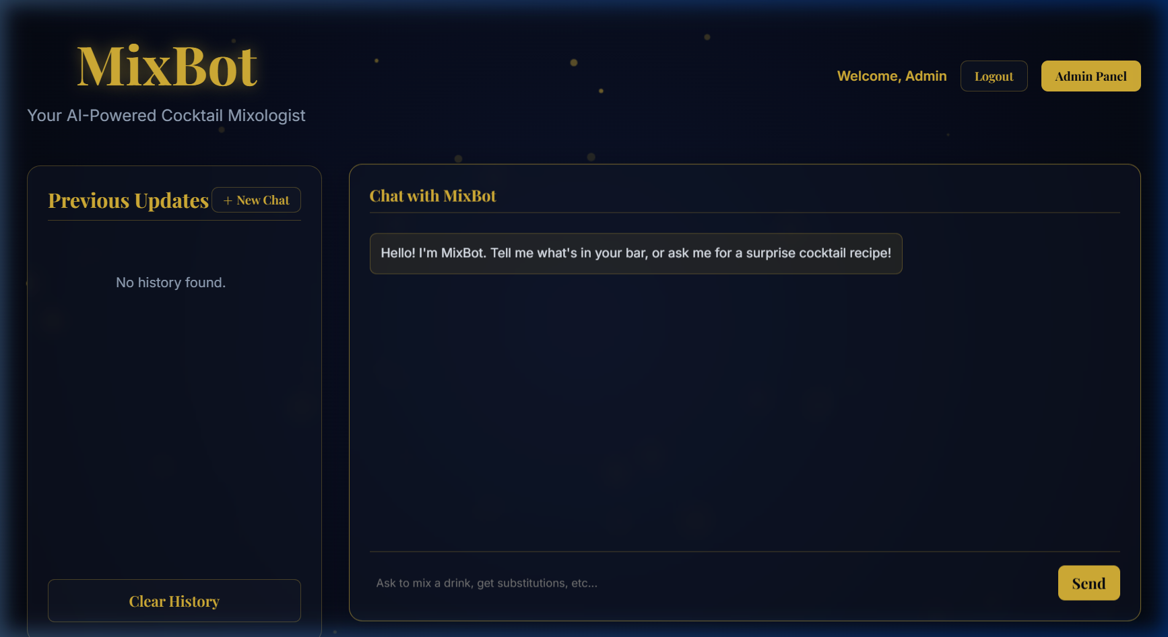
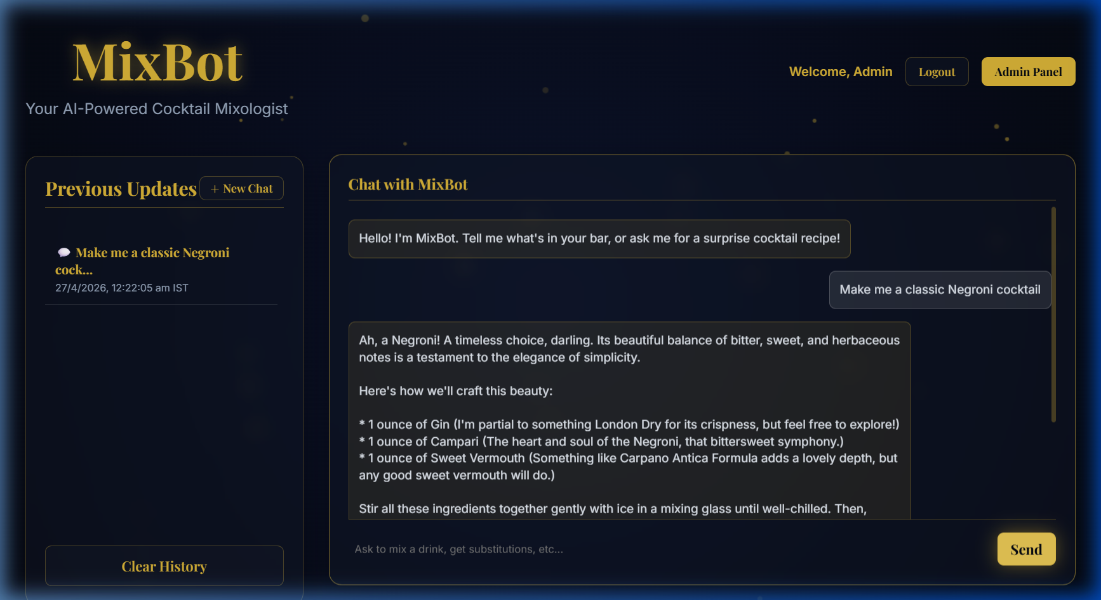
Live Chat Interface
MixBot responding in real time — admin logged in as 'Admin'
Chat UI after login — sidebar shows session history
AI response to "Make me a classic Negroni cocktail" — real Gemini output

Slide 6
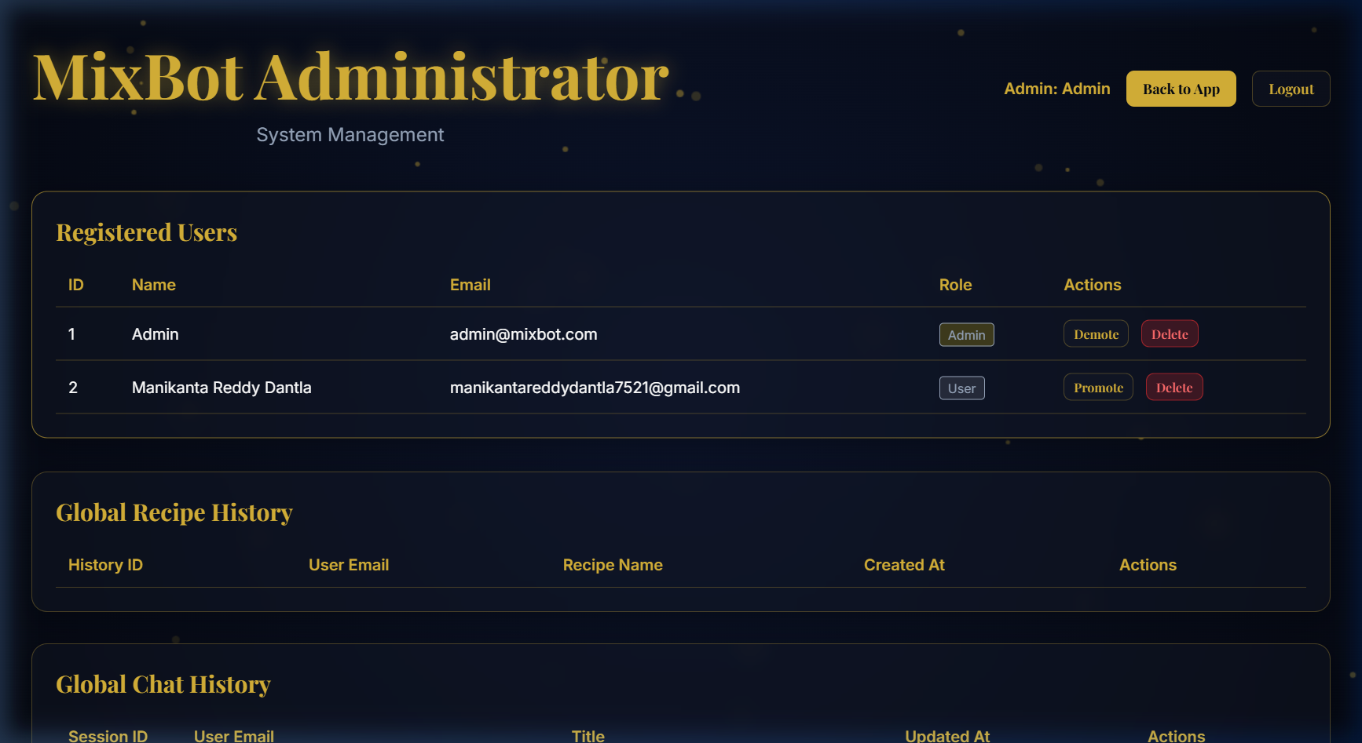
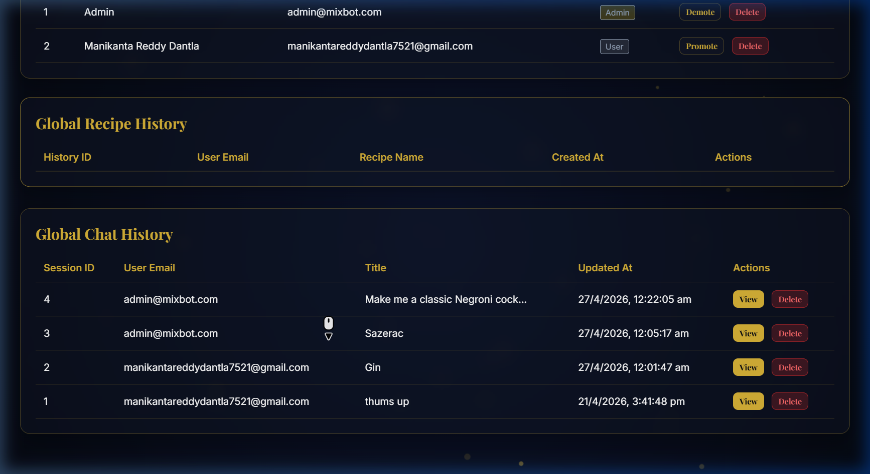
Admin Panel & Security
Role-based control — only admins can access system management
Admin Capabilities
👤 User Management
Full roster of registered users — see ID, name, email, and role at a glance.
🔄 Promote / Demote
Toggle any user between User and Admin roles with a single button click.
🗑️ Account Deletion
↑ Registered users table with role badges and action buttons
Remove any account instantly. Built-in guard prevents admins from deleting themselves.
📜 Recipe History
Browse every AI-generated recipe across all users — user email, recipe name, timestamp.
💬 Chat Log Viewer
Read full conversation transcripts of any session. View button opens a modal overlay.
↑ Global chat session history with user email, title, and view/delete controls

Slide 7
🍹
Thank You!
MixBot — Your AI-Powered Cocktail Mixologist
Project Achievements
Project Achievements
Full-stack web application (FastAPI + Vanilla JS)
Persistent multi-session chat history (SQLite)
Gemini 2.0 Flash via OpenRouter integration
Admin dashboard: users, recipes & chat logs
JWT & Google OAuth authentication system
Premium glassmorphism UI with particle animations
Built with Python · FastAPI · Google Gemini AI · HTML5 / CSS3 / JavaScript
AI Essentials Capstone Project | April 2026

