Slide 1

Automated Diagnosis of Diabetic Retinopathy using Convolutional Neural network
Guided By:
Dr.Kiran Kumar Eranki
SAP
School of Computing
SASTRA University
Presented By:
Mani Kanta Reddy
121003294
CSE
SASTRA Deemed University

Slide 2
Agenda
Base Paper Details
Abstract
Problem Statement
Dataset
Existing Methods
Proposed Method
Experimental Results
Conclusion
Improvements & future work

Slide 3
Base Paper Details
TITLE: Automated Diabetic Retinopathy Detection Based on Binocular Siamese-Like Convolutional Neural Network
DOI: 7110.1109/ACCESS.2019.29031
Authors: XIANGLONG ZENG , HAIQUAN CHEN1,YUAN LUO2, , AND WENBIN YE
Published In: IEEE Access, 7, 30744-30753 (2019).

Slide 4
Abstract
Diabetic retinopathy (DR) is an important cause of blindness worldwide.
However, DR is hard to be detected in the early stages, and the diagnostic procedure can be time-consuming even for the experienced experts.
Therefore, a computer-aided diagnosis method based on deep learning algorithms is proposed to automatedly diagnose the diabetic retinopathy by classifying color retinal fundus photographs.
In this paper, a novel convolutional neural network model is trained with a transfer learning technique.

Slide 5
Problem Statement
Can the detection of Diabetic Retinopathy be Automated
Does the Classification of Diabetic Retinopathy be possible using Convolutional Neural Network

Slide 6
Dataset
Source: Kaggle Diabetic Retinopathy competition provided by EyePACS
Link: “https://www.kaggle.com/c/diabetic-retinopathy-detection/data”
The Dataset consists of high resolution colour retinal fundus photographs of five different classes:
  0-No RDR
  1-Mild RDR
  2-Moderate RDR
  3-Severe RDR
  4-Proliferative RDR

Slide 7
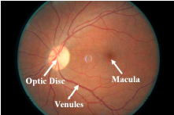
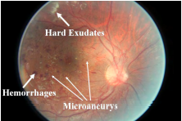
Existing Methods
Multiple automated diagnosis systems have been developed over the last decade.
Human experts usually focus on some typical lesions associated with DR such as microaneurysms, hemorrhages and hard exudates.
When evaluating fundus photographs, many works paid attention to automatedly detect and segment these lesions or calculate some numerical indexes.

Slide 8
Existing Methods Contd..
Shahin et al. developed a system to automatedly classify retinal fundus images into those with or without proliferate diabetes retinopathy and a sensitivity of 88% and a specificity of 100% are obtained.
Jaafar et al. proposed an automated algorithm, which mainly consist of two parts:
  Top-down segmentation: To Segment Exudates Legions.
  A polar coordinate system centered at the fovea to grade the severity of hard exudates.
  And a sensitivity of 93.2% is obtained.
Casanova et al. introduced an algorithm of random forest to discriminate people with or without DR with the accuracy of more than 90%.

Slide 9
Disadv’s of Existing Methods
Most of works above mentioned mostly rely on:
  The variables that are manually measured by experts
  Extracting handcrafted features with image processing techniques.
Hence these two methods bring extra complexity and unstability.

Slide 10
Proposed Method
Thus, the deep learning method with the ability to learn significant features directly from the fundus photography has aroused the attention of researchers in recent years.
In this paper, a deep learning based method is proposed to automatically classify the fundus photographs into 2 types – with or without RDR.
In this work, we built a novel CNN model based on Inception V3 (pre-trained model using imagenet dataset) by using transfer learning concept.

Slide 11
Proposed Method Contd..
Image Pre-processing:
  Standardization:This step is to unify the size of images into 299×299 pixels.
  Normalization: In this step all the images are normalized from [0 – 255] to [0 – 1].
Data-Augmentation:
  Randomly flip the images of eyes horizontally. Since human eyes are structurally mirror symmetric.
  Randomly perform geometric transformation on images including randomly inverting, cropping, scaling, translating, rotating and shearing.

Slide 12
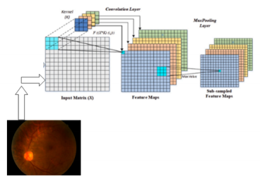
Proposed Method Contd..
Network Architecture:
A Schematic Representation of convolution and Max pool layers

Slide 13
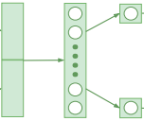

Proposed Method Contd..
Network Architecture:
Fully Connected Layer
No RDR
Proliferated RDR
Concatenate layer
Block Diagram of the proposed binary classification convolutional neural network.

Slide 14
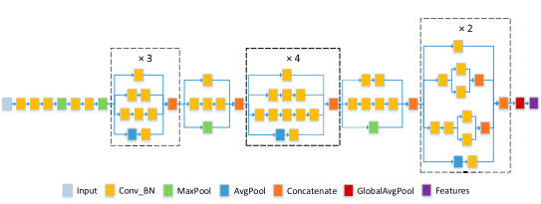
Proposed Method Contd..
Inception V3 Network Architecture:
Block Diagram of Inception V3 architecture without the last layer

Slide 15
Proposed Method Contd..
Model Compilation & Training:
  Optimizer = Adam(lr=0.0001),
  loss = 'categorical_crossentropy',
  metrics = ['accuracy']
  Batch size = 20
  Target size = 299X299
  No.of.Epochs = 15

Slide 16
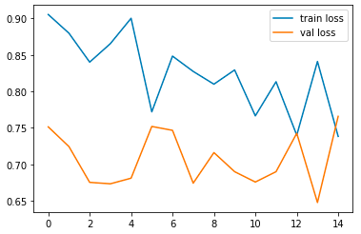
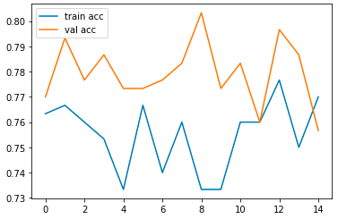
Experimental Results
We implemented the proposed model and trained for 15 epochs and an accuracy of 75.67% obtained.
loss
accuracy
epochs
epochs
Graph depicts how loss changes based on epochs
Graph depicts how accuracy changes based on epochs

Slide 17
Conclusion
In this paper, A novel CNN model to automatically detect RDR based on the deep learning method is developed.
The evaluation results shows that proposed novel CNN model achieves an accuracy of 75.67%
These results also demonstrates that the proposed model has great potential to assist ophthalmologists to diagnose RDR more efficiently and improve the screening rate of RDR.
The proposed model can be modified and applied to the auto detection of other ophthalmic diseases without much difficulty.

Slide 18
Improvements and future work
But there is still much room for proposed model to get improvement.
Developing an extra model to distinguish whether fundus images are clear before feeding into the network.
The other bottleneck is the small size of our data set.
Predictably the performance of model can be further improved if more data is collected in the future.

Slide 19
References
[1] E. M. Shahin, T. E. Taha, W. Al-Nuaimy, S. El Rabaie, O. F. Zahran, and F. E. A. El-Samie, ``Automated detection of diabetic retinopathy in blurred digital fundus images,'' in Proc. 8th Int. Comput. Eng. Conf., Dec. 2013, pp. 20_25.
[2] H. F. Jaafar, A. K. Nandi, and W. Al-Nuaimy, ``Automated detection and grading of hard exudates from retinal fundus images,'' in Proc. 19th Eur. Signal Process. Conf., 2011, pp. 66_70.
[3] R. Casanova, S. Saldana, E. Y. Chew, R. P. Danis, C. M. Greven, and W. T. Ambrosius, ``Application of random forests methods to diabetic retinopathy classi_cation analyses,'' PLoS One, vol. 9, no. 6, p. e98587, 2014

Slide 20
References
[4] G. Quellec, K. Charrière, Y. Boudi, B. Cochener, and M. Lamard, ``Deep image mining for diabetic retinopathy screening,'' Med. Image Anal., vol. 39, pp. 178_193, Jul. 2017.
[5] Kaggle. (Jul. 27, 2015). Diabetic Retinopathy Detection. Accessed: May 7, 2018. [Online]. Available: https://www.kaggle.com/c/diabeticretinopathy- Detection.
[6] V. Gulshan et al., ``Development and validation of a deep learning algorithm for detection of diabetic retinopathy in retinal fundus photographs,'' Jama, vol. 316, no. 22, pp. 2402_2410, 2016.
[7] R. Gargeya and T. Leng, ``Automated identi_cation of diabetic retinopathy using deep learning,'' Ophthalmology, vol. 124, no. 7, pp. 962_969, 2017.

Slide 21


Slide 22

5
Questions?

