Slide 1
My Dream Places
A collection of breathtaking destinations I dream to visit.

Slide 2
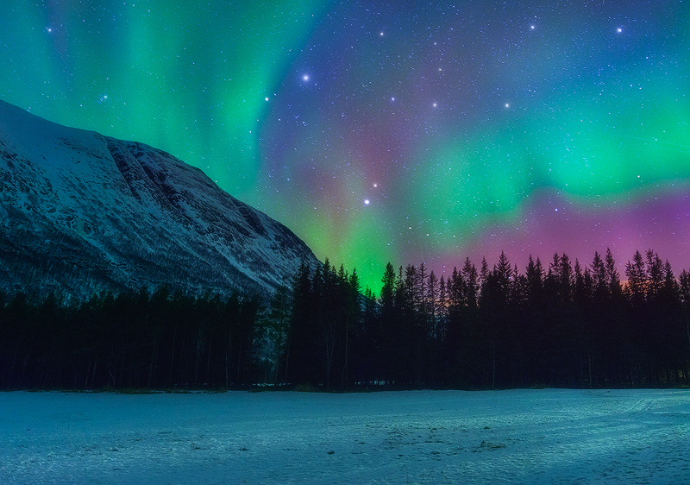
Northern Lights, Norway
The Northern Lights, or Aurora Borealis, are a spectacular
natural phenomenon seen in Norway's Arctic regions.

Slide 3
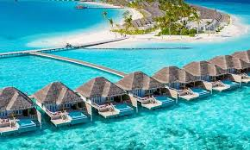
Maldives
A tropical paradise known for its crystal-clear waters, luxurious resorts, and overwater bungalows.

Slide 4
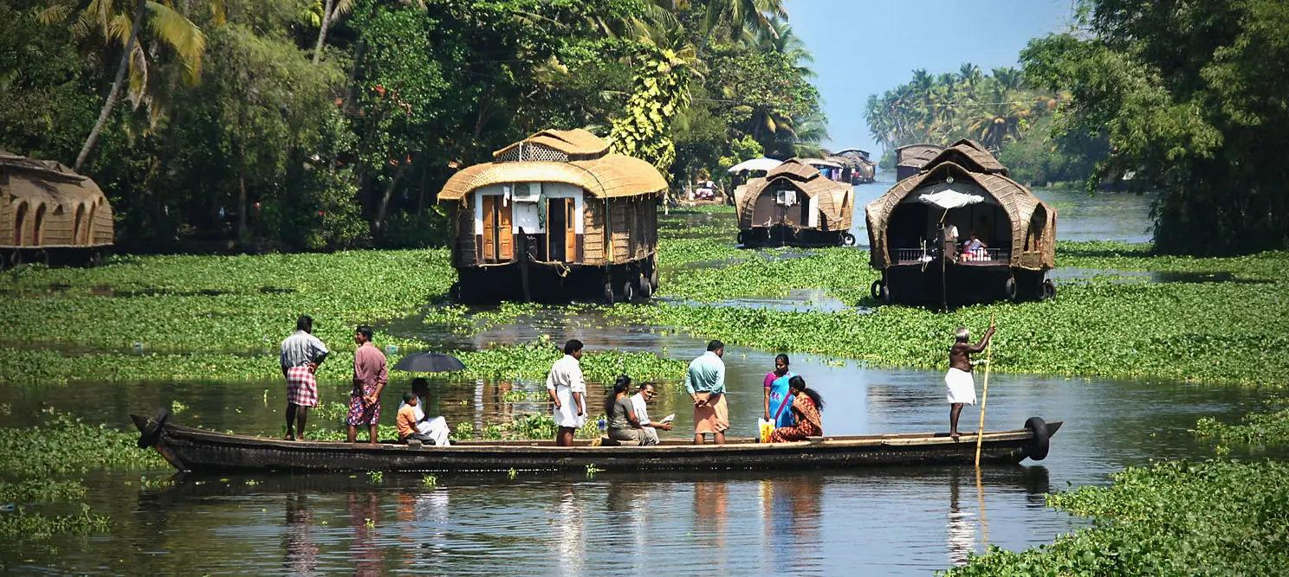
Kerala Backwaters, India
A network of lagoons and lakes along the Arabian Sea coast, famous for houseboat cruises and serene beauty.

Slide 5
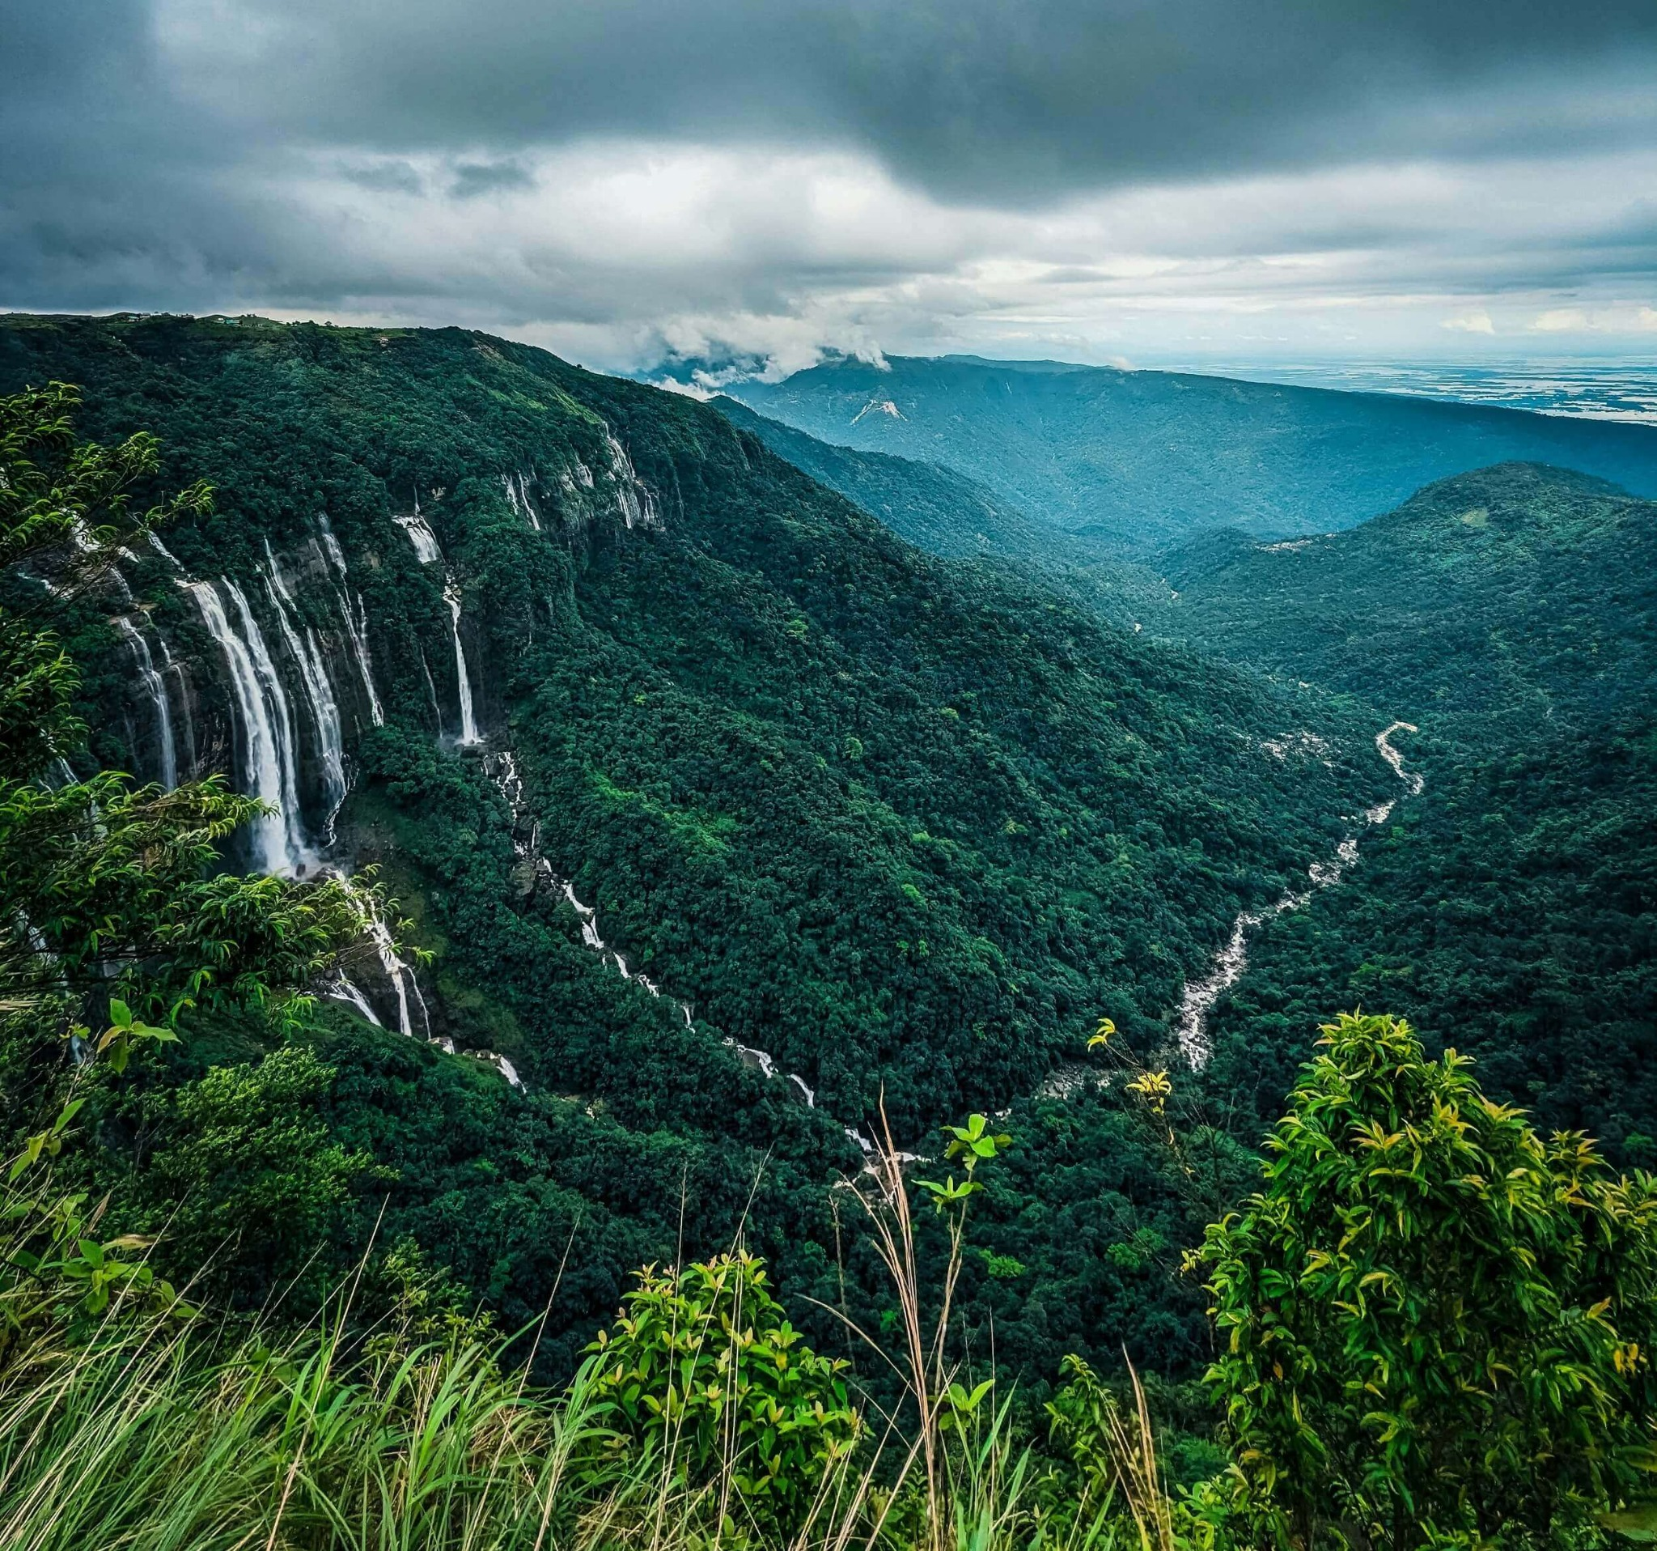
Cherrapunji , India
One of the wettest places on Earth, known for its lush green hills, waterfalls, and living root bridges.

