Slide 1
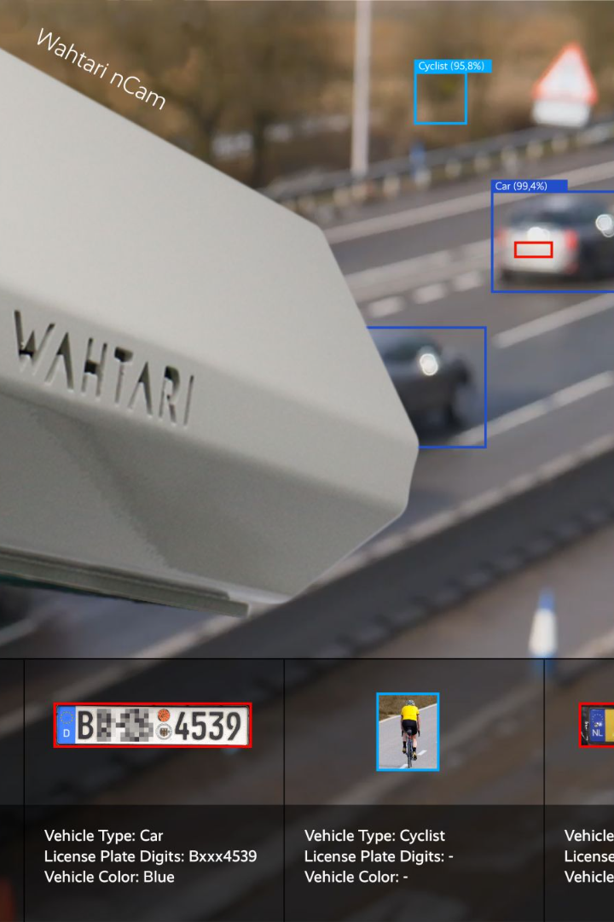
Automatic Number Plate Recognition System
ANPR systems use advanced algorithms to capture and analyze vehicle license plates. In this presentation, we will explore the different applications, advantages, and challenges of ANPR.

Slide 2
Introduction and Purpose of ANPR
What is ANPR?
Why is ANPR important?
History of ANPR
ANPR is a technology that uses optical character recognition to read and interpret license plates.
ANPR was first developed in the 1970s to enforce traffic laws and reduce crime rates. The technology has since advanced to include machine learning and artificial intelligence.
ANPR provides real-time data on vehicle movements, facilitating law enforcement, traffic management, and toll collection.

Slide 3
How ANPR Works
1
Camera captures image
A camera captures an image of a passing vehicle, which is then forwarded to the ANPR system.
License plate recognized
2
The ANPR software reads and interprets the characters on the license plate using optical character recognition (OCR) technology.
3
Matched against database
The system compares the recognized license plate number against a database of registered vehicles to extract relevant information about the vehicle owner or driver.
Alert triggered
4
If there is a match between the license plate and the database, the system triggers an alert to notify the relevant authorities.

Slide 4
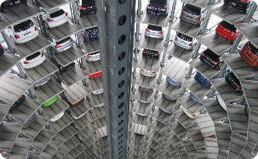
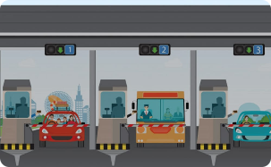
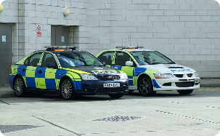

Applications of ANPR
Parking Management
Toll Collection
Law Enforcement
ANPR can be used to automate parking fees collection or enforce parking regulations in private and public parking lots.
ANPR can be deployed at toll booths to identify and charge drivers without the need for cash, tokens or manual checks.
ANPR can aid law enforcement agencies in detecting crime, tracking suspects, and capturing license plates associated with criminal activities.
Traffic Management
ANPR can be used to monitor the flow of traffic and detect traffic violations such as speeding, crossing a red light, or using a bus lane.

Slide 5
Advantages of ANPR
1
Efficiency
2
Accuracy
ANPR can accurately read multiple license plates at once, reducing the need for manual checks and increasing throughput.
ANPR can read and interpret license plates under different lighting conditions and weather conditions.
3
Cost-effective
4
Security
ANPR can save costs associated with manual checks, paper-based systems, and cash handling.
ANPR can aid in the detection of stolen vehicles or vehicles associated with illicit activities, improving public safety.

Slide 6
Challenges of ANPR
Privacy concerns
Accuracy issues
Legislation
ANPR can capture sensitive information such as license plate numbers and vehicle movements, raising privacy concerns.
Anpr systems may not be able to recognize non-standard fonts or reflective plates, leading to errors or false alerts.
The deployment and use of ANPR is subject to local laws and regulations, which vary from country to country and state to state.

Slide 7
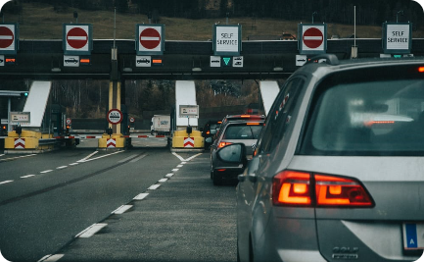
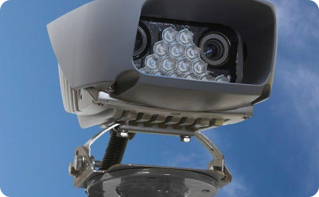
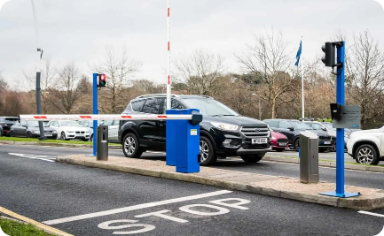
Examples of ANPR Usage
Border control
Surveillance
Car Rental
ANPR can help border control agencies to detect and identify vehicles associated with smuggling or illegal immigration.
ANPR can assist public and private entities in monitoring vehicle movements in public spaces, parking lots, and buildings.
ANPR can be used by car rental companies to track and manage their fleet efficiently and ensure compliance with local laws and regulations.

Slide 8
Conclusion and Future Developments
Conclusion
Future Developments
ANPR is a powerful technology that can provide real-time data on vehicle movements, facilitate law enforcement, reduce crime, and enhance transportation efficiency.
ANPR is expected to continue to advance with the use of machine learning, artificial intelligence, and cloud computing. Future applications may include shared mobility, autonomous driving, and smart cities.

