Slide 1
C-Hub
Detail Project Report

Slide 2
DPR Details
1.Executive Summary:
Objective: Build an internal CHub-like Source Control Management (SCM) system for the company.
MVP features: C hosting, Web UI, Authentication, Repo permissions, Merge Requests, Webhooks, API, CI integration.
2. Project Scope & Objectives:
Scope: Create an internal platform for source code hosting, versioning, collaboration, and CI/CD.
Objectives: Improve code security, enable collaboration, integrate with company systems, ensure scalability.
3. Technical Architecture:
C hosting over SSH & HTTPS.
Core services: API/Web UI, Auth, Git Workers, Background Workers, CI Runners.
Storage: PostgreSQL (metadata), Redis (cache/queue), S3/MinIO (repos & artifacts).
Deployed on Kubernetes with monitoring and backups.

Slide 3
DPR Details
4. Features (MVP):
C hosting with SSH/HTTPS.
Web UI for repos, commits, branches.
User accounts, teams, repo permissions.
Pull/Merge Requests with review workflow.
REST API + Webhooks.
Basic issue tracker.
CI/CD runner integration.
Audit logs and backups.

Slide 4
DPR Details
5. Implementation Roadmap
Phase A (8–12 weeks): C hosting, Web UI, HTTPS purchase,Auth, MR workflow, REST API, backups.
Phase B (8–12 weeks): CI runners, issues, tokens, audit logs.
Phase C (12–20 weeks): Search, SSO, HA, monitoring, DR.
Phase D (Ongoing): Package registries, advanced analytics, enterprise features.
6. Security & Compliance
TLS everywhere, MFA for users, LDAP/SSO integration.
RBAC permissions and branch protection.
Regular backups and DR testing.
Audit logs and monitoring.

Slide 5
DPR Details
7. Tools & Tech Stack
Backend: Node.js.
Frontend: React.
Database: PostgreSQL.
Cache: Redis.
Storage: S3 or On-premises
CI/CD: Kubernetes runners.
Monitoring: Prometheus and Grafana.
8. Recommendations:
Start with CHub
Focus internal effort on integration, scaling, and security.
Adopt phased implementation to ensure smooth rollout.

Slide 6
Frontend Development Team
Language: React.JS
Team Size: 40

Slide 7
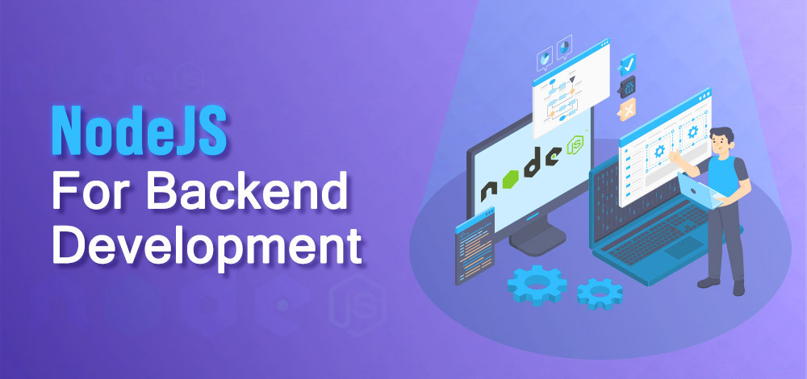
Backend Development Team
Language: Node.JS
Team Size: 30

Slide 8

Database Team
Language: PostgreSQL
Team Size : 5

Slide 9
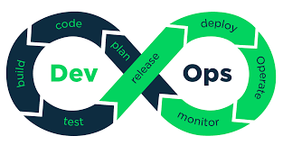
Deployment Team
Deployment using DevOps tools.

Slide 10
Permissions
HTTPS and SSH.
Domain.
Webhook to integrate with Jenkins.

Slide 11
This is my Overview Of Project Report Thank you

