Slide 1

Java Programming Cornerstone Project
Final Review
Online Shopping Cart
Presented by
R JWALITHA PRIYA DARSHINI (24B11CS24)
K MANIKANTA SAI (25B21CS090)
K CHANDRA MOULI (25B21CS065)
K EBENEZER (24B11CS528)
Department of Computer Science and Engineering

Slide 2
Presentation Outline
1. Abstract
2. Introduction
3. System Analysis
4. Technology Description
5. Database Design
6. System Design
7. System Implementation
8. Future Enhancements
9. References
10. Conclusion

Slide 3
ABSTRACT
The Online Shopping Cart (OCS) is a desktop-based Java application designed to simulate a complete e-commerce shopping experience.
It enables users to register, log in, browse available products, add items to their cart, and place orders through a structured and secure workflow.
An admin module allows product management and system oversight, including adding, updating, and removing products from the catalogue.
Developed using Core Java, Java Swing (GUI), JDBC (database connectivity), and MySQL as the backend database, ensuring data integrity and reliability.

Slide 4
INTRODUCTION
The Online Shopping Cart (OCS) provides users with a simulated e-commerce experience on a desktop platform.
Traditional shopping management in small businesses relies on manual records or disconnected tools, leading to data duplication and poor order tracking.
OCS replaces paper-based or spreadsheet-driven order tracking with a relational database solution, improving data accuracy and retrieval speed.
This project focuses on developing a GUI-based Java application for effective shopping cart management using Java, Swing, JDBC, and MySQL.

Slide 5
INTRODUCTION
Objectives of the Project
To develop a user-friendly desktop application for simulating online shopping
To implement secure login and registration for both users and admin
To allow users to browse products, manage a cart, and place orders
To enable the admin to add, update, and manage product listings
To store all data reliably in a MySQL relational database using JDBC
To demonstrate referential integrity through proper foreign key relationships

Slide 6
SYSTEM ANALYSIS
Functional Requirements:
User Registration & Login: Allows new customers to register and authenticated users/admin to log in securely.
Product Browsing: Displays available products with names and prices for users to browse.
Add to Cart: Authenticated users can select products and add them with a defined quantity.
View and Manage Cart: Users can view, update quantities, or remove items from their cart.
Place Order: Users confirm their cart to place an order; total is auto-calculated with timestamp.
Admin Product Management: Admin can add, update, and remove products through a dedicated admin login.

Slide 7
SYSTEM ANALYSIS
Hardware Requirements
Software Requirements
Processor: Intel i3 or above
RAM: Minimum 4 GB
Storage: 20 GB free space
Display: 1024×768 or higher
Input Devices: Keyboard, Mouse
Operating System: Windows 7/10/11
Programming Language: Java (JDK 8+)
IDE: Visual Studio Code (Java Extension Pack)
Database: MySQL Server 5.7+
Connectivity: JDBC (MySQL Connector/J)
Non-Functional Requirements:
Performance: Respond to operations without noticeable delay
Security: Credentials validated before access; passwords stored securely
Usability: Simple, intuitive interface requiring minimal training

Slide 8
TECHNOLOGY DESCRIPTION
Java (Core): High-level, object-oriented, platform-independent language. Implements all core functionality — authentication, cart management, order processing, and database interaction.
Java Swing: GUI toolkit in JFC providing lightweight components — buttons, labels, text fields, tables. Used to build all screens of the Online Shopping Cart application.
JDBC: API that connects Java to databases. Used to execute INSERT, UPDATE, DELETE, SELECT queries and retrieve results for display in the GUI.
MySQL Database: Open-source RDBMS storing all data: products, users, cart items, admin credentials, and orders. Enforces data integrity via primary/foreign keys and NOT NULL constraints.
VS Code: Primary IDE with Java Extension Pack — provides syntax highlighting, IntelliSense, debugging, and integrated terminal for development and testing.

Slide 9
Database Design
Database Tables:
Products Table :
Stores all available product listings
Field Name | Data Type | Key | Description
product_id | INT | Primary Key | Product ID (Auto Increment)
name | VARCHAR(50) | — | Product Name
price | DOUBLE | — | Product Price

Slide 10
Database Design
Database Tables:
Users Table :
Stores registered customer credentials
Field Name | Data Type | Key | Description
user_id | INT | Primary Key | User ID (Auto Increment)
username | VARCHAR(50) | — | User Name
password | VARCHAR(50) | — | User Password

Slide 11
Database Design
Database Tables:
Admin Table :
Stores administrator login credentials
Field Name | Data Type | Key | Description
admin_id | INT | Primary Key | Admin ID (Auto Increment)
username | VARCHAR(50) | — | Admin Username
password | VARCHAR(50) | — | Admin Password

Slide 12
Database Design
Database Tables:
Cart Table :
Stores items added to cart by each user
Field Name | Data Type | Key | Description
cart_id | INT | Primary Key | Cart ID (Auto Increment)
product_id | INT | Foreign Key | References Products
user_id | INT | Foreign Key | References Users
quantity | INT | — | Item Quantity (Default: 1)

Slide 13
Database Design
Database Tables:
Orders Table :
Records confirmed orders with total amount and timestamp
Field Name | Data Type | Key | Description
order_id | INT | Primary Key | Order ID (Auto Increment)
user_id | INT | Foreign Key | References Users
total_amount | DOUBLE | — | Total Order Amount
order_date | TIMESTAMP | — | Default: CURRENT_TIMESTAMP

Slide 14
SYSTEM DESIGN
Modules:
User Module: Handles user registration, login, product browsing, cart management, and order placement.
Admin Module: Admin login via dedicated screen; allows adding, updating, and deleting products from the catalogue.
Cart Module: Manages cart items — links products to users, tracks quantities, and supports removal.
Order Module: Confirms cart contents as an order, calculates total, and stores order with timestamp.
Database Connectivity Module: Establishes JDBC connection to MySQL and executes all SQL operations.
User Interface Module: All Swing-based screens that present information and capture user input.

Slide 15
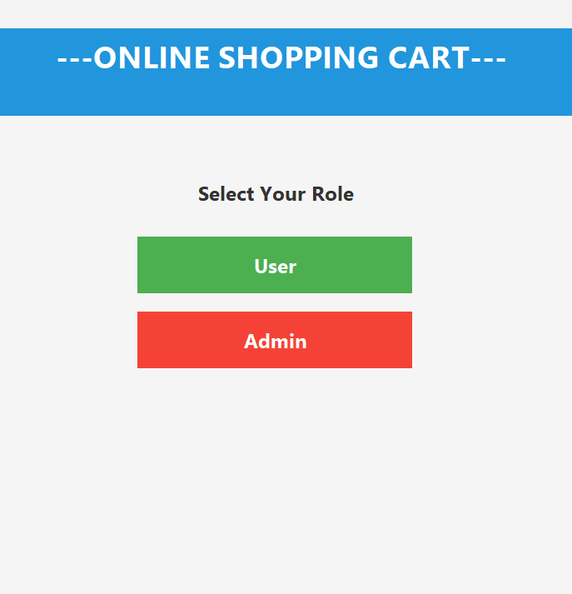
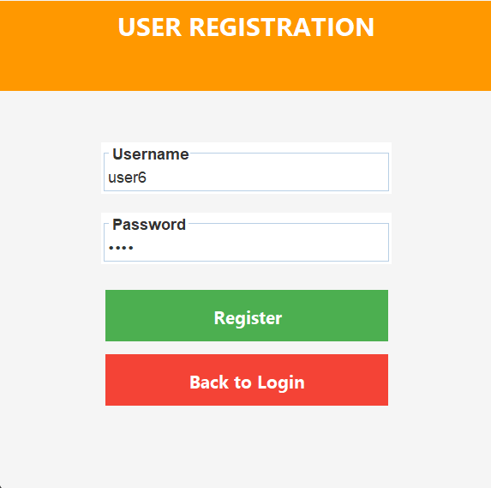
SYSTEM IMPLEMENTATION
Login Screen:
User Registration Screen:
Displays the login interface where the user or admin enters their username and password to access the system.
Displays the registration form where new users enter a username and password to create an account.
[Screenshot to be inserted]
[Screenshot to be inserted]

Slide 16
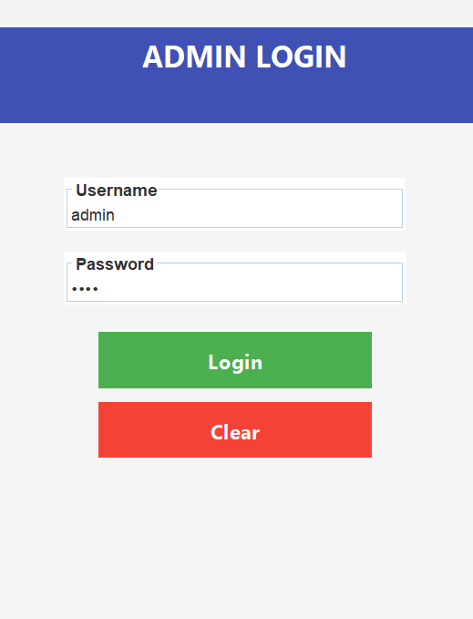
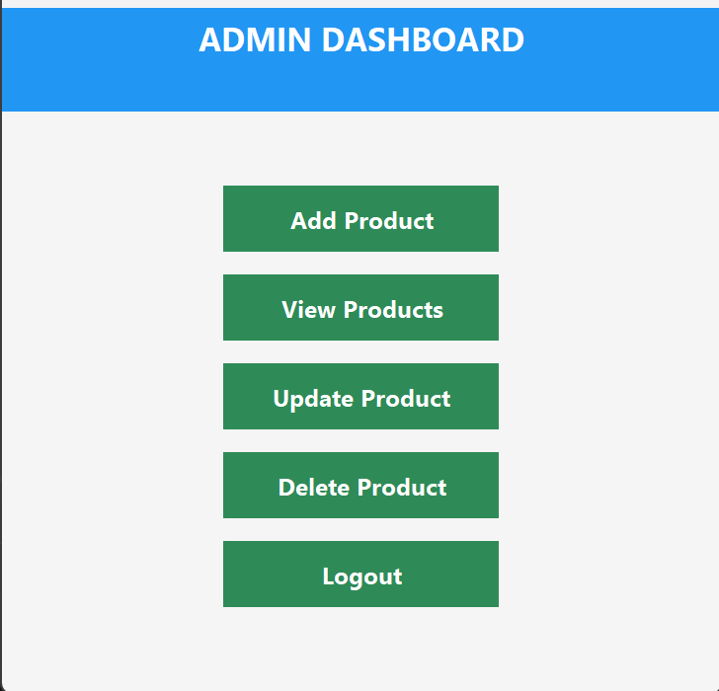
SYSTEM IMPLEMENTATION
Admin Login Screen:
Admin Product Management Screen:
Displays a dedicated admin login interface. The admin enters credentials to access the admin panel, separate from the user login flow.
Shows the admin panel where the administrator can add new products, update existing product details (name and price), and delete products from the system.
[Screenshot to be inserted]
[Screenshot to be inserted]

Slide 17
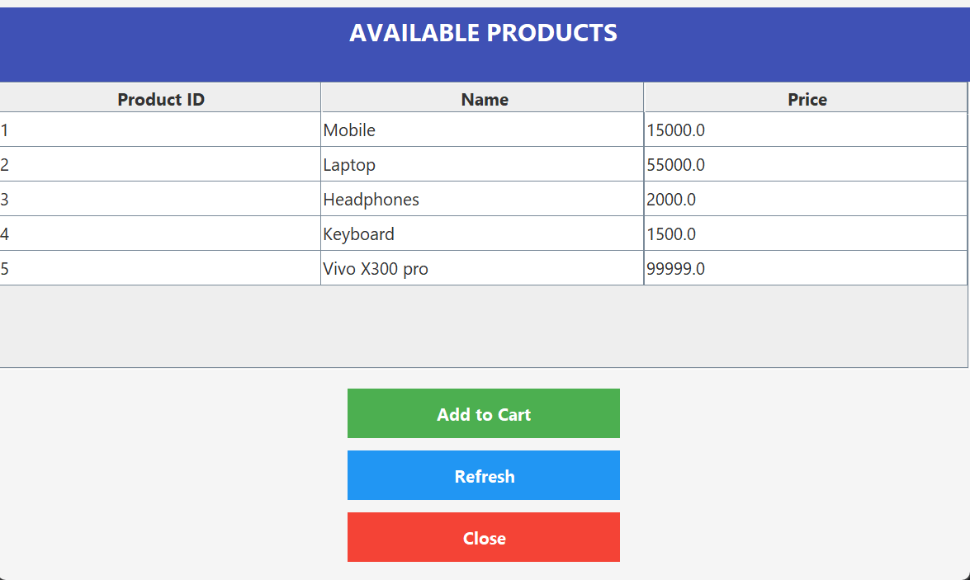
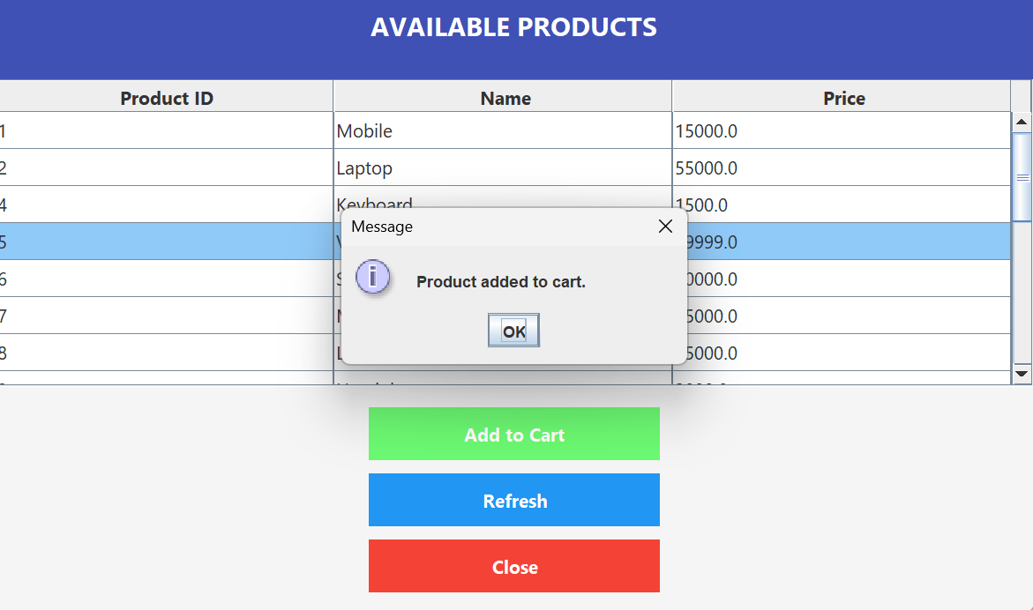
SYSTEM IMPLEMENTATION
Product Listing Screen:
Add to Cart Screen:
Shows all available products with their names and prices. Users can select items to add to their cart.
Allows users to select a product, specify quantity, and confirm adding the item to their cart.
[Screenshot to be inserted]
[Screenshot to be inserted]

Slide 18
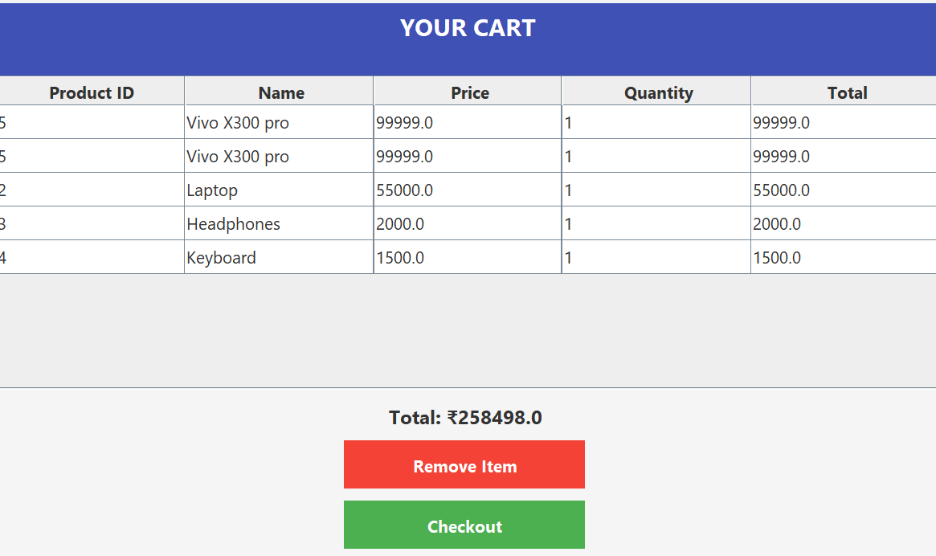
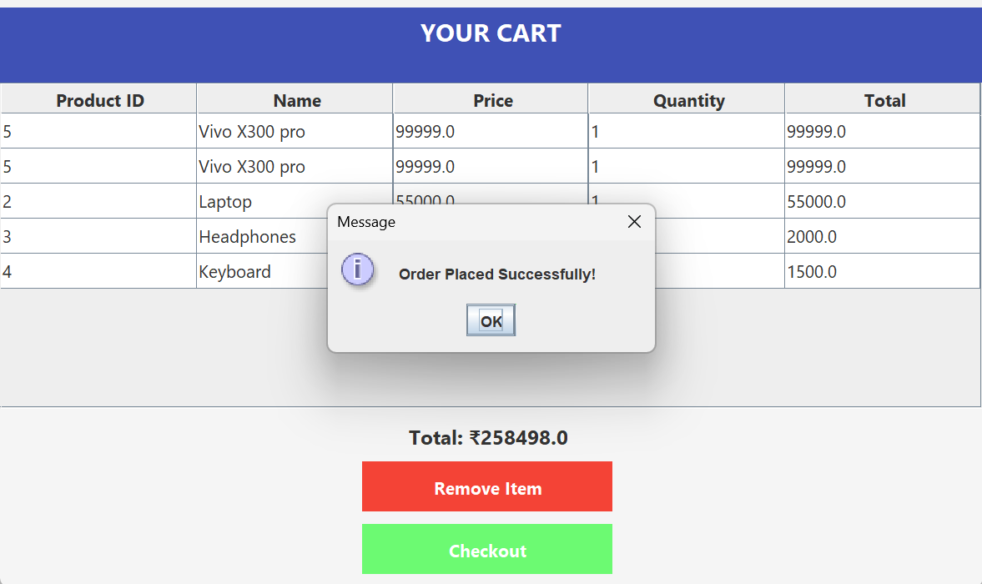
SYSTEM IMPLEMENTATION
Cart View Screen:
Order Summary Screen:
Displays all items currently in the user's cart with product names, quantities, and individual prices.
Shows a summary of the confirmed order including total amount and order date after successful checkout.
[Screenshot to be inserted]
[Screenshot to be inserted]

Slide 19
FUTURE ENHANCEMENTS
Payment Gateway Integration: Adding support for UPI, credit/debit card, or net banking to simulate real-world checkout.
Order History & Invoice Generation: Enabling users to view past orders and download PDF invoices for each completed purchase.
Product Search and Filtering: Keyword search, category filtering, and price range filtering for faster product discovery.
Web-Based Application: Migrating the desktop application to a web-based platform using Java Servlets, JSP, or Spring Boot.
Role-Based Access Control: Expanding authentication to support multiple admin roles with different permission levels.
Stock / Inventory Management: Adding a stock quantity field to prevent overselling and track product availability.
Improved User Interface: Redesigning the GUI with modern themes, responsive layouts, and improved visual feedback.

Slide 20
REFERENCES
The following references were used during the development of the Online Shopping Cart:
1. Herbert Schildt, Java: The Complete Reference, Oracle Press, 11th Edition.
2. E. Balagurusamy, Programming with Java, McGraw Hill Education.
3. Korth, Silberschatz, Sudarshan, Database System Concepts, McGraw Hill.
4. MySQL Documentation, https://dev.mysql.com/doc/
5. Java Documentation (Oracle), https://docs.oracle.com/javase
6. JDBC Tutorial – GeeksforGeeks, https://www.geeksforgeeks.org/jdbc/
7. Java Swing Tutorial – TutorialsPoint, https://www.tutorialspoint.com/java_swing
8. W3Schools Java Tutorial, https://www.w3schools.com/java/

Slide 21
CONCLUSION
The Online Shopping Cart was successfully developed as a desktop-based Java application simulating a complete e-commerce workflow.
The system replaces manual product and order tracking with a reliable, database-driven solution, improving data consistency and accessibility.
All planned functionalities have been delivered: user registration, product browsing, cart management, order placement, and admin product control.
Technologies — Java, Swing, JDBC, and MySQL — ensure stable performance, data integrity through relational constraints, and a user-friendly experience.
The project successfully demonstrates object-oriented programming, GUI development, and relational database design.
The application provides a scalable foundation for future enhancements such as payment integration and web-based access.

Slide 22
THANK YOU
Online Shopping Cart | Department of Computer Science and Engineering

