Slide 1
C++ Project
Student Management System
Professor Name: Kavitha Rani

Slide 2
Project Participants
1) R. Abhiram Chowdary - AP23110010260
2) K. Tejaswi - AP23110010276
3) K. Lakshmi Swetha - AP23110010286
4) T. Bala Manindra - AP23110010293

Slide 3
Table of Contents
Problem Statement
Introduction
Core Concept Used in the Code
Source Code
Ouputs of the Code
Code Analysis
Conclusion

Slide 4
Problem Statement
Managing student records manually is prone to human errors and inefficiencies, leading to inaccuracies and data inconsistencies. This process is time-consuming, limiting the ability to access, update, and analyze information quickly. As the number of students grows, scalability becomes a significant challenge, making traditional methods unsustainable.

Slide 5
Introduction
A C++ program for student management
Uses a doubly linked list structure
Supports adding, removing, searching, and displaying students
Emphasizes efficiency and simplicity
Suitable for small to medium datasets

Slide 6
Core Concept Used in the Code
Doubly Linked List for student records
Dynamic memory allocation using pointers
Modular programming for clarity and reusability
Efficient traversal for searching and displaying
Destructor to ensure memory cleanup

Slide 7
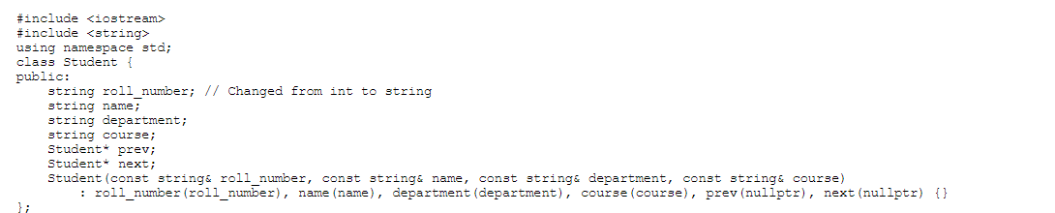
Student Class:

Slide 8
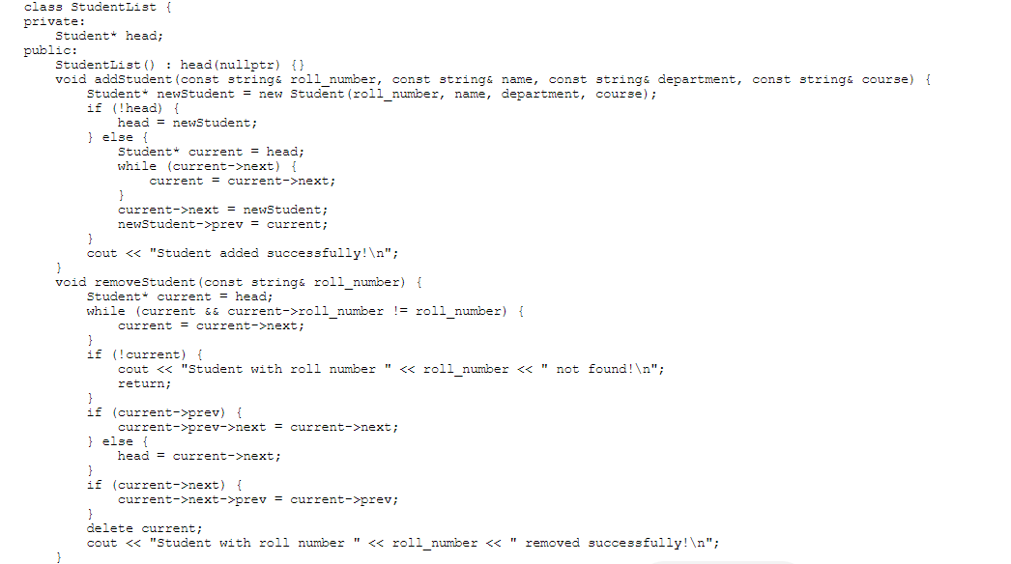
StudentList Class:

Slide 9
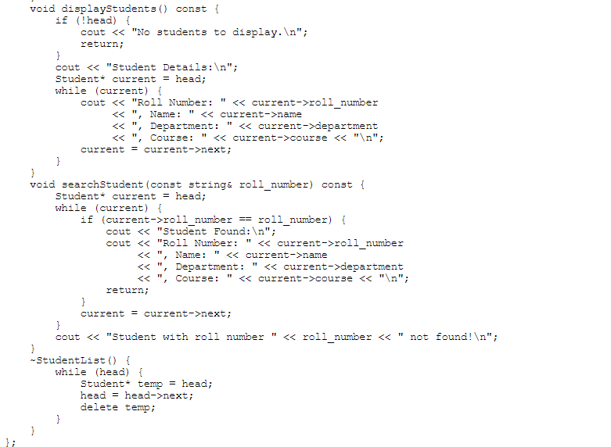

Slide 10
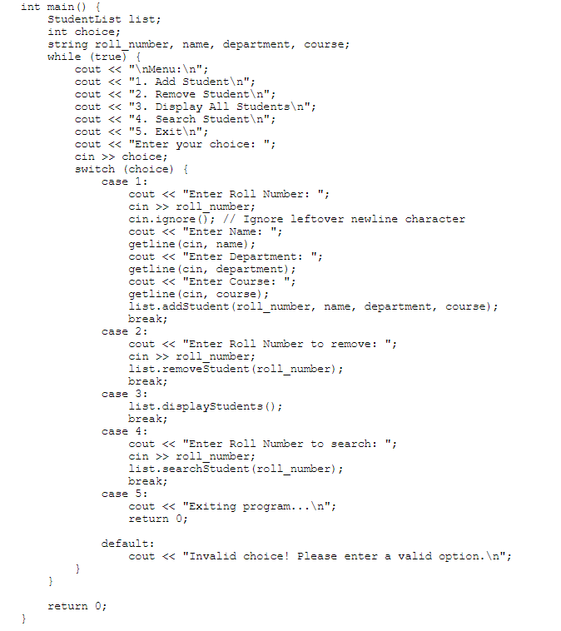
Main Function:

Slide 11
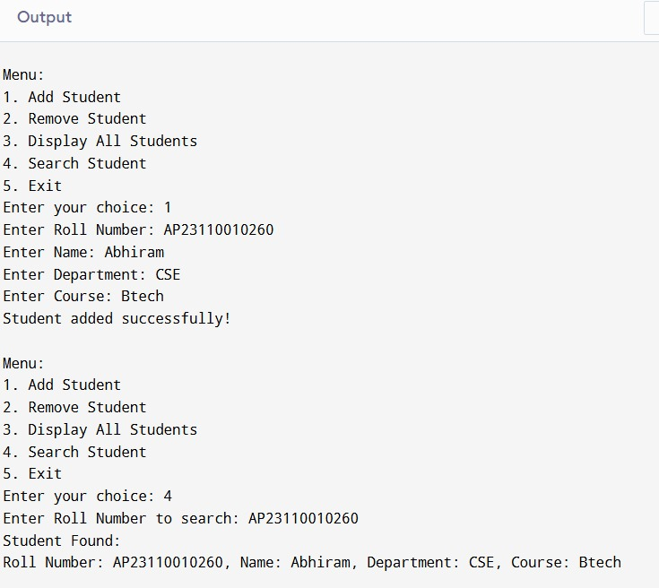
Add and Search a Student:

Slide 12
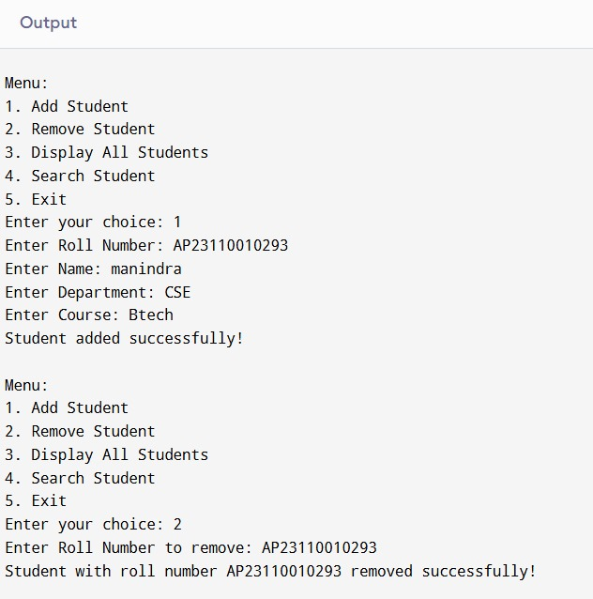
Add and Remove Student:

Slide 13
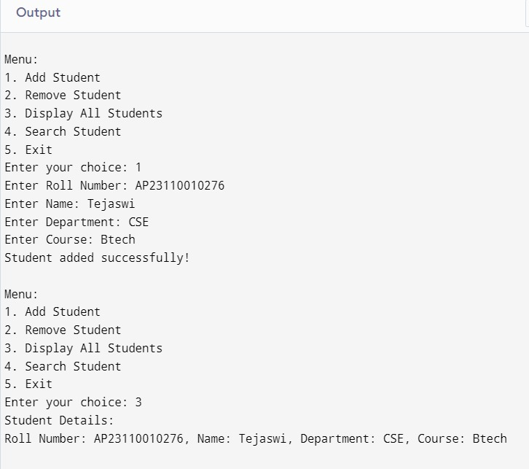
Add and Display Student:

Slide 14
Code Analysis
Object-Oriented Programming concepts used
Encapsulation through the StudentList class
Dynamic list manipulation using pointers
Robust error handling for invalid inputs
Seamless user interaction through a menu-driven interface

Slide 15
Conclusion
Provides an efficient solution for student management
Demonstrates the power of linked lists in C++
Easy to extend for larger systems or additional features
Emphasizes modular design for maintainability
Practical application for educational institutions

Slide 16
Thank You

