Slide 1
Introduction
Hello ! Greetings to all . I am here to share my insights for the company
sales performance for the year of 2011.
I appreciate TATA Group for providing me with this opportunity to gain insightful information from the data of stores’ Performance.
Thanks to respected CEO and CMO for questions asked to me and provide directions for the insights of the data.

Slide 2
Thought Process
I ensure you that I look all the necessary steps to ensure that this analysis is accurate and correct.
I cleaned up the data you provided by removing all the negatives values in the unit price and quantity columns and also filtered the data as required for all the visualizations.

Slide 3
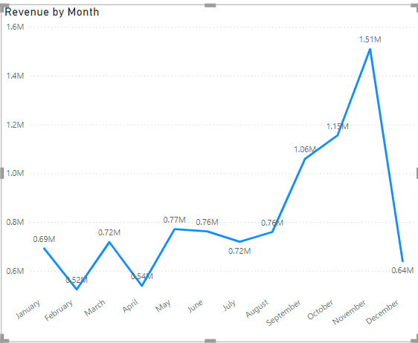
The first 8 months had stable monthly revenue with an average of 685K.
The revenue trend from August to December how seasonally are the retail store sales.

Slide 4
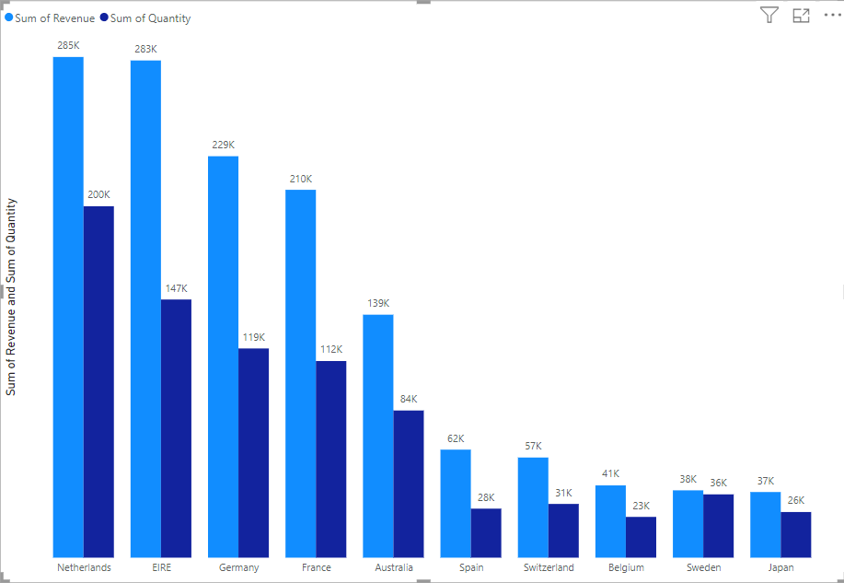
This chart represents the top 10 countries in revenue and the quantities bought in these countries except the United Kingdom.
There is no major difference between the revenue and the quantity of goods and sold in these countries showing a high performance power in these countries.

Slide 5
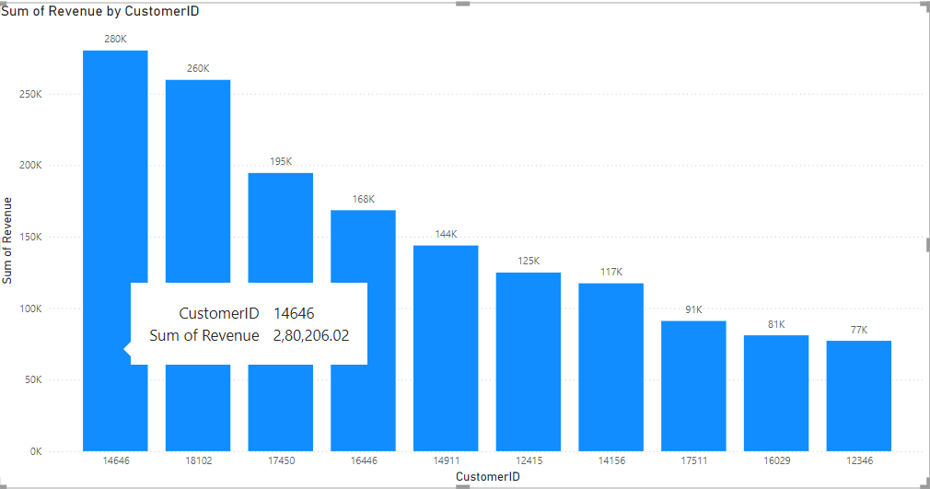
The average difference in revenue between the top 10 countries is 15.8%.
The company can aim to strengthen the relationships with these customers to increase customer loyalty and retention and ultimately drive more sales and revenue for the company.

Slide 6
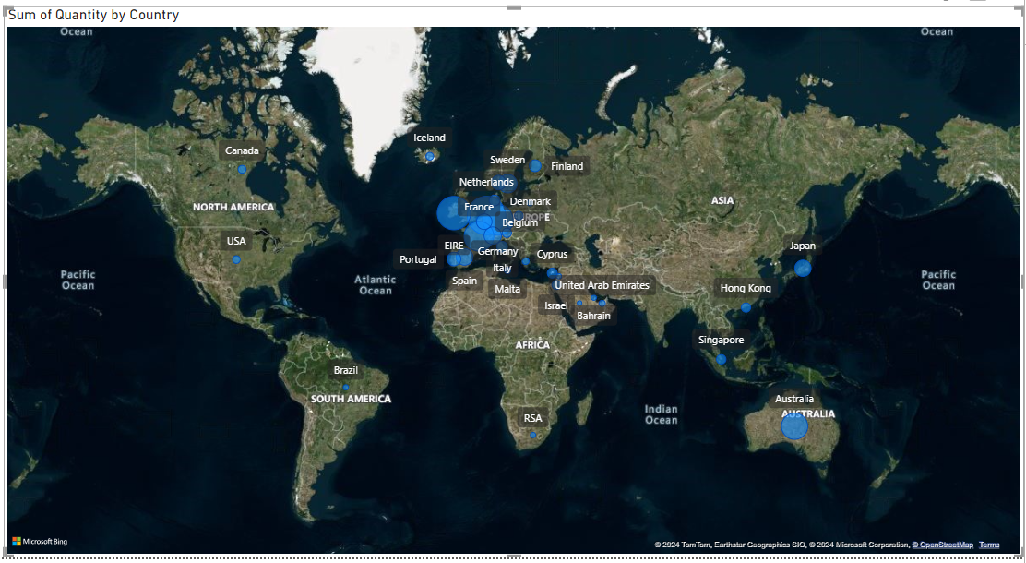
The map chart concludes by comparing the places that have produced the greatest
revenue to those that have not.
There is no market in Africa, Asia and Russia .
The map also reveals that the majority of the sales occur only in European market more and dive deeper into these region to maximize sales.

Slide 7
recommendations
The company should come up with strategies that aim at shocking and advertising seasonal products to maximize sales when the demand go up.
The company should create special relationship with the customers who order in big quantities in order to increase the retention.
The European market has more potential to grow sales hence company should build strategies to maximize the sales.

