Slide 1

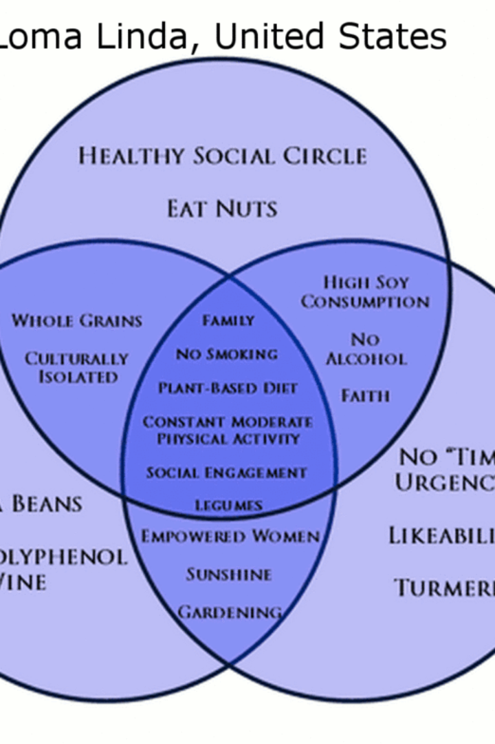

Blue Zones Project
The Blue Zones Project aims to promote longevity and healthier living based on the research conducted in regions called "Blue Zones," where people live longer and healthier lives.
by Team 1.

Slide 2

Origins of the Blue Zones Project
The Blue Zones Project originated from the research conducted by National Geographic Fellow Dan Buettner and his team. They studied regions such as Okinawa, Sardinia, Nicoya, Icaria, and Loma Linda to identify the key elements contributing to longevity and well-being.

Slide 3
Lifestyle in Blue Zones
1
Plant-Based Diet
2
Regular Physical Activity
In Blue Zones, the population follows a predominantly plant-based diet rich in fruits, vegetables, legumes, and whole grains.
Blue Zone residents engage in natural physical activities like walking, gardening, and manual labor to stay active and healthy.
3
Social Connections
4
Sense of Purpose
Strong social connections and a sense of community play a vital role in the well-being of individuals living in Blue Zones.
Having a strong sense of purpose or "ikigai" contributes to lower stress levels and a positive outlook on life in Blue Zones.
5
Moderation in Consumption
6
Stress Reduction Practices
In Blue Zones, moderation in eating and drinking is practiced, with a focus on mindful enjoyment of food within the context of social gatherings.
Blue Zone inhabitants incorporate stress reduction practices like rituals, mindfulness, and relaxation into their daily lives.

Slide 4

Pilot Projects in Alberta Lea, Minnesota, USA, and Singapore
Alberta Lea, Minnesota, USA
The Blue Zones Project was first implemented in Alberta Lea, Minnesota, involving collaboration with local leaders, businesses, schools, and residents to encourage healthier lifestyle choices.
Singapore
The Blue Zones Project expanded globally with a pilot project in Singapore, adapting Blue Zone principles to the urban context of the city-state.

Slide 5
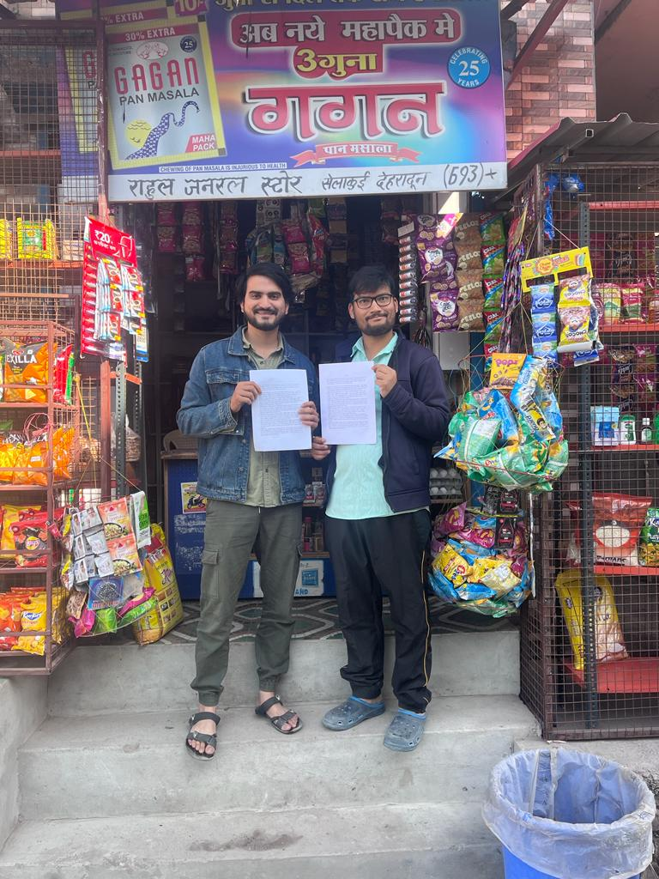
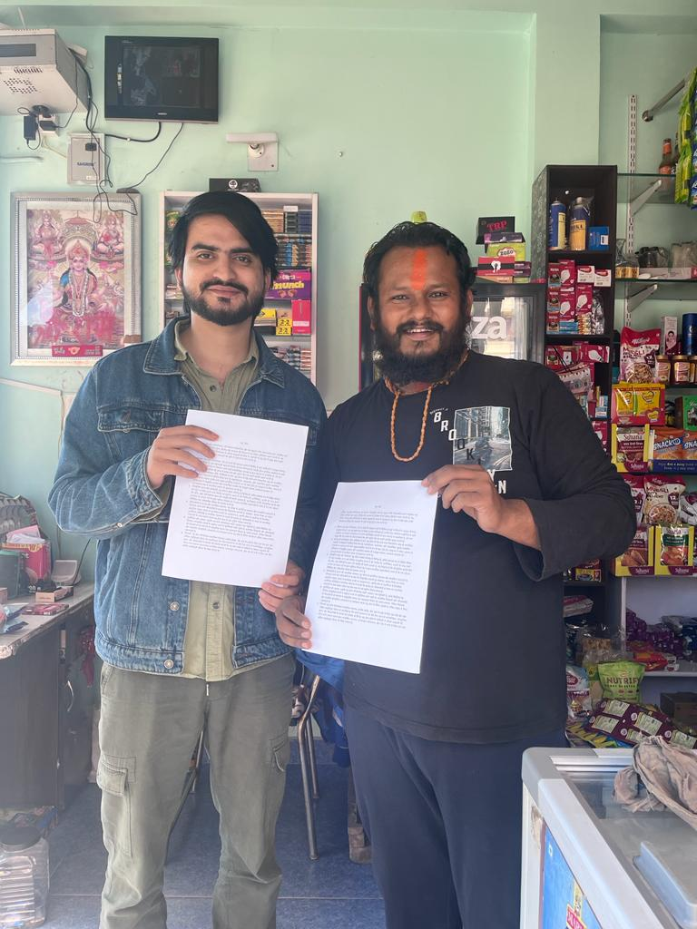
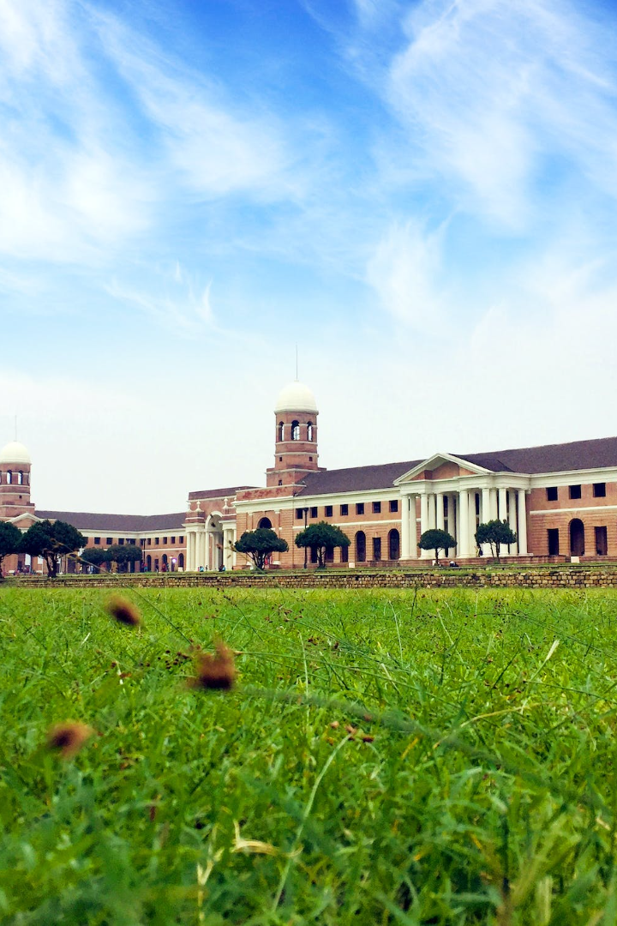
Community Outreach in Dehradun
During our visit to a local neighborhood in Dehradun, we shared the findings of the Blue Zones Project, translating them into Hindi to promote healthier living in the community.

Slide 6

Interview With a Centenarian
We had the privilege of interviewing Mr. Sethuraman, a remarkable 97-year-old former engineer who shared his secrets to a happy and long life.

Slide 7
Potential Blue Zones in India
Kerala, India
Himachal Pradesh, India
Sikkim, India
Uttarakhand, India
Known for dietary habits, cultural practices, and social connectivity, Kerala showcases the interconnectedness of lifestyle factors contributing to longevity.
Sikkim boasts a plant-based diet, harmonious living, and community unity as factors that contribute to the potential of becoming a Blue Zone.
With an active routine, local nutrition, and a rich cultural heritage, Uttarakhand has the potential to foster longevity and well-being as a Blue Zone.
Himachal Pradesh stands out with its active lifestyle, natural diet, and strong social bonds that contribute to the well-being of the community.

Slide 8
Conclusion
The potential Blue Zones in India illustrate diverse yet interconnected lifestyles that align with the global Blue Zone principles. Further research is required to validate the impact of lifestyle factors on longevity within the Indian context. Embracing these unique aspects can inspire a broader conversation about fostering well-being and longevity in diverse cultural settings.

