Slide 1

Reviving Cherry Blossom: A Journey of Innovation and Adaptation
Once a dominant leader in the shoe care market, Cherry Blossom faced challenges in the late 1990s, witnessing a significant decline in market share. Join us as we explore the journey of Cherry Blossom and how it navigated through changing consumer habits and the emergence of competitors to revive its position as a market leader.
by Manivannan P.T.

Slide 2

About Cherry Blossom
Cherry Blossom is a century-old brand in the shoe care market, known for its commitment to quality and innovation. With a rich heritage and a strong focus on customer satisfaction, Cherry Blossom has been a trusted choice for discerning shoe care consumers for decades. Let's delve into the fascinating story of this iconic brand.

Slide 3

The Evolving Shoe Care Landscape
1
The Dominance of Cherry and Kiwi
In the past, Cherry and Kiwi held a commanding share of the Indian market, both in value and volume. Their products were synonymous with shoe care for generations of customers.
2
Changing Consumer Preferences
The growth in non-leather shoes and evolving consumer preferences brought about a shift in the shoe care market. Cherry Blossom needed to adapt to these changing dynamics.
3
The Rise of Competitors
With the entry of Kiwi in the Indian market and its aggressive consumer promotions, Cherry Blossom faced fierce competition that challenged its market leadership.

Slide 4

The Traditional vs. Liquid Shoe Polish Debate
1
Traditional Wax Polishes
2
Cherry's Liquid Innovation
3
Consumer Preferences and Adoption
For years, shoe polish in India was synonymous with wax polishes. Traditional users valued the nourishment and craftsmanship associated with wax-based products.
In 1991-92, Cherry introduced liquid shoe polish, providing a more convenient alternative. However, the perception that it dried leather and lacked nourishment affected its widespread adoption.
While some embraced the convenience of liquid polishes, loyal wax polish users, especially serious shoe care enthusiasts, remained devoted to the traditional format.

Slide 5

The Competing Forces: Cherry vs. Kiwi
Cherry Blossom
With a rich heritage and long-standing brand loyalty, Cherry Blossom had maintained a dominant position in the market. However, the rise of Kiwi challenged its market share.
Kiwi
A multinational brand, Kiwi strategically entered the Indian market in the 1970s. By the 1990s, it actively pursued market dominance through aggressive consumer promotions and a focus on non-leather shoes.
Brand Visibility and Market Share
Kiwi's relentless efforts propelled it ahead of Cherry Blossom in terms of market share and brand visibility. Cherry Blossom needed to devise a strategy to regain its lost ground.

Slide 6
Trends Shaping the Footwear Market
The footwear market witnessed significant changes in recent years, impacting the growth of the shoe care industry. From shifting shoe ownership trends to the introduction of new shoe types like sports shoes and sneakers, consumer preferences were evolving rapidly. Let's explore these trends in detail.

Slide 7

The Power of Distribution
RBIL's extensive distribution network, reaching over a million outlets, served as a significant strength for Cherry Blossom. The brand's deep penetration in the trade channel, particularly in northern India, contributed to its market presence, while Kiwi had a comparatively narrower distribution. Understanding the power of distribution and leveraging it effectively became crucial for Cherry Blossom's revival.

Slide 8
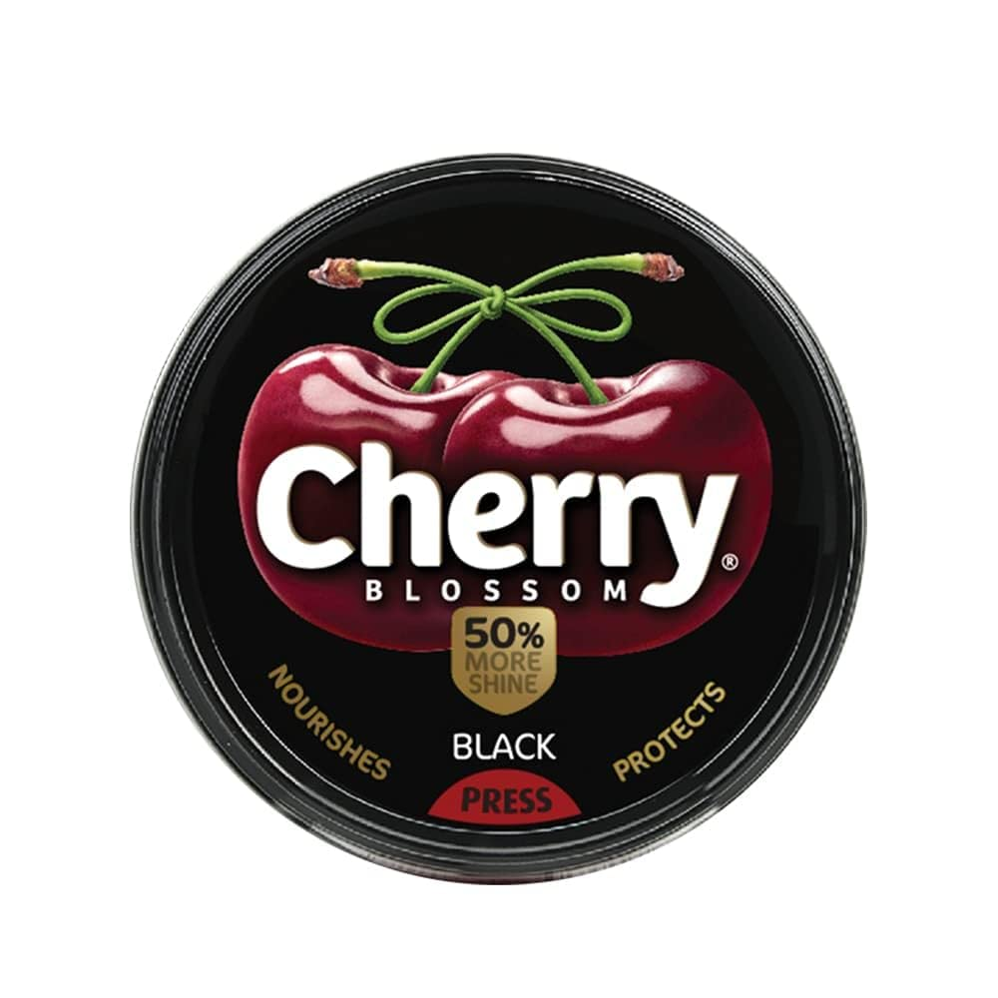

Reviving Cherry Blossom: The Path Forward
Embracing Innovation
Market Analysis and Insights
Cherry Blossom will embark on a journey of innovation, leveraging its rich heritage to develop products that cater to evolving consumer preferences, while retaining the craftsmanship that loyal customers cherish.
Deep market analysis and consumer insights will drive strategic decision-making, enabling Cherry Blossom to identify growth opportunities and position itself as a brand that understands and fulfills the needs of its target audience.

Slide 9
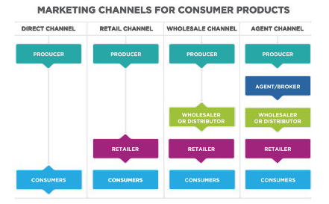

Customer Satisfaction and Engagement
Optimizing Distribution Strategies
Cherry Blossom will focus on optimizing its distribution strategies, leveraging its extensive network to reach a wider customer base and strengthening its presence in key markets.
Ultimately, Cherry Blossom's success hinges on delighting its customers. By prioritizing customer satisfaction and engaging with shoe care enthusiasts, the brand will enhance loyalty and build long-lasting relationships.

