Slide 1


Match. Connect. Thrive.

Slide 2

Team
ManiVannan - Executive operations and management
Robin - Field operations
Simran - Strategies
Ashmita - Content and CRM
Aiman : Funds and Financials

Slide 3
What and Why we do
We provide a overall modernised solution to hotels and businesses finding sources for their business aka the distributors and we provide them with the assurance and quality
We provide the distributors the right business to approach based on their bandwidth and capacity
We ensure quality and schedule for the hotels ensuring maximum productivity thus thriving in their business

Slide 4
Pain Points
We observed that the purchase managers and operation managers struggle to keep up with timelines and trust with the vendors for their business
And this wasn't just the case for hotels there were a spectrum of businesses that struggle with finding the right resource for them
We took that decision to help B2B to thrive by being the middle men for these businesses to connect
Streamlining the process to find the right resource person is what we do

Slide 5
USP
The Introduction of hyper-connectivity in supply chain
The fairly traditional process of supply chain to be revolutionised
Introduction of trustable source of app that not only guarantees quality but also punctuality
Eliminating of middle man and unwanted confusions and delays in supplies
Easy access via app and no long process of PO and bills or cheques.

Slide 6
Business Model
Places we will make money:
Platform entry fees (minimal)
For each order depending on the order size we will get commissions
The Percentage of commissions in the product will be decided by the company
The distributor and the purchase dept will both be satisfied with the Cut percentages

Slide 7
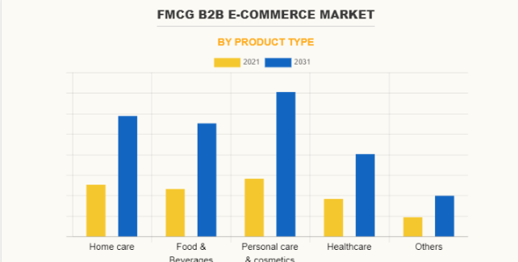
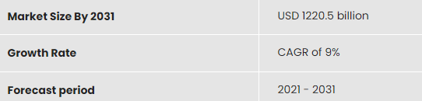
Market size

Slide 8
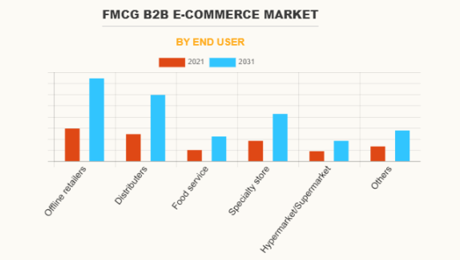

Slide 9
Traction
Connections.
Hotels - Hyatt, the park , hyatt regency , Chroma, taj coromandel, feather, chola ITC , GRT grand , Tulaa , HOliday INN , TULIP , etc,
Hospitals , Vending Machines , Hospitality managements companies, catering services , spas, Resorts etc.
Distributors : SUNSRI, VIJL, Third eye, Esquire etc.

Slide 10
Competition
No Competition,
Travel Agencies : make my trip , Agoda , Booking.com - May be

Slide 11
Funding Need
Why we need Funds:
App development and management,
Initial partnerships and contracts
Company induction and Office spaces
To support the Growing Man Power.

Slide 12
Equity And Exit
Equal Equity among 5 members: 20% each
Exit options : Ideally looking to launch a IPO after going global and having a international market.

