Slide 1

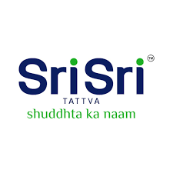

Sri Sri Tattva: Unlocking Growth and Wellness
Sri Sri Tattva (SST), founded by spiritual guru Sri Sri Ravi Shankar, is a renowned brand dedicated to holistic health and wellness. With an aim to expand internationally and establish more exclusive stores in India, SST offers a diverse range of high-quality products across various segments.
by Manivannan P.T.

Slide 2
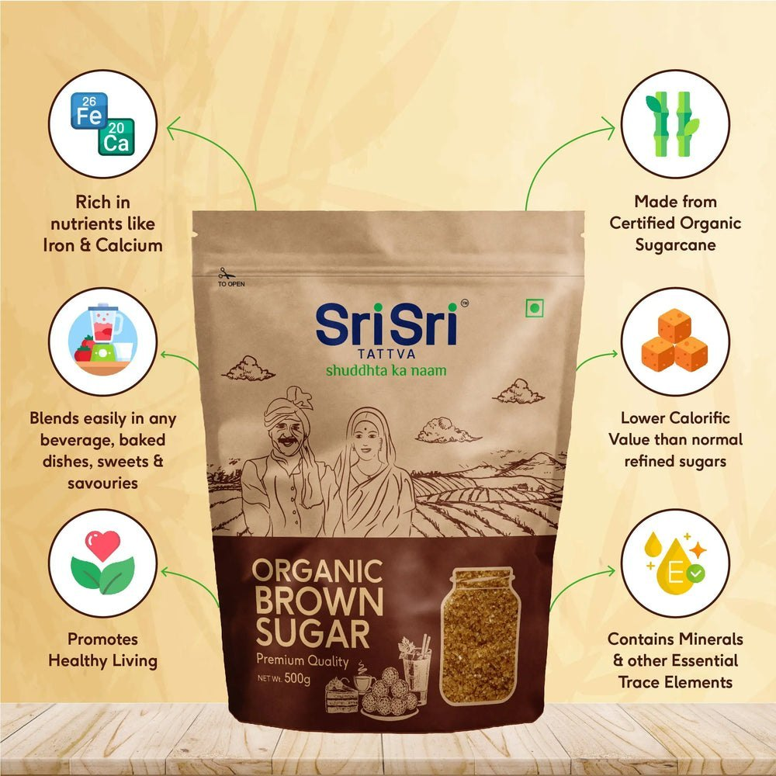
Company Background
Founded in 2003
As part of the Art of Living group, SST has evolved from an ayurvedic medicine manufacturing company to a leading FMCG player with over 350 products.
Premium Positioning
SST's commitment to quality and extensive research has established its premium positioning in the market, setting it apart from competitors.
Diverse Product Portfolio
From groceries to personal care and health supplements, SST caters to a wide range of consumer needs, consistently expanding its product portfolio.

Slide 3
Marketing Mix
Product
Price
Place
SST offers a comprehensive range of groceries, beverages, personal care, and health supplements to meet diverse consumer needs.
With a focus on quality and purity, SST employs a premium pricing strategy, attracting consumers who appreciate the value of herbal products.
Accessing SST products is convenient through 600 franchise stores, Divine Shops, and online platforms, with plans for more specialized stores in the future.

Slide 4
Marketing Mix (Continued)
Promotion
People
Process
Physical Evidence
SST invests significantly in marketing, leveraging mass media, point-of-sale advertising, and strategic partnerships to enhance brand visibility.
At the core of SST's success is its dedicated workforce led by CEO Tej Katpitia, committed to delivering high-quality products and offering Ayurvedic consultations.
SST's GMP-certified manufacturing facilities and technological advancements ensure efficient production of Ayurvedic medicines, cosmetics, and food products.
Tangible elements like the College of Ayurvedic Science, Panchakarma center, and wellness centers substantiate SST's commitment to holistic health and wellness.

Slide 5

The FMCG Market in India
1
Dynamic Market Growth
2
Competition and Landscape
3
Meeting Diverse Consumer Needs
The FMCG market in India is witnessing rapid growth driven by rising income levels, evolving lifestyles, and increasing awareness of herbal and Ayurvedic products.
SST faces competition from established players like Hindustan Unilever, Dabur, Patanjali, and the Himalaya Drug Company in a diverse and competitive landscape.
India's culturally diverse consumer base seeks products that cater to their distinct preferences influenced by religion, language, tradition, and increasing disposable incomes.

Slide 6
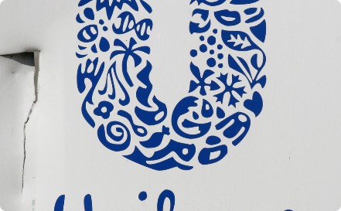
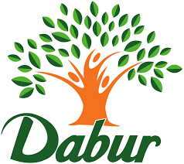
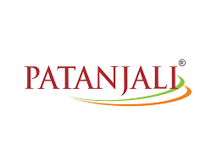

Competitors
Hindustan Unilever
Dabur
One of the main competitors, Hindustan Unilever, brings a strong portfolio of FMCG products and a wide market reach.
Dabur is known for its extensive range of herbal products, backed by a rich heritage and a loyal customer base.
Patanjali
Himalaya Drug Company
The rapidly rising Patanjali, founded by Baba Ramdev, has gained popularity for its Ayurvedic offerings and focus on indigenous products.
A trusted name in herbal healthcare, the Himalaya Drug Company offers a diverse range of Ayurvedic and personal care products.

Slide 7

Conclusion
1
Strategic Marketing Mix
SST's marketing mix, encompassing product diversification, premium pricing, omni-channel distribution, and robust promotion, positions the brand effectively in the competitive FMCG landscape.
2
Commitment to Holistic Health
SST's focus on holistic health and wellness, backed by tangible physical evidence like the College of Ayurvedic Science and wellness centers, aligns with the evolving preferences of the diverse Indian consumer base.

