Slide 1

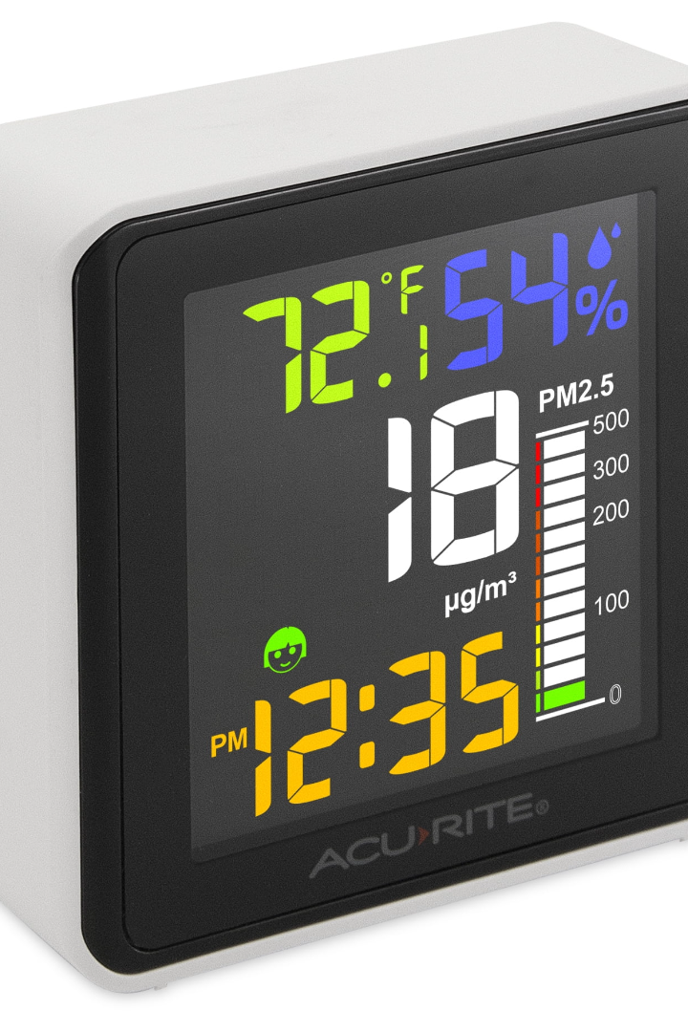
Python Program for Air Quality Monitoring with IoT Sensors
In this presentation, we will explore the fascinating world of air quality monitoring using IoT sensors. Join us as we delve into the importance, working principle, benefits, and challenges of this innovative technology.

Slide 2

Air Quality Monitoring: An Introduction
1
What is Air Quality Monitoring?
2
Importance of Monitoring Air Quality
3
Overview of IoT Sensors
Explore the role of IoT sensors in revolutionizing air quality monitoring and data collection.
Discover the definition and purpose of air quality monitoring and its impact on human health and the environment.
Learn why monitoring air quality is crucial for sustainable development and creating healthier living environments.

Slide 3
Working Principle of IoT Sensors for Air Quality Monitoring
1
Sensor Placement
Discover how the strategic placement of IoT sensors ensures accurate and representative air quality data.
Data Collection
2
Learn about the process of collecting real-time air quality data using IoT sensors and its integration with software platforms.
3
Data Analysis
Explore the analysis techniques utilized to interpret the collected air quality data and identify potential health hazards.

Slide 4


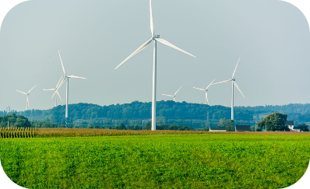
Benefits of Using IoT Sensors for Air Quality Monitoring
Promoting Healthier Communities
Enabling Smart City Initiatives
Driving Green Energy Transition
Discover how IoT sensors contribute towards creating cleaner and healthier cities by monitoring air pollutants.
Explore how the integration of IoT sensors in air quality monitoring fosters sustainable and efficient urban development.
Learn how IoT sensors assist in identifying air pollution sources and supporting the transition to renewable energy sources.

Slide 5
Challenges and Limitations of IoT Sensors for Air Quality Monitoring
Data Accuracy
Complexity of Data Analysis
Explore the challenges associated with ensuring accurate and reliable air quality data collected by IoT sensors.
Discuss the complexity of analyzing vast amounts of air quality data obtained from IoT sensors.
Regulatory Compliance
Data Visualization
Learn about the challenges of ensuring regulatory compliance in the use of IoT sensors for air quality monitoring.
Understand the importance of effectively visualizing air quality data to provide meaningful insights for decision-making.

Slide 6
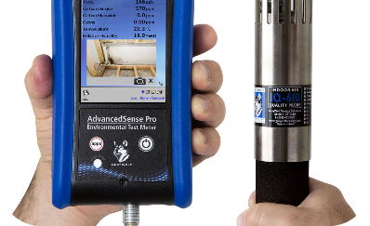
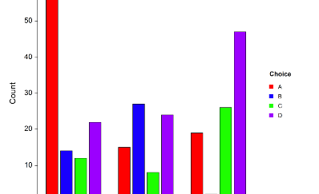
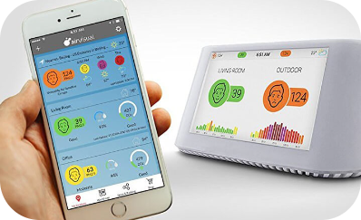
Current Technology in Air Quality Monitoring Sensors
Advanced Sensor Technologies
Data Analytics and Machine Learning
Mobile Applications for Air Quality Monitoring
Discover the latest advancements in sensor technologies used for precise air quality measurements.
Explore how data analytics and machine learning algorithms enhance the interpretation of air quality data.
Learn about user-friendly mobile apps that enable individuals to monitor air quality in real-time.

Slide 7
Full Project Implementation Budget
Component
Estimated Cost
IoT Sensors
$5,000
Data Storage and Analysis Software
$2,000
Data Visualization Tools
$1,000
Installation and Maintenance
$3,000

Slide 8
Implementation of Air Quality Monitoring in Society
1
Government Initiatives
Explore how governments are implementing air quality monitoring systems to regulate pollution levels and protect public health.
2
Business and Industrial Applications
Learn how industries are adopting air quality monitoring technologies to enhance workplace safety and environmental stewardship.
3
Community Engagement
Discover how communities can actively participate in air quality monitoring programs and contribute to building healthier neighborhoods.

Slide 9
Working Principle of IoT Sensors for Air Quality Monitoring
1
Sensor Placement
Discover how the strategic placement of IoT sensors ensures accurate and representative air quality data.
Data Collection
2
Learn about the process of collecting real-time air quality data using IoT sensors and its integration with software platforms.
3
Data Analysis
Explore the analysis techniques utilized to interpret the collected air quality data and identify potential health hazards.

Slide 10
Hardware Requirements :
Monitoring air quality using a Raspberry Pi and IoT involves connecting air quality sensors to the Raspberry Pi and then sending the collected data to an IoT platform or server for analysis and visualization. Below is a simple example using a Raspberry Pi and the Adafruit CCS811 air quality sensor. Make sure you have the necessary libraries installed by running

Slide 11
Python program :
import time
import board
import busio
import adafruit_ccs811from datetime
import datetime
from Adafruit_IO import Client, Feed, RequestError
# Adafruit IO setup
ADAFRUIT_IO_USERNAME = 'YOUR_AIO_USERNAME’
ADAFRUIT_IO_KEY = 'YOUR_AIO_KEY’
# Create an instance of the REST client
aio = Client(ADAFRUIT_IO_USERNAME, ADAFRUIT_IO_KEY)
# Create a new feed
try:
air_quality_feed = aio.feeds('air-quality’)
except RequestError:
air_quality_feed = Feed(name='air-quality')
air_quality_feed = aio.create_feed(air_quality_feed)
# CCS811 Air Quality Sensor setup
i2c = busio.I2C(board.SCL, board.SDA)
ccs = adafruit_ccs811.CCS811(i2c)

Slide 12
while True:
try:
# Check if data is ready to be read
while not ccs.data_ready:
pass
# Read the sensor values
temperature = ccs.temperature
humidity = ccs.humidity
air_quality = ccs.eco2
# Print the values to the console
print("Temperature: {:.2f} C".format(temperature))
print("Humidity: {:.2f}%".format(humidity))
print("Air Quality: {}".format(air_quality))
# Send data to Adafruit IO
aio.send_data(air_quality_feed.key, air_quality)
except Exception as e:
print("Error: {}".format(e))
# Delay for a minute before taking the next reading
time.sleep(60)

Slide 13
NOTE :
Replace 'YOUR_AIO_USERNAME' and 'YOUR_AIO_KEY' with your Adafruit IO username and key. This code reads data from the CCS811 sensor, including temperature, humidity, and air quality, and then sends the air quality data to Adafruit IO for visualization.
Make sure you have an Adafruit IO account and set up a feed named 'air-quality' before running this code. Also, ensure that you have an active internet connection on your Raspberry Pi.
Keep in mind that this is a simple example, and you may need to adjust the code based on your specific sensor and IoT platform requirements. Additionally, make sure to adhere to any safety guidelines when working with air quality sensors.

Slide 14
DEVICE OUTPUT EXPLANATION :
Adafruit IO Dashboard: Adafruit IO provides a web-based dashboard for visualizing your data. You can create a dashboard and add widgets to display sensor data in real-time. These widgets can include line charts, gauges, and text elements. Once configured, the dashboard will continuously update with your air quality data.
Graphing Libraries: You can use Python libraries like Matplotlib or Plotly to
generate charts and graphs based on your sensor data. Here's an example
using Matplotlib:
import matplotlib.pyplot as plt
# Sample data
timestamps = [...] # List of timestamps
air_quality_values = [...] # List of air quality values

Slide 15
# Create a time series plot
plt.plot(timestamps, air_quality_values, label='Air Quality')
plt.xlabel('Time')
plt.ylabel('Air Quality')
plt.title('Air Quality Monitoring')
plt.legend()
plt.grid(True)
plt.show()

Slide 16
IOT REAL-TIME PLATFORMS
IoT Platforms: If you're using other IoT platforms like ThingSpeak, Blynk, or Ubidots,
they often have built-in charting and visualization features to display your data.
2. Mobile App: You can create a mobile app to monitor and visualize the air quality data
from your Raspberry Pi. Popular app development platforms like Flutter or React
Native can help you build a custom app.
3. Integration with IoT Devices: If you have IoT devices with screens (such as displays or
LCDs), you can display air quality data on those devices directly.
4. Database Tools: If you're storing your data in a database, you can use tools like Grafana
to create custom dashboards and visualize the data. Grafana can connect to various
databases and display real-time data.
5. Custom Web Interface: Create a custom web interface using HTML, CSS, and
JavaScript to display your air quality data.

Slide 17
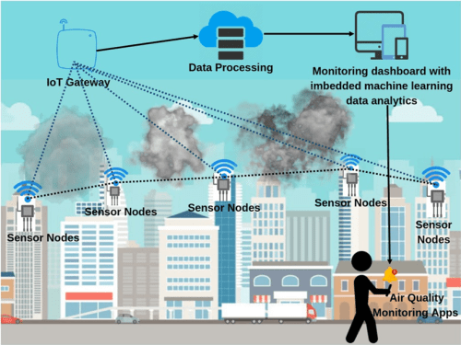
Real – Time Working Principle :

Slide 18

Conclusion
From improving public health to promoting sustainable development, IoT sensors have revolutionized air quality monitoring. Embrace this transformative technology to build a cleaner and healthier future for all with pure air facility .

