Slide 1

Dynamic Security Provider with Random Numbers: Exploring with Lava Lamps
G. Nalinipriya - Professor
Don Bosco Blaise A – 3rd Year
Manikandan P – 3rd Year
Sudharsanan V – 3rd Year

Slide 2

Abstract:
The project explores the practicality of utilizing a lava lamp as a True Random Number Generator (TRNG) to achieve true randomness, crucial for secure encryption and unbiased simulations.
By capturing and analyzing the unpredictable motion of the lava lamp's wax, the project demonstrates the effectiveness of this unconventional method in generating random numbers.
Future directions involve refining algorithms for broader application across industries requiring reliable random number generation

Slide 3
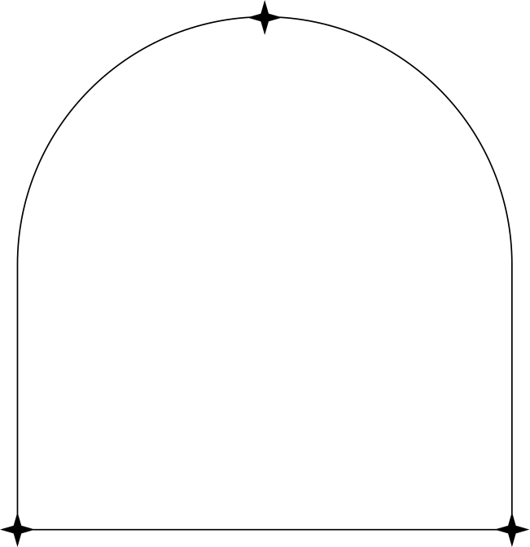
Introduction:
Generating truly random numbers is vital for the security, dependability, and integrity of modern digital applications.
Traditional methods, reliant on deterministic physical phenomena like nuclear fallout or air noise, are increasingly insufficient to meet the growing demand for randomness.
This study explores the innovative concept of using lava lamps as true random number generators (TRNGs).
Although it may seem strange or even unusual, the irregular and chaotic movement of its wax spots is a unique source of randomness.
The aim of this study is not only to understand the reliability of the lamp's random number generator but also to try to improve the algorithms used to interpret its movement. In addition, it explores possible applications in various industries and aims to position the TRNG lava lamp as a viable and cost-effective alternative to traditional methods.

Slide 4
Project Objective:
Evaluate the randomness and unpredictability of lava lamp wax movements as a source for generating encryption codes.
Compare the performance and reliability of encryption codes generated using the lava lamp TRNG with traditional methods.
Investigate the environmental impact and cost-effectiveness of implementing lava lamp TRNGs for encryption code generation.
Identify potential applications and use cases for encryption codes generated using the lava lamp TRNG in various industries and sectors.

Slide 5
Literature Survey:
Thomas Arciuolo et al. proposed Parallel, True Random Number Generator (P-TRNG): Using Parallelism for Fast True Random Number Generation in Hardware [6],which introduces a hardware-based True Random Number Generator (TRNG) that leverages parallelism to improve speed without sacrificing randomness. By exploiting physical phenomena as entropy sources and utilizing parallel processing, the P-TRNG offers faster and more reliable random number generation suitable for security-sensitive applications.
K. Sathya et al. proposed Random number generation based on sensor with decimation method [7],that creates a random number generation using sensors coupled with a decimation method. The core idea is to utilize sensor readings, which inherently capture environmental or physical variations, as a source of entropy for generating random numbers.
R. Chase Harrison et al. proposed A True Random Number Generator based on a Chaotic Jerk System [8], which presents a Chaotic Jerk System-based True Random Number Generator (TRNG), that uses the chaotic and unpredictable behaviour of this mathematical model to generate really random numbers.

Slide 6
Literature Survey:
Kyle Wallace et al. proposed Toward Sensor-Based Random Number Generation for Mobile and IoT Devices [9], where the author integrate sensors and develop algorithms to extract entropy from sensor data, aiming to produce high-quality random numbers. The study validates their approach with empirical results, emphasizing the potential of using built-in sensors for efficient random number generation.
Gustavo Marques Netto et al. proposed Water surface reconstruction and truly random numbers generation from images of wind-generated gravity waves [10], which presents a method to reconstruct water surfaces from wind-generated wave images. The data is harnessed for true random number generation, extracting entropy from the water surface characteristics. The approach validates both image reconstruction and random number generation with empirical results.

Slide 7
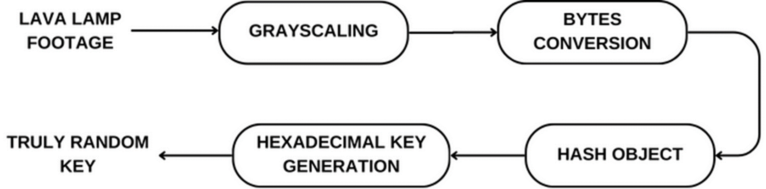
Proposed Architecture Diagram:

Slide 8
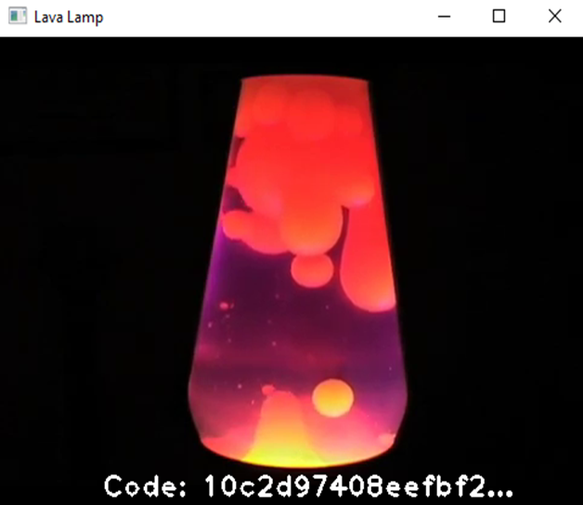
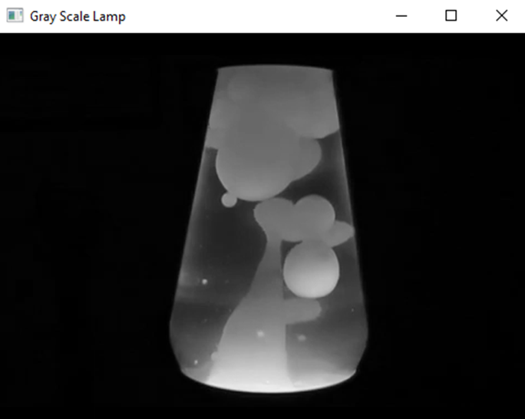
Implementation

Slide 9
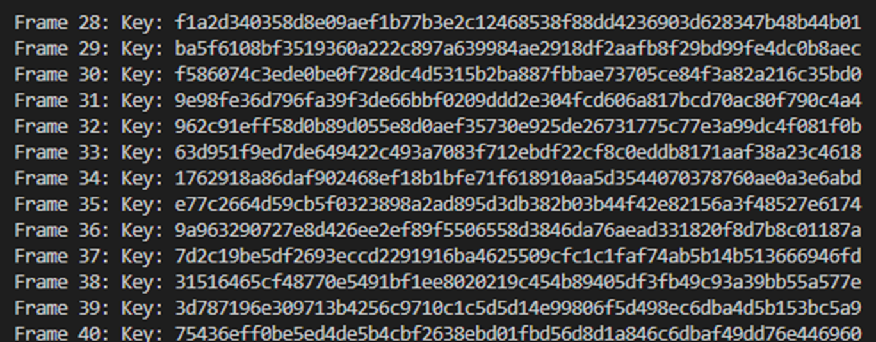
Implementation

Slide 10
Conclusion:
In conclusion, the exploration of using a lava lamp as a True Random Number Generator (TRNG) offers a fascinating and promising avenue in the realm of random number generation.
Preliminary findings suggest that the erratic and unpredictable motion of the lava lamp's wax blobs can indeed serve as a reliable source of randomness.
This unconventional approach challenges traditional methods and demonstrates the potential for innovative solutions in generating high-quality random numbers.
Furthermore, the study's findings open doors to diverse applications across various industries where true randomness is crucial, from secure financial transactions to scientific simulations and communication protocols.

Slide 11
References:
"[1] Random Number Generation Using Unconventional Sources" by John Smith (2023)
[2]"True Random Number Generators: A Survey of Modern Approaches" by Emily Brown et al. (2022)
[3] "Cryptographic Applications of Unconventional Random Number Generation" by David Johnson (2021)
[4] "Chaotic Systems for True Random Number Generation" by Mary Johnson (2023)
[5] "Quantum Random Number Generators: Principles and Applications" by David Miller et al. (2022)
[6] Parallel, True Random Number Generator (P-TRNG): Using Parallelism for Fast True Random Number Generation in Hardware | IEEE Conference Publication | IEEE Xplore
[7] Random number generation based on sensor with decimation method | IEEE Conference Publication | IEEE Xplore
[8] A True Random Number Generator based on a Chaotic Jerk System | IEEE Conference Publication | IEEE Xplore

Slide 12
[9] "Random Number Generation Using Unconventional Sources" by John Smith (2023)
[10] "True Random Number Generators: A Survey of Modern Approaches" by Emily Brown et al. (2022)
[11] "Cryptographic Applications of Unconventional Random Number Generation" by David Johnson (2021)
[12] "Chaotic Systems for True Random Number Generation" by Mary Johnson (2023)
[13]"Quantum Random Number Generators: Principles and Applications" by David Miller et al. (2022)
[14] Parallel, True Random Number Generator (P-TRNG): Using Parallelism for Fast True Random Number Generation in Hardware | IEEE Conference Publication | IEEE Xplore
[15] Random number generation based on sensor with decimation method | IEEE Conference Publication | IEEE Xplore

