Slide 1

Restaurant Recommendation System
Team Members :
Sai Mani Kiran Chatrathi
Likhith Kolli
Goutham
Sahil
Harsh
Xiaoying

Slide 2
Defining the Problem
Personalization: Provide personalized restaurant recommendations tailored to each user's unique preferences, dietary restrictions, budget, and past behavior. The system aims to offer suggestions that align closely with the individual tastes and preferences of users, enhancing their overall dining experiences.
Diversity: Ensure that the recommendations reflect a diverse range of restaurant options, including various cuisine types, price ranges, ambiance, and locations. By offering a diverse selection of recommendations, the system can cater to a wide range of tastes and preferences among users.

Slide 3

Source of the Data
The Yelp Dataset is a collection of data released by Yelp for academic research purposes. It contains a wealth of information related to businesses, users, and reviews from the Yelp platform. The dataset provides researchers and developers with access to rich and diverse data for various analytical and machine learning tasks.

Slide 4
.
Different Datasets
Businesses: Information about businesses registered on Yelp, including their names, addresses, categories, ratings, review counts, and attributes such as hours of operation and price range.
Users: Profiles of users who have registered on Yelp, including their usernames, review counts, average ratings, and the number of friends and fans.
Reviews: Textual reviews written by users for businesses on Yelp, along with associated metadata such as the review date, star rating, and votes (useful, funny, and cool)

Slide 5

EDA
Data Quality: Identify missing values, outliers, or anomalies in the dataset. Understanding the data quality is crucial for preprocessing and modeling.
Feature Relationships: Analyze relationships between different features in the dataset, such as correlations or dependencies. This helps in understanding how features interact with each other and can provide insights for feature engineering.
Data Summaries: Compute summary statistics such as mean, median, mode, standard deviation, etc., to summarize the data distribution. This provides a concise overview of the dataset.

Slide 6
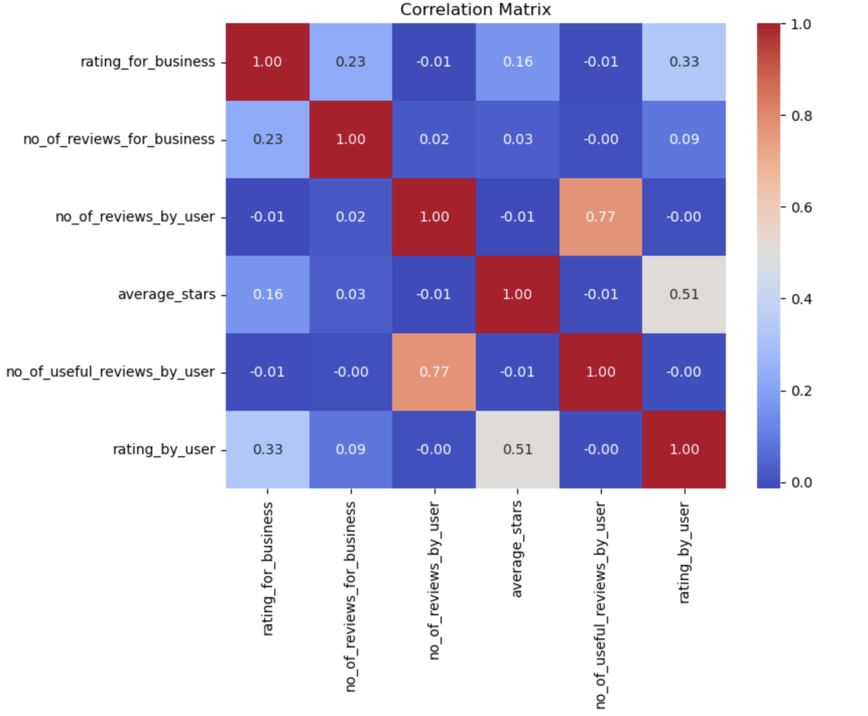

Slide 7
Feature Engineering
Feature Creation
Feature Selection
Handling Missing Values
Encoding Categorical Variables

Slide 8
Experimented Models
Decision Tree Classifier
Random Forest Classifier
MLP Classifier
Gradient Boosting Machines
GaussianNB
Neural Network
Ada Boost
XGBoost
LightGBM
CatBoost

Slide 9
Results
Decision Tree Classifier - 0.4558791801510248
Random Forest Classifier - 0.553706272152874
MLP Classifier - 0.5125285450620953
Gradient Boosting Machines – 0.5624550317514937
GaussianNB – 0.21747427034128947
Neural Network - 0.5622746348381042
Ada Boost – 0.5574498701786217
XGBoost - 0.5636750398848813
LightGBM - 0.5657083867738606
CatBoost - 0.5610473300591234

Slide 10
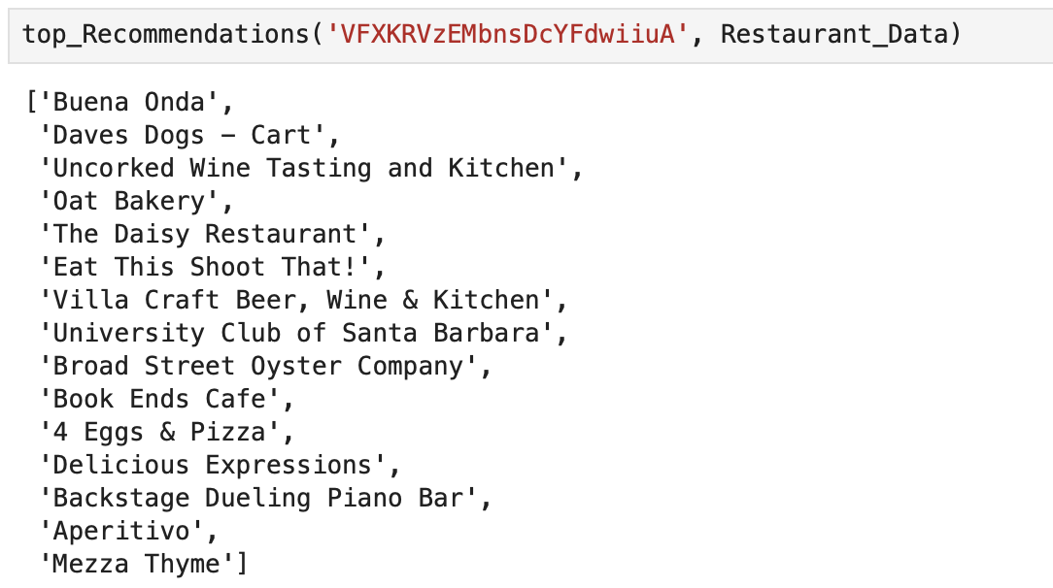

Slide 11

Thank YOU
.

