Slide 1
COMPUTER ORGANIZATION AND ARCHITECTURE
K.M.BABU (Asst. Professor)
CSE (AI & ML)
VITS, TS

Slide 2
Computer Arithmetic
Addition and Subtraction
Multiplication Algorithm
Division Algorithm
Floating-point Arithmetic operations
Decimal Arithmetic unit
Decimal Arithmetic operations

Slide 3
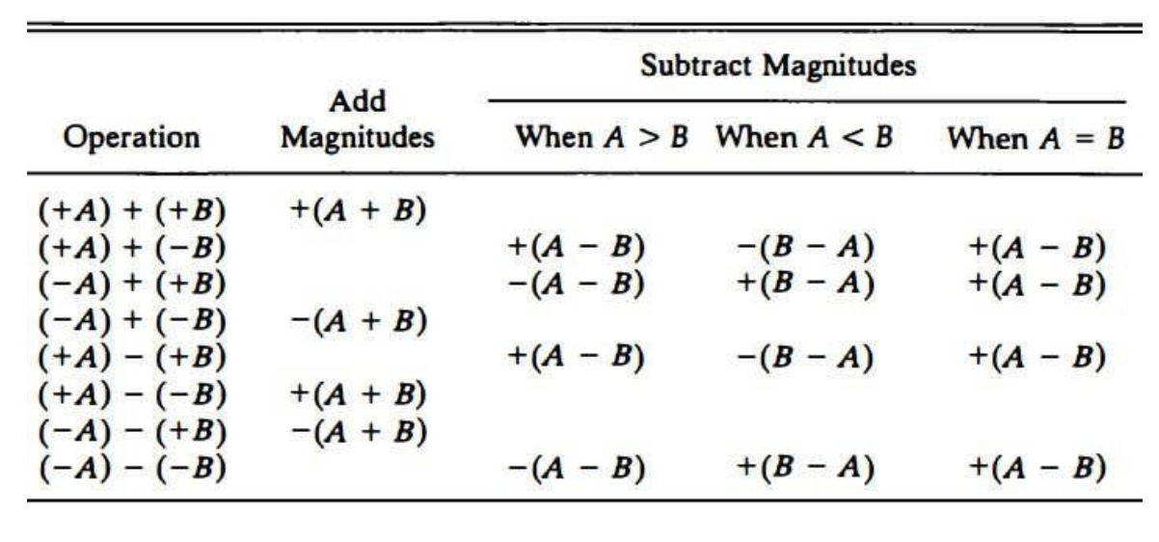
Addition and Subtraction with signed magnitude data

Slide 4
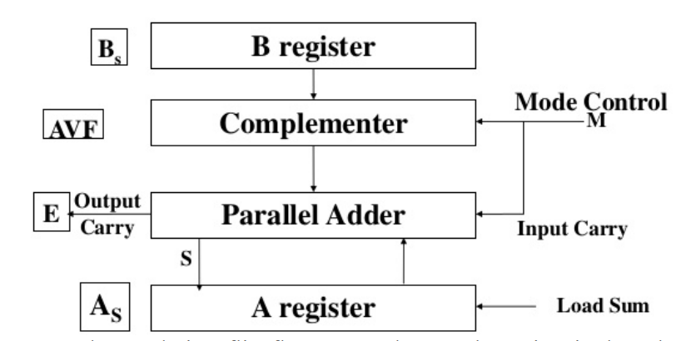
Hardware Implementation

Slide 5
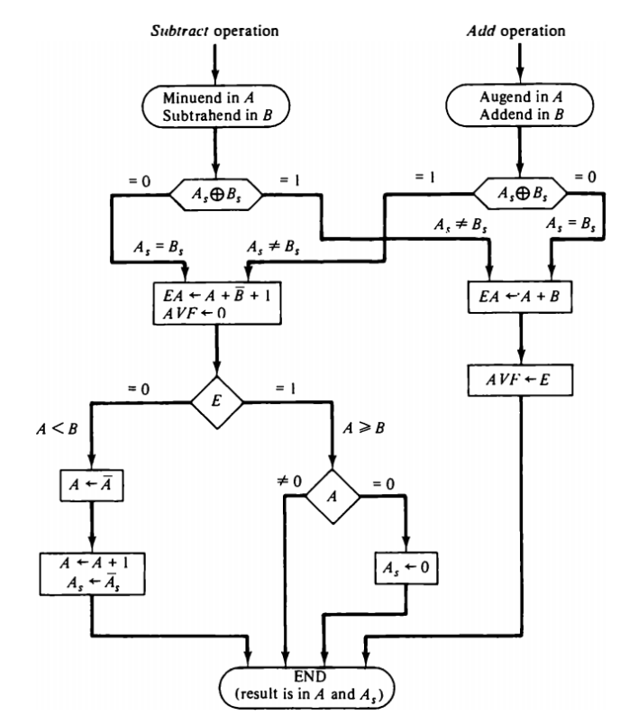

Slide 6
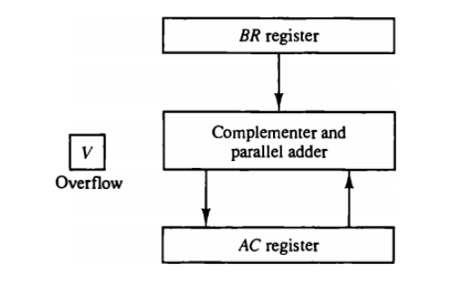
Addition and Subtraction with signed 2’s compliment data

Slide 7
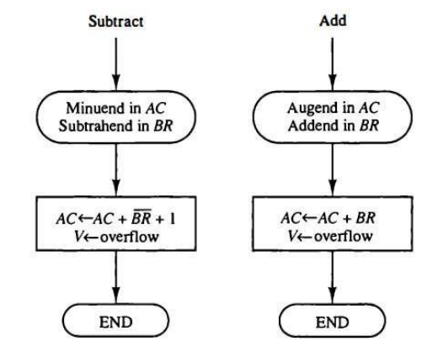
Hardware Algorithm

