Slide 1
DATABASE MANAGEMENT SYSTEMS
K.M.BABU (Asst. Professor)
CSE (AI & ML)
VITS, TS

Slide 2
Contents
Database System Applications:
A Historical Perspective
File System Vs DBMS
Data Model
Levels of Abstraction in DBMS
Data Independence
Structure of a DBMS

Slide 3
Contents (Contd..)
Introduction to Database Design:
Database Design
ER Diagrams, Entities, Attributes
Entity Sets, Relationship, Relationship Sets
Additional Features of ER Model
Conceptual Design with ER Model

Slide 4
Introduction
DBMS?
Database?
Data?
Information?
Data vs Information
Knowledge?
Wisdom?

Slide 5
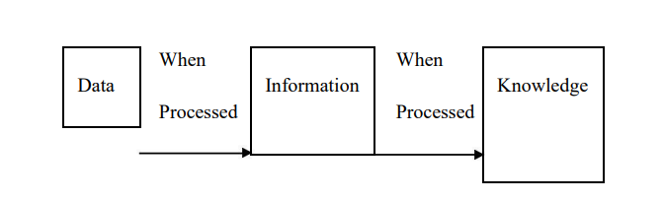

Slide 6
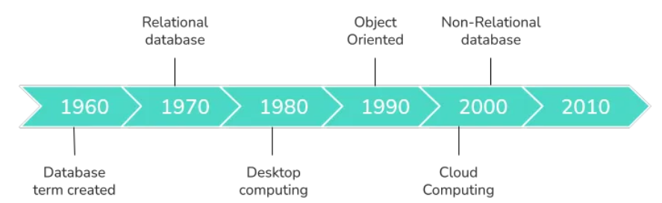
Historical Perspective

Slide 7
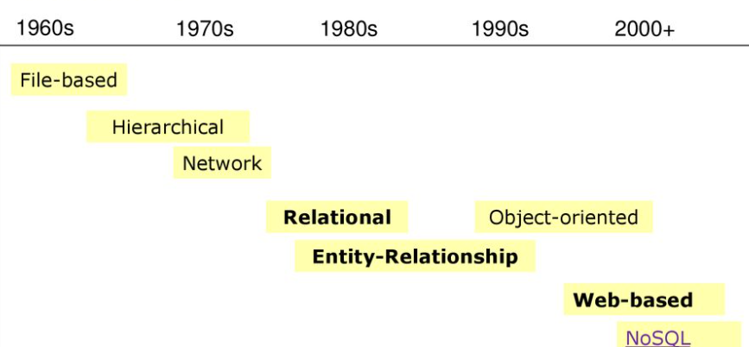
Evolution of Databases

Slide 8
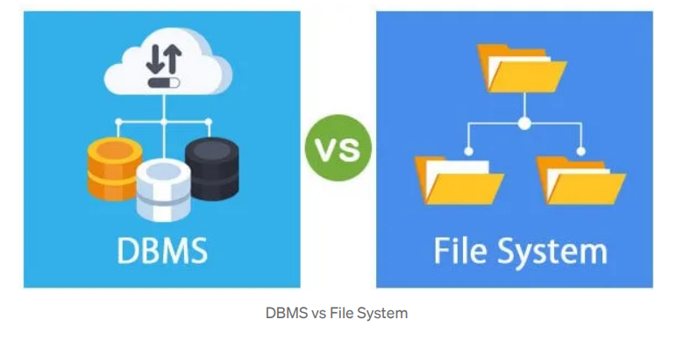

Slide 9
Advantages of File System
Backup
Compactness
Data Retrieval
Editing
File Sharing

Slide 10
Disadvantages of File System
Data Redundancy
Data Inconsistency
Limited Data Sharing

Slide 11
Advantages of DBMS
Better Data Transfer
Better Data Security
Data inconsistency is minimized
Better decision-making
Increased end-user productivity
Faster data access

Slide 12
Difference Between File System and DBMS
Definition
Usage
Operations
Data Consistency
Data Redundancy
Security
Backup and Recovery Process
Users
Complexity
Examples

Slide 13
Data Model
Types of Data Models:
Hierarchical data model
Network data model
Relational data model
Entity Relationship data model
Object Oriented data model
Semi-structured data model

Slide 14
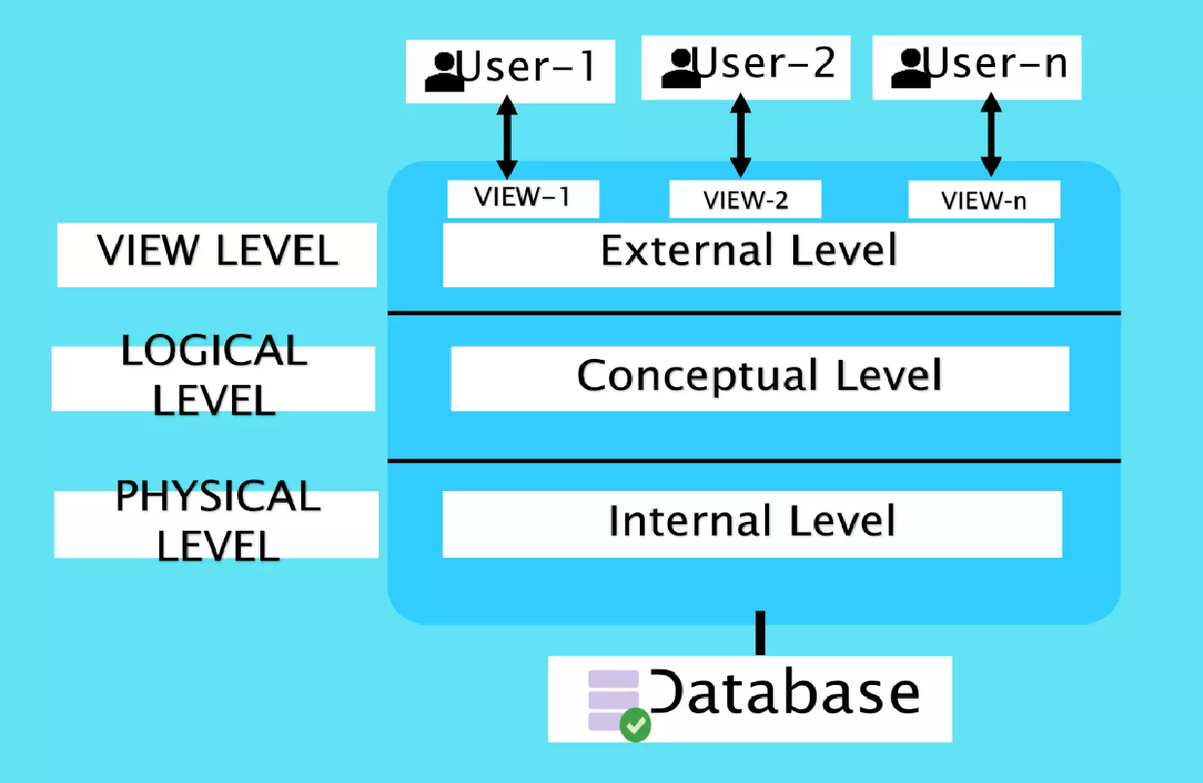
Levels of Abstraction

Slide 15
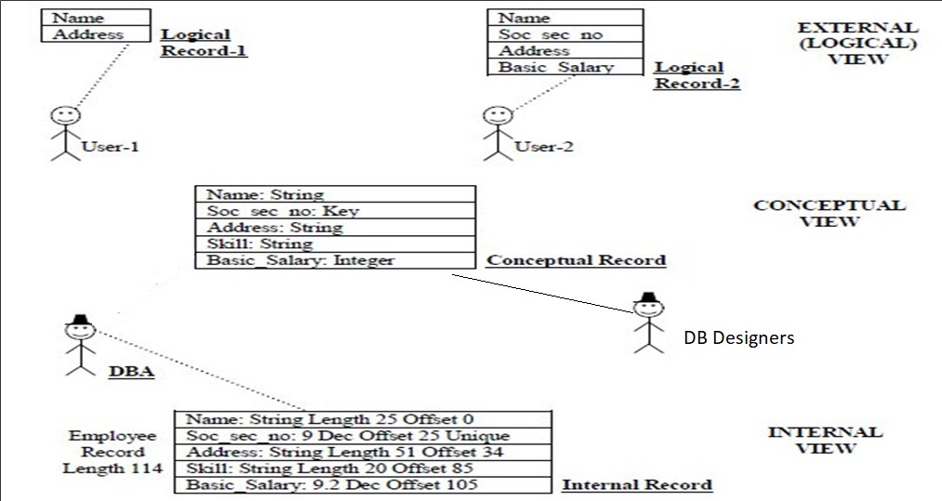
Levels of Abstraction - Example

Slide 16
Data Independence
Physical Data Independence
Logical Data Independence

Slide 17
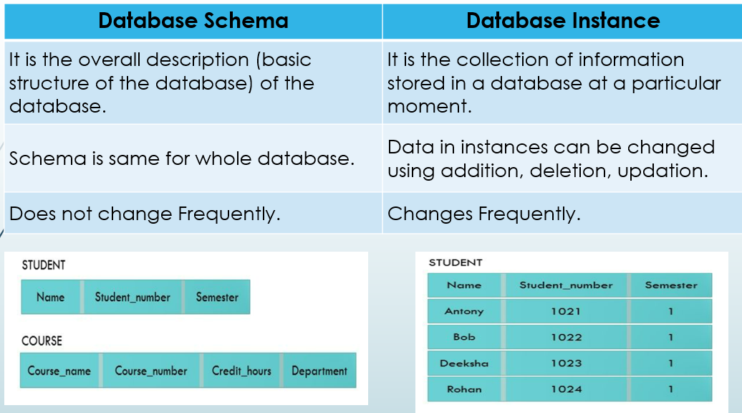

Slide 18
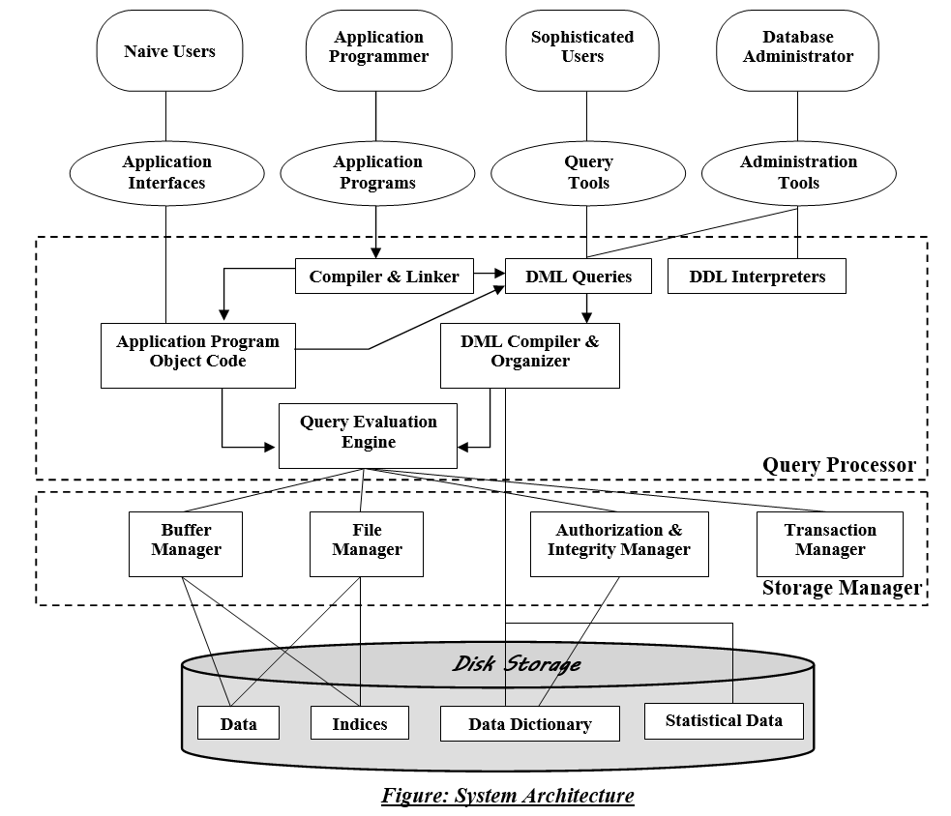
Structure of a DBMS

Slide 19
Components
Storage Manager
Query Processor

Slide 20
Components of Storage Manager
Authorization and integrity manager
Transaction manager
File manager
Buffer manager

Slide 21
Storage Manager also have
Data files
Data Dictionary
Indices

Slide 22
Components of Query Processor
DDL interpreter
DML compiler
Query evaluation engine
Compiler and Linker
Application program object code

Slide 23
Database Users
Naïve users
Application programmers
Sophisticated users
DBA (Database Administrator)

Slide 24
Functions of a DBA
Schema Definition
Schema Modification
Granting Authorization
Routine Maintenance

Slide 25
Types of DBMS Architecture
1- TIER ARCHITECTURE
2- TIER ARCHITECTURE
3- TIER ARCHITECTURE

Slide 26
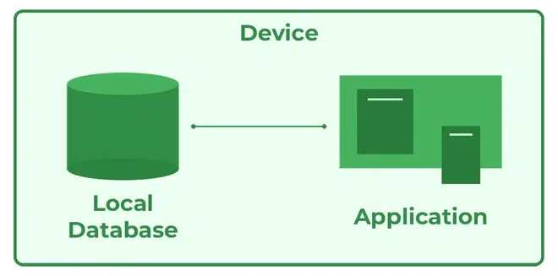
1-tier architecture

Slide 27
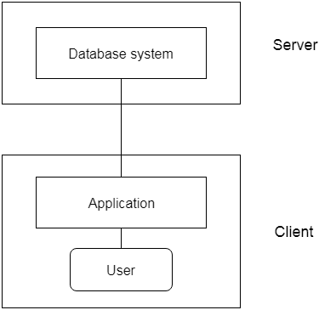
2-tier architecture

Slide 28
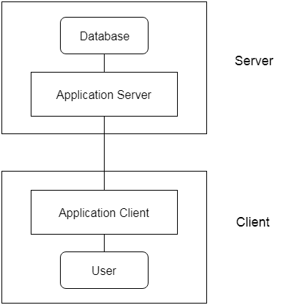
3-tier architecture

Slide 29
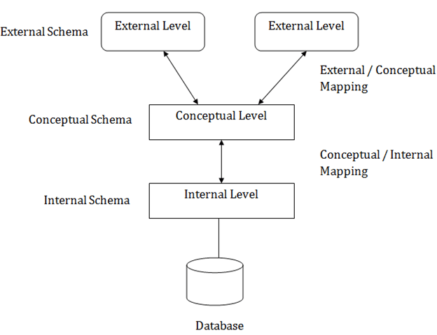
Three-Schema Architecture

Slide 30
Database Design
Database Design Process is divided into 6 steps:
Requirement Analysis
Conceptual Database Design
Logical Database Design
Schema Refinement
Physical Database Design
Security Design

Slide 31
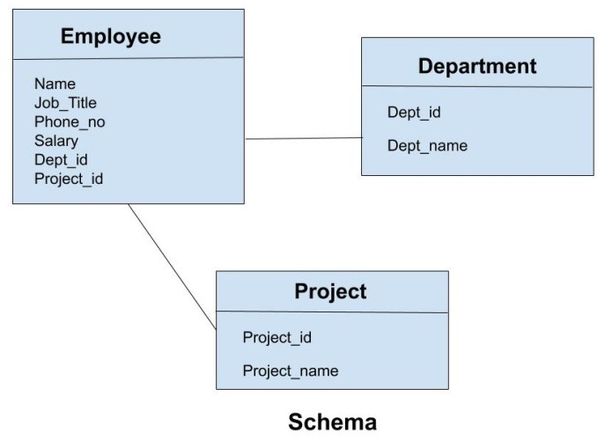
What is schema?

Slide 32
What is an instance?

Slide 33
Entity-Relationship (ER) Model
Entity
- Entity Set
- Regular Entity and Weak Entity
Attributes
- Domain of Attributes
- Key attribute
- Simple attribute
- Composite attribute
- Single-valued attribute
- Multi-valued attribute
- Derived attribute

Slide 34
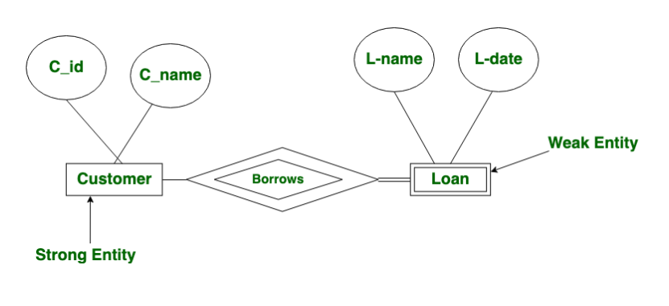
ER Diagram

Slide 35
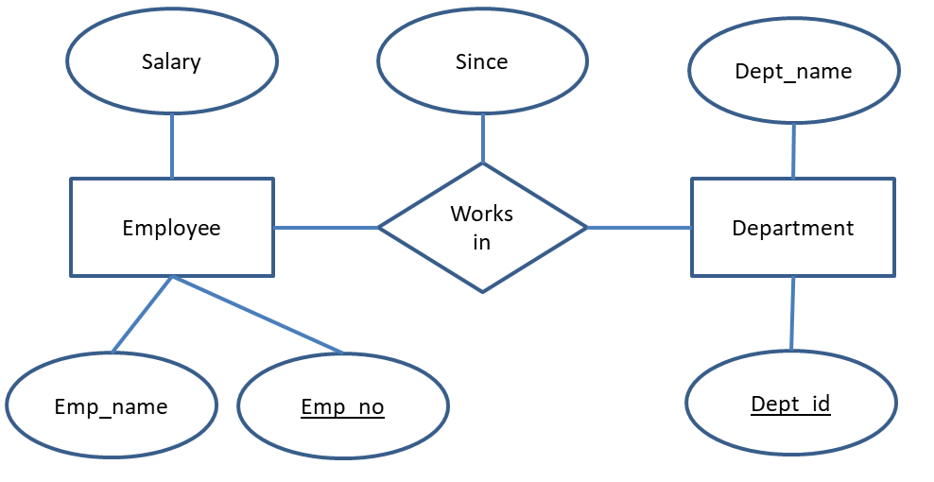
Relationship

Slide 36
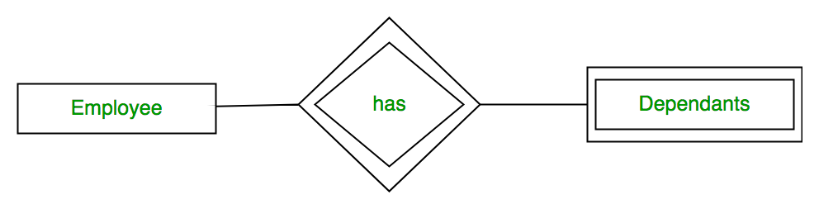
Weak relationship

Slide 37
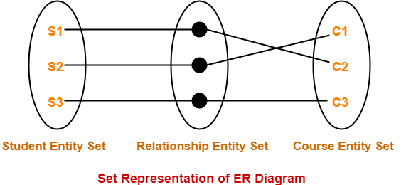
Relationship Set

Slide 38
Types of Relationship sets:
Unary relationship set
Binary relationship set
Ternary relationship set
N-ary relationship set

Slide 39
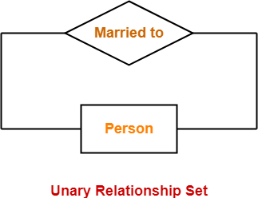

Slide 40
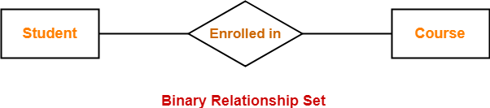

Slide 41
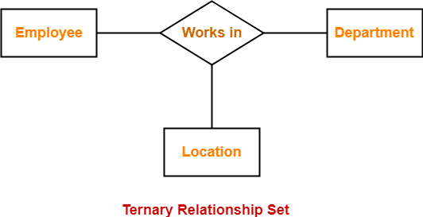

Slide 42
Cardinality of a Relationship
One to one (1:1) relationship
One to many (1:N)relationship
Many to one (M:1)relationship
Many to many (M:N) relationship

Slide 43
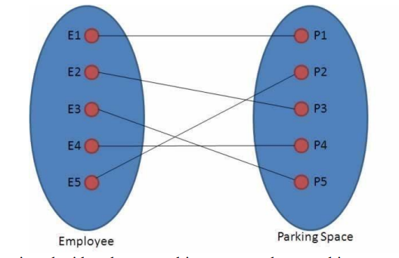
One-to-one(1:1)

Slide 44
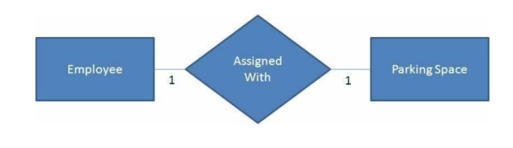

Slide 45
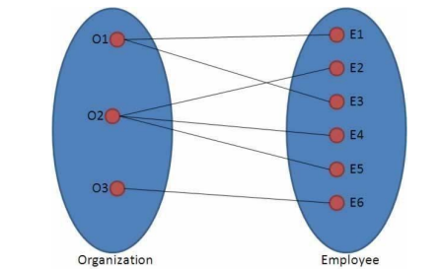
One-to-many(1:N)

Slide 46
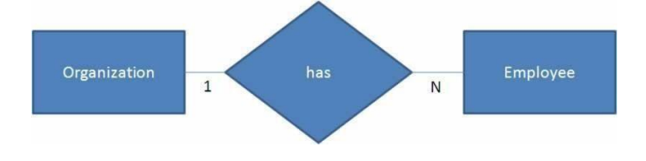

Slide 47
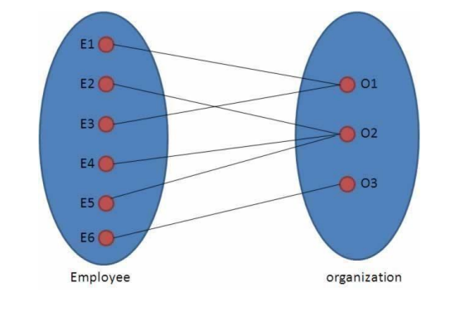
Many-to-one(M:1)

Slide 48
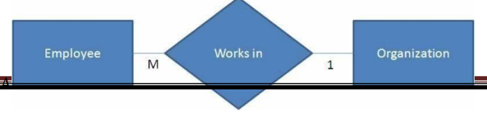

Slide 49
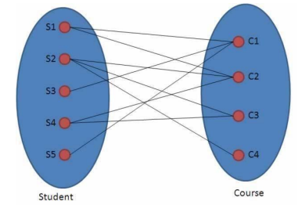
Many-to-Many(M:N)

Slide 50
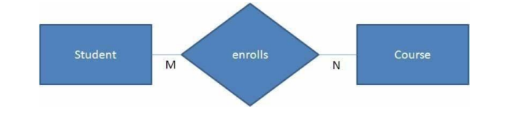

Slide 51
Additional Features of ER model
Specialization
Generalization
Inheritance
Aggregation

Slide 52
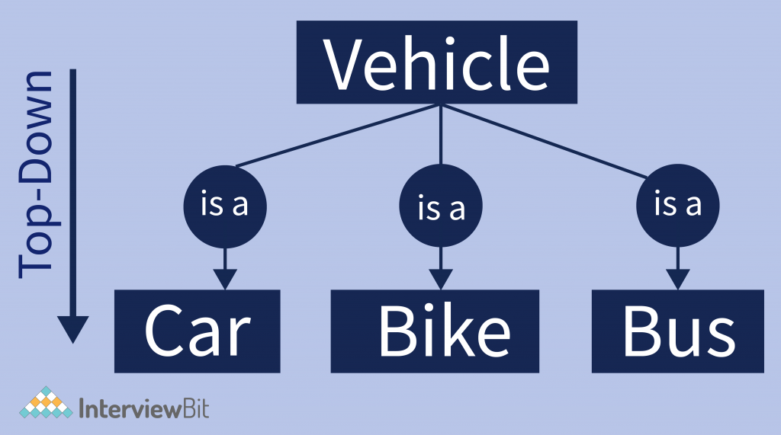
Specialization

Slide 53
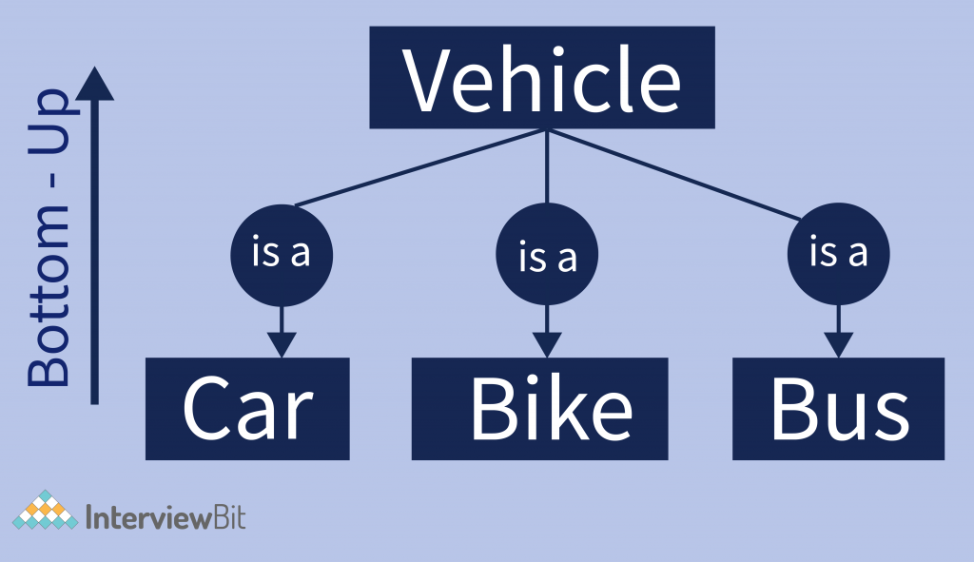
Generalization

Slide 54
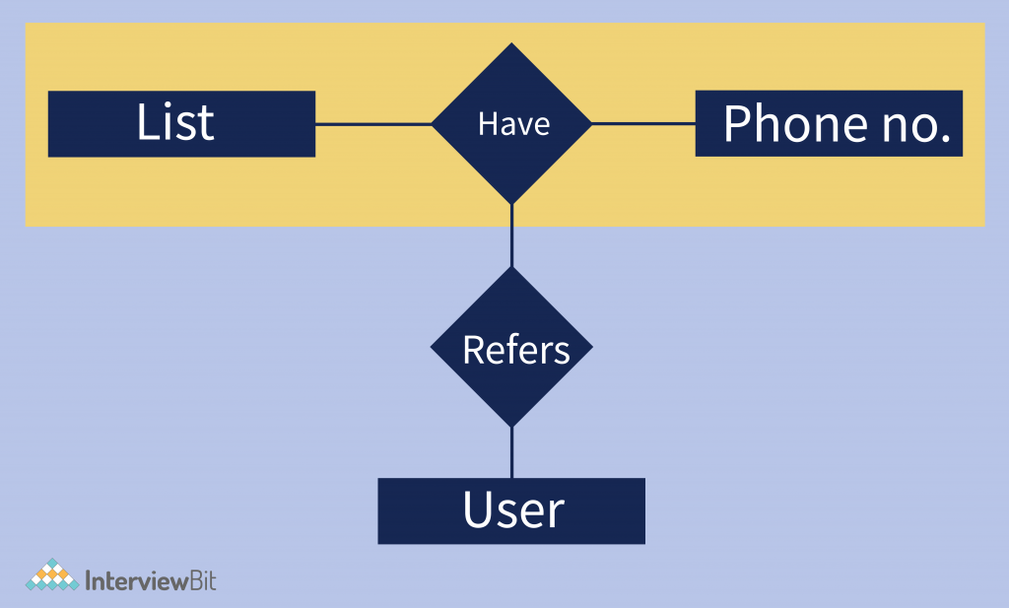
Aggregation

Slide 55
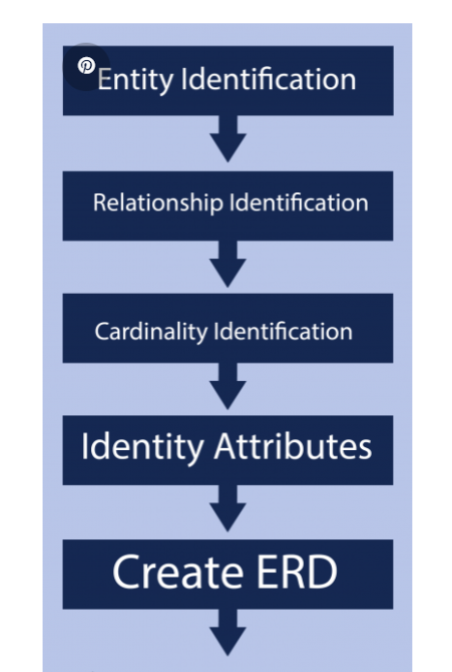
Conceptual Design with ER Model

Slide 56
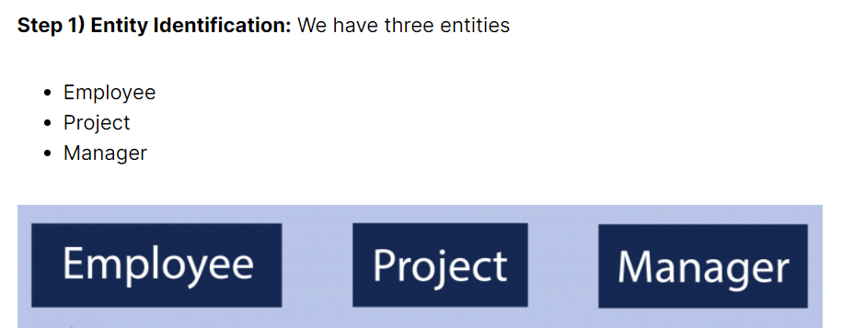

Slide 57
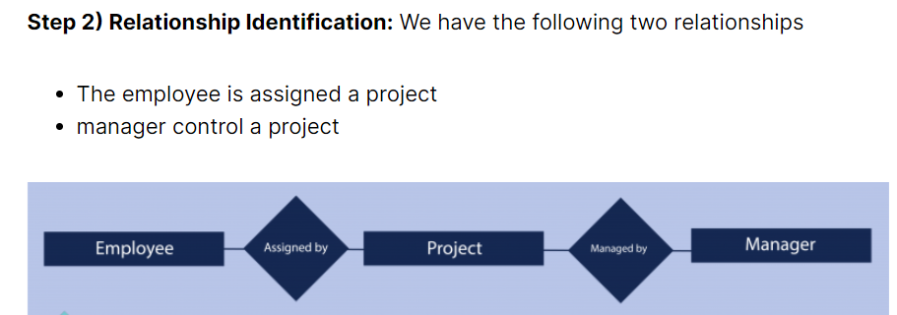

Slide 58
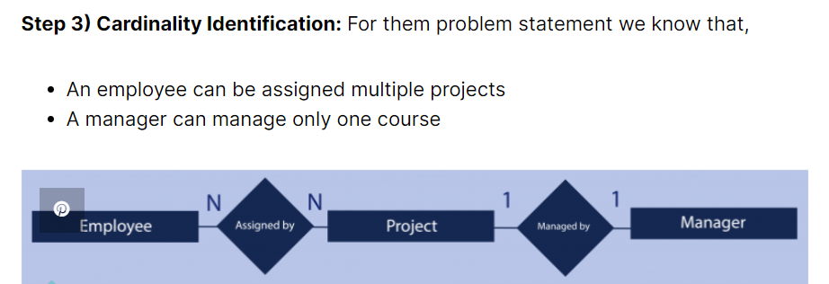

Slide 59
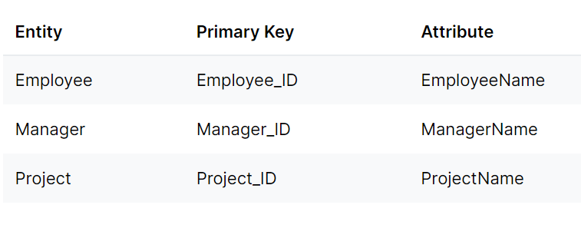
Step 4) Attributes Identification

Slide 60
