Slide 1
UNIT-4

Slide 2
Transaction
A transaction is a single logical unit consisting of one or more database operations.

Slide 3
Definitions
It can be defined as group of tasks being executed.
(Or)
It also referred to as an event that occur on a database with read/write operation.

Slide 4
Example: Withdrawing 1000 rupees from ATM.
:
The following set of operations are performed
i. Read current balance from Database (Let say 5000 rupees)
ii. Deduct 1000 from current balance ( 5000 – 1000 = 4000)
iii. Update current balance in Database (4000 rupees)
The above 3 operations together is called one transaction.

Slide 5
PROPERTIES OF TRANSACTION (ACID PROPERTIES)
Atomicity
Consistency
Isolation
Durability

Slide 6
ATOMICITY
This property states that all of the instructions with in a transaction must be executed or none of them should be executed.

Slide 7
ATOMICITY
Example: Transferring $100 from account A to
account B.
(Assume account A balance = $400 and account B balance = 700
Transferring $100 from account A to account B has two operations
Debiting 100$ from A’s balance
($400 -$100 = $300)
b) Crediting 100$ to B’s balance
($700+$100 = $800)

Slide 8
ATOMICITY

Slide 9
CONSISTENCY
The consistency property ensures that the database must be in consistent state before and after the transaction.

Slide 10
CONSISTENCY
Example:
Assume initially, A balance = $400 and
B balance = 700$.
The total balance of A + B = 1100$
(Before transferring 100$ from A to B)
The total balance of A + B = 1100$
(After transferring 100$ from A to B)

Slide 11
Total before T occurs = 500 + 200 = 700.
Total after T occurs = 400 + 300 = 700.

Slide 12
ISOLATION
When executing multiple transactions concurrently & trying to access shared resources.
The system should create an order such that the only one transaction can access the shared resource at the same time & release it after completion of it’s execution for other transaction

Slide 13
ISOLATION

Slide 14
DURABILITY
Once a transaction completes successfully, the changes it has made into the database should be permanent even if there is a system failure.
The recovery-management component of database systems ensures the durability of transaction.

Slide 15
DURABILITY
Example
assume account A balance = 1000$.
If A withdraw 100$ today, then the A balance = 900$.
After two days or a month,
A balance should be 900$, if no other transactions done on A.

Slide 16
STATES OF TRANSACTION

Slide 17
Active State
This is the first state in the life cycle of a transaction.
Once the transaction starts executing, then it is said to be in active state.
During this state it performs operations like READ and WRITE on some data items. All the changes made by the transaction are now stored in the buffer in main memory. They are not updated in database.

Slide 18
Partially Committed State
When the transaction executes its last statement, then the transaction is said to be in partially committed state.
Still, all the changes made by the transaction are stored in the buffer in main memory, but they are not updated in the database.

Slide 19
Committed State
After all the changes made by the transaction have been successfully updated in the database, it enters into a committed state and the transaction is considered to be fully committed.
After a transaction has entered the committed state, it is not possible to roll back (undo) the transaction. This is because the system is updated into a new consistent state and the changes are made permanent.

Slide 20
Failed State
When a transaction is getting executed in the active state or partially committed state and some failure occurs due to which it becomes impossible to continue the execution, it enters into a failed state.

Slide 21
Aborted State
After the transaction has failed and entered into a failed state, all the changes made by it have to be undone.
To undo the changes made by the transaction, it becomes necessary to roll back the transaction.
After the transaction has rolled back completely, it enters into an aborted state.

Slide 22
Terminated State
This is the last state in the life cycle of a transaction.
After entering the committed state or aborted state, the transaction finally enters into a terminated state where its life cycle finally comes to an end.

Slide 23
Implementation of Durability & Atomicity
Durability and atomicity can be ensured by using Recovery manager which is available by default in every DBMS.

Slide 24
Implementation of Atomicity
We can implement atomicity by using
1. Shadow copying technique
2. Using recovery manager which available by default in DBMS.

Slide 25
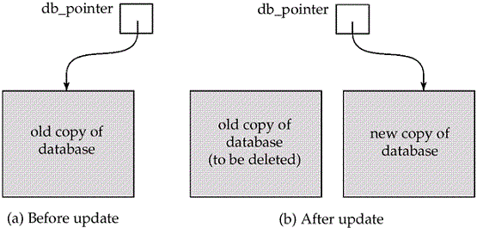
Shadow Copying Technique

Slide 26
Implementation of Durability
We can implement durability by using
1. Logs
2. Using recovery manager which available by default in DBMS.

Slide 27
LOGS
Logs keep track of actions carried out by transactions which can be used for the recovery of database in case of failure.
Logs files should be stored always on stable storage devices.
When a transaction begins its execution it is recorded in the log as follows
<Tn, start>
When a transaction performs an operation it is recorded in log as follows
<Tn, X, V1, V2>
When a transaction finishes it’s execution, it is recorded as
<Tn, commit>

Slide 28
Concurrent Execution
Concurrent execution refers to the ability of the system to handle multiple transactions or operations simultaneously.
This is crucial for ensuring efficient performance and maximizing resource utilization in a multi-user environment.

Slide 29
Serial Schedule
All the transactions execute serially one after the other.
When one transaction executes, no other transaction is allowed to execute.

Slide 30
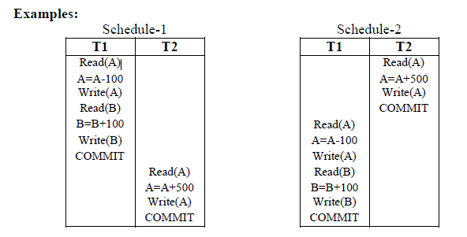

Slide 31
Non- Serial Schedule
In non-serial schedules, multiple transactions execute concurrently.
Operations of all/some of the transactions are inter-leaved or mixed with each other.
Some non-serial schedules may lead to inconsistency of the database and may produce wrong results.

Slide 32
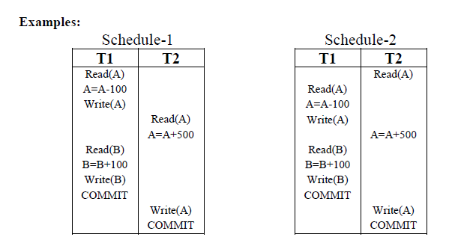

Slide 33
Serializable Schedules:
A non-serial schedule of ‘n’ transactions is equivalent to some serial schedule of ‘n’ transactions, then it is called as a serializable schedule.
In simple words, A transaction is said to be Serializable if it is equivalent to serial schedule

Slide 34
In other words, the results produced by the transactions in a serial schedule are equal to the result produced by the same transactions in some non-serial schedule, then that non-serial schedule is called as serializability.
Serializable schedules behave exactly same as serial schedules.
Even though, Serial Schedule and Serializable Schedule produce same result, they have some differences.

Slide 35
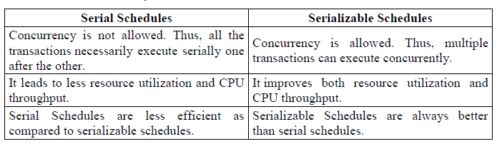

Slide 36
What is Serializability?
It is a process to find if the given non-serial schedule is a serializable schedule or non-serializable schedule.

Slide 37
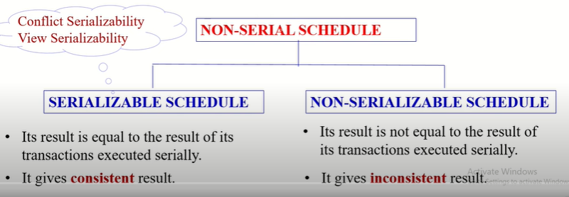

Slide 38
Conflict Serializability
It is used to check whether a given non-serial schedule is conflict serializable or not.

Slide 39
How it works?
It performs the process by converting the given non-serial schedule into a serial schedule by swapping its non-conflicting operations.

Slide 40
Conflict operations?
Non-conflict operations?

Slide 41
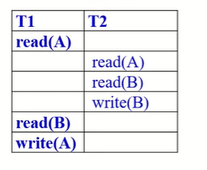
Given this non-serial schedule, S1

Slide 42
View Serializability
It is used to check whether a given non-serial schedule is view serializable or not.

Slide 43
View Serializability
If the given non-serial schedule is View Equivalent to its serial schedule, then it is view serializable.

Slide 44
View Equivalent
If two schedules S1 (non-serial schedule) and S2 (serial schedule) are said to be view equivalent if they satisfy the following condition.
Condition:
In both the schedules s1 & s2, if same transactions perform
Initial Read
Final Write
Update Read
on each data item.

Slide 45
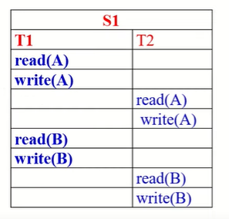
Given this non serial schedule S1

Slide 46
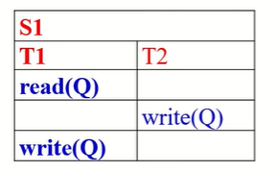
Example-2, Given a non-serial schedule

Slide 47
Non-serializability
Characteristics:
May or may not be consistent
May or may not be recoverable

Slide 48
Recoverability
Recoverability is a property of database systems that ensures that, in the event of a failure or error, the system can recover the database to a consistent state.

Slide 49
Recoverability Schedule
Based on whether recovery of failure transaction schedules are classified as
1. Irrecoverable schedules.
2. Recoverable schedules with cascade rollback.
3. Cascade less recoverability.

Slide 50
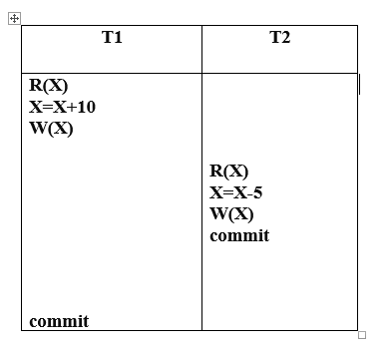
Non-Recoverable Schedule (irrecoverable)

Slide 51
Recoverable schedules with cascade rollback.
If transaction T2 reading a value updated by T1 & commit of T2 is delay till the commit of T1, it is called recoverable schedule with cascade roll back.

Slide 52
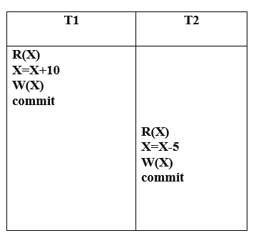
Recoverable Schedule (cascade less)

Slide 53
Implementation of Isolation
It means that a transaction should take place in a system in such a way that it is the only one transaction that is accessing the resources in a database system.

Slide 54
3 Isolation Phenomenon
A) Dirty Read
B) Non-repeatable Read
C) Phantom Read

Slide 55
Dirty Read:
If a transaction reads a data value updated by an uncommitted transaction, then this type of read is called as dirty read.

Slide 56
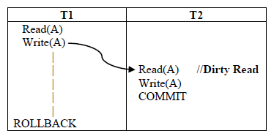

Slide 57
Non-Repeatable Read
Non repeatable read occurs when a transaction read same data item twice and get a different value each time. It happens when a transaction reads once before and once after committed UPDATES from another transaction.

Slide 58
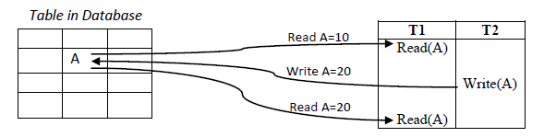

Slide 59
Phantom reads
Phantom reads occurs when a transaction read same data item twice and get a different value each time. It happens when a transaction reads once before and once after committed INSERTS and/or DELETES from another transaction.

Slide 60
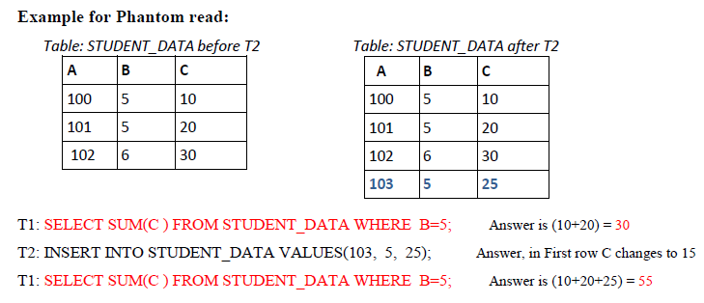

Slide 61
Difference between Non-repeatable and Phantom:
Scenario | Non-repeatable read | Phantom read
When T1 performs a second read | No change in the number of rows | T1 doesn't see the changes made by T2
T2 updates the table | T1 may see a different value for the data
T2 inserts or deletes a row |  | T1 may see a new row or may not see a deleted row

Slide 62
Based on these 3 phenomena, SQL define FOUR ISOLATION LEVELS
Read uncommitted
Read Committed
Repeatable Read
Serializable

Slide 63
Read uncommitted
This is the lowest level of isolation.
In this level, one transaction may read the data item modified by other transaction which is not committed. It mean dirty read is allowed.
In this level, transactions are not isolated from each other.

Slide 64
Read Committed
This isolation level guarantees that any data read is committed at the moment it is read.
Thus, it does not allow dirty read.
The transaction holds a read/write lock on the data object,
Thus prevents other transactions from reading, updating or deleting it.

Slide 65
Repeatable Read
This is the most restrictive isolation level.
The transaction holds read locks on all rows it references and writes locks on all rows it inserts, updates, or deletes.
other transactions cannot read, update or delete these data items.

Slide 66
Serializable:
This is the highest isolation level.
A serializable execution is guaranteed to be a serial schedule. Serializable execution is defined to be an execution of operations in which concurrently executing transactions appears to be serially executing.

Slide 67
Testing for Serializability
Why Serializability Check?
Serializability process is used to check whether the given schedule is serializable or not. (whether it produces consistent result or not)
We use precedence graph to test serializability.

Slide 68

Precedence Graph
Precedence graph is a directed graph
which consists of a pair G = (V,E)
where V denotes all the transactions in a schedule
E denotes directed edge constructed between nodes T_{i} to T_{j} ( if Ti performs conflict operation before T_{j} performs )

Slide 69
Conflicts
Conflicts occur when two transactions access the same data item and at least one of them is a write operation.
There are three types of conflicts:
Write(Q) Read(Q)
Read(Q) Write(Q)
Write(Q) Write(Q)

Slide 70
Steps for Creating Precedence Graph:
Find Vertices
Draw edges by finding conflicting pairs.
If there is no cycle, it’s a serializable schedule otherwise not serializable.
Perform Topological Sorting to determine serializability order.

Slide 71
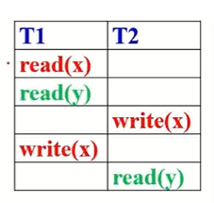

Slide 72

Precedence Graph for conflict operations

Slide 73
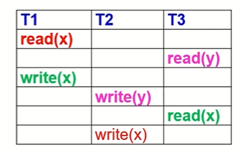

Slide 74
Steps for Topological Sorting:
Choose the vertex with indegree 0.
Remove the outgoing edges from that vertex.
Repeat the steps 1 and 2 until no vertex with indegree 0 exits.

Slide 75
Concurrency Control
It is a process of managing simultaneous execution of transactions in a database.

Slide 76
Purpose of concurrency control:
To enforce isolation.
To preserve database consistency.
To resolve conflicts (RW, WR, WW)

Slide 77
Concurrency Control Protocols
Lock Based Protocols
Timestamp Based Protocols
Validation Based Protocols

Slide 78
Lock Based Protocol
In this type of protocol,
Any transaction cannot read or write data until it acquires an appropriate lock on it.

Slide 79
Two Lock Modes
There are two lock modes:
(1). Shared Lock
(2). Exclusive Lock

Slide 80
1. Shared lock:
It is also known as a Read-only lock.
A transaction with a shared lock can only perform read only operation.
It is indicated using LOCK-S
Example:
If a transaction acquires shared lock on data item A. Then it is indicated
Like below
LOCK-S(A)
Read(A)

Slide 81
2. Exclusive lock:
A transaction with an exclusive lock can perform both read and write operation.
It is indicated using LOCK-X
Example:
LOCK-X(A)
Read(A)
A = A + 100
Write(A)

Slide 82
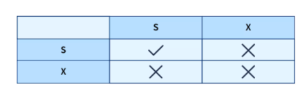
Lock Compatibility Matrix:

Slide 83
Four types of lock based protocols
Simplistic lock protocol
Pre-claiming Lock Protocol
Two-phase locking (2PL) protocol
Strict Two-phase locking (Strict-2PL) protocol

Slide 84
1. Simplistic lock protocol
It allows transactions to perform write/read operation on a data item only after obtaining a lock on that data item.
Transactions unlock the data item immediately after completing the write/read operation.

Slide 85
2. Pre-claiming Lock Protocol
For each transaction a list is prepared consisting of the data items and type of lock required on each of the data item.
Before initiating an execution of the transaction, it requests DBMS to issue all the required locks as per the list.

Slide 86
Pre-claiming Lock Protocol
If all the locks are granted
then this protocol allows the transaction to begin. When the transaction is completed then it releases all the lock.
If all the locks are not granted
then this protocol allows the transaction to rolls back and waits until all the locks are granted.

Slide 87
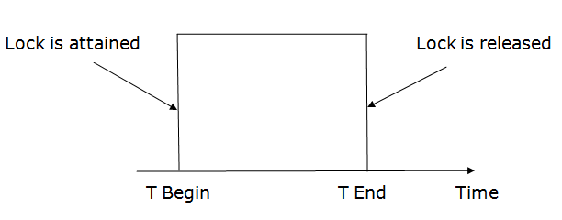
Pre-claiming Lock Protocol

Slide 88
3. Two-phase locking (2PL)
The two-phase locking protocol divides the execution phase of the transaction into three parts.
In the first part, when the execution of the transaction starts, it seeks permission for the lock it requires.
In the second part, the transaction acquires all the locks. The third phase is started as soon as the transaction releases its first lock.
In the third phase, the transaction cannot demand any new locks. It only releases the acquired locks.

Slide 89
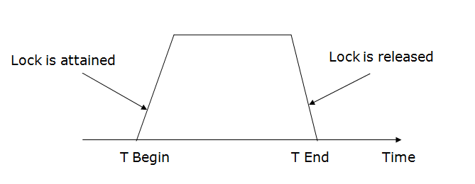
Two-phase locking (2PL)

Slide 90
Two Phase Locking (2PL) has two phases.
Growing phase: In the growing phase, a new lock on the data item may be acquired by the transaction, but none can be released.
Shrinking phase: In the shrinking phase, existing lock held by the transaction may be released, but no new locks can be acquired.

Slide 91
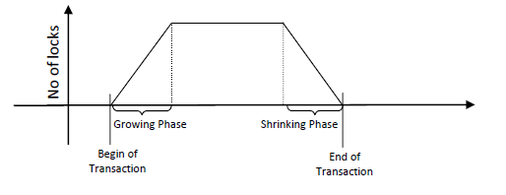
Two-phase locking (2PL)

Slide 92
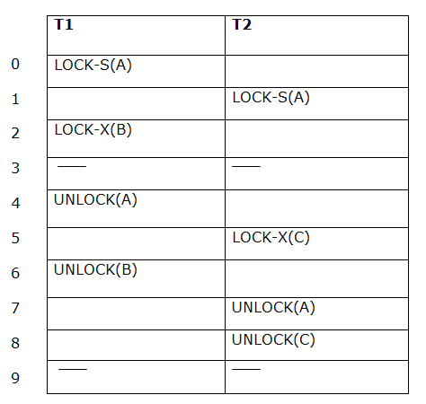
Example

Slide 93
Transaction T1:
Growing phase: from step 1-3
Shrinking phase: from step 5-7
Lock point: at 3
Transaction T2:
Growing phase: from step 2-6
Shrinking phase: from step 8-9

Slide 94
Strict Two-phase locking (Strict-2PL)
The first phase of Strict-2PL is similar to 2PL. In the first phase, after acquiring all the locks, the transaction continues to execute normally.
The only difference between 2PL and strict 2PL is that Strict-2PL does not release a lock after using it.

Slide 95
Strict Two-phase locking (Strict-2PL)
Strict-2PL waits until the whole transaction to commit, and then it releases all the locks at a time.
Strict-2PL protocol does not have shrinking phase of lock release.

Slide 96
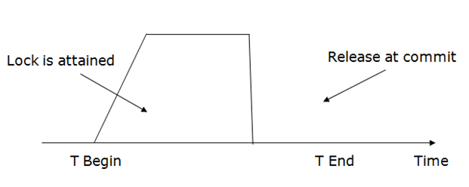
Strict Two-phase locking (Strict-2PL)

Slide 97
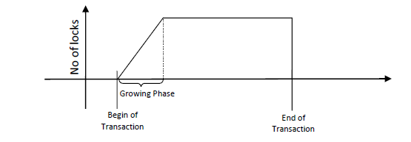
Strict Two-phase locking (Strict-2PL)

Slide 98
Timestamp Based Protocol
It is most commonly used concurrency protocol.
A timestamp is issued to each transaction when it enters into the system.
It uses either system time or logical counter as a timestamp.
The timestamp of transaction T is denoted as TS(T).

Slide 99
Timestamp Based Protocol
The system order the transactions based on their arrival time.
For example, let the arrival times of transactions T1, T2 and T3 be 9:00AM, 9:01AM and 9:02AM respectively.
Then, timestamp ordering will be
TS(T1) < TS(T2) < TS(T3)
(9:00AM < 9:01AM < 9:02AM)
By using timestamp, the system prepares the serializability order. i.e., T1→T2→T3

Slide 100
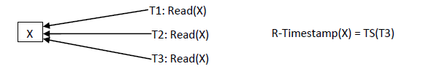
The read timestamp of data item X is denoted by R–timestamp(X).
R–timestamp(X): It is the time stamp of the youngest transaction that performed read operation on X.

Slide 101
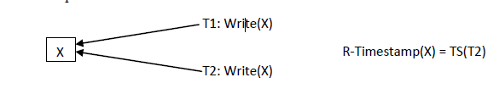
The write timestamp of data item X is denoted by W–timestamp(X).
W–timestamp(X): It is the time stamp of the youngest transaction that performed write operation on X.

Slide 102
Two Timestamp Ordering Algorithms
Basic Timestamp Ordering
Thomas Write rule

Slide 103
1.Basic Timestamp Ordering
Check the following condition whenever a transaction Ti issues a Read (X) operation:
If W_ timestamp(X) >TS(Ti) then the operation is rejected.
If W_ timestamp(X) <= TS(Ti) then the operation is executed.
(Read is not allowed by Ti, if any younger transactions than Ti write X)

Slide 104
Example:
Imagine transactions T1 and T2 accessing the same data item, "balance":
T1 starts with a timestamp (TS(T1) = 1) and reads the "balance". (Assume W_timestamp("balance") = 0, indicating no prior writes). The read is allowed.
T2 starts with a timestamp (TS(T2) = 2) and updates the "balance". W_timestamp("balance") is updated to 2.
Now, if T1 tries to read the "balance" again, it might be rejected because W_timestamp("balance") (which is 2) is greater than TS(T1) (which is 1). This ensures T1 doesn't read a value written by a younger transaction (T2) that started after T1 began.

Slide 105
Basic Timestamp Ordering
Check the following condition whenever a transaction Ti issues a Write(X) operation:
If TS(Ti) < R_ timestamp(X) then the operation is rejected. (Write is not allowed by Ti, if any younger transactions than Ti read X)
If TS(Ti) < W_ timestamp(X) then the operation is rejected and Ti is rolled back otherwise the operation is executed.
(Write is not allowed by Ti, if any younger transactions than Ti write X and also Ti should be rolled back and restarted later)

Slide 106
Example:
Continuing the scenario with T1 and T2:
T1 starts (TS(T1) = 1) and reads the "balance". (Assume W_timestamp("balance") and R_timestamp("balance") are both 0). The read is allowed, and R_timestamp("balance") is updated to 1.
Now, suppose T2 starts (TS(T2) = 2) and tries to write a new value to "balance". Since TS(T2) is less than R_timestamp("balance") (2 < 1), the write operation is rejected to prevent T2 from overwriting the value read by T1.

Slide 107
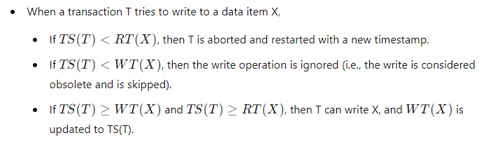
2.Thomas Write Rule

Slide 108
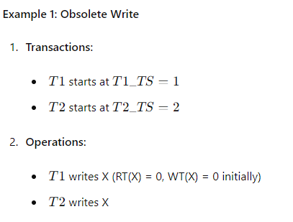

Slide 109
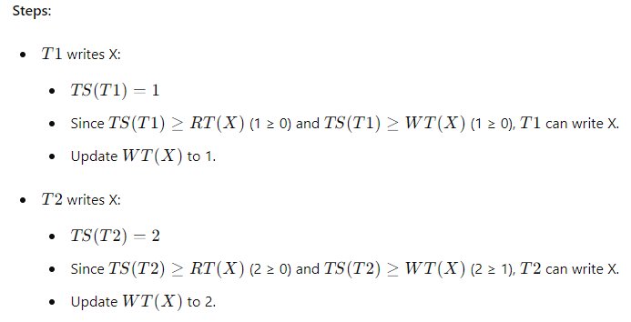

Slide 110
