Slide 1
DATABASE MANAGEMENT SYSTEMS
K.M.BABU (Asst. Professor)
CSE (AI & ML)
VITS, TS

Slide 2
Relational Data Model
Ted Codd, a computer scientist and mathematician, introduced this concept in 1970. •
Uses the concept of mathematical relation.

Slide 3
Terminologies related to RDBMS:
a. Relation
b. Tuple
c. Attributes
d. Domain
e. Relation Schema
f. Degree of a relation
g. Cardinality of a relation
h. Relational Database Schema
i. Relation instance (Relational database sta

Slide 4
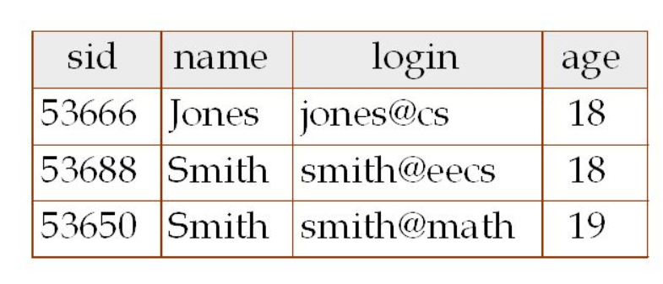
Degree and Cardinality of a Relation

Slide 5
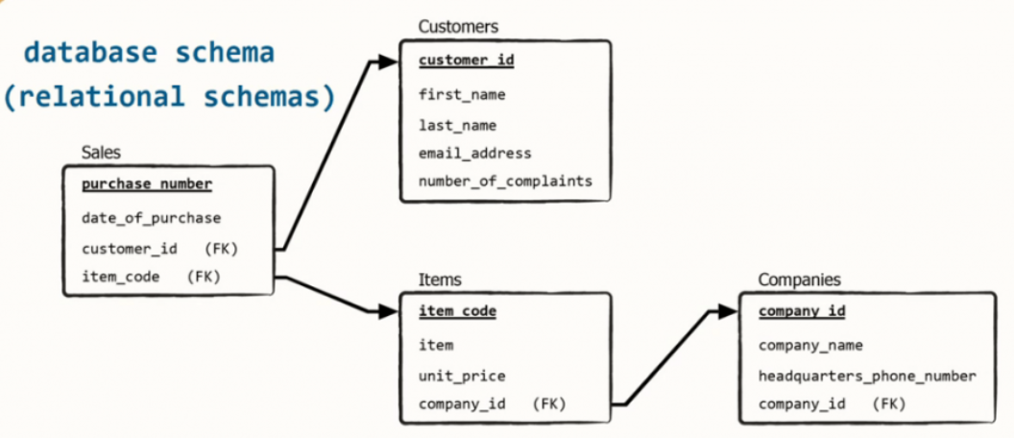

Slide 6
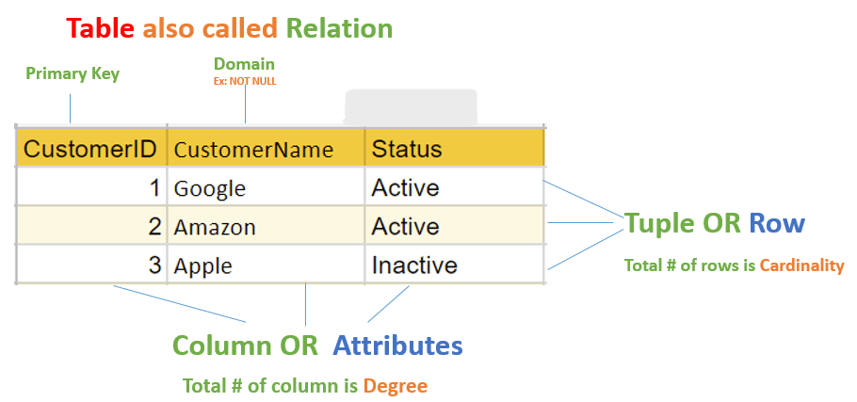

Slide 7
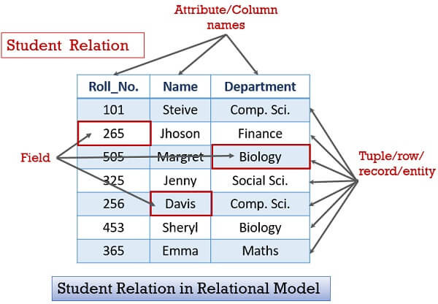

Slide 8
Integrity Constraints
1. Domain Constraints
2. Entity Integrity Constraints
3. Referential Integrity Constraints
4. Key Constraints

Slide 9
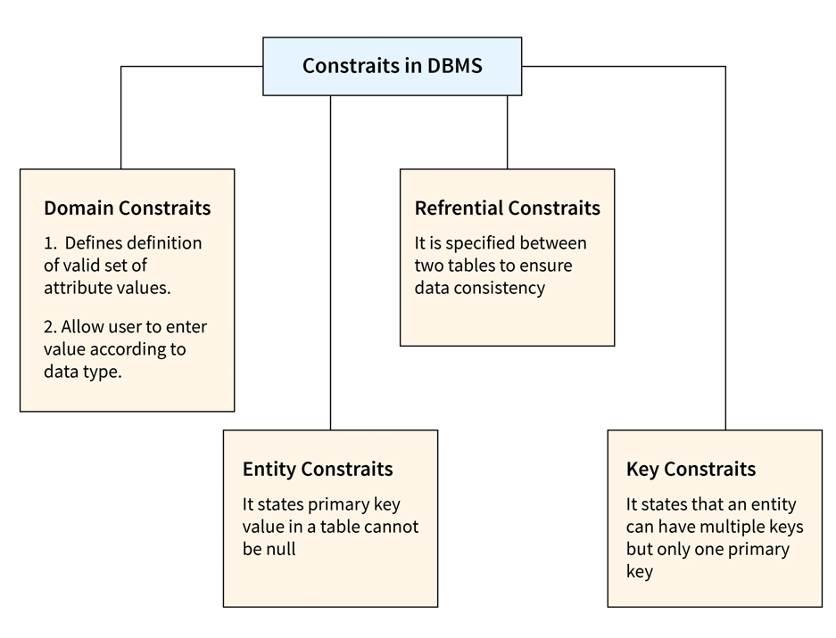

Slide 10
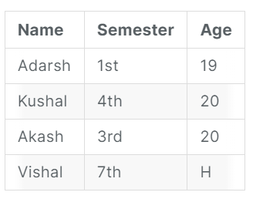
Domain Constraints

Slide 11
Types of Domain Constraints
•Not Null Domain Constraint
•Check Domain Constraint

Slide 12
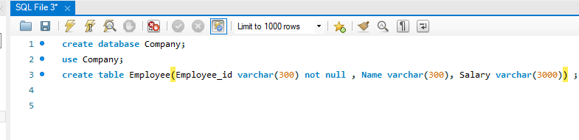
Not Null Domain Constraint: Example-1:

Slide 13
Example-2:
CREATE TABLE customers (
customer_id INT NOT NULL,
customer_name VARCHAR (255) NOT NULL
);

Slide 14
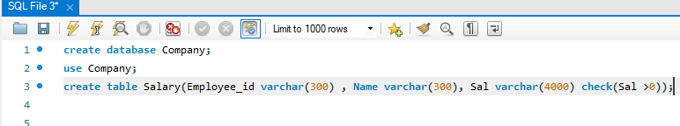
Check Domain Constraint: Example-1:

Slide 15
EXAMPLE-2
CREATE TABLE products (
product_id INT NOT NULL,
product_name VARCHAR(255) NOT NULL,
price DECIMAL(10,2) CHECK (price >= 0)
);

Slide 16
Entity Integrity Constraints
Example:
CREATE TABLE customers (
customer_id INT PRIMARY KEY,
customer_name VARCHAR(255) NOT NULL
);

Slide 17
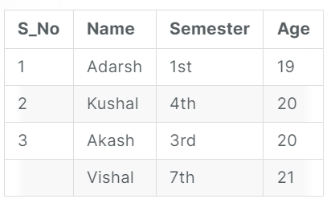
Example-2

Slide 18
Referential Integrity Constraints
Example-1:
CREATE TABLE orders (
order_id INT PRIMARY KEY,
customer_id INT NOT NULL,
);
CREATE TABLE customers (
customer_id INT PRIMARY KEY,
customer_name VARCHAR(255) NOT NULL,
);
ALTER TABLE orders
ADD FOREIGN KEY (customer_id) REFERENCES customers (customer_id) ON DELETE CASCADE;

Slide 19
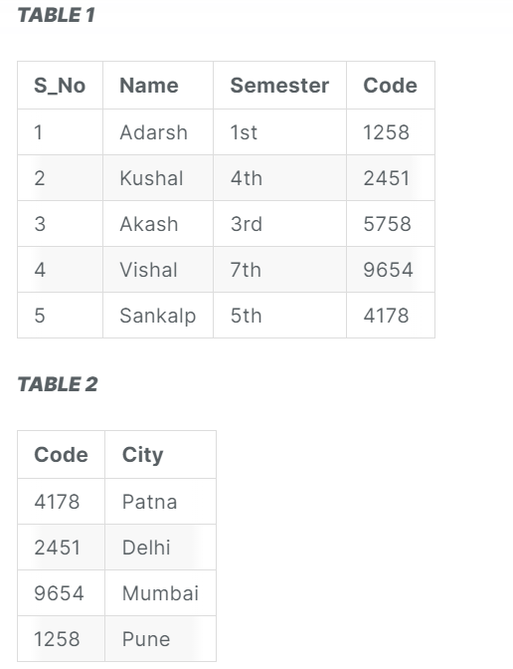
Example-2:

Slide 20
Types of Key Constraints:
1.Unique Key
2.Primary Key
3.Candidate Key
4.Super Key
5.Composite Key
6.Alternate Key
7.Foreign Key

Slide 21
Unique Key
CREATE TABLE Persons (
ID int NOT NULL,
LastName varchar(255) NOT NULL,
FirstName varchar(255),
Age int,
UNIQUE (ID)
);

Slide 22
CREATE TABLE Persons (
ID int NOT NULL,
LastName varchar(255) NOT NULL,
FirstName varchar(255),
Age int,
CONSTRAINT UC_Person UNIQUE (ID,LastName)
);

Slide 23
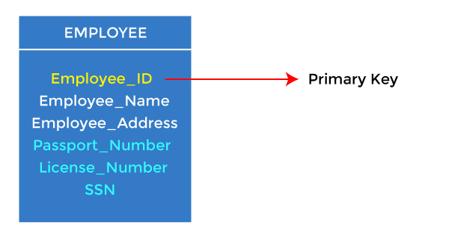
Primary Key:

Slide 24
CREATE TABLE EMPLOYEE (
Employee_ID INT NOT NULL PRIMARY KEY,
Employee_Name VARCHAR(255) NOT NULL,
Employee_Address VARCHAR(255),
Passport_Number VARCHAR(20),
License_Number VARCHAR(20),
SSN CHAR(11)
);

Slide 25
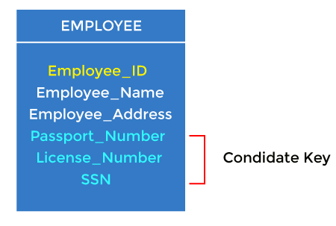
Candidate Key

Slide 26
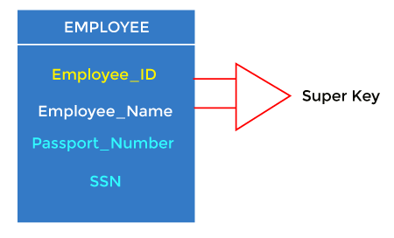
Super Key:

Slide 27
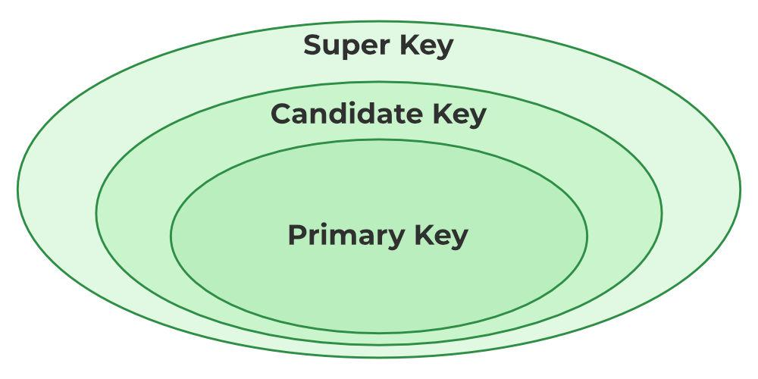

Slide 28
CREATE TABLE EMPLOYEE (
Employee_ID INT NOT NULL,
Employee_Name VARCHAR(255) NOT NULL,
Employee_Address VARCHAR(255),
Passport_Number VARCHAR(50),
License_Number VARCHAR(50),
SSN VARCHAR(50),
PRIMARY KEY (Employee_ID, Employee_Name)
);

Slide 29
Composite Key:
Example-1:
CREATE TABLE EMPLOYEE (
Employee_ID INT NOT NULL,
Employee_Name VARCHAR(255) NOT NULL,
Employee_Address VARCHAR(255),
Passport_Number VARCHAR(50),
License_Number VARCHAR(50),
SSN VARCHAR(50),
PRIMARY KEY (Employee_ID, Employee_Name)
);

Slide 30
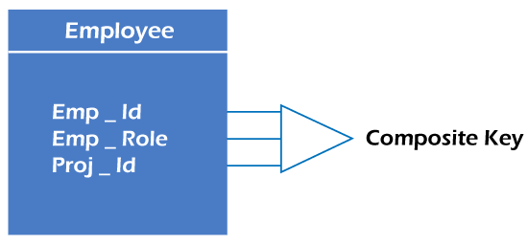
example-2:

Slide 31
CREATE TABLE EMPLOYEE (
Emp_Id INT NOT NULL;
……
……
Emp_Role VARCHAR(50) NOT NULL,
Proj_Id VARCHAR(50) NOT NULL,
PRIMARY KEY (Emp_Id, Emp_Role, Proj_Id)
);

Slide 32
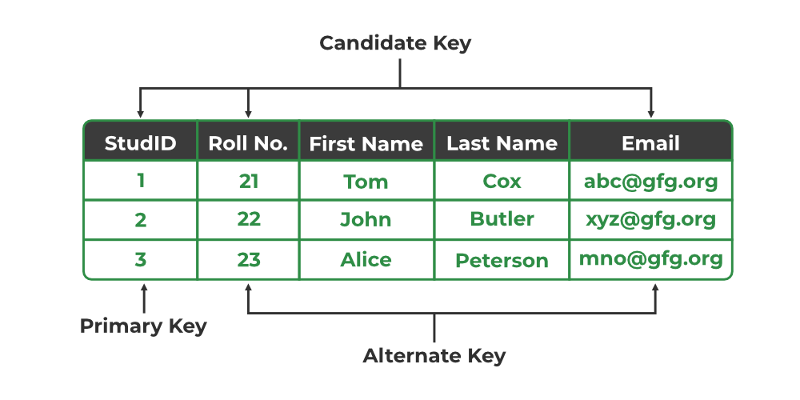
Alternate Key:

Slide 33
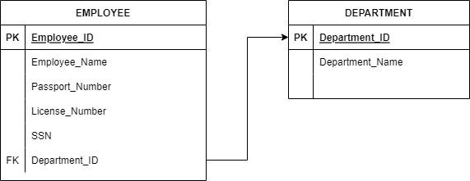
Foreign Key:

Slide 34
CREATE TABLE DEPARTMENT (
Department_ID INT PRIMARY KEY,
Department_Name VARCHAR(255) NOT NULL
);

Slide 35
CREATE TABLE EMPLOYEE (
Employee_ID INT PRIMARY KEY,
Employee_Name VARCHAR(255) NOT NULL,
Employee_Address VARCHAR(255),
Passport_Number VARCHAR(50),
License_Number VARCHAR(50),
SSN VARCHAR(50),
Department_ID INT NOT NULL,
FOREIGN KEY (Department_ID) REFERENCES DEPARTMENT(Department_ID)
);

Slide 36
Logical Database Design:
Here, we will see how to convert
●Regular (Strong) Entity Sets to Tables
●Weak Entity Sets to Tables
●Relationship Sets to Tables

Slide 37
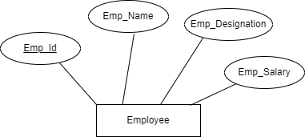
Converting Regular Entity Set to Table:

Slide 38
Process of Converting “Employee” ER Diagram to “Employee” Table
Step 1: Identify the entity name. The entity name in ER Diagram is simply the table name for the table.
Step 2: Identify the attributes of the entity. Attributes are the column names for the table.
Step 3: Draw the table.

Slide 39
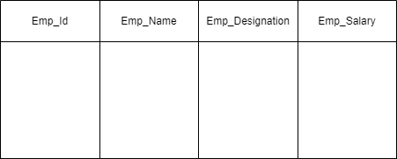

Slide 40
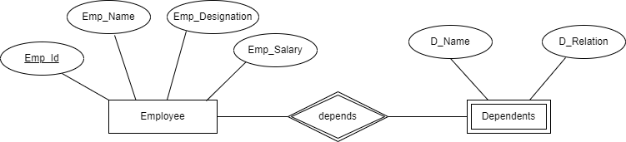
Converting Weak Entity Set to Table:

Slide 41
CREATE TABLE Employee (
Emp_Id INT NOT NULL AUTO_INCREMENT,
Emp_Name VARCHAR(50) NOT NULL,
Emp_Designation VARCHAR(50) NOT NULL,
Emp_Salary DECIMAL(10,2) NOT NULL,
PRIMARY KEY (Emp_Id)
);

Slide 42
CREATE TABLE Dependents (
Emp_ID INT NOT NULL,
D_Name VARCHAR(50) NOT NULL,
D_Relation VARCHAR(50) NOT NULL,
FOREIGN KEY (Emp_ID) REFERENCES Employee(Emp_Id),
PRIMARY KEY (Emp_ID, D_Name)
);

Slide 43
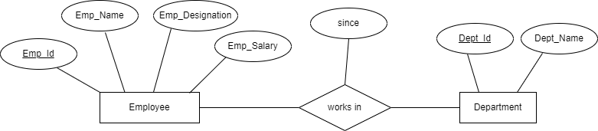
Converting Relationship Set to Table:

Slide 44
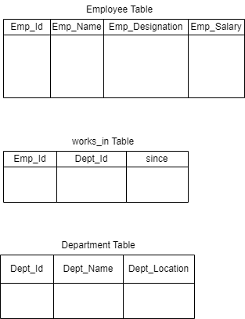

Slide 45
CREATE TABLE Department (
Dept_Id INT NOT NULL AUTO_INCREMENT,
Dept_Name VARCHAR(50) NOT NULL,
PRIMARY KEY (Dept_Id)
);

Slide 46
CREATE TABLE Employee (
Emp_Id INT NOT NULL AUTO_INCREMENT,
Emp_Name VARCHAR(50) NOT NULL,
Emp_Designation VARCHAR(50) NOT NULL,
Dept_Id INT NOT NULL,
PRIMARY KEY (Emp_Id),
FOREIGN KEY (Dept_Id) REFERENCES Department(Dept_Id)
);

Slide 47
CREATE TABLE works_in (
Emp_Id INT NOT NULL,
Dept_Id INT NOT NULL,
Since DATE NOT NULL,
PRIMARY KEY (Emp_Id, Dept_Id),
FOREIGN KEY (Emp_Id) REFERENCES Employee(Emp_Id),
FOREIGN KEY (Dept_Id) REFERENCES Department(Dept_Id)
);

Slide 48
Querying Relational Data
Query?
Querying?
SQL?

Slide 49
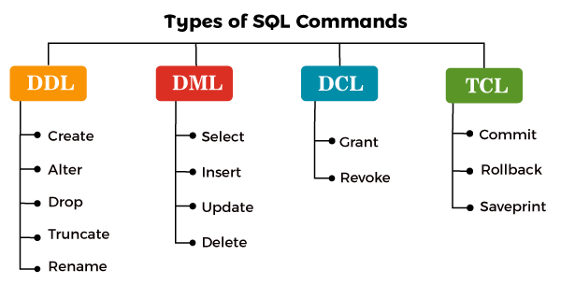

Slide 50
Data Definition Language (DDL)
Commands of DDL are:
CREATE,
ALTER,
DROP,
TRUNCATE,
RENAME

Slide 51
CREATE
Syntax for Creating a database:
CREATE DATABASE databasename;
Example:
CREATE DATABASE company;

Slide 52
Syntax for Creating a table:
CREATE TABLE table_name (
column1 datatype,
column2 datatype,
....
);
Example:
CREATE TABLE Employee (
Emp_Id INT,
Emp_Name VARCHAR(50),
Emp_Designation VARCHAR(50),
Emp_Salary DECIMAL(10,2)
);

Slide 53
ALTER
Using ALTER, We can achieve the following operations in a table:
●Add Column (Adding a new column)
●Drop Column (Deleting a Column)
●Modify Column Name (Changing the name of a column)
●Modify Column Datatype (Changing the datatype of a column)

Slide 54
ADD COLUMN:
Syntax for Adding a New Column in a Table;
ALTER TABLE table_name
ADD column_name datatype;
Example:
ALTER TABLE Employee
ADD date_of_birth DATE;

Slide 55
DROP COLUMN:
Syntax for Dropping a Column in a Table;
ALTER TABLE table_name
DROP COLUMN column_name;
Example:
ALTER TABLE Employee
DROP COLUMN date_of_birth;

Slide 56
RENAME COLUMN:
Syntax for Modifying a Column Name;
ALTER TABLE table_name RENAME COLUMN old_column_name TO new_column_name;
Example:
ALTER TABLE Employee RENAME COLUMN Emp_Designation TO Emp_Role;

Slide 57
MODIFY COLUMN DATATYPE:
Syntax for Modifying a Column Datatype;
ALTER TABLE table_name
MODIFY COLUMN column_name datatype;
Example:
ALTER TABLE Employee
MODIFY COLUMN Emp_Salary FLOAT;

Slide 58
DROP:
Syntax for deleting a database:
DROP DATABASE databasename;
Example:
DROP DATABASE company;

Slide 59
TRUNCATE
Syntax for making a table empty:
TRUNCATE TABLE table_name;
Example:
TRUNCATE TABLE Employee;

Slide 60
RENAME
Syntax for renaming a table:
RENAME old_table _name TO new_table_name;
Example:
RENAME Employee TO Emp;

Slide 61
DML (Data Manipulation Language):
Commands of DML are:
SELECT,
INSERT,
UPDATE,
DELETE

Slide 62
SELECT
Syntax to access all the rows(records) from a table:
SELECT * FROM table_name;
Example:
SELECT * FROM Employee;

Slide 63
Syntax to access selected rows(records) from a table:
SELECT column1, column2 FROM table_name;
Example:
SELECT Emp_Name, Emp_Salary FROM Employee;

Slide 64
INSERT:
We can perform insertion of records in two ways:
●Insert record in a single row
●Insert record in multiple rows

Slide 65
Syntax to insert a single record in table:
INSERT INTO table_name ( field1, field2,...fieldN )
VALUES ( value1, value2,...valueN );
Example:
Let's say we created a table like shown below:
CREATE TABLE People(
id int NOT NULL PRIMARY KEY,
name varchar(45) NOT NULL,
occupation varchar(35) NOT NULL,
age int
);

Slide 66
If we want to store single record
INSERT INTO People (id, name, occupation, age)
VALUES (101, 'Peter', 'Engineer', 32);

Slide 67
If we want to store multiple records
INSERT INTO People VALUES
(102, 'Joseph', 'Developer', 30),
(103, 'Mike', 'Leader', 28),
(104, 'Stephen', 'Scientist', 45);

Slide 68
UPDATE:
Syntax:
UPDATE table_name
SET column_name1 = new-value1,
column_name2 = new-value2, ...
[WHERE Clause]

Slide 69
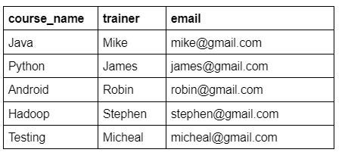

Slide 70
Scenario-1: Update Single Column
UPDATE institute
SET email = 'mike@yahoo.com'
WHERE course_name = 'Java';

Slide 71
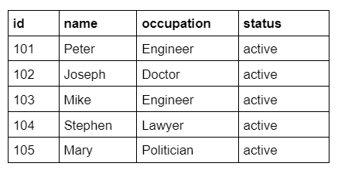
Scenario-2: Update Multiple Columns

Slide 72
UPDATE Society
SET status = 'inactive'
WHERE occupation = 'Engineer';

Slide 73
DELETE:
Syntax:
DELETE FROM table_name WHERE condition;

Slide 74
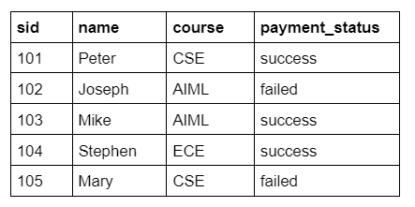
Example

Slide 75
DELETE FROM student WHERE payment_status=’failed’;

Slide 76
Views:
Syntax to create a view:
CREATE VIEW view_name AS
SELECT columns
FROM tables
[WHERE conditions];
- - - Here WHERE condition is optional

Slide 77
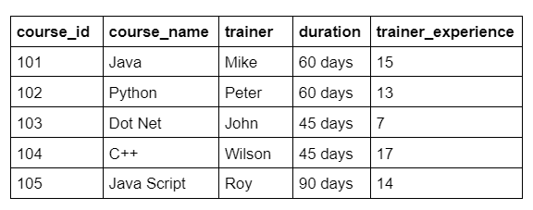
Example

Slide 78
Creating View
CREATE VIEW trainer AS
SELECT trainer, trainer_experience
FROM courses;

Slide 79
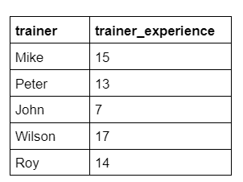
To see the created VIEW
SELECT * FROM view_name;
Example:
SELECT * FROM trainer;

Slide 80
Update View:
Syntax to update the existing view in MySQL:
ALTER VIEW view_name AS
SELECT columns
FROM table
WHERE conditions;

Slide 81
Example
ALTER VIEW trainer AS
SELECT trainer, trainer_experience, course_id
FROM courses;

Slide 82
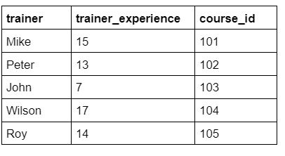
To see the view
SELECT * FROM trainer;

Slide 83
Drop VIEW:
Syntax:
DROP VIEW view_name;
Example:
DROP VIEW trainer;

Slide 84
Relational Algebra:
Relational Algebra is a procedural query language i.e. it focuses on what to do and how to do it.
Relational Algebra was introduced by Edgar F.Codd.

Slide 85
Types of Relational Operations:
1.Unary relational operations
2.Cartesian Product
3.Set Operations
4.Joins

Slide 86

1. Unary relational operations:

Slide 87
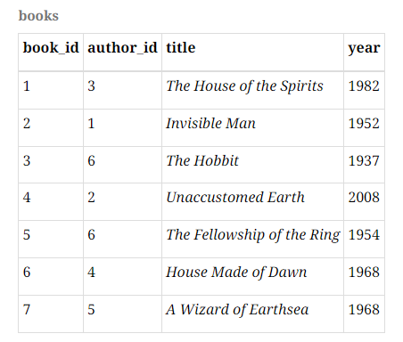
Example

Slide 88

Selection

Slide 89
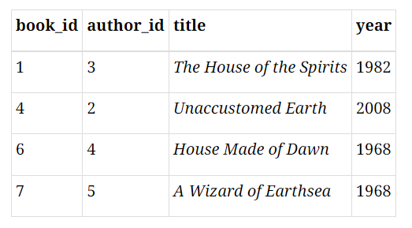
the result will be

Slide 90

For example, if we are interested in books published after 1960 as well as books by the author with author_id equal to 6, we could write:

Slide 91

For example, we could find the books published after 1950, and then select from that result the books with author_id equal to 6:

Slide 92
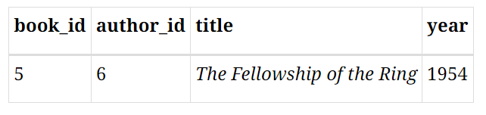
This would give us a result with one tuple:

Slide 93

Projection

Slide 94
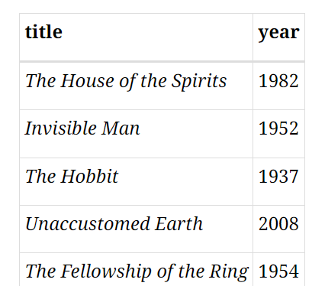
then the result will be

Slide 95

Since the result of projection is a relation, we can apply selection to the result:

Slide 96

Similarly, since the result of a selection is a relation, we can apply projection after selection. The above expression is equivalent to:

Slide 97
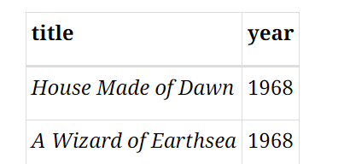
The result in both cases:

Slide 98

Renaming

Slide 99

A non-standard alternative notation allows us to rename only the attributes we want to change:

Slide 100
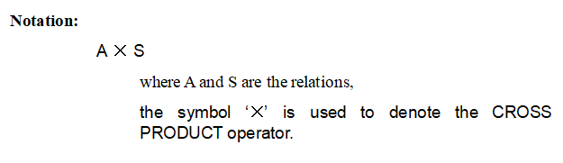
Cartesian Product:

Slide 101
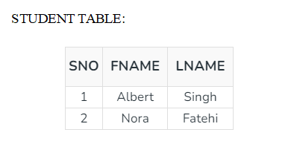
Example:

Slide 102
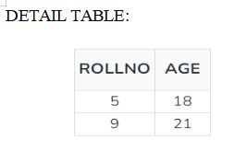

Slide 103
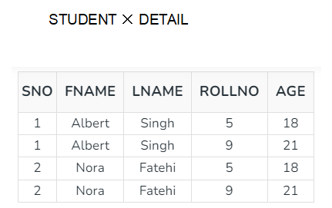
On applying CROSS PRODUCT on STUDENT and DETAIL:

Slide 104
Cardinality = m*n
where
m= number of attributes in 1st relation
n= number of attributes in 1st relation

Slide 105

Set Operations:

Slide 106
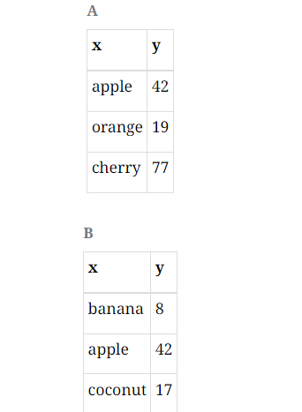
Union (U) -

Slide 107
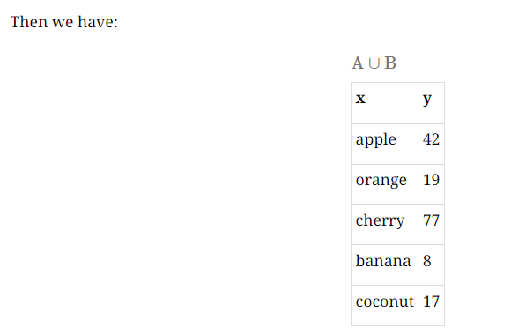

Slide 108
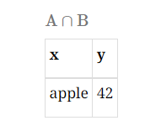
Intersection:

Slide 109
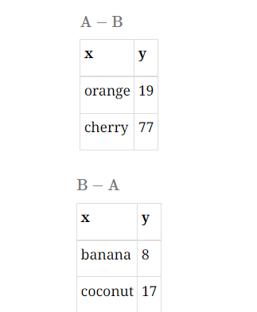
Set Difference:

Slide 110
Joins:
● It is denoted by ⨝.
Types of Join
1.Inner Join
2.Outer join

Slide 111
Inner join of two types.
●Equi Join
●Natural Join

Slide 112
Equi Join (=):
Let’s say we have two tables:
Customers table with columns:
customer_id, customer_name, and city
Orders table with columns:
order_id, customer_no, and order_date

Slide 113
For example
SELECT c.customer_name, o.order_id, o.order_date
FROM Customers c
INNER JOIN Orders o
ON c.customer_id = o.customer_no
WHERE c.customer_name = 'Alice';

Slide 114
Natural Join:
Let’s say we have two tables:
Customers table with columns:
customer_id, customer_name, and city
Orders table with columns:
order_id, customer_id, and order_date

Slide 115
For Example
SELECT *
FROM Customers
NATURAL JOIN Orders;

Slide 116
Outer Joins:
●Left Outer Join
●Right Outer Join
●Full Outer Join

Slide 117
Left Outer Join:
Imagine you have a library database with two tables:
Books (book_id, title, author_id) and Authors (author_id, author_name).
You want to see a list of all books, including those by authors who might not be in the Authors table yet.

Slide 118
Example
SELECT b.title, a.author_name
FROM Books b
LEFT OUTER JOIN Authors a ON b.author_id = a.author_id;

Slide 119
Right Outer Join:
Now, suppose you're tracking website traffic with tables
●Visitors (visitor_id, visit_time) and
● Locations (location_id, country).

Slide 120
Example
SELECT v.visitor_id, l.country
FROM Visitors v
RIGHT OUTER JOIN Locations l ON v.visitor_id = l.location_id;

Slide 121
Full Outer Join:
SELECT s.name, c.course_name
FROM Students s
FULL OUTER JOIN Courses c ON s.student_id = c.course_id;

Slide 122
Relational Calculus:
Relational Calculus exist in two forms:
●Tuple Relational Calculus
●Domain Relational Calculus

Slide 123
1. Tuple Relational Calculus (TRC)
{T | P (T)} or {T | Condition (T)}
Where
T is the resulting tuples
P(T) is the condition used to fetch T.

Slide 124
For example
{t | STUDENTS(t) ∧ t.name = "Alice"}

Slide 125
2. Domain Relational Calculus (DRC)
Notation:
1.{ a1, a2, a3, ..., an | P (a1, a2, a3, ... ,an)}
Where
a1, a2 are attributes
P stands for formula built by inner attributes

Slide 126
For example
{age | STUDENTS(s) ∧ s.name = "Alice" ∧ age = s.age}

