Slide 1
UNIT-5

Slide 2
Data on External Storage
Why we need External Storage?
Primary memory has limited storage capacity and is volatile. To overcome this limitation, secondary memory is also termed as external storage devices are used.
Examples of External Storage?
External storage devices such as disks and tapes are used to store data permanently.

Slide 3
Benefits:
The Secondary storage devices such as hard disk can be fixed or removable.
Storage devices that are portable and can be taken outside the computer are termed as removable storage devices such as CD, DVD, external hard disk, etc.

Slide 4
File Organization
The database is stored as a collection of files. Each file contains a set of records. Each record is a collection of fields. For example, a student table (or file) contains many records and each record belongs to one student with fields (attributes) such as Name, Date of birth, class, department, address, etc.
“File organization defines how file records are mapped onto disk blocks”

Slide 5
What is Disk Block?
The records of a file are stored in the disk blocks because a block is the unit of data transfer between disk and memory.
When the block size is larger than the record size, each block will contain more than one record.
If record size is larger than the block size, we can store part of a record on one block and the rest on another block.
A pointer at the end of the first block points to the next consecutive block for this type of large records.

Slide 6
Different types of file organization
Sequential File Organization
Heap File Organization
Hash File Organization
Clustered File Organization

Slide 7
1. Sequential File Organization
Sequential file organization is a method where records are stored in a specific order.
At the end of the file, new records can be added and there is no fixed length in it as you can update it.
Efficient for small datasets as the linear structure allows for quick processing and the entire set can be traversed easily.

Slide 8
Types of Sequential File Organization
Pile File Method
Sorted File Method

Slide 9
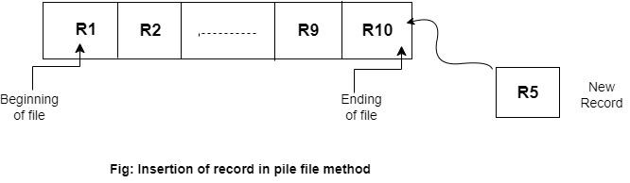
Pile File Method
The pile file method operates on a “first-come, first-served” basis, where the record comes first would be stored first in sequence.

Slide 10
Pile File Method
Whenever a new record is added then it will automatically append itself to the end of the existing file in a sequential manner.
In this, the files are not stored in a sorted manner.
Suppose in this the record R5 will be added to the end of the file, i.e., after record R10.

Slide 11
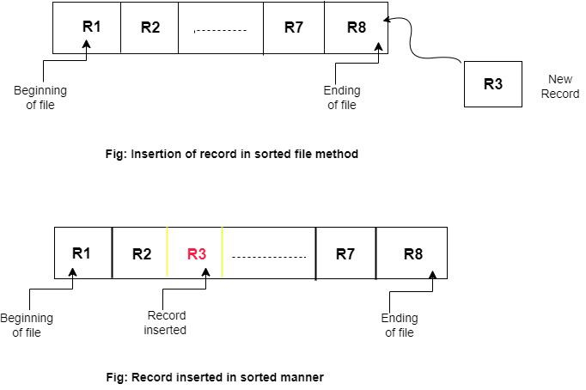
Sorted File Method: files are sorted in ascending or descending order

Slide 12
2. Heap File Organization
It works with data blocks. In heap file organization, the records are inserted at the file's end. When the records are inserted, it doesn't require the sorting and ordering of records.
When the data block is full, the new record is stored in some other block.
This new data block need not to be the very next data block, but it can select any data block in the memory to store new records.

Slide 13
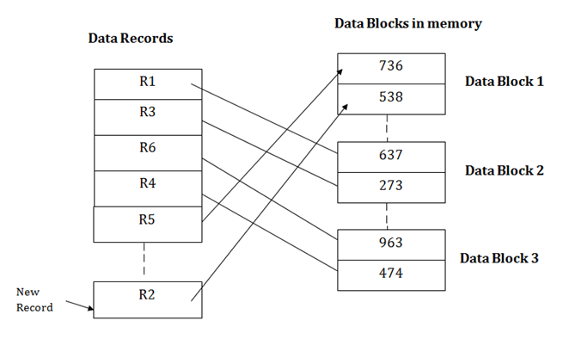
2. Heap File Organization

Slide 14
3. Hash File Organization
Hash File Organization uses the computation of hash function on some fields of the records.
The hash function's output determines the location of disk block where the records are to be placed.
When a record has to be received using the hash key columns, then the address is generated, and the whole record is retrieved using that address.
In the same way, when a new record has to be inserted, then the address is generated using the hash key and record is directly inserted. The same process is applied in the case of delete and update.

Slide 15
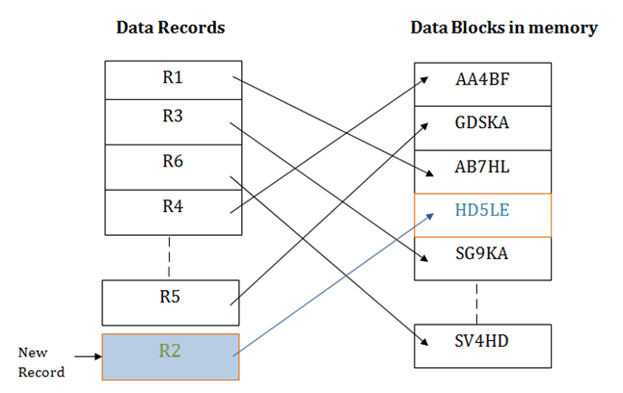

Slide 16
4. Clustered File Organization
When the two or more records are stored in the same file, it is known as clusters. These files will have two or more tables in the same data block, and key attributes which are used to map these tables together are stored only once.
This method reduces the cost of searching for various records in different files.
The cluster file organization is used when there is a frequent need for joining the tables with the same condition. These joins will give only a few records from both tables.

Slide 17
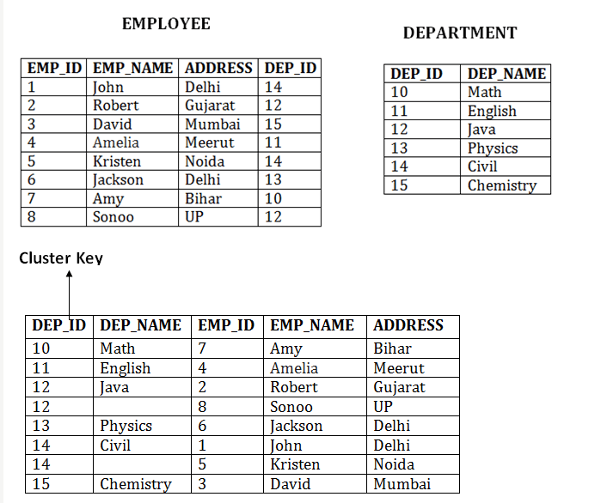

Slide 18
INDEXING
Indexing is a data structure technique which allows you to quickly retrieve records from a database file.
An Index is a small table having only two columns.
The first column contains a copy of the primary or candidate key of a table. The second column contains a set of disk block addresses where the record with that specific key value stored.

Slide 19
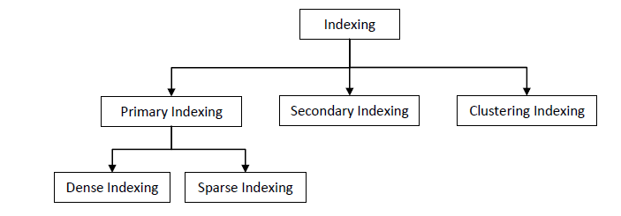
INDEXING

Slide 20
Primary Indexing
If the index is created by using the primary key of the table, then it is known as primary indexing.
As primary keys are unique and are stored in a sorted manner, the performance of the searching operation is quite efficient.
The primary index can be classified into two types: dense index and sparse index

Slide 21
Primary Index
Dense indexing
Sparse indexing

Slide 22
Dense indexing
If every record in the table has one index entry in the index table, then it is called dense index.
In this, the number of records (rows) in the index table is same as the number of records (rows) in the main table.
As every record has one index entry, searching becomes faster.

Slide 23
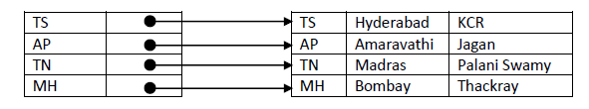
Dense indexing

Slide 24
Sparse indexing
If only few records in the table have index entries in the index table, then it is called sparse index.
In this, the number of records (rows) in the index table is less than the number of records (rows) in the main table.
As not all the record have index entries, searching becomes slow for records that does not have index entries.

Slide 25
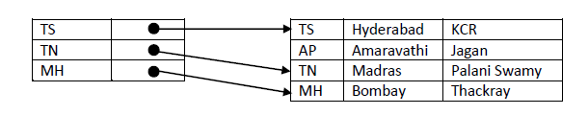
Sparse indexing

Slide 26
Secondary Indexing
When the size of the main table grows, then size of index table also grows. If the index table size grows then fetching the address itself becomes slower. To overcome this problem, secondary indexing is introduced.
In secondary indexing, to reduce the size of mapping, another level of indexing is introduced.
It contains two levels. In the first level each record in the main table has one entry in the first-level index table.
The index entries in the first level index table are divided into different groups. For each group, one index entry is created and added in the second level index table.

Slide 28
Clustering Index
Sometimes the index is created on non-primary key columns which may not be unique for each record.
In this case, to identify the record faster, we will group two or more columns to get the unique value and create index out of them. This method is called a clustering index.
The records which have similar characteristics are grouped, and indexes are created for these group.

Slide 29
Example:
Consider a college contains many students in each department. All the students belong to the same Dept_ID are grouped together and treated as a single cluster. One index pointers point to the one cluster as a whole. The idex pointer points to the first record in each cluster. Here Dept_ID is a non-unique key.

Slide 30
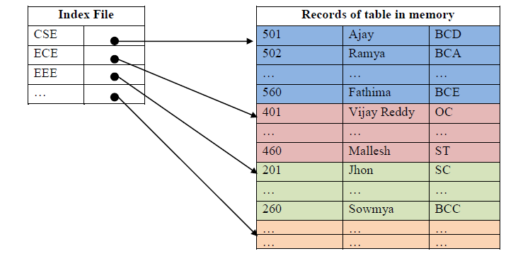

Slide 31
HASH BASED INDEXING
Hashing is a technique to directly search the location of desired data on the disk without using index structure.
Hash function is a function which takes a piece of data ( key) as input and produces a hash value as output which maps the data to a particular location in the hash table.

Slide 32
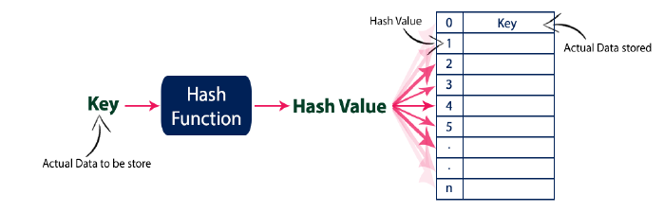

Slide 33
There are mainly two types of hashing methods:
i. Static Hashing
ii. Dynamic Hashing
Extended hashing
Linear hashing

Slide 34
STATIC HASHING
In static hashing, the hash function produce only fixed number of hash values.
For example consider the hash function
f(x) = x mod 7
For any value of x, the above function produces one of the hash value from {0, 1, 2, 3, 4, 5, 6}. It means static hashing maps search-key values to a fixed set of bucket addresses.

Slide 35
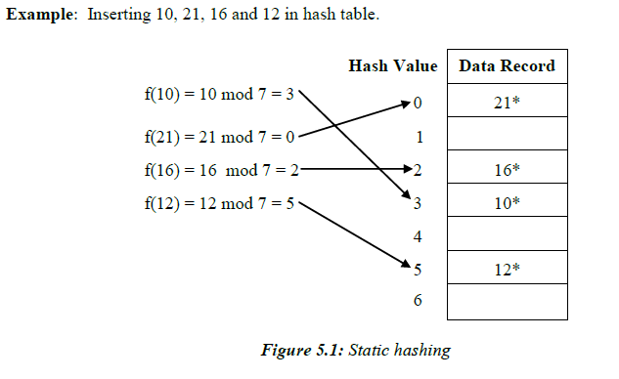

Slide 36
Suppose, latter if we want to insert 23, it produce hash value as 2 ( 23 mod 7 = 2 ). But, in the above hash table, the location with hash value 2 is not empty (it contains 16*). So, a collision occurs.
To resolve this collision, the following techniques are used.
Open addressing
Separate Chaining or Closed addressing

Slide 37
Open Addressing:
Open addressing is a collision resolving technique which stores all the keys inside the hash table.
No key is stored outside the hash table.

Slide 38
Techniques used for open addressing:
Linear Probing
Quadratic Probing
Double Hashing

Slide 39
Linear Probing
In linear probing, when there is a collision, we scan forwards for the next empty slot to fill the key’s record. If you reach last slot, then start from beginning.

Slide 40
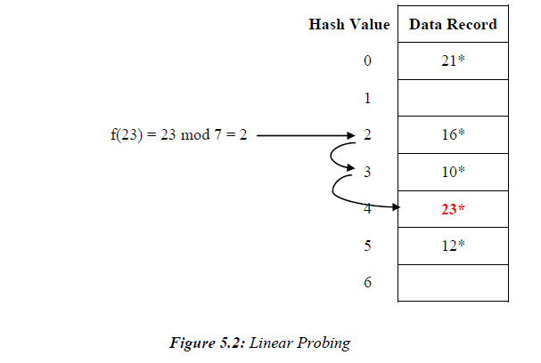

Slide 41
Quadratic Probing:
In quadratic probing, when collision occurs, it compute new hash value by taking the original hash value and adding successive values of quadratic polynomial until an open slot is found. If here is a collision, it use the following hash function: h(x) = ( f(x) + i2 ) mod n , where I = 1, 2, 3, 4,….. and f(x) is initial hash value.

Slide 42
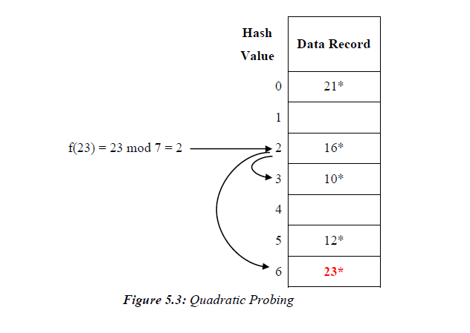

Slide 43
Double Hashing
In double hashing, there are two hash functions. The second hash function is used to provide an offset value in case the first function causes a collision. The following function is an example of double hashing:
(firstHash(key) + i * secondHash(key)) % tableSize.
Use i = 1, 2, 3, …
A popular second hash function is :
secondHash(key) = PRIME – (key % PRIME)
where PRIME is a prime smaller than the TABLE_SIZE.

Slide 44
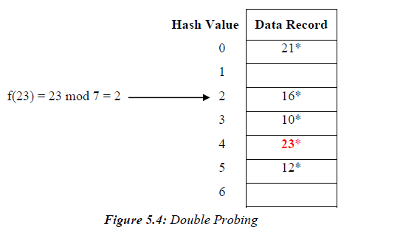

Slide 45
Separate Chaining or Closed addressing
To handle the collision, This technique creates a linked list to the slot for which collision occurs. The new key is then inserted in the linked list. These linked lists to the slots appear like chains.
So, this technique is called as separate chaining. It is also called as closed addressing

Slide 46
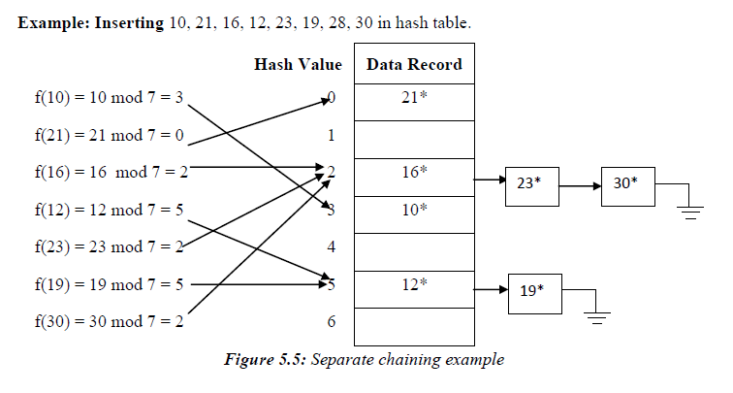

Slide 47
Dynamic Hashing
The problem with static hashing is that it does not expand or shrink dynamically as the size of the database grows or shrinks. Dynamic hashing provides a mechanism in which data buckets are added and removed dynamically and on-demand. Dynamic hashing can be implemented using two techniques.
They are:
Extended hashing
Linear Hashing

Slide 48
Extendable hashing
In extendable hashing, a separate directory of pointers to buckets is used.
The number bits used in directory is called global depth (gd) and number entries in directory = 2gd.
Number of bits used for locating the record in the buckets is called local depth(ld) and each bucket can stores up to 2ld entries.
The hash function use last few binary bits of the key to find the bucket. If a bucket overflows, it splits, and if local depth greater than global depth, then the table doubles in size.

Slide 49
Example: Let global depth (gd) = 2. It means the directory contains four entries. Let the local depth (ld) of each bucket = 2. It means each bucket need two bits to perform search operation. Let each Bucket capacity is four.
Let us insert 21, 15, 28, 17, 16, 13, 19, 12, 10, 24, 25 and 11.

Slide 50
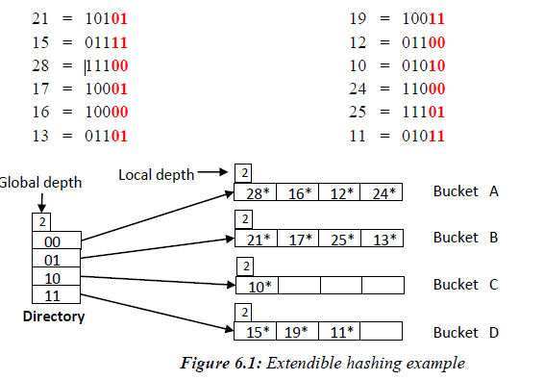

Slide 51
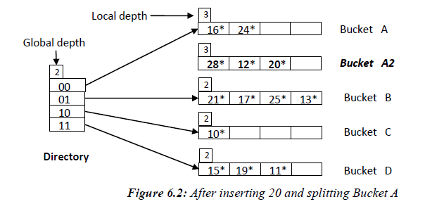

Slide 52
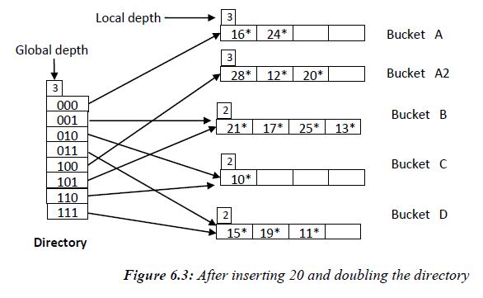

Slide 53
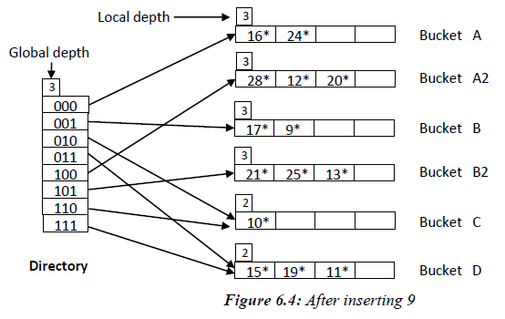

Slide 54
Key Observations:
A Bucket will have more than one pointers pointing to it if its local depth is less than the global depth.
When overflow condition occurs in a bucket, all the entries in the bucket are rehashed with a new local depth.
If new Local Depth of the overflowing bucket is equal to the global depth, only then the directories are doubled and the global depth is incremented by 1.
The size of a bucket cannot be changed after the data insertion process begins.

Slide 55
Linear Hashing
Linear hashing is a dynamic hashing technique that linearly grows or shrinks number of buckets in a hash file without a directory as used in Extendible Hashing. It uses a family of hash functions instead of single hash function.

Slide 56

Linear Hashing
where N is the initial number of buckets and i = 0,1,2,….

Slide 57
Linear Hashing
Initially it use N buckets labelled 0 through N–1 and an initial hashing function h0(key) = key % N is used to map any key into one of the N buckets.
For each overflow bucket, one of the buckets in serial order will be splited and its content is redistributed between it and its split image.
That is, for first time overflow in any bucket, bucket 0 will be splited, for second time overflow in any bucket; bucket 1 will be splited and so on.

Slide 58
Example: Let N = 4, so we use 4 buckets and hash function h0(key) = key % 4 is used to map any key into one of the four buckets. Let us initially insert 4, 13, 19, 25, 14, 24, 15, 18, 23, 11, 16, 12 and 10.This is shown in the below figure.

Slide 59
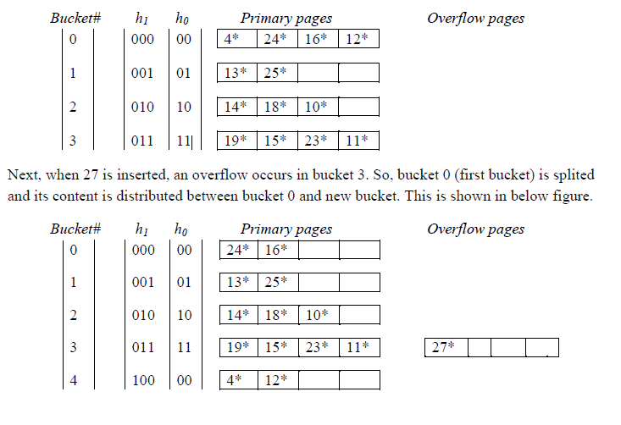

Slide 60
Next, when 30, 31 and 34 is inserted, an overflow occurs in bucket 2. So, bucket 1 is splited and its content is distributed between bucket 1 and new bucket. This is shown in below figure.

Slide 61
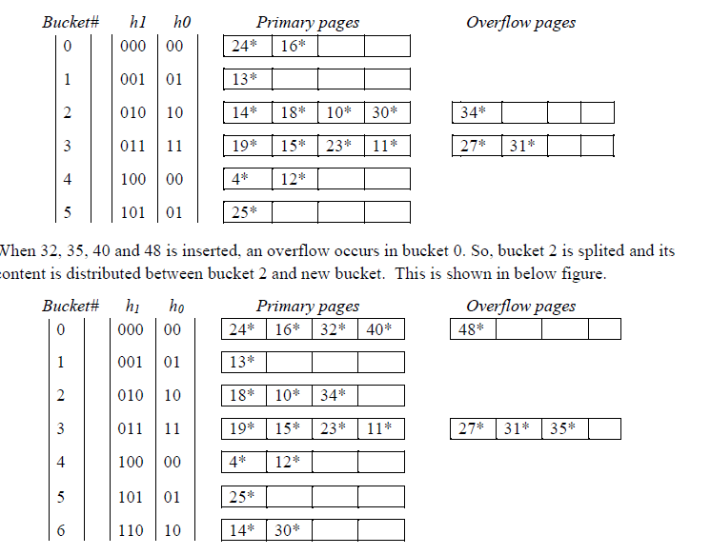

Slide 62
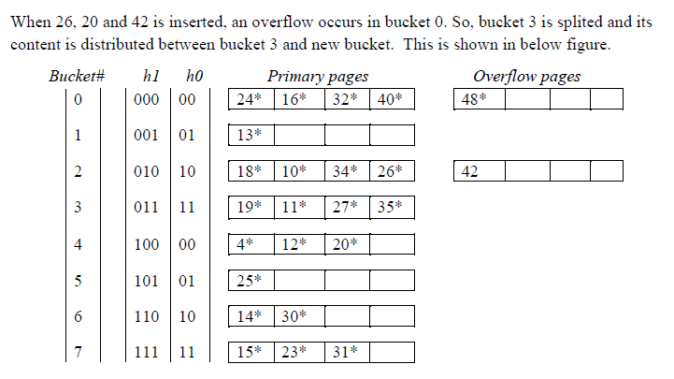

Slide 63
Tree Structure Indexes
We use mainly two tree structure indexes in DBMS. They are:
Indexed Sequential Access Methods (ISAM)
B+ Tree

Slide 64
Indexed Sequential Access Methods (ISAM)
ISAM contain three types of nodes:
Non-leaf nodes(Data pages): They store the search index key values.
Leaf nodes (Primary leaf pages): They store the index of records.
Overflow nodes(overflow pages): They also store the index of records but after the leaf node is full.

Slide 65
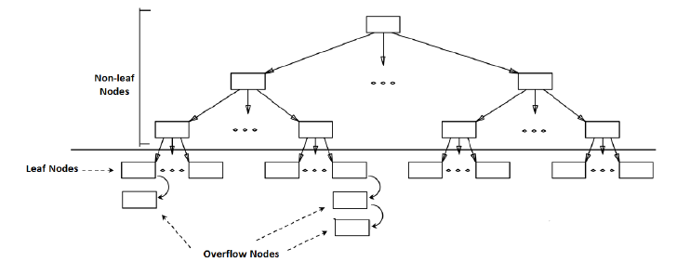

Slide 66
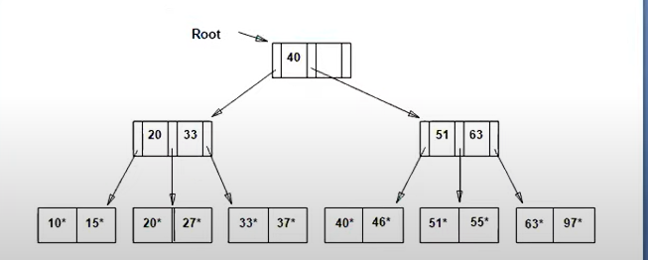

Slide 67
If we are not able to accommodate data in primary leaf pages, we store the data in overleaf pages.

Slide 68
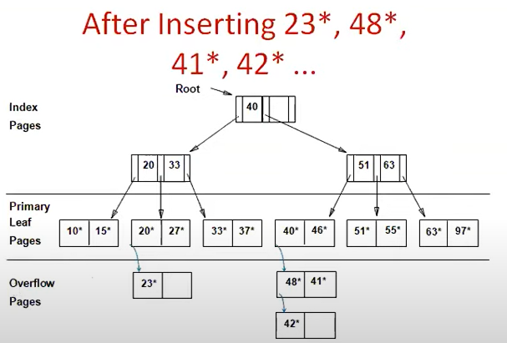

Slide 69
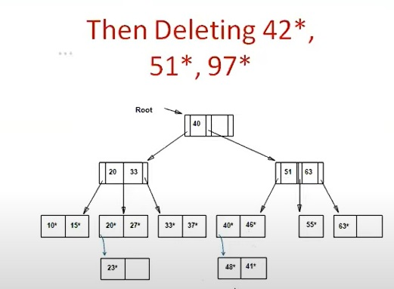

Slide 70
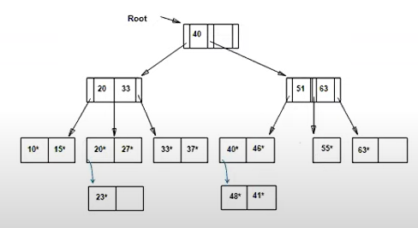

Slide 71
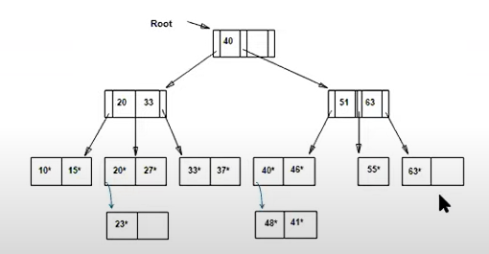

Slide 72
Pros of ISAM
Searching the record is quick and easy.
Cons of ISAM
When the record is deleted, the space used by it needs to be released. Otherwise, the performance of the database will decrease.

Slide 73
B+ TREE
The B+ tree is a balanced binary search tree. It follows a multi-level index format.
In the B+ tree, leaf nodes denote actual data pointers. B+ tree ensures that all leaf nodes remain at the same height.
In the B+ tree, the leaf nodes are linked using a link list. Therefore, a B+ tree can support random access as well as sequential access.

Slide 74
Structure of a B+ Tree
Internal Nodes: These nodes contain keys and pointers to child nodes. They do not store actual data values but are used to guide the search process.
Leaf Nodes: These nodes contain keys and corresponding data values or pointers to data records.

Slide 75
Nodes
Max child nodes (m)
Min child nodes (m/2)
Keys:
Max keys(m-1)
Min keys(m/2 -1)

Slide 76
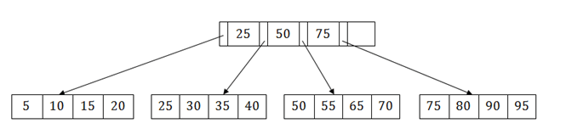
Example of B+ Tree Search

Slide 77
Example of B+ Tree Insertion 5,10,12,15,6,21,45,36,65,14
Lets say Order=4 i.e m=4
Nodes
Max child nodes (m) = 4
Min child nodes (m/2) = 2
Keys:
Max keys(m-1)= 3
Min keys(m/2 -1)=2-1-1

Slide 78
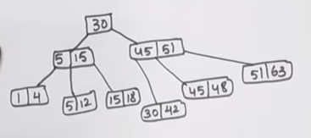
Example of B+ Tree Deletion (with Order(m)=4)

Slide 79
DELETE 12,51,30,5,18

