Slide 1
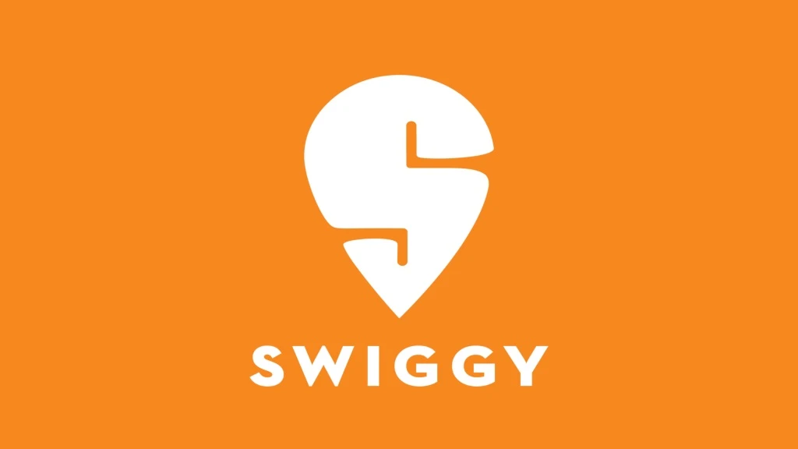

Slide 2
📌 Overview
This project performs a comprehensive Exploratory Data Analysis (EDA) on a dataset derived from Swiggy, one of India’s largest online food delivery platforms. The goal is to uncover insights into restaurant performance, delivery trends, customer ratings, and city/area-based behaviors to guide business decisions and strategy.

Slide 3
🔍 Key Objectives
Analyze restaurant performance by city and area.
Explore distribution of food prices, delivery times, and average ratings.
Identify top-performing and underperforming areas and restaurants.
Visualize trends and outliers using histograms, scatter plots, KDEs, and bar charts.
Compare delivery times and ratings across cities and restaurant types.

Slide 4
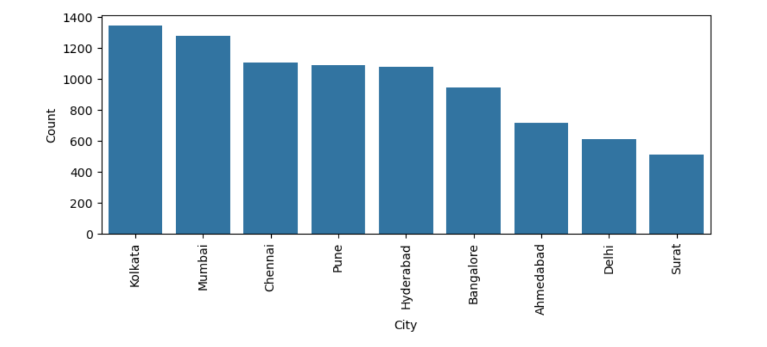
Maximum number of restaurants is in Kolkata followed by Mumbai

Slide 5
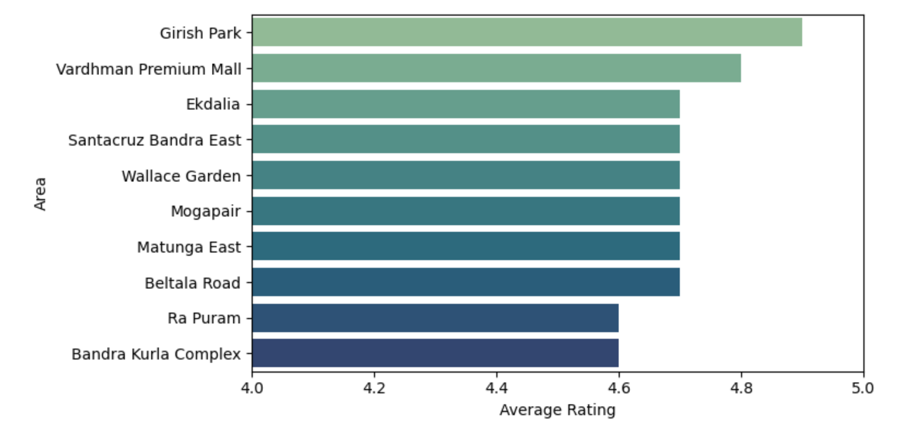
Top 10 Areas having highest rating

Slide 6
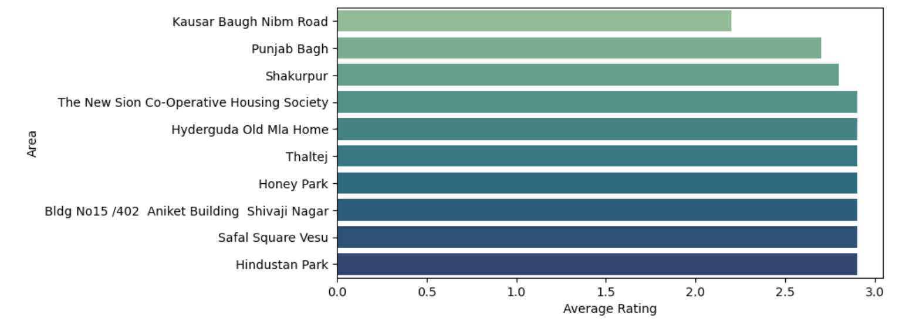
Bottom 10 Areas having lowest rating

Slide 7
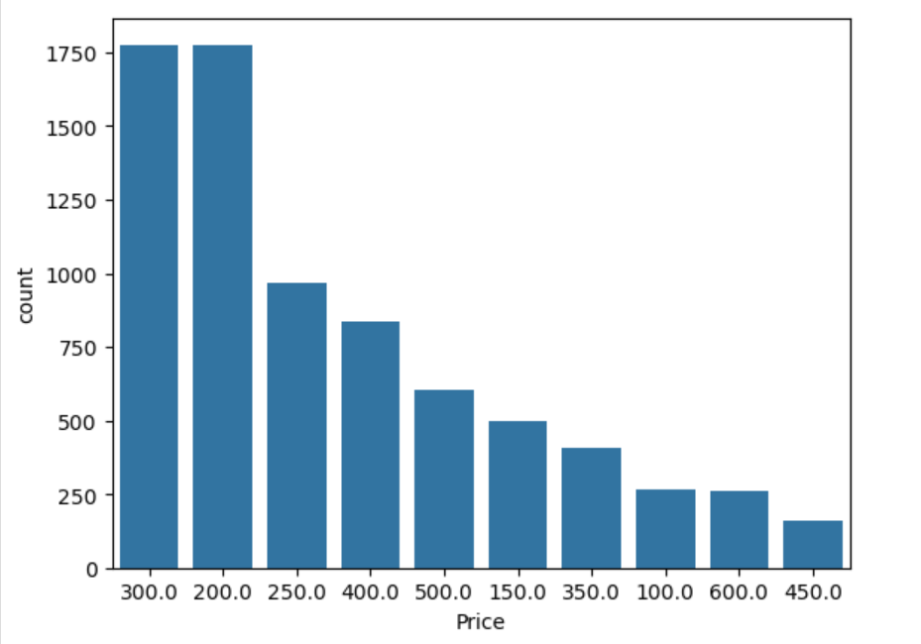
Most frequent ordered prices are 300 and 200.

Slide 8
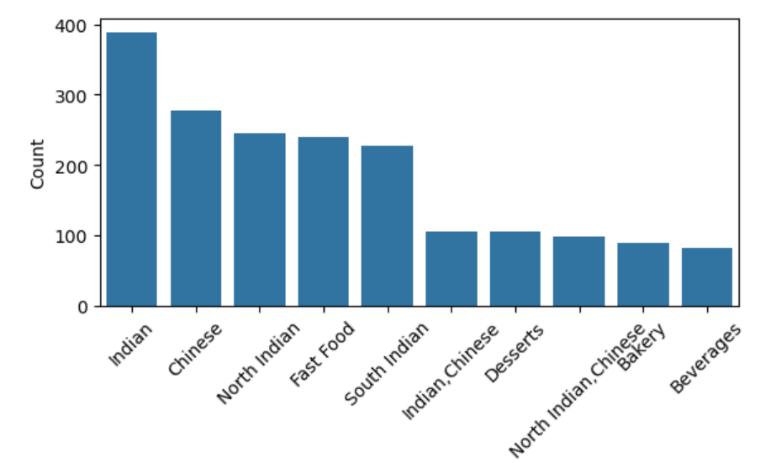
Indian Food Type was ordered most followed by Chinese having significant difference. Lease ordered Food Type is beverages. Top 5 are Indian > Chinese > North Indian > Fast Food > South Indian

Slide 9
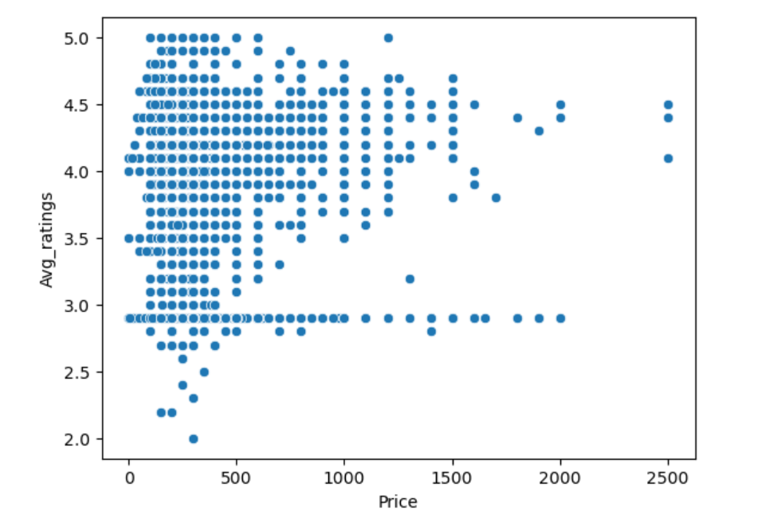
Scatterplot between Avg_ratings and Price:
Most dots are concentrated between:
Price: ₹100 to ₹500
Avg ratings: 3.5 to 4.5

Slide 10
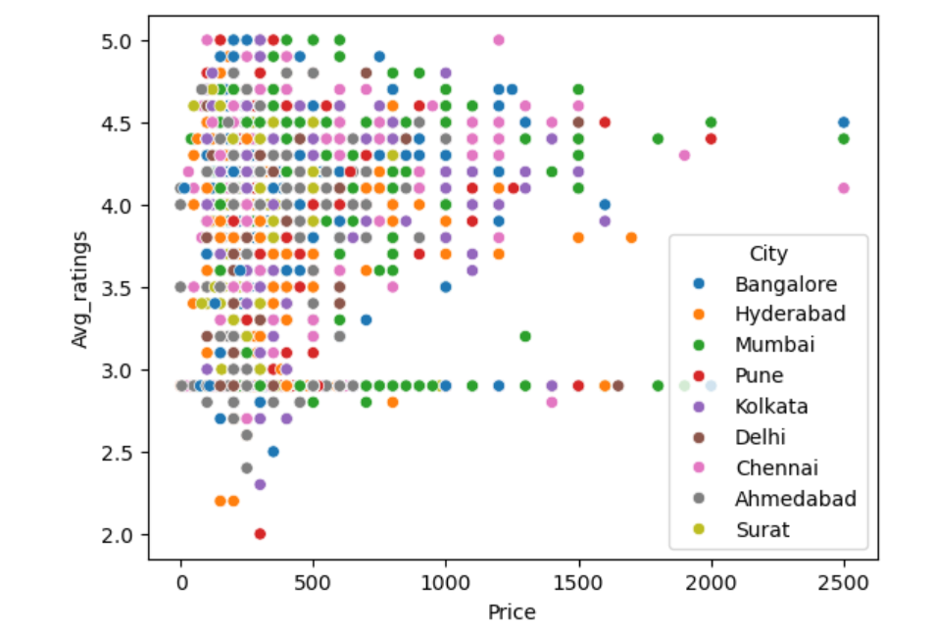
Scatterplot between Avg_ratings and Price taking City as hue:

Slide 11
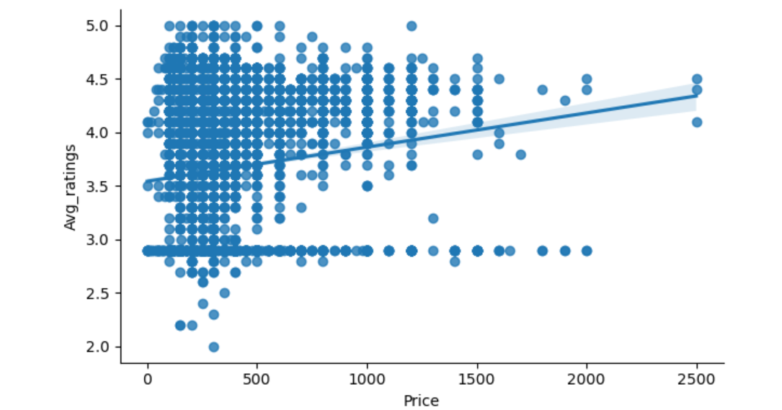
The upward slope of the line suggests a slight positive correlation: as price increases, ratings tend to increase a little.
However, the spread of the dots around the line shows lots of variability, meaning price is not a strong predictor of rating.
The shaded area is the confidence interval, showing uncertainty around the trend. A wider band = less confidence.

Slide 12
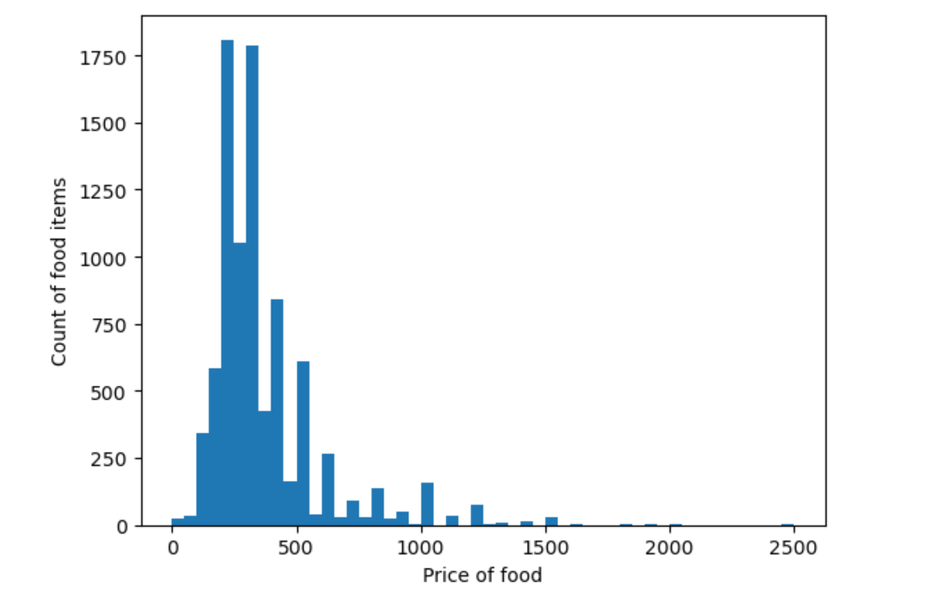
Below graph shows that maximum food items have their price around 200 to 300.

Slide 13
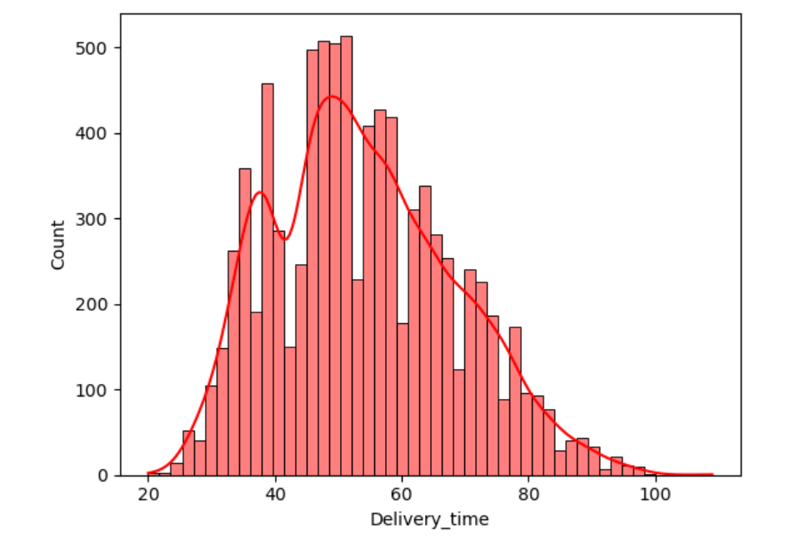
Most Common Delivery Time (Mode) : 45 minutes.
The KDE shows a right-skewed distribution (longer tail on the right). Most deliveries happen in 35–60 minutes, but some take longer, up to 100+ minutes.
Multi-modality (Two Peaks): The KDE line has two visible humps (peaks) — one around 35–40 mins and another around 45–50 mins. Two types of delivery patterns (e.g., quick-service vs full-service restaurants).

Slide 14
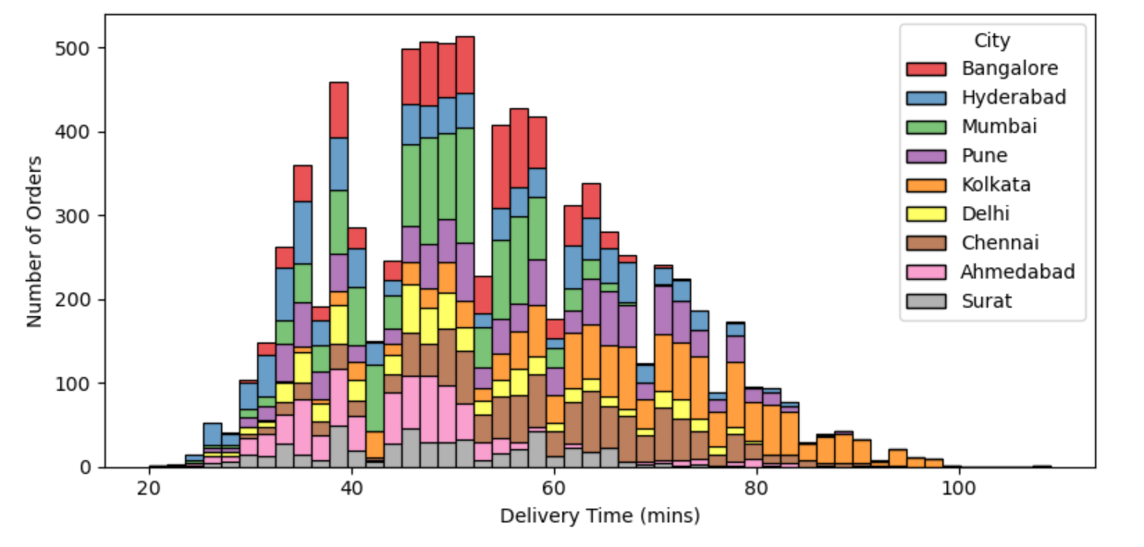
Majority deliveries 35–55 mins across cities
Mumbai & Hyderabad Fastest & most consistent
Kolkata Longest delivery tails
Surat & Ahmedabad Tend to deliver faster

Slide 15
Observations:
Maximum number of restaurants is in Kolkata followed by Mumbai
Top 5 restaurants having highest rating:
La Pino'Z Pizza > Nic Natural Ice Creams > Baskin Robbins > Subway > Kfc
Bottom 10 restaurants having lowest rating:
Maggi Bowl > Jannath Chicken > Urban Foods Ambawadi > Down Town House > Cia Chinese
Top 5 Areas having highest rating:
Girish Park > Vardhman Premium Mall > Ekdalia > Santacruz Bandra East > Wallace Garden
Top 5 Areas having lowest rating:
Kausar Baugh Nibm Road > Punjab Bagh > Shakurpur > Dapodi > Dhanakawadi

Slide 16
Most frequent ordered prices are 300 and 200.
Indian Food Type was ordered most followed by Chinese having significant difference. Lease ordered Food Type is beverages. Top 5 are Indian > Chinese > North Indian > Fast Food > South Indian
Average delivery time is 53.96 min
Avg ratings: 3.5 to 4.5
Most deliveries happen in 35–60 minutes
Regression Plot: Slight positive trend — higher price may slightly relate to higher rating, but with high variability
KDE Plots: Suggest two delivery patterns — quick-service and full-service
Mumbai & Hyderabad Fastest & most consistent
Kolkata Longest delivery tails
Surat & Ahmedabad Tend to deliver faster

