Slide 1
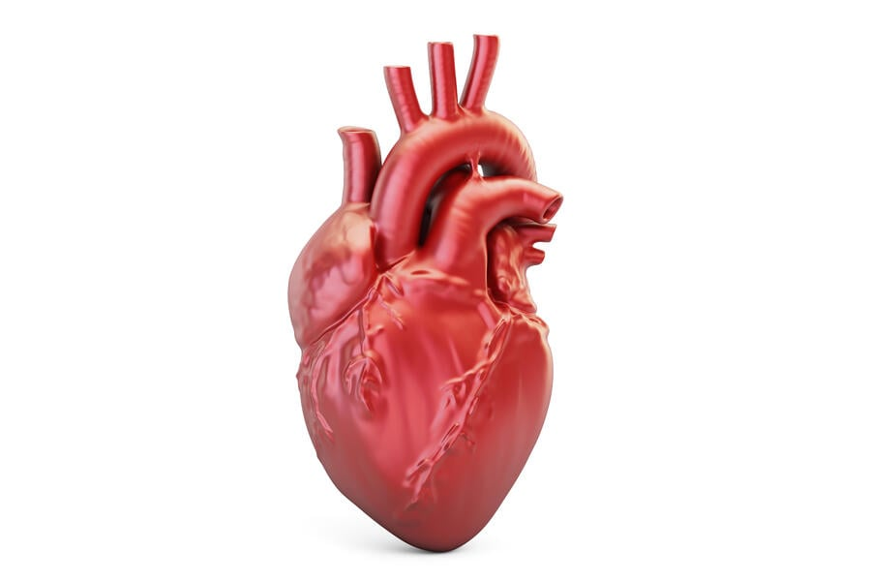
ANALYSIS AND PROGNOSIS OF HEART ATTACKS
TEAM # 14
NAVYATHA YAMSANI
MANI RENUKUNTLA
ADITYA ANANTHULA
NITHIN KUMAR NAGULA
AKHILA GOGULAMUDI

Slide 2
Agenda
Introduction
Dataset
Data description
Data Dependency
Model
Model Accuracy
Results

Slide 3
INTRODUCTION
According to estimates, 21.8 million people died from cardiovascular diseases (CVs) last year, which accounted for 32% of all global deaths. Of those, 4 out of 5 were due to heart attacks and stroke, and one-third occurred before the age of 70. In 2012 alone, nearly 7 million people died because of heart problems, which was an increase of 6.6% compared to 2011. Cardiovascular diseases account for the highest number of deaths globally. The rate of cardiovascular deaths is higher among males than females and increases with advancing age.
So, we are proposing a machine learning model which will be able to help identify those with cardiovascular disease or who might be at higher risk due to the presence of certain risk factors such as high blood pressure, diabetes, high cholesterol levels, or an underlying medical condition.

Slide 4
Dataset
The dataset is open-sourced dataset from Kaggle. It consists of csv file “heart.csv” with patient following information:
Age:- patient age
Sex:- Patient sex
Cp :- Chest pain type(0,1,2,3)
Trtbps:- resting blood pressure
Chol:- cholesterol using BMI sensor
Fbs:- fasting blood sugar (1,0)
Restecg:- Resting electrocardiographic results(0,1,2)
Thalachh:- Maximum heart rate achieved
Exng:- Exercise induced angina
OldPeak:- Previous Peak
Slp:- Slope
Caa:- Number of major vessels
Thall:- Thalium Stress Test result ~ (0,3)
Output:- Target Variable

Slide 5
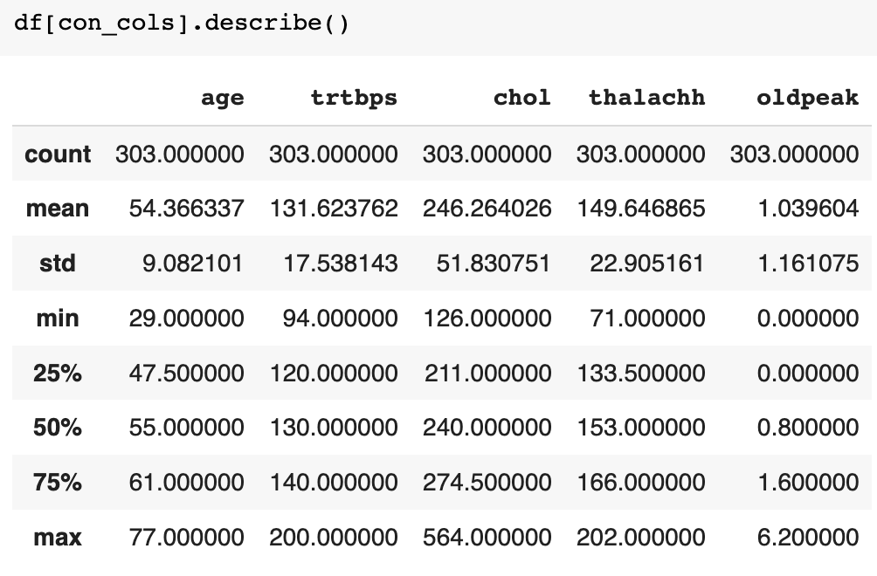
Describing the data

Slide 6
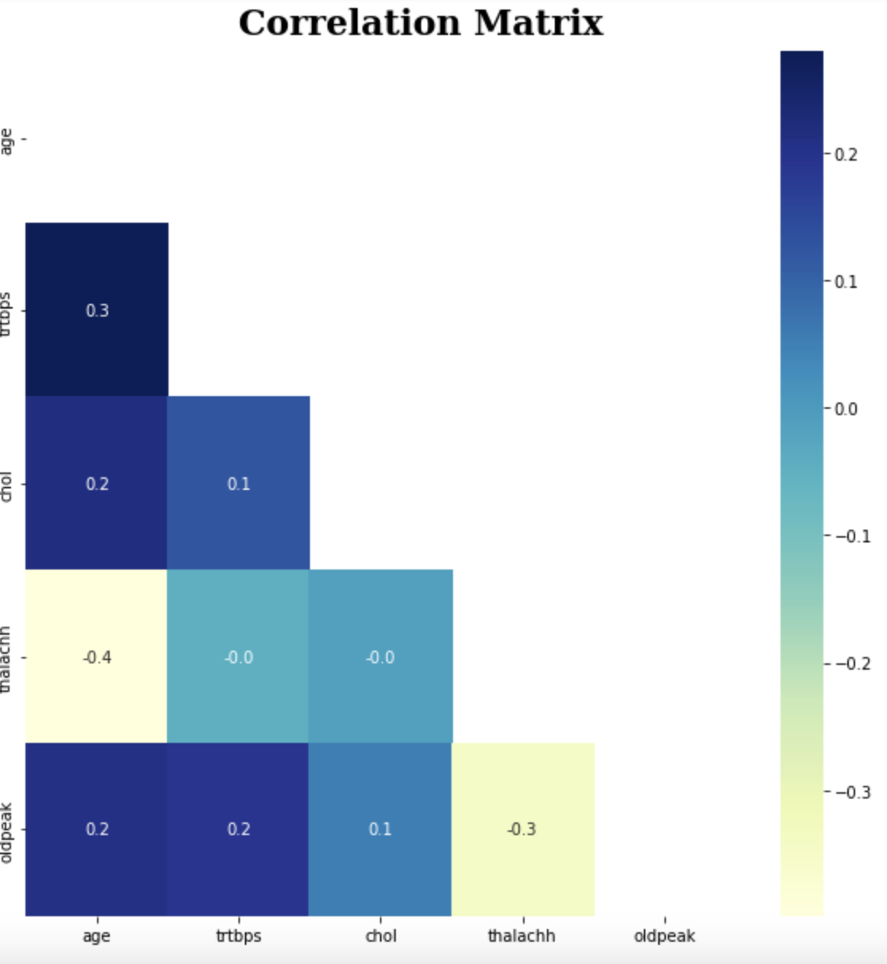
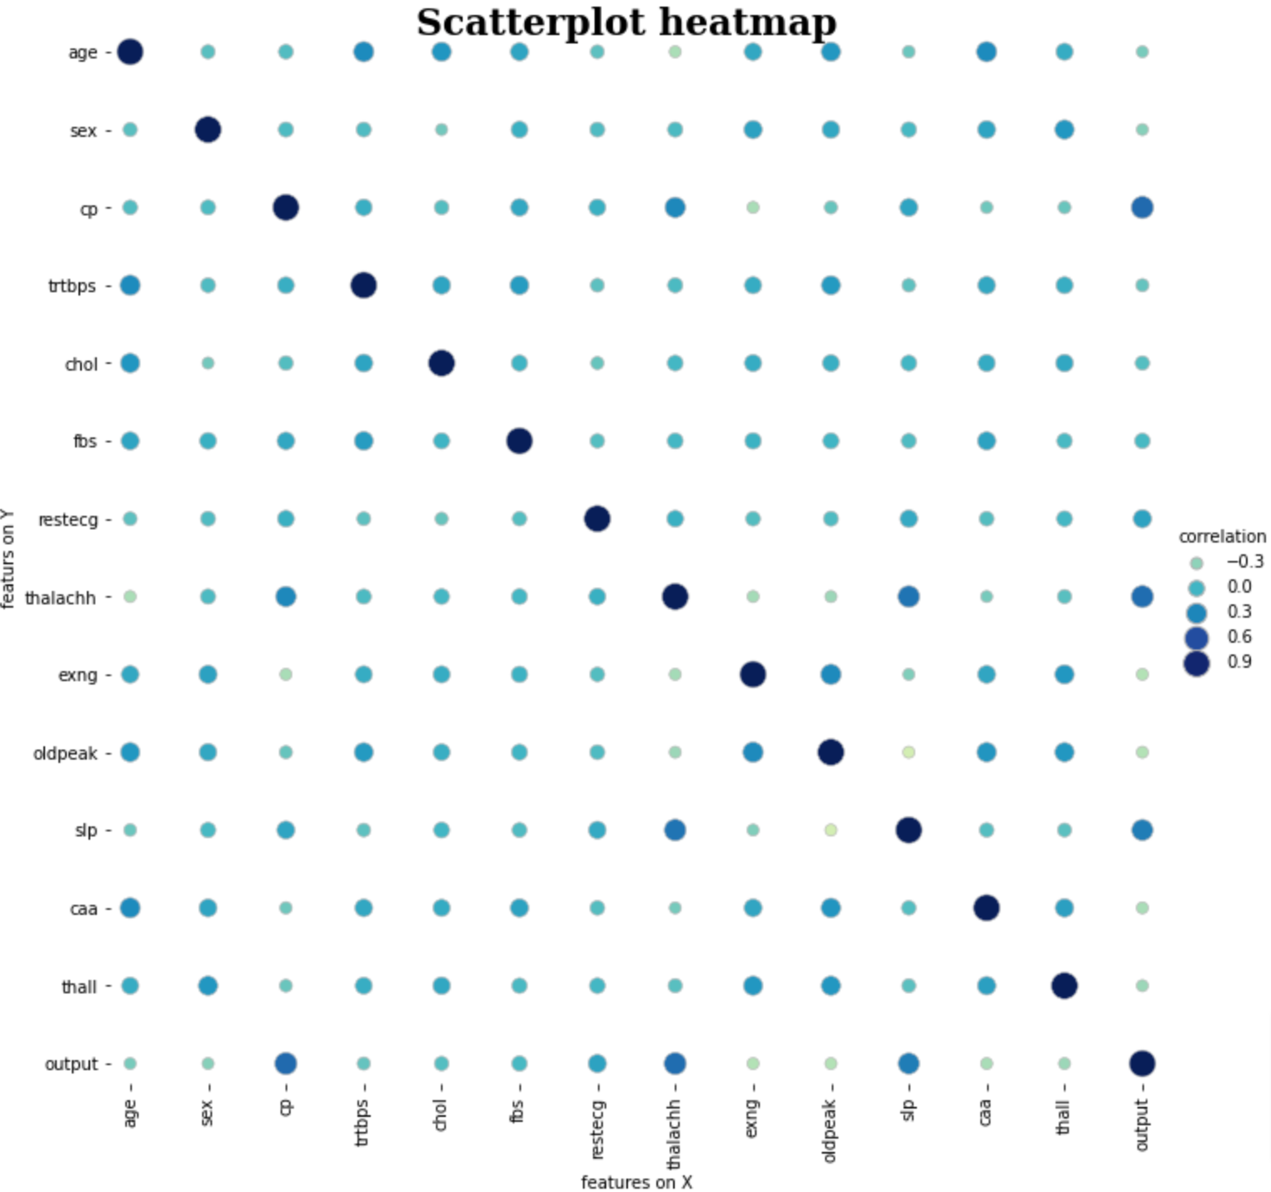
Data Dependency

Slide 7
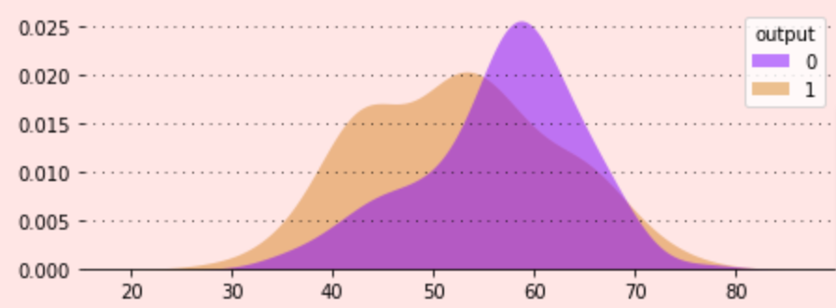
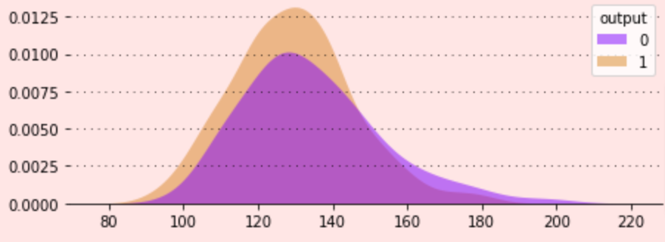
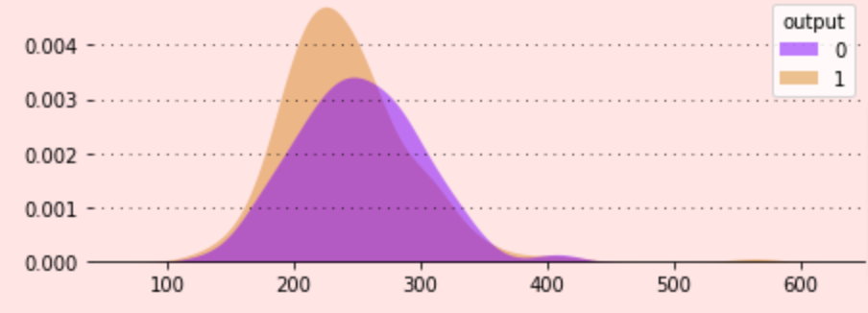
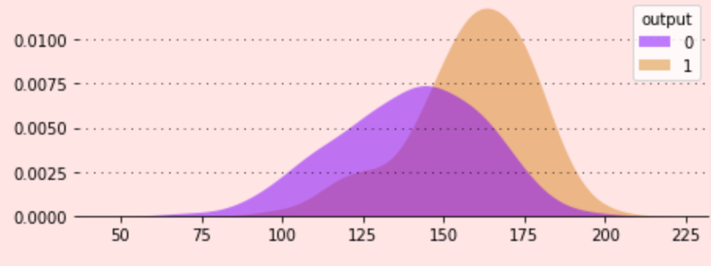
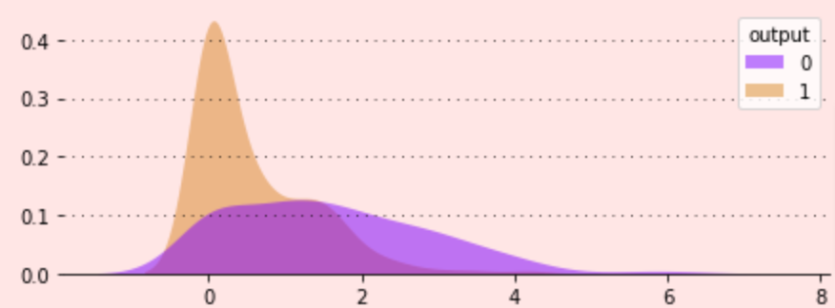
Age vs Output
trtbps vs Output
Chol vs Output
thalachh vs Output
oldPeak vs Output

Slide 8
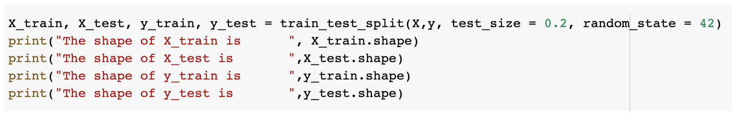
Data Split

Slide 9
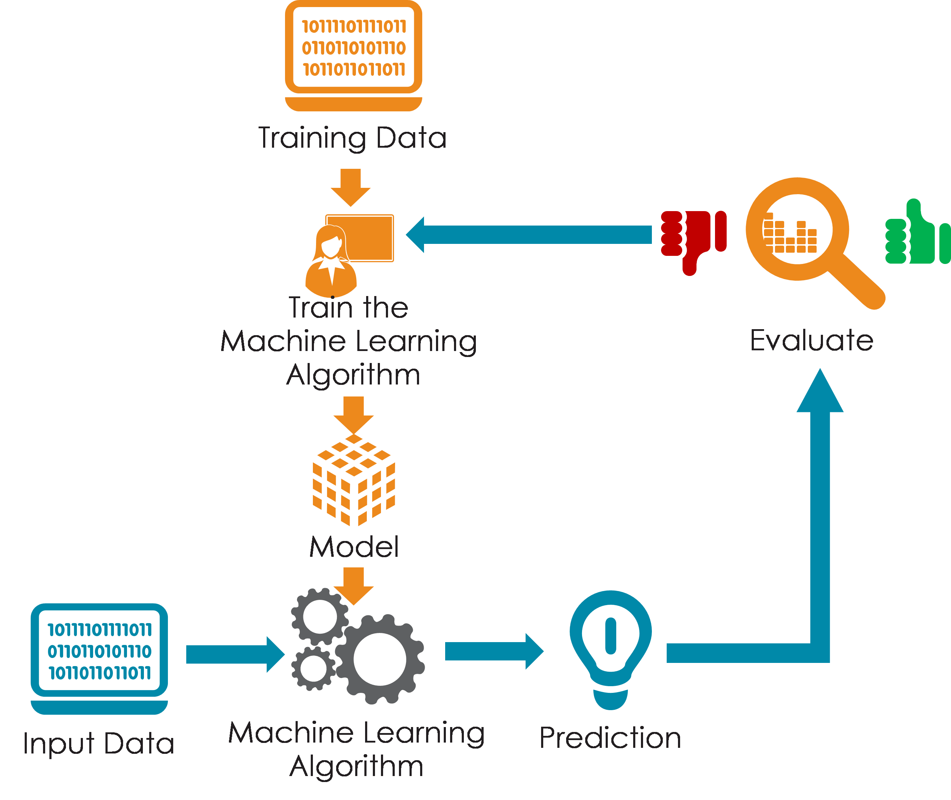
Model

Slide 10
Model Accuracy
Models | Accuracy
SVM | 0.8688524590163934
Logistic Regression | 0.9016393442622951
Decision Tree | 0.7868852459016393
Random Forest | 0.7796392732972397

Slide 11
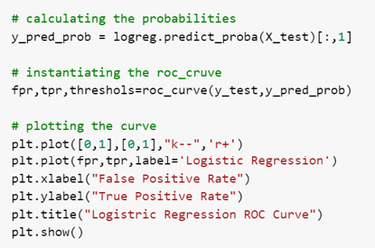
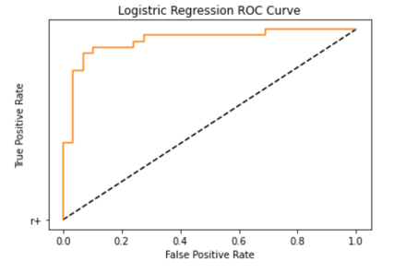
Logistic Regression

Slide 12
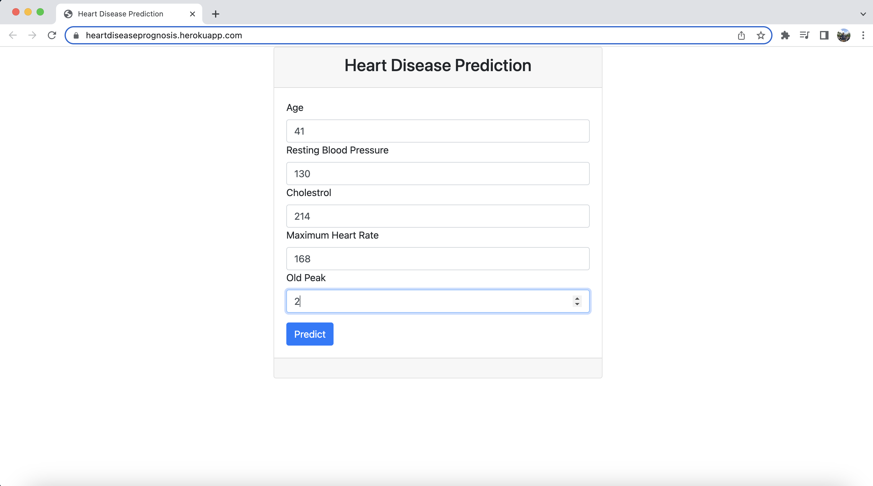
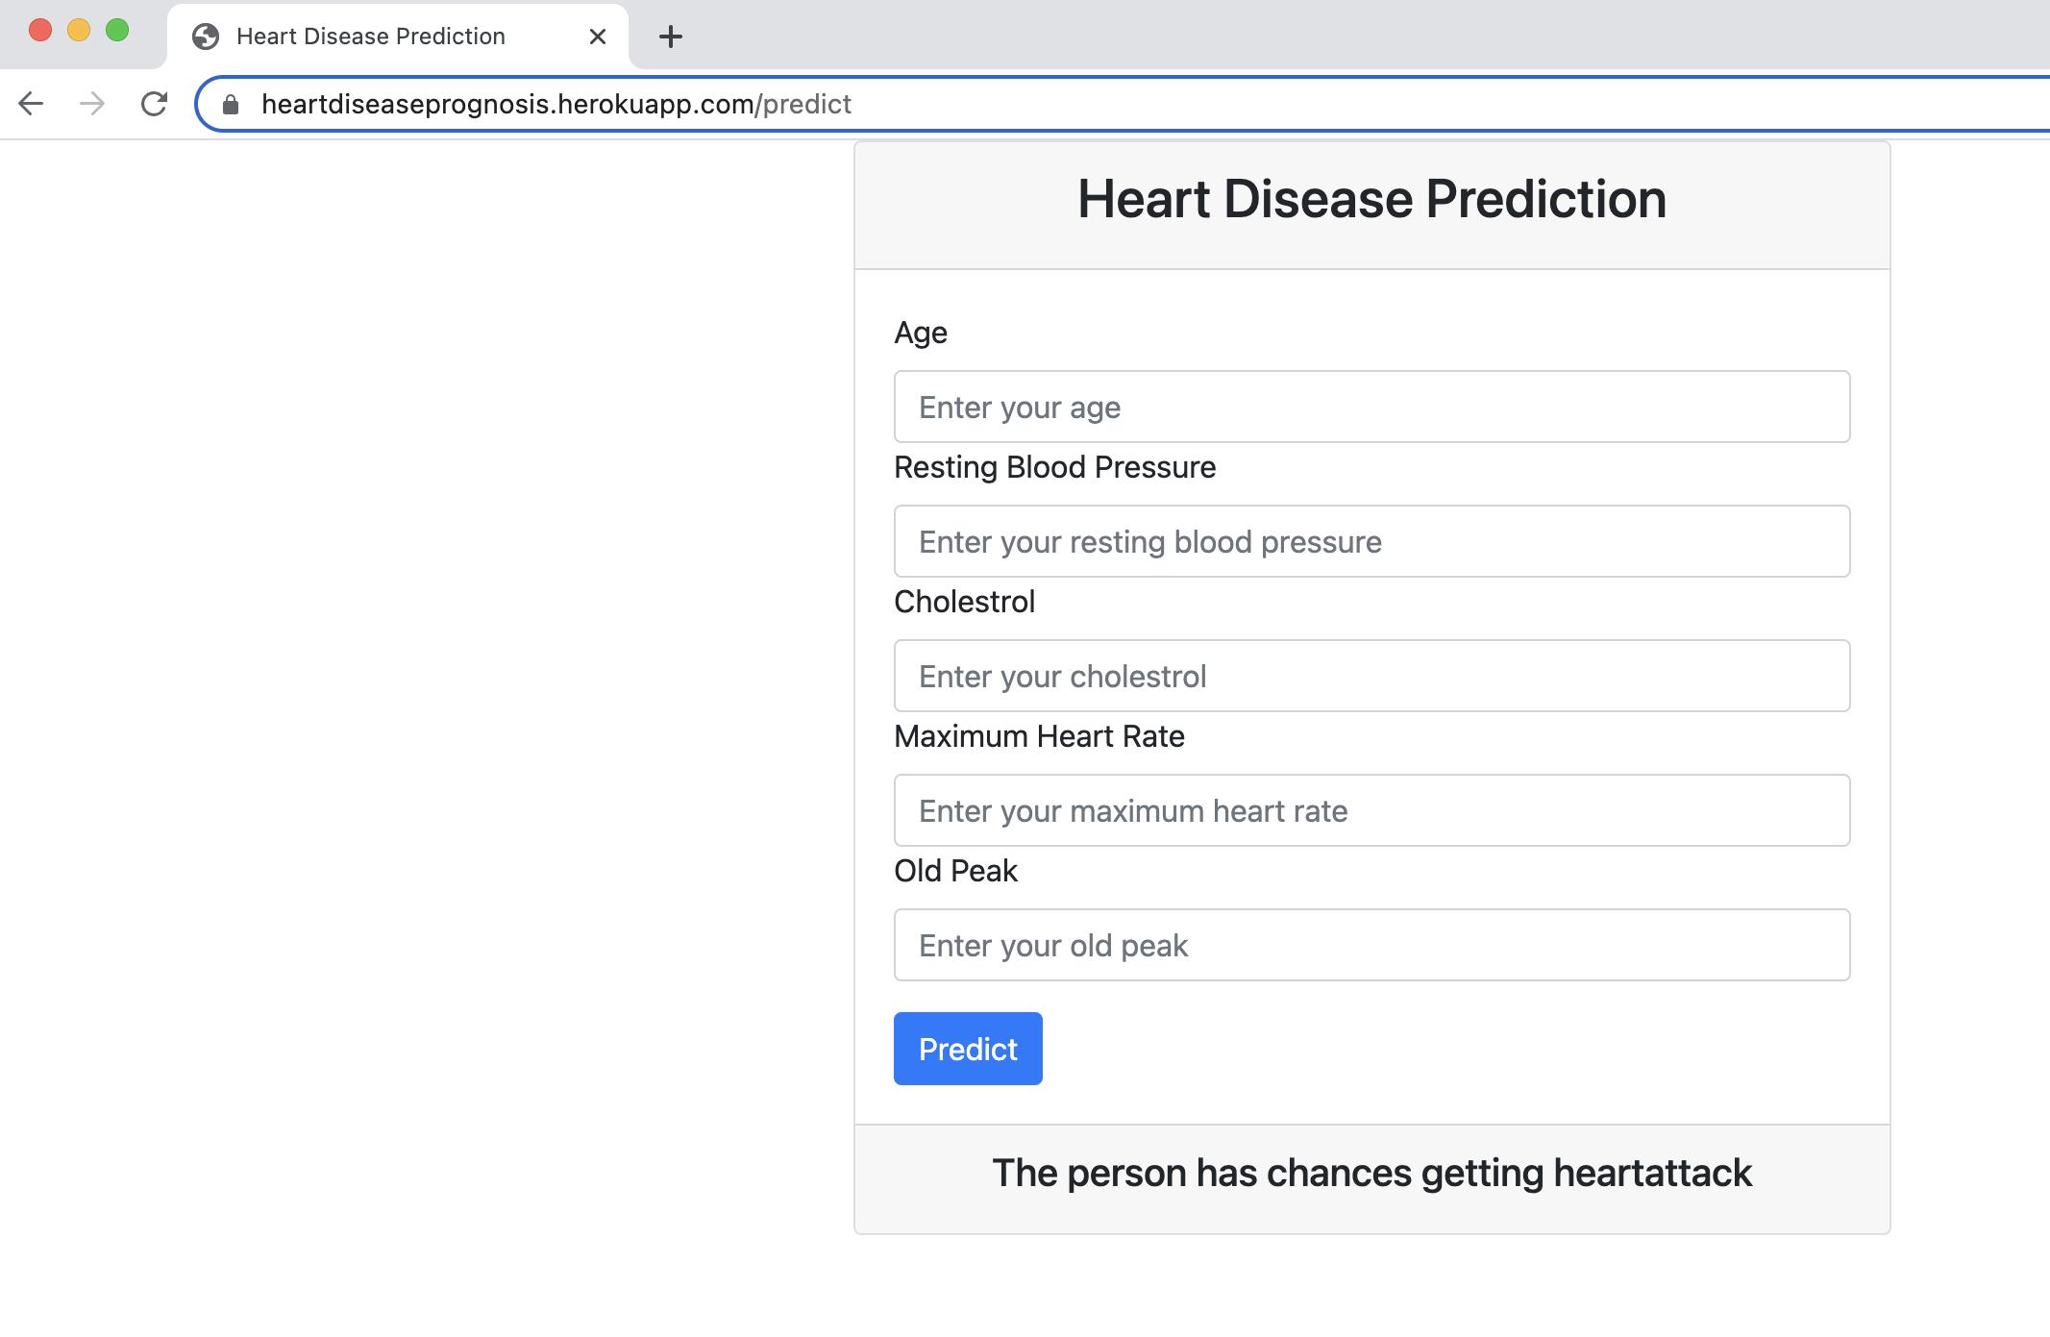
Results

Slide 13
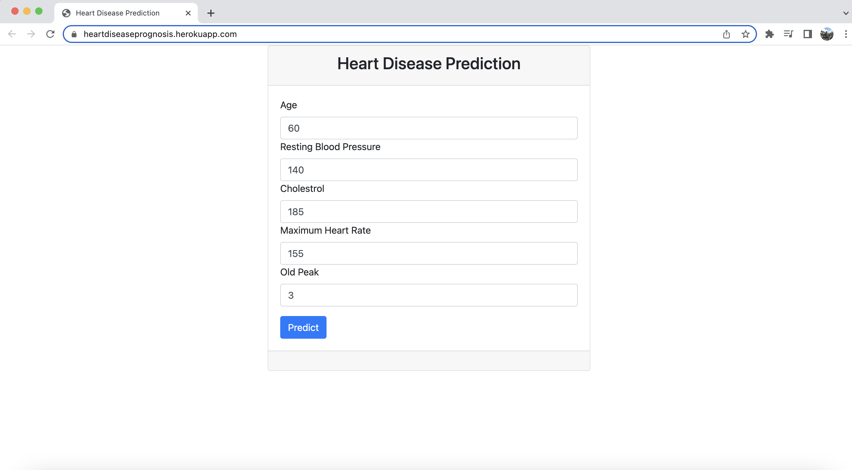
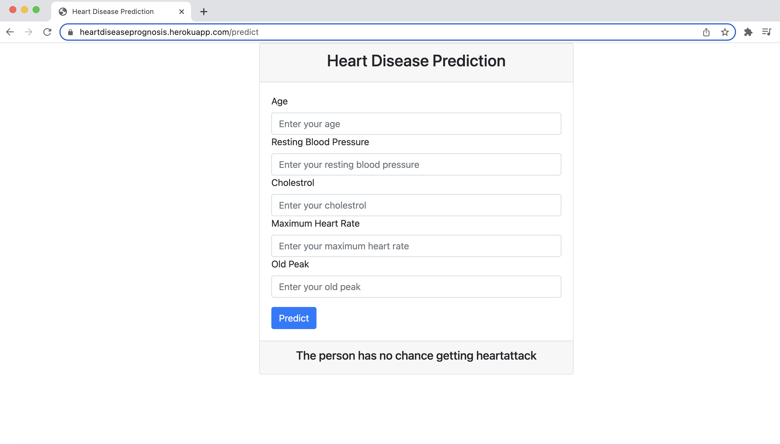

Slide 14
Any Questions ?

Slide 15
Thank you

