Slide 1
ICP Presentation Two
WEB AND MOBILE PROGRAMMING
Group: 11
Students:
Mani Sai Gundumogula
Sai Saranya Vipparla

Slide 2
Introduction
What is Android studio ?
Android studio is the official integrated development environment for Google Android operating system basically it's built on JetBrains IntelliJ idea software and designed specifically for Android development.
Android studio provides a unified environment where we can build apps for Android phones tablets Android Wear Android TV and Android Auto.
Structured code modules allow you to divide our project into units of functionality that we can independently build test and debug .

Slide 3
Introduction
In this presentation we're going to discuss about the ICP’s that we have completed ICP 8, ICP 9, ICP 10 and ICP 11.

Slide 4
Features
In Android Studio, a blank activity project is created using the java programming language.
The login page defaults to activity main.xml, and I have the following functions configured.
The navigation text is shown using the TextView method.
To obtain the user's inputs into the system, the PlainText function is utilized.
For execution, the button function is employed.
The toast function is analogous to the alert feature of the web and is used as a popup.
The programming script java is linked to the layout.xml page using setContentView.
For page navigation, the purpose is used.

Slide 5
Features
Basic Login with Validation
Username/ Password
Incorrect Credentials
Logout

Slide 6
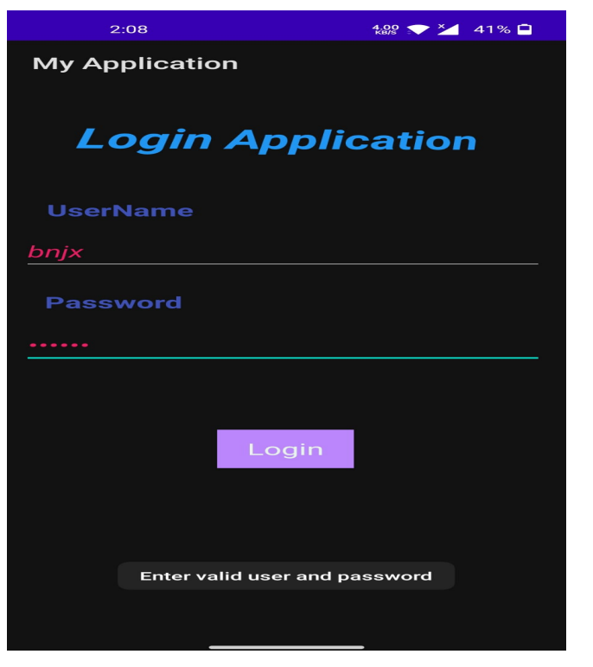
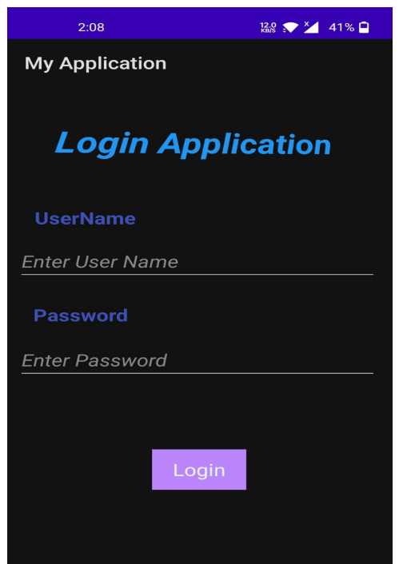
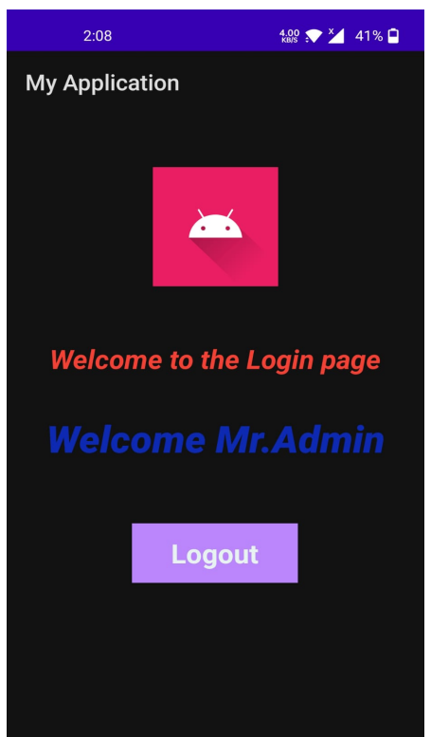

Slide 7
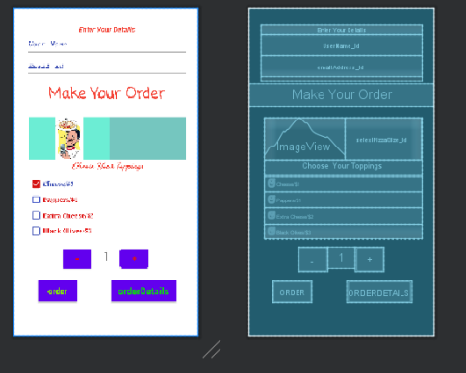
Pizza App
Created a pizza ordering application.
Functionality:
Selecting pizza toppings
Quantity
Place order
Summary

Slide 8
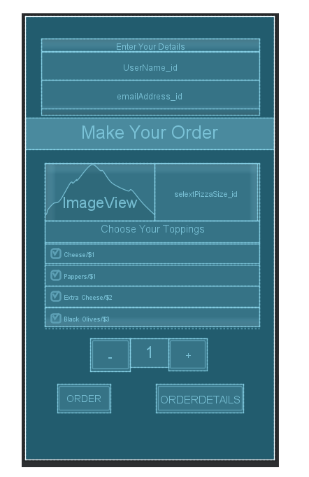

Slide 9
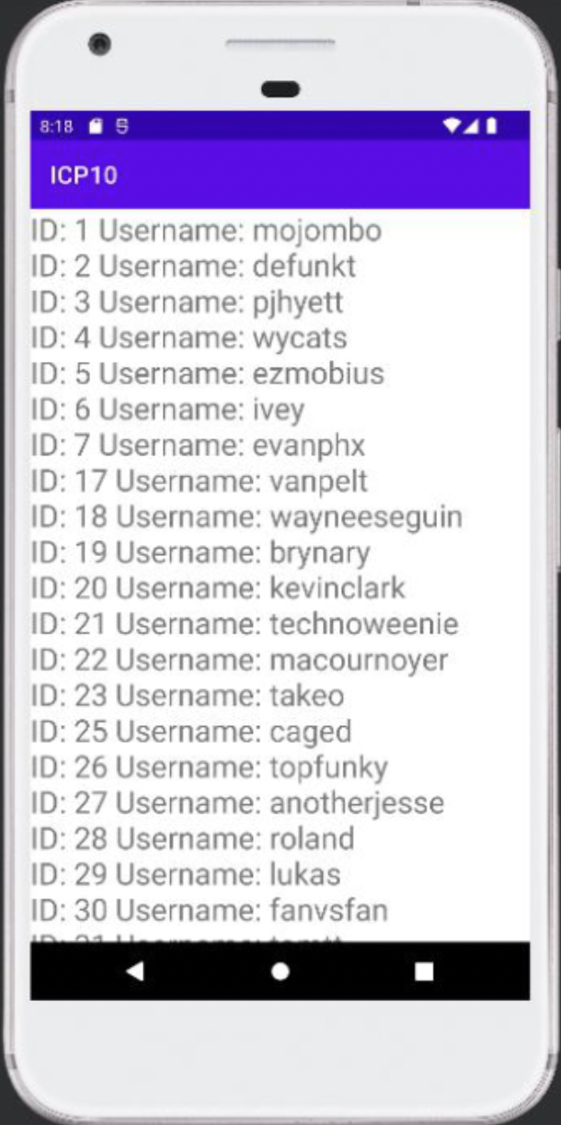
User.java is a new java class file that acts as a data transfer object containing getters and setters for id and username.
In the onCreate work in MainActivity.java, which consumes the github rest programming interface, the Retrofit programming interface is utilized to obtain the users' information.
After a successful call to the programming interface, the reaction is gathered in the onResponse strategy and projected to the User class, which is gathered in the rundown. The information is then displayed to the user.

Slide 10
Text to speech
We included textview, edittext, and a button with an id for each element in mainactivity.xml.
When the button is clicked, an event listener is added, and this is where the text to speech conversion happens.
Text to speech (an Android built-in package) is used for the transformation.
Text to speech is a programming interface included into the Android operating system that, if successful, selects English as the locale and starts the transformation process.
The speech technique is used to convert text to speech, which results in a speech output.

Slide 11
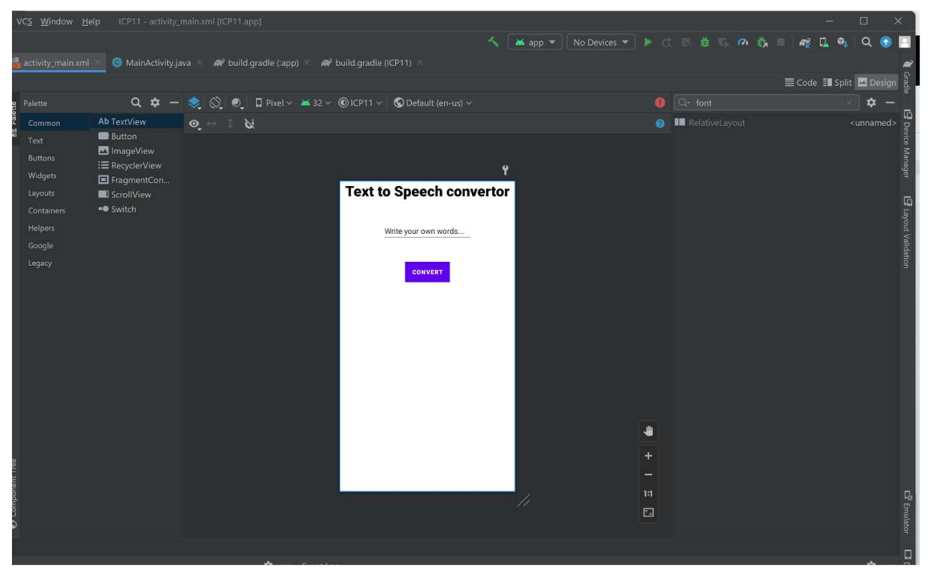

Slide 12
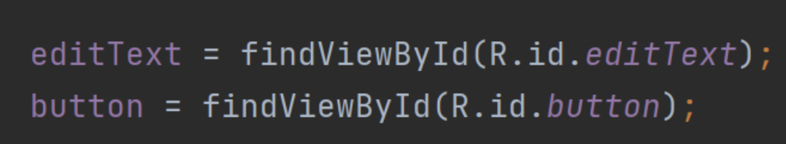
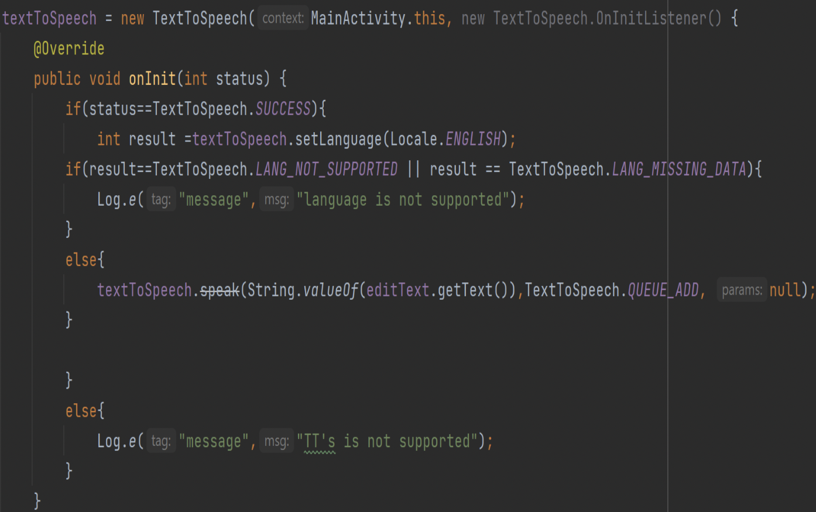
Fetching the data using Id’s
Text to speech logic which handles error and success scenario’s

Slide 13
THANK YOU ☺

