Slide 1
Web Apps Got Super Powers

Slide 2
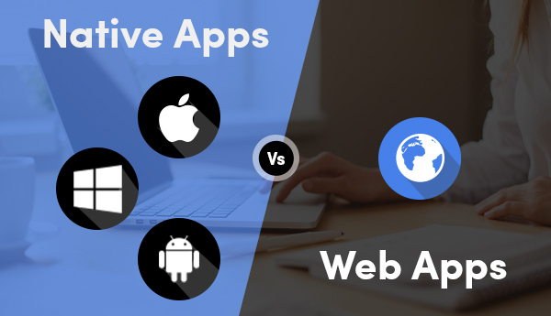

Slide 3
Native apps Super Powers
Fast
Responsive Design
Installable
Push Notifications
Works Offline
Periodic Sync
Ratings and Reviews

Slide 4
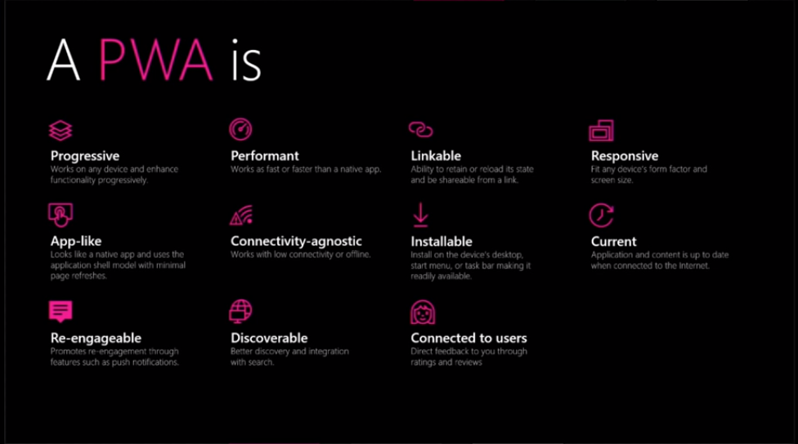

Slide 5
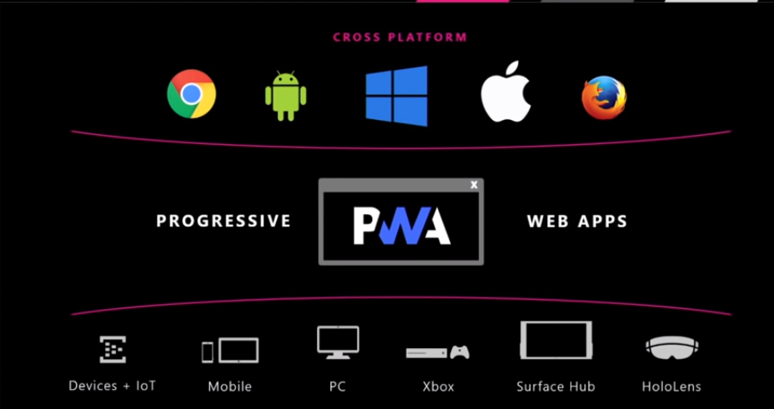

Slide 6
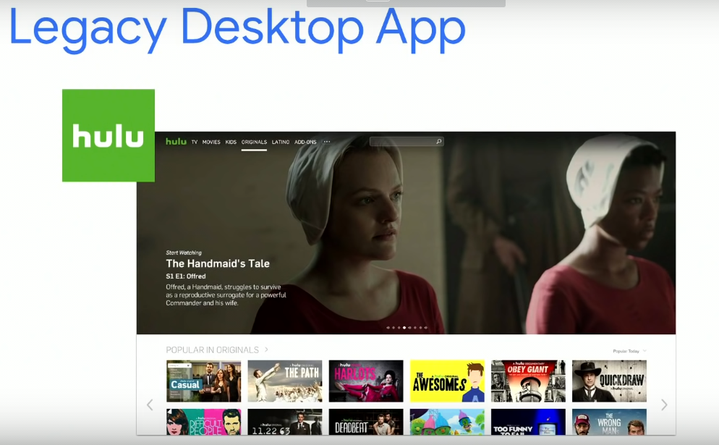

Slide 7
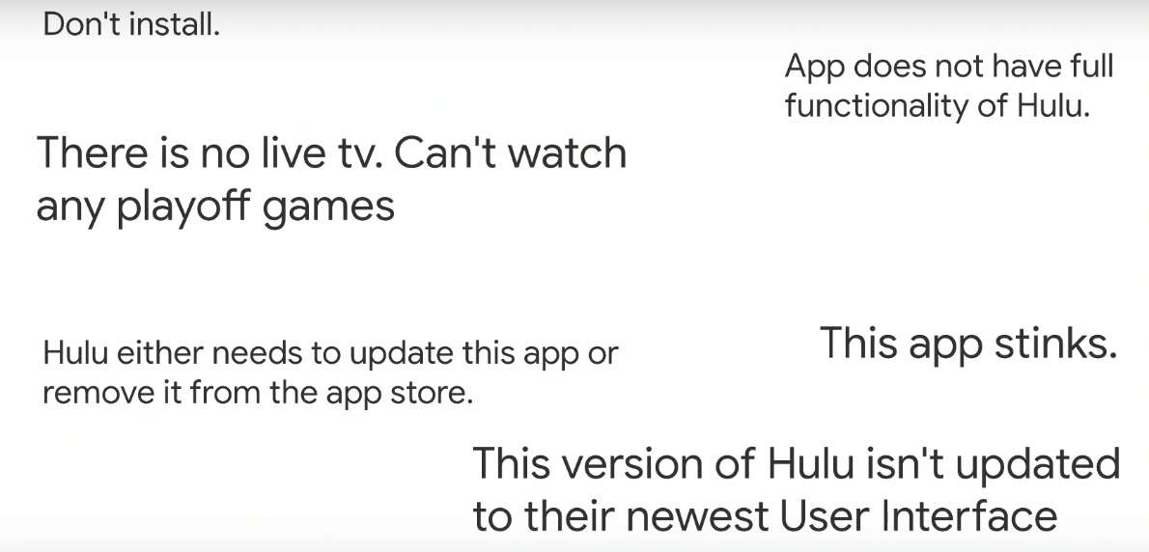

Slide 8
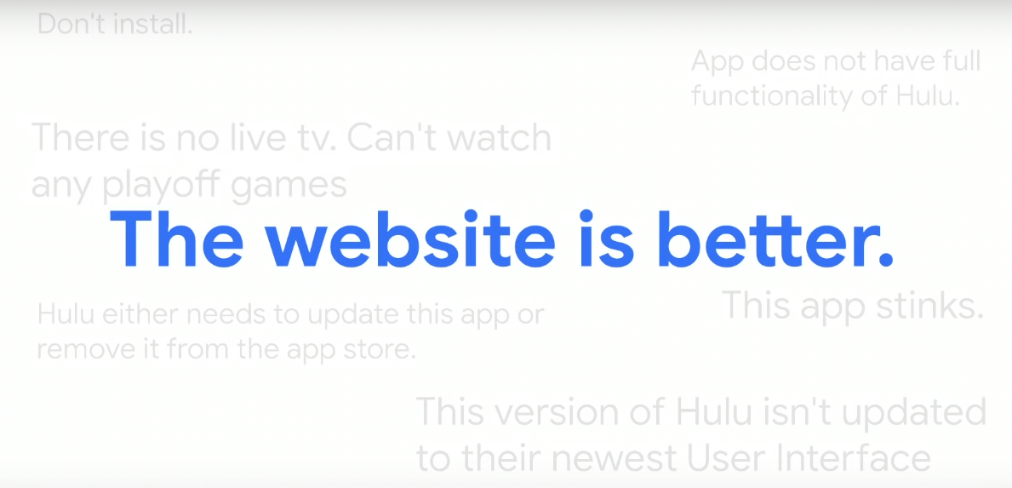

Slide 9

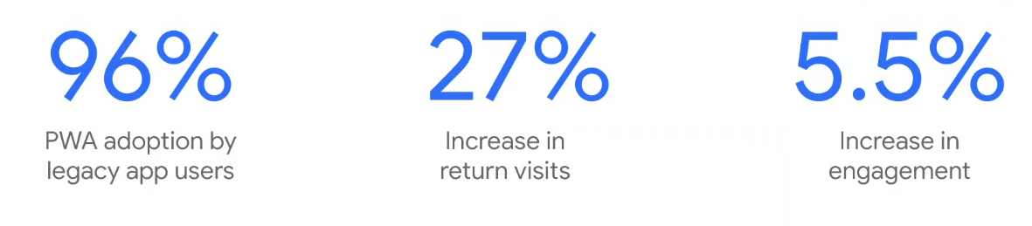

Slide 10
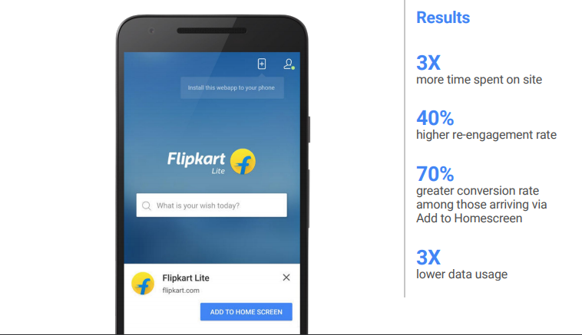
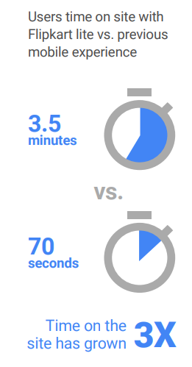


Slide 11
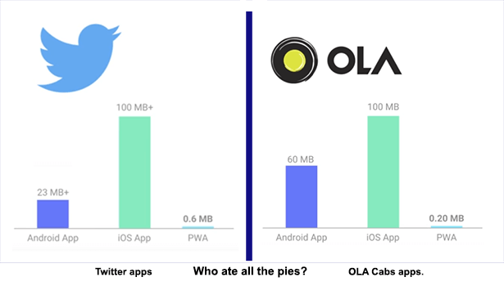
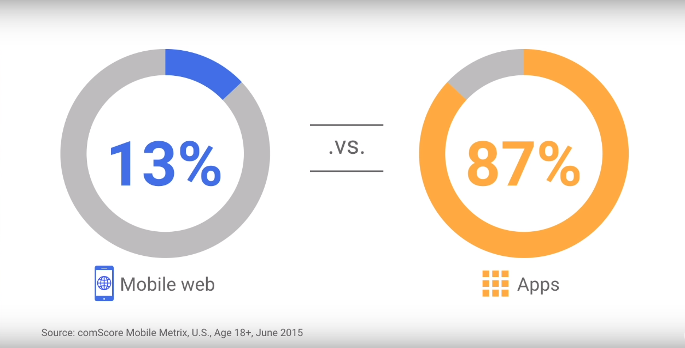
Native vs PWA App Size

Slide 12
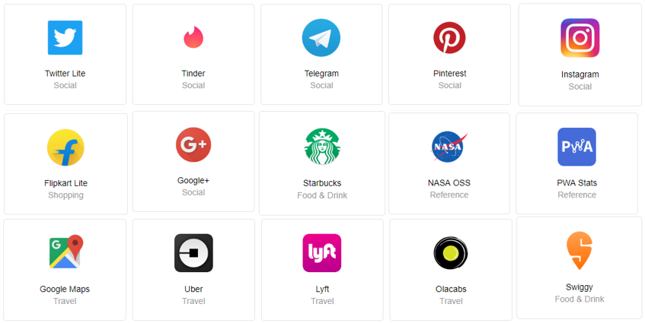
Few PWA Apps

Slide 13
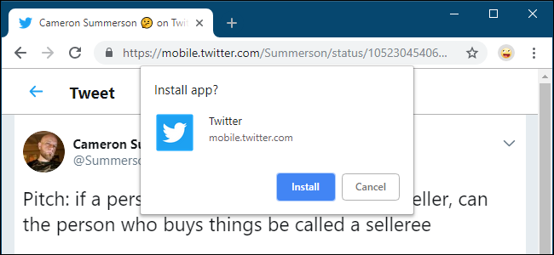
PWA Install

Slide 14
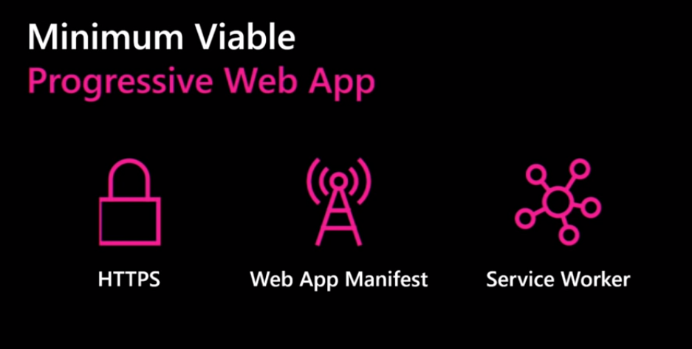

Slide 15
Demo

Slide 16
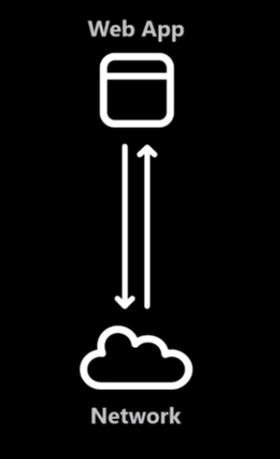
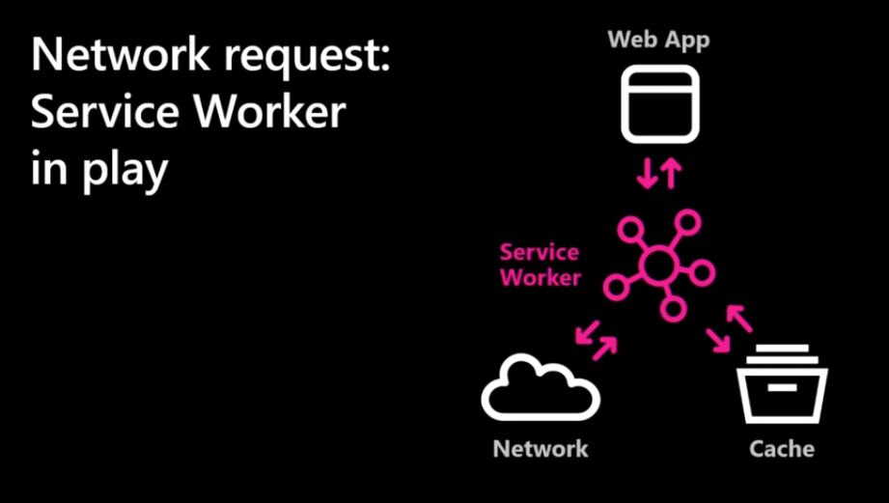
Network Request: Typical/Service Worker

Slide 17
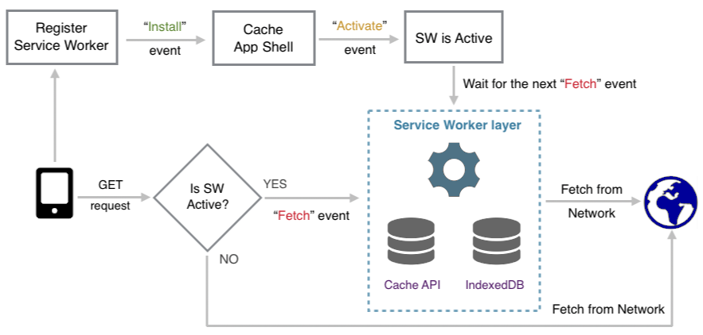

Slide 18
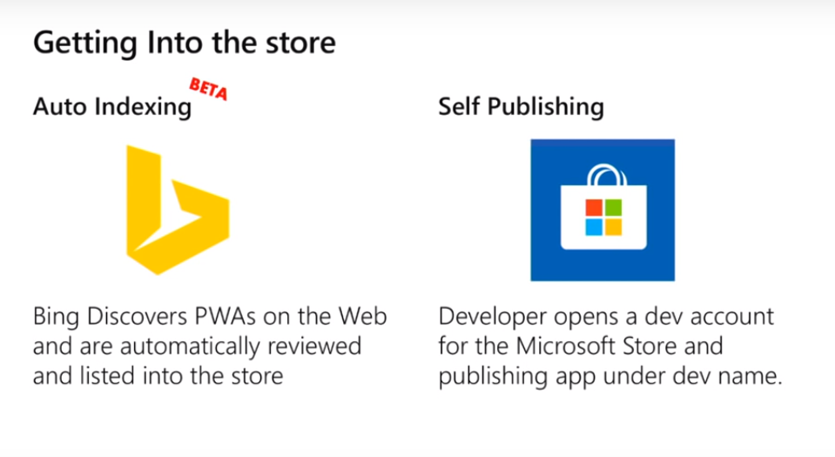
PWA web app into Microsoft store

Slide 19
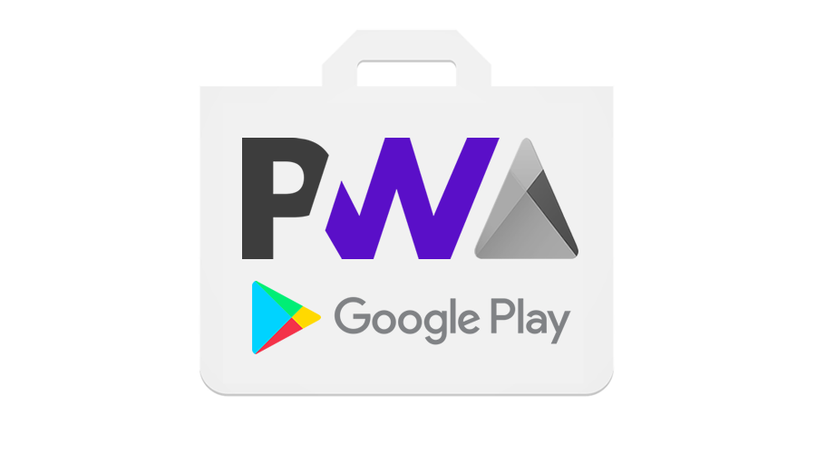
PWA App into Google Play Store(TWA)

Slide 20
What we have used
News API
Postman
Fetch API
Emmet
Chrome Web Server
Web Manifest
Promise
Service worker
Indexed DB
Google Analytics
GitHub Pages

