Slide 1
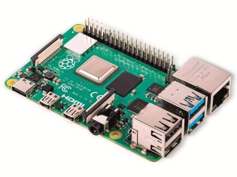

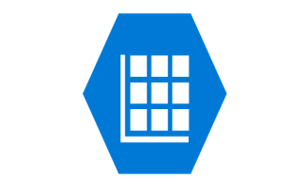


Wipro L1 Assignment Architecture
2
3
4
1
5

Slide 2
Raspberry Pi Web Simulator push data to Azure IoT hub with iothub device connection string.
IoT Hub receive data and send it to steam analytics.
Stream Analytics will process data and push it to Azure table storage
Azure Table Storage will hold the device telemeter.
App service will pull data from table storage using node app and show it on web app.

