Slide 1
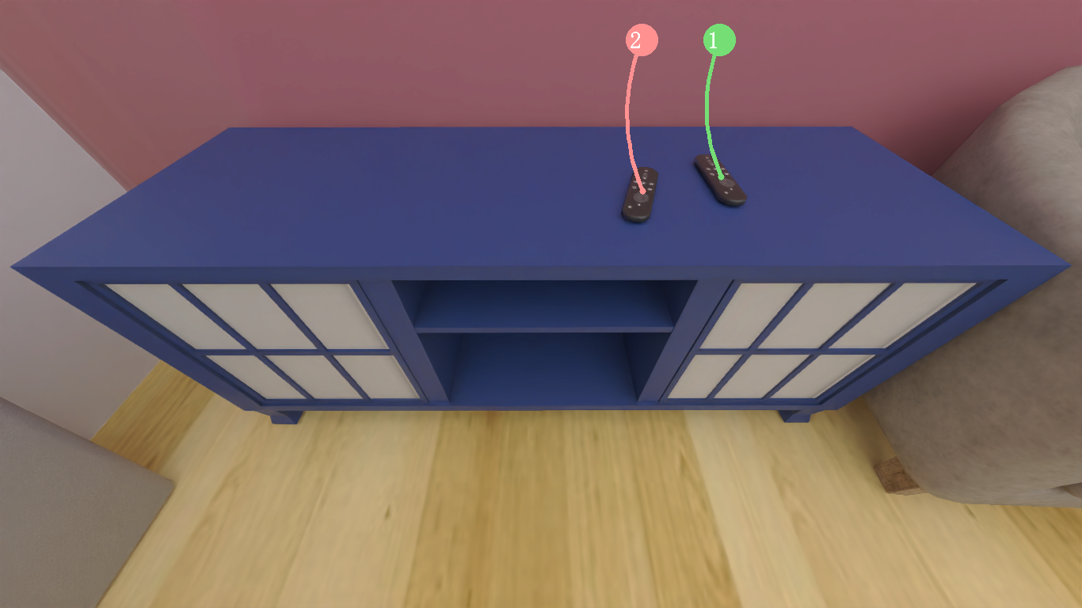

show_receptacle(1)

Slide 2
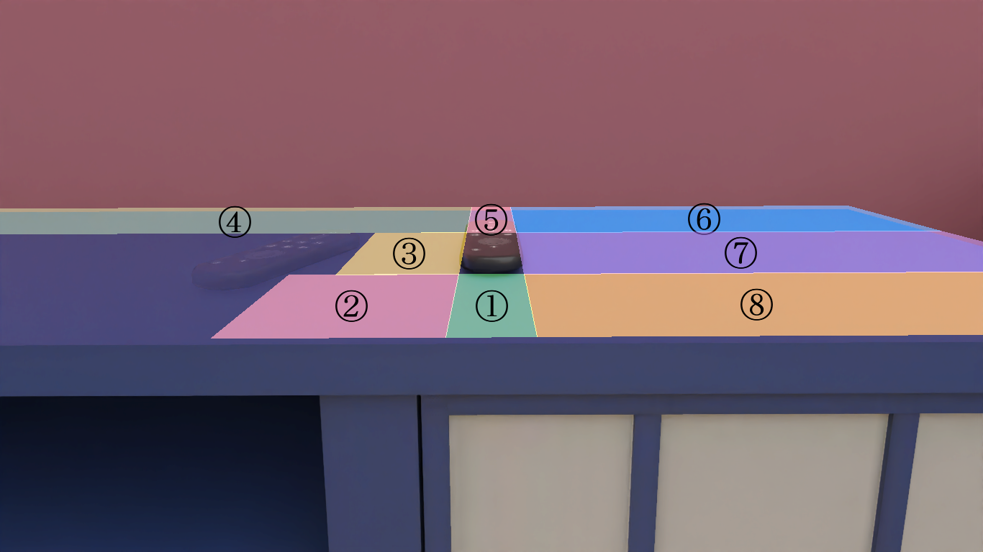

Slide 3
show_receptacle(2)

Slide 4
