Slide 1
IMAGE ACQUISITION · OPTICS
Lens Effects in
Image Acquisition
Identifying Distortion Problems and Engineering Solutions in Camera Lens Systems
Seminar Presentation • Compiled for coursework in Image Processing / Computer Vision

Slide 2
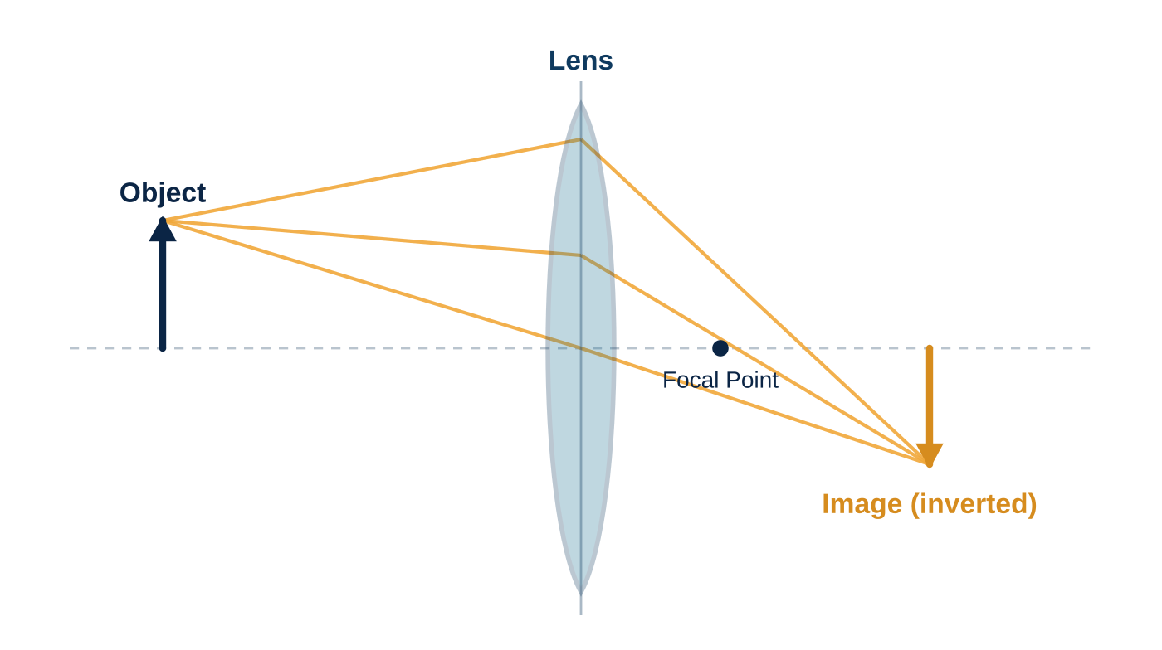
01 · INTRODUCTION
How a Lens Forms an Image
1
Refraction, not a pinhole
A real lens bends light through curved glass surfaces to focus rays onto a sensor — unlike the ideal pinhole model used in basic geometry.
2
Ideal vs. real optics
The thin-lens equation assumes perfect focusing. Real glass introduces shape and material imperfections that the ideal model ignores.
3
Why it matters
These imperfections show up as geometric and colour errors in the captured image — the subject of this presentation.
Key idea: every distortion discussed in this deck is a departure of a real lens from this ideal converging-ray model.
2

Slide 3
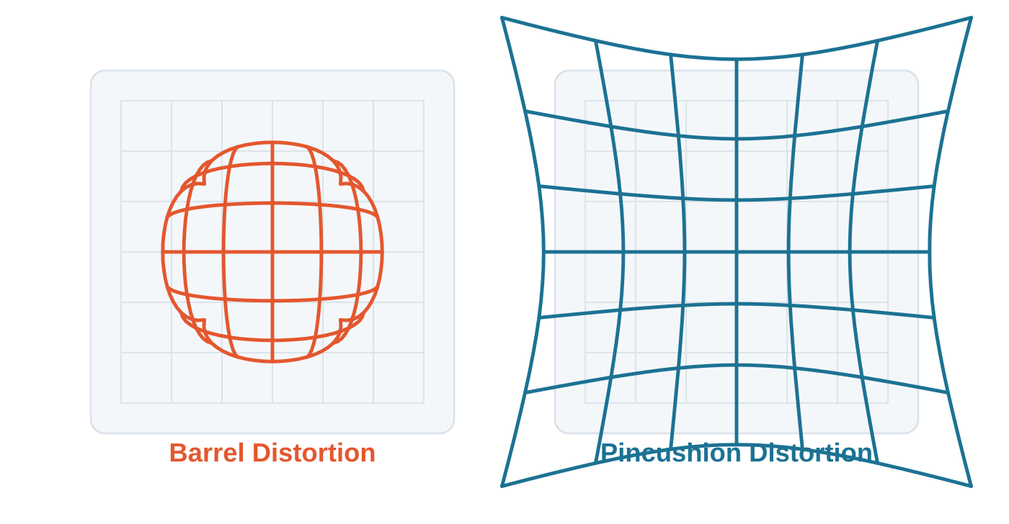
02 · DISTORTION PROBLEMS
Geometric Distortion: Barrel & Pincushion
Barrel — wide-angle lenses: Magnification falls with distance from the optical axis, so straight lines bow outward. Common in wide-angle and fisheye lenses.
Pincushion — telephoto lenses: Magnification rises with distance from the axis, pulling lines inward at the edges. Common in telephoto and zoom lenses.
3

Slide 4
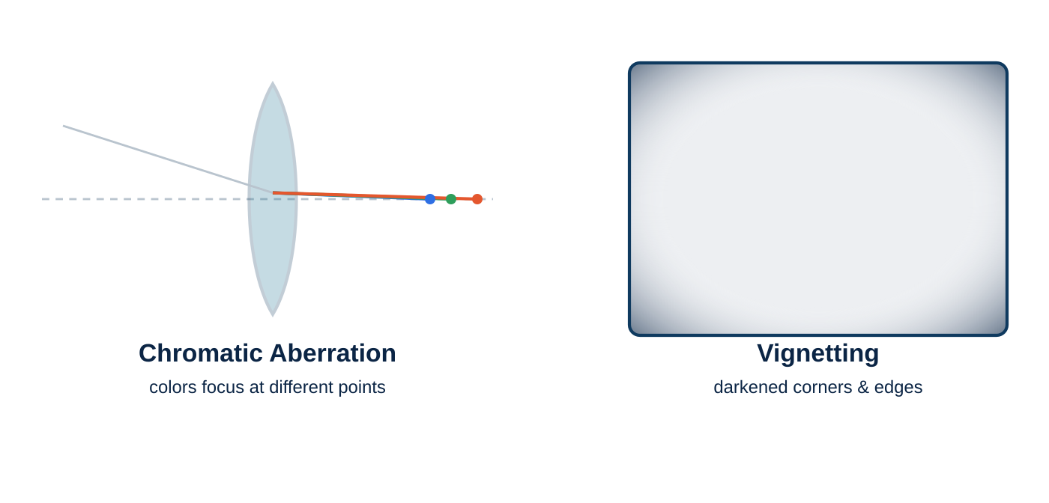
02 · DISTORTION PROBLEMS
Chromatic Aberration, Vignetting & Spherical Error
Spherical Aberration
Rays striking the outer edge of a spherical lens focus closer than paraxial (central) rays, softening overall sharpness.
Effect on images
Colour fringing at edges, soft corners, uneven brightness across the frame — all reduce measurement and visual accuracy.
4

Slide 5
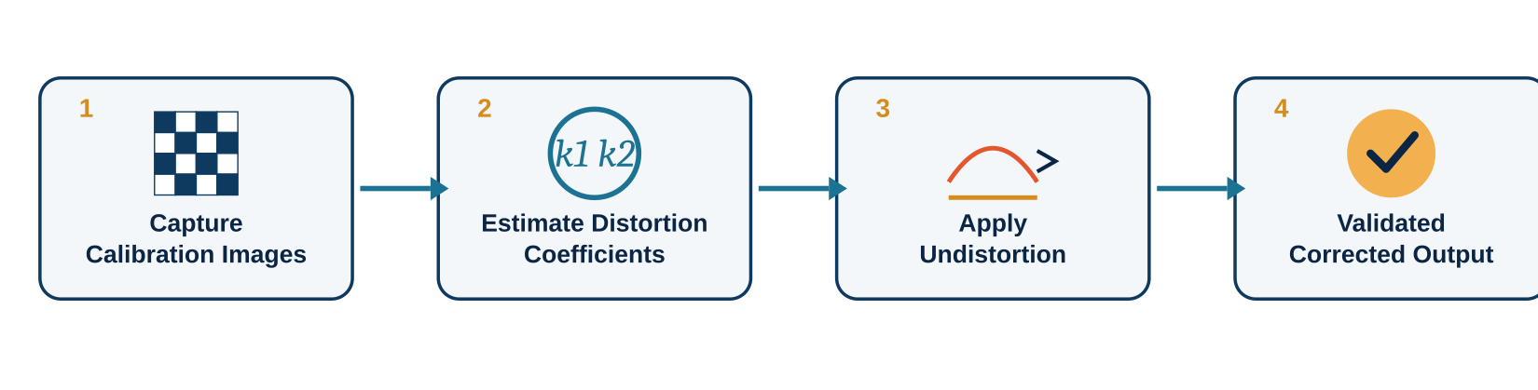
03 · SOLUTIONS
Correcting Lens Distortion
1
Hardware fixes
2
Mathematical model
3
Software correction
Achromatic & apochromatic lens groups, aspherical elements, and multi-coating reduce aberration and flare at the optical level.
The Brown–Conrady model separates radial (k1, k2, k3) and tangential (p1, p2) distortion coefficients from a calibration pattern.
OpenCV's calibrateCamera() and undistort() (or equivalent tools) remap pixels using the fitted coefficients to straighten the image.
5

Slide 6
SUMMARY
Key Takeaways
2
5
3
Main geometric distortion types
Brown–Conrady coefficients
Optical error families
Barrel & pincushion
k1, k2, k3, p1, p2
Chromatic, vignetting, spherical
Every lens departs from the ideal thin-lens model — distortion is a predictable, measurable consequence of optics, not a random flaw.
Geometric errors (barrel/pincushion) and optical errors (chromatic, vignetting, spherical) require different fixes — better glass vs. software remapping.
Camera calibration with a known pattern (e.g. checkerboard) plus an undistortion pipeline restores accurate, measurement-ready images.
Thank you • Questions welcome
6

