Slide 1
Lending Club Case Study
Background:
Like most other lending companies, lending loans to ‘risky’ applicants is the largest source of financial loss (called credit loss). The credit loss is the amount of money lost by the lender when the borrower refuses to pay or runs away with the money owed. In other words, borrowers who default cause the largest amount of loss to the lenders. In this case, the customers labelled as 'charged-off' are the 'defaulters'.
LendingClub wants to identify these risky loan applicants, then such loans can be reduced thereby cutting down the amount of credit loss. Identification of such applicants using EDA is the aim of this case study. 1.In other words, the company wants to understand the driving factors (or driver variables) behind loan default, i.e. the variables which are strong indicators of default. 2.The company can utilize this knowledge for its portfolio and risk assessment.
Business Objective:
To identify variables which are strong indicators of default and potentially use the insights in approval /
rejection decision making.

Slide 2
Data Fetching and Cleaning Operations
Analysis Approach:
We have to analyze the data to identify the driving factors
To start with the data analysis, the data set had to be cleaned and prepared for the analysis, then analyzed and visualized.
Clean the dataset using appropriate methods
Once the data set was cleaned, univariate, bivariate and mulitvariate analysis need to be done
Visualization techniques were used to draw charts and graphs and then meaningful insights from them
Data Cleaning:
We have analyzed the past loan data for all loans issued through the time period 2007 to 2011.
Multiple Columns with more than 70% of null values were dropped.
Missing values were imputed into respective stat, so that all the NULL and NAN values were removed.
Descriptive columns, other unnecessary columns are removed from the dataset , so that we don’t waste time analyzing those fields

Slide 3
Data Understanding
Types of variables that we need for analysis
Categorical Variables
Purpose
term
verification_status
home_ownership
grade and sub_grade
loan_status
Numeric Variables
loan_amnt
funded_amnt
funded_amnt_inv
int_rate
emp_length
annual_inc
issue_d
dti
installment
deliquency values

Slide 4
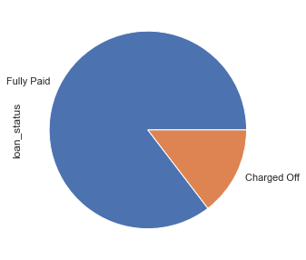
Data Understanding - Overall Default Rate is 14.6%
loan_status:
Charged Off : 14.586412 %
Fully Paid : 85.413588 %
Conclusion:
Nearly 14.6% of loans are Charged off loans
Now we need to find out the driving factors among the considered columns for this defaulter percentages
In some parts of ppt and code , you can see the following variable for loans
default_status(0- Fully paid, 1- charged off)

Slide 5
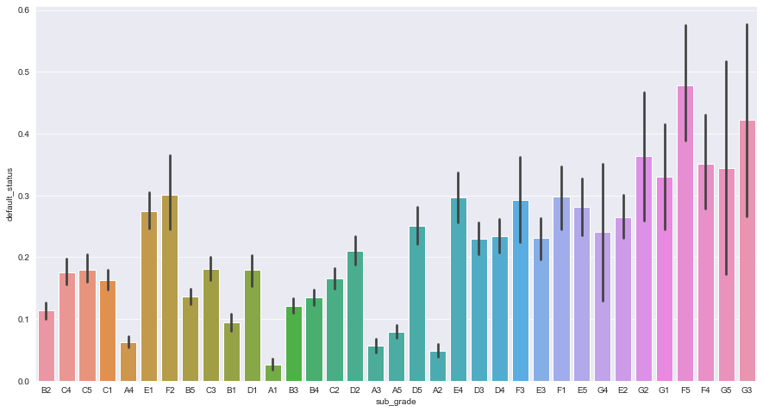
UniVariate Analysis
Grade and Sub-Grade
F5 grade has highest ratio
As whole grade level ,G has Highest defaulters
among the G grade G3 sub_grade has highest defaulter ratio.
Higher the Grade of the Loan ,
Higher is the risk of becoming
defaulter.

Slide 6
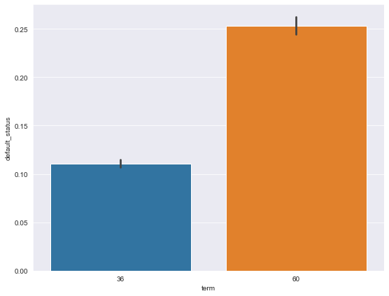
Term of the Loan
The graph suggests that
'Higher the Term of the Loan ,
Higher is the risk of becoming defaulter

Slide 7
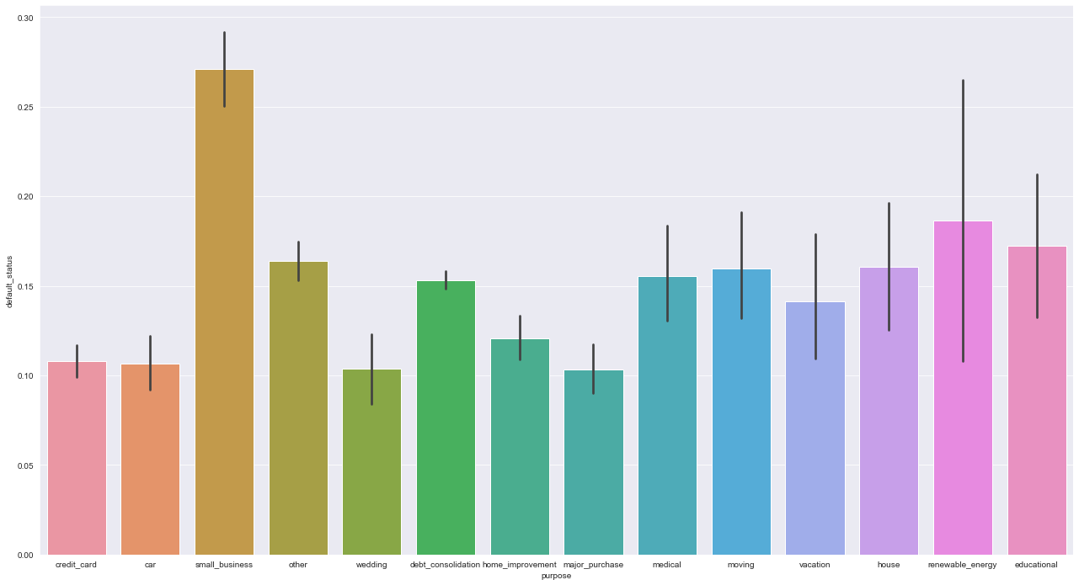
Loan Purpose
small_business purpose has
highest defaulter rate.
2. debt_consolidation,
credit_card,home_improvement,
other,major_purchase,
'small_business' are the important
purposes that we need to
consider as they are covering
most(~85-90%) of loan purposes

Slide 8
Other Important Univariate Conclusions
Among the verification statuses ,the ‘Verified Status’ Loans have higher Default Ratio when compared to other status defaulter’s ratio
The 'other' home ownership customers have higher Default Ratio
Year and month of loan issuing didn't help much in analysis
Note:
We observed the individual numerical data graphs for fields [interest_rate,annual_income, dti,loan_amount], we saw that the density and fluctuations in them are specified to particular ranges for respective fields. Though we can get some insights, they might not be of much help, so instead we will do some segmentation on them and do analysis furthur.

Slide 9
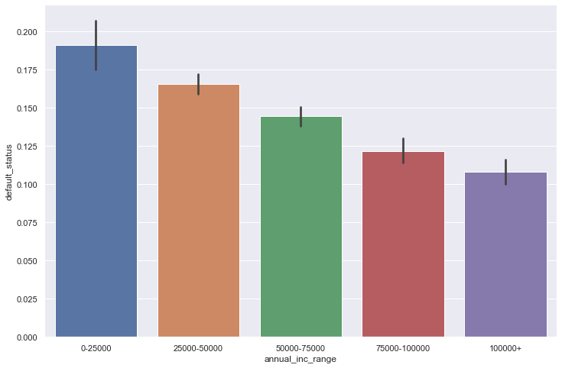
Segmented Univariate Analysis Annual Income Range
Lower the Annual Income range
of customer, higher the risk of falling
into defaulter state
In our Dataset, we have
Minimum Income : 4000$
Maximum Income : 600000$

Slide 10
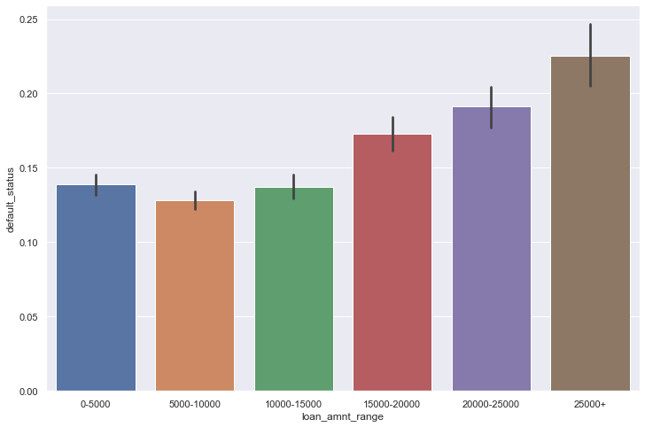
Loan Amount Range
Higher the Loan amount of
customer, higher the risk of
falling into defaulter state
In our Dataset, we have
Minimum Loan: 500$
Maximum Loan: 35000$

Slide 11
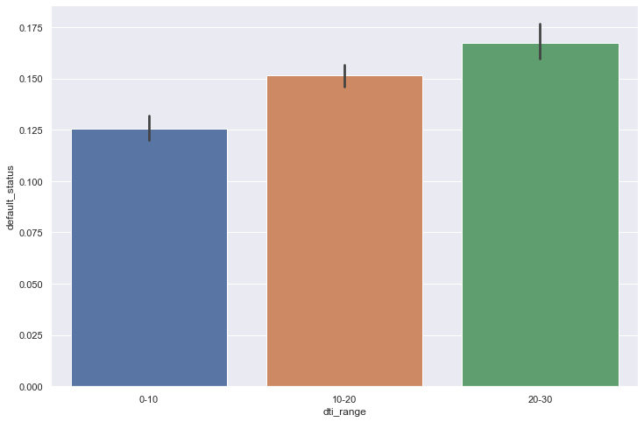
DTI Range
dti is defined : existing debt to total
income ratio of customer
2. Higher the dti range of person,
higher the risk of falling into defaulter
state
In our Dataset, we have
Minimum dti : 0.0
Maximum dti : 29.99

Slide 12
Other Important Segmented Univariate Conclusions
Higher the Interest rate for the loan of customer, higher the risk of falling into defaulter state
Funded amount Inv is similar to that of Loan amount in terms of trend, so higher the range of
funded-amnt_inv, higher the risk of falling into defaulter state
3. Higher the installment amount for a given loan, higher the risk of falling into defaulter state
Note:
For upcoming Bivariate analysis, when ever we do data analysis with respect to purpose, we use
debt_consolidation,credit_card,home_improvement,other,major_purchase,'small_business' purposes as
they are covering most(~85-90%) of loan purposes because these will be sufficient from Business standpoint
to come-up with useful patterns

Slide 13
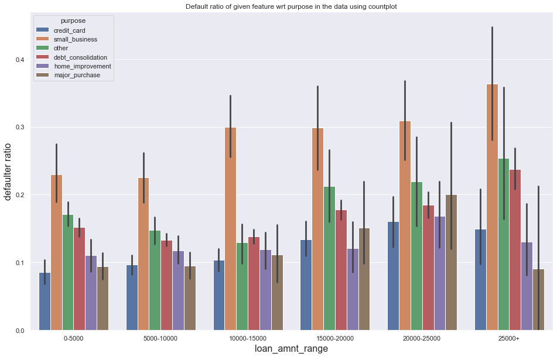
Bivariate Analysis loan_amnt_range wrt purpose
loan_amnt_range wrt purpose , we can observe the similar upward trend for mostly all the purposes in above graph. Thus, defaulter ratio increases with increase of loan amount

Slide 14
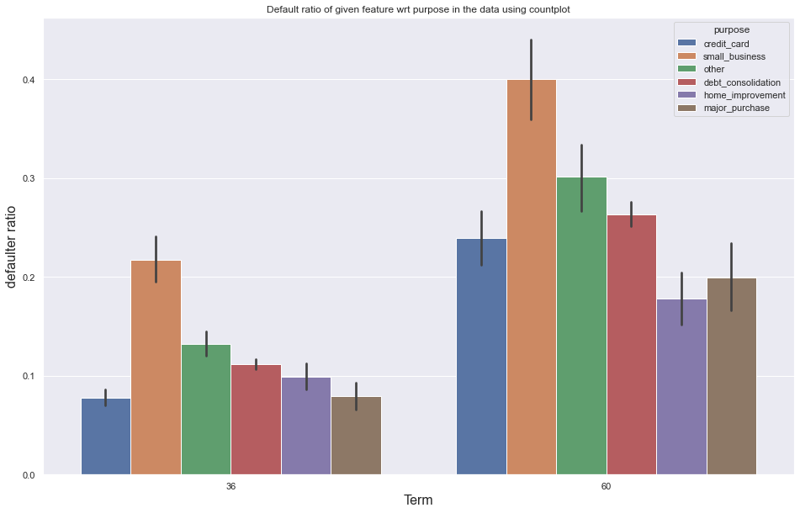
Term of loan wrt purpose
Term of loan wrt purpose ,
we can observe the upward
trend for all the purposes .
Hence defaulter ratio increases
with increase of term period for
purposes

Slide 15
Other Important Observations
funded_amnt_inv_range wrt purpose , we can observe the similar or upward trend for mostly all the purposes , defaulter ratio increases with increase of loan amount.
annual_inc_range wrt purpose , we can observe the similar or downward trend for mostly all the purposes , defaulter ratio is highest for low income ranges
interest range wrt purpose , we can observe the upward trend for all the purposes , defaulter ratio increases with increase of interest rate on given loan.
installment_range wrt purpose , we can observe the similar or upward trend for mostly all the purposes , defaulter ratio increases with increase of installment amounts of loan.
dti_range wrt purpose , we can observe the upward trend for all the purposes , defaulter ratio increases with increase of dti ratio of loan

Slide 16
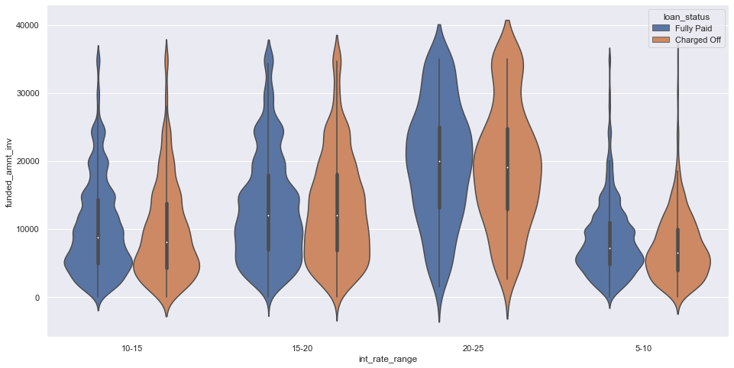
Funded amount wrt Interest Range
Funded amount wrt
Interest Range,
we can observe the width or
distribution from central line
Is getting increasing when we
Move up interest rate for
Funded amounts.

Slide 17
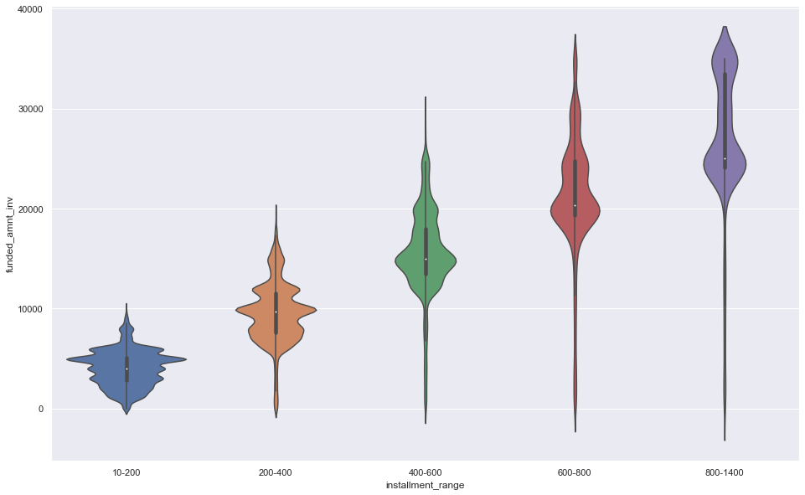
Funded amount wrt instalment Range
We are seeing here a simple
straight line relationship among
The medians of data indicating
High correlation.
Since we know that both have
Higher defaulters at higher ends,
We need to be careful for this
Combinations.

Slide 18
Other Important Observations
In Term wrt interest rate ,we can see the defaulter distribution is higher at higher interest rates with respect to term of loan(higher at higher term as well)
The above explanation holds true for term wrt funded amount as well
Multivariate Analysis:
As an attempt for Multivariates, we tried set of 3 or more factors and how this combination effects
Defaulter rate. We mentioned an example here with which we can very much of granular level analysis and have better insights over data

Slide 19
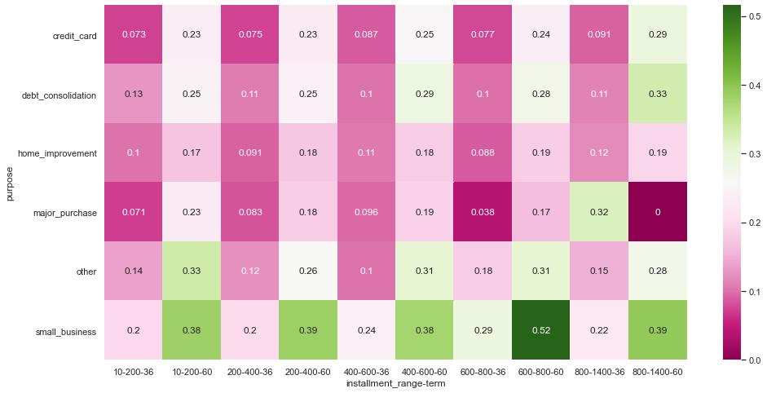
Multivariate Analysis
purpose - small_business
wrt installment-range 600-800
and 60 months term
have the highest defaulter
correlation and followed by
other combinations
Since the values are of
default_status , the values
In the grid is actual
distribution of defaulter values

Slide 20
Thank You
praneethvelamuri@gmail.com
kollaneeraja99@gmail.com

