Slide 1

ShopEZ
E-Commerce Application
Developed by Maniar Roshan
Programme Cognizant uGE_DotNet FSD (Angular)
Angular 19
ASP.NET Core 8
Microservices
SQL Server
Docker
JWT Auth
Notes:
Good morning. I am Maniar Roshan. Today I present ShopEZ — a full-stack e-commerce application built with Angular 19, ASP.NET Core 8 Microservices, Ocelot API Gateway, SQL Server, JWT Authentication, and Docker.

Slide 2
OVERVIEW
Agenda
01
Introduction & Overview
13
Use Case Diagram
02
Problem Statement & Solution
14
Component Diagram
03
Technology Stack
15
Sequence Diagram — Order Flow
04
System Architecture Overview
16
Key Features
05
Application Flow Diagram
17
Customer Module Screenshots
06
Route Architecture Diagram
18
Admin Module Screenshots
07
Frontend Architecture
19
API Testing — Postman & Swagger
08
Backend Microservices
20
Docker & Deployment
09
API Gateway — Ocelot
21
Dapper + EF Core Strategy
10
JWT Authentication Flow
22
Unit Testing
11
JWT Role-Based Access
23
Future Enhancements
12
Database Design — ER Diagram
24
Learning Outcomes & Conclusion
Notes:
24 slides covering the complete project.

Slide 3
ABOUT THE PROJECT
Introduction — What is ShopEZ?
ShopEZ is a full-stack, production-ready E-Commerce web application built on Angular 19 Standalone frontend and ASP.NET Core 8 Microservices backend — designed for scalable, secure online shopping.
4
7
16
25+
Microservices
Docker Containers
Angular Components
REST Endpoints
Customers
Administrators
Architecture
Browse products, manage cart, place orders, view order history with JWT auth
Product CRUD with image upload, user role management, all orders visibility
4 microservices behind Ocelot Gateway, containerized with Docker Compose
Notes:
ShopEZ is enterprise-architecture in a student project. 4 microservices, 7 Docker containers, 16 components, 25+ REST endpoints.

Slide 4
WHY SHOPEZ?
Problem Statement & Proposed Solution
❌ Problems with Existing Systems
✅ How ShopEZ Solves It
Monolithic design — single point of failure
4 independent microservices — isolated failures
Cannot scale individual services independently
Each service scales independently
No centralized API security or gateway
→
Ocelot API Gateway — single secure entry point
No role separation — admin features exposed
JWT role auth: Customer vs Admin separated
Manual deployment across environments
Docker Compose — one-command deployment
No structured JWT authentication flow
HMACSHA256 JWT — defense-in-depth security
Notes:
Every problem on the left is directly solved on the right.

Slide 5


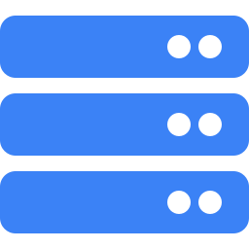





Technology Stack
Angular 19
ASP.NET Core 8
Frontend SPA — Standalone Components, Guards, RxJS
Backend Web API — Microservices, DI, Middleware
Ocelot Gateway
SQL Server 2022
API Routing, JWT Validation, Reverse Proxy
EF Core (writes + migrations) + Dapper (reads)
JWT Bearer Auth
Docker Compose
HMACSHA256 — Role-Based — Defense-in-Depth
7-Container Orchestration, Multi-Stage Nginx Build
xUnit + Moq
Karma + Jasmine
Backend Tests — no live DB required
Angular Unit Tests — 13 spec files
Notes:
8 technologies. Most impressive: Angular 19 standalone, Ocelot Gateway, Dapper+EF hybrid, Docker Compose.

Slide 6
HIGH-LEVEL DESIGN
System Architecture Overview
Angular 19 Frontend (Port 4200)
🐳 Docker
Standalone Components · Bootstrap 5 · RxJS · Karma+Jasmine
↕
Ocelot API Gateway (Port 5000)
🐳 Docker
JWT Validation · Route Matching · Request Forwarding
↕
UserService :5001 · ProductService :5002 · CartService :5003 · OrderService :5004
🐳 Docker
ASP.NET Core 8 Microservices · Each Independent · Each in Docker Container
↕
SQL Server 2022 — ECommerceDb
🐳 Docker
Tables: Users · Products · CartItems · Orders · OrderItems
Internal: CartService & OrderService → ProductService via Docker DNS (not through Gateway)
Notes:
Layered architecture — Angular talks only to Gateway. Gateway routes to services. Internal calls use Docker DNS.

Slide 7
USER JOURNEY
Application Flow Diagram
Browse Products
Register
(New Users)
View Cart
Checkout & Orders
Order Confirmation
Home Page
Login
(Existing Users)
User
Dashboard
View Order History
User
Interacts
Admin Panel
Logout
Notes:
This flow diagram shows the complete user journey. Users land on Home Page, register or login, reach the Dashboard, then branch to all features. Logout returns them to Home Page.

Slide 8
ANGULAR ROUTER
Route Architecture Diagram
NavbarComponent
[Global]
AppComponent
(Root)
FooterComponent
[Global]
ToastComponent
[Global]
Router Outlet
app.routes.ts
PUBLIC ROUTES (No Guard)
/home
/products
/product/:id
/login
/register
/admin-login
AUTH GUARD (requires valid JWT → redirect /login)
🔒 /cart
🔒 /checkout
🔒 /orders
ADMIN GUARD (requires JWT + role = 'Admin' → redirect /admin-login)
🛡 /admin-dashboard
🛡 /admin (products, users, orders)
Notes:
Route architecture: 3 tiers. Public routes: no protection. authGuard: checks JWT expiry, redirects to /login. adminGuard: checks JWT AND role=Admin, redirects to /admin-login.

Slide 9
ANGULAR 19 SPA
Frontend Architecture & Data Flow
Bootstrap Flow
main.ts
app.config.ts
AppComponent
bootstrapApplication
(AppComponent, appConfig)
→
provideRouter(routes)
provideHttpClient
+withInterceptors
→
Root — Navbar
+ <router-outlet>
+ Footer + Toast
Standalone Components
Functional authGuard
Functional adminGuard
standalone: true — no NgModules. Each imports its own dependencies. bootstrapApplication() in main.ts.
checks isLoggedIn() — validates JWT exp timestamp → redirect /login. Modern Angular 15+ functional pattern.
checks isLoggedIn() AND isAdmin() (role='Admin') → redirect /admin-login. Double-layer route protection.
authInterceptor (Global)
BehaviorSubject State
ObjectUrlPipe
withInterceptors([authInterceptor]). Attaches Bearer token. Catches HTTP 401 → auto-logout + redirect.
authState$ in AuthService. NavbarComponent subscribes reactively. No NgRx needed for this scale.
Converts File/Blob → temporary preview URL in admin panel. No base64 overhead. Instant image preview.
Notes:
Angular 19 has no NgModules. 6 key patterns: Standalone components, functional guards (×2), authInterceptor, BehaviorSubject state, ObjectUrlPipe.

Slide 10
Backend — ASP.NET Core 8 Microservices
UserService
ProductService
CartService
OrderService
:5001
:5002
:5003
:5004
▸ POST /auth/register
▸ GET /products (Dapper)
▸ GET /cart
▸ POST /orders (create)
▸ POST /auth/login → JWT
▸ GET /products/search
▸ POST /cart (add/increment)
▸ GET /orders [Admin]
▸ GET /user/profile
▸ POST/PUT/DELETE [Admin]
▸ PUT /cart/:id (qty)
▸ GET /orders/myorders
▸ GET /users [Admin]
▸ POST /images/upload
▸ DELETE /cart/:id (item)
▸ PUT /orders/:id/cancel
▸ PUT /users/:id/toggle-role
▸ GET /products/admin/all
▸ DELETE /cart (clear all)
▸ Stock updated via ProductSvc
Shared Database: SQL Server — ECommerceDb | Each service: own DbContext + EF Core Migrations
Notes:
4 independent microservices. CartService and OrderService call ProductService directly using typed HTTP clients.

Slide 11
ROUTING & SECURITY LAYER
API Gateway — Ocelot :5000
Ocelot is a .NET API Gateway library — the single entry point for all Angular requests. It validates JWT tokens and routes to the correct microservice.
Route Configuration (Ocelot.json)
Upstream Path (Client) | → Downstream Service | Auth Required
POST /api/auth/register | POST /api/auth/login | UserService :5001 | ❌ Public
GET /api/products | GET /api/products/search | ProductService :5002 | ❌ Public
POST/PUT/DELETE /api/products (Admin) | ProductService :5002 | 🔐 Admin Role
GET/POST/PUT/DELETE /api/cart | CartService :5003 | ✅ Bearer Token
GET/POST/PUT /api/orders | OrderService :5004 | ✅ Bearer Token
GET /images/:filename | ProductService :5002 | ❌ Public Static
📌 Two Configuration Files:
Ocelot.json (Local Dev): downstream → localhost:5001..5004 Ocelot.Docker.json (Docker): downstream → userservice:8080... Selected via OCELOT_CONFIG env variable in docker-compose.yml
Notes:
Angular only knows one URL: localhost:5000. Ocelot handles routing. Two config files for local vs Docker deployment.

Slide 12
SECURITY ARCHITECTURE
JWT Authentication Flow
User
Browser
Angular
App
Ocelot
Gateway
UserService
:5001
1. Submit email + password
▶
2. POST /api/auth/login
▶
3. Forward to UserService
▶
4. 200 OK { token: 'eyJ...' }
◀
5. JWT returned to Angular
◀
6. Store localStorage · Decode · authState$.next(true)
7. Protected request + Authorization: Bearer <token>
▶
8. 401 → interceptor: logout() + redirect /login
◀
Notes:
JWT validated TWICE — Ocelot Gateway (Layer 1) and each microservice (Layer 2). This is defense-in-depth. Steps 1-5 are the login flow. Steps 6-8 are a protected request.

Slide 13
AUTHORIZATION
JWT Role-Based Access Control & Token Structure
JWT Token Payload
Defense-in-Depth (2 Validation Layers)
{
Layer 1 — Ocelot Gateway
"nameid": "1",
AuthenticationProviderKey: 'Bearer'. Validates BEFORE forwarding. Invalid token → 401. Request never reaches any microservice.
"unique_name": "Roshan",
"email": "r@shopez",
"role": "Admin",
"exp": 1748000000
Layer 2 — Microservice Middleware
}
AddAuthentication().AddJwtBearer() in Program.cs. Same Key/Issuer/Audience. [Authorize] + [Authorize(Roles='Admin')] per endpoint.
Role Access Matrix
Role | Allowed Endpoints | Blocked → HTTP Status
Customer (Auth) | /cart, /checkout, /orders, GET /api/products | Admin endpoints → 403 Forbidden
Admin (Auth) | All + DELETE/POST/PUT /products, GET /users | Full access with Admin JWT role
No Token | /home, /products, GET /api/products, /images/* | Protected routes → 401 Unauthorized
Notes:
The role claim is inside JWT. Client-side guards are UX protection. Real enforcement: [Authorize(Roles='Admin')] on server-side controller actions.

Slide 14
DATA LAYER
Database Design — ER Diagram
Users
Products
CartItems
⭐ Key Design
Decisions
🔑 UserId (PK, int)
🔑 Id (PK, int)
🔑 Id (PK, int)
Name (nvarchar)
Name
UserId → Users
IsActive (Soft Delete)
Products marked IsActive=false instead of deleted — preserves order history integrity
1:N
Email (unique)
Description
ProductId → Products
Password (hashed)
Price (decimal)
Quantity (int)
Role (Customer/Admin)
Category
Stock (int)
Denormalized OrderItems
ProductName, Price, ImageUrl snapshot at order time — history never stale after product edits
1:N
ImageUrl
Orders
IsActive ⭐
🔑 OrderId (PK, int)
OrderItems
UserId → Users
Shared Database
Single ECommerceDb for simplicity. Each service owns its own DbContext + migrations.
🔑 Id (PK, int)
OrderDate
1:N
OrderId (FK) → Orders
TotalAmount
ProductName ⭐
Status
Quantity
PaymentMethod
Price ⭐
ImageUrl ⭐
Notes:
Two critical decisions: soft delete preserves order history, denormalized order items mean old orders never break when products are edited.

Slide 15
UML DIAGRAM 1/3
Use Case Diagram — ShopEZ
ShopEZ System
Register / Login
Admin Login
Browse & Search Products
Manage Products (CRUD)
Manage Cart
Upload Product Images
Customer
Checkout & Pay
View All Orders
View Order History
Toggle User Roles
Admin
Notes:
Use case diagram. Blue = Customer actions. Purple = Admin actions. System boundary represents ShopEZ application.

Slide 16
UML DIAGRAM 2/3
Component Diagram — Angular Frontend
NavbarComponent
[Always Visible]
AppComponent (Root)
FooterComponent
[Always Visible]
ToastComponent
[Global Overlay]
Router Outlet
app.routes.ts
PUBLIC (no guard)
/home
/products
/product/:id
/login
/register
/admin-login
authGuard — requires valid JWT → redirect /login
🔒 /cart [authGuard]
🔒 /checkout [authGuard]
🔒 /orders [authGuard]
adminGuard — requires JWT + role = 'Admin' → redirect /admin-login
🛡 /admin-dashboard [adminGuard]
🛡 AdminComponent — products, users, orders [adminGuard]
Notes:
3-tier component protection. Public: no guard. authGuard: valid login. adminGuard: login + Admin role.

Slide 17
UML DIAGRAM 3/3
Sequence Diagram — Place Order Flow
Customer
Angular
Checkout
Ocelot
Gateway
OrderService
:5004
ProductService
:5002
1. Fill checkout form
▶
2. POST /api/orders + Bearer token
▶
3. Validate JWT → forward
▶
4. GetProduct(id) — price, name, imageUrl
▶
5. Product details returned
◀
6. Create Order + OrderItems. TotalAmount.
7. UpdateStock(id, qty) — decrement
▶
8. 200 OK stock updated
◀
9. 201 Created → navigate /order-success
◀
Notes:
Order flow: Angular → Ocelot → OrderService → ProductService (internal). Key: OrderService calls ProductService directly via Docker DNS, not through the public gateway.

Slide 18





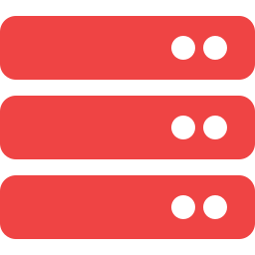

Key Features
JWT Role Authentication
Product Catalogue
Customer & Admin roles. Defense-in-depth: Gateway + Service layers.
Browse, search, filter by category, pagination. Dapper-powered fast reads.
Shopping Cart
Checkout & Orders
Server-persisted. Real-time enrichment via ProductService. Update qty.
Full address form + payment method. Order history. Soft stock management.
Admin Dashboard
Ocelot API Gateway
Product CRUD + image upload. Toggle user roles. View all customer orders.
Single entry :5000. JWT validation + route forwarding to 4 microservices.
Docker Compose
Unit Testing
7-container one-command startup. Multi-stage Nginx Angular build.
xUnit + Moq (backend, no live DB). Karma + Jasmine (13 Angular spec files).
Notes:
8 features. Most impressive: JWT defense-in-depth, Dapper+EF hybrid, Docker Compose one-command deployment.

Slide 19
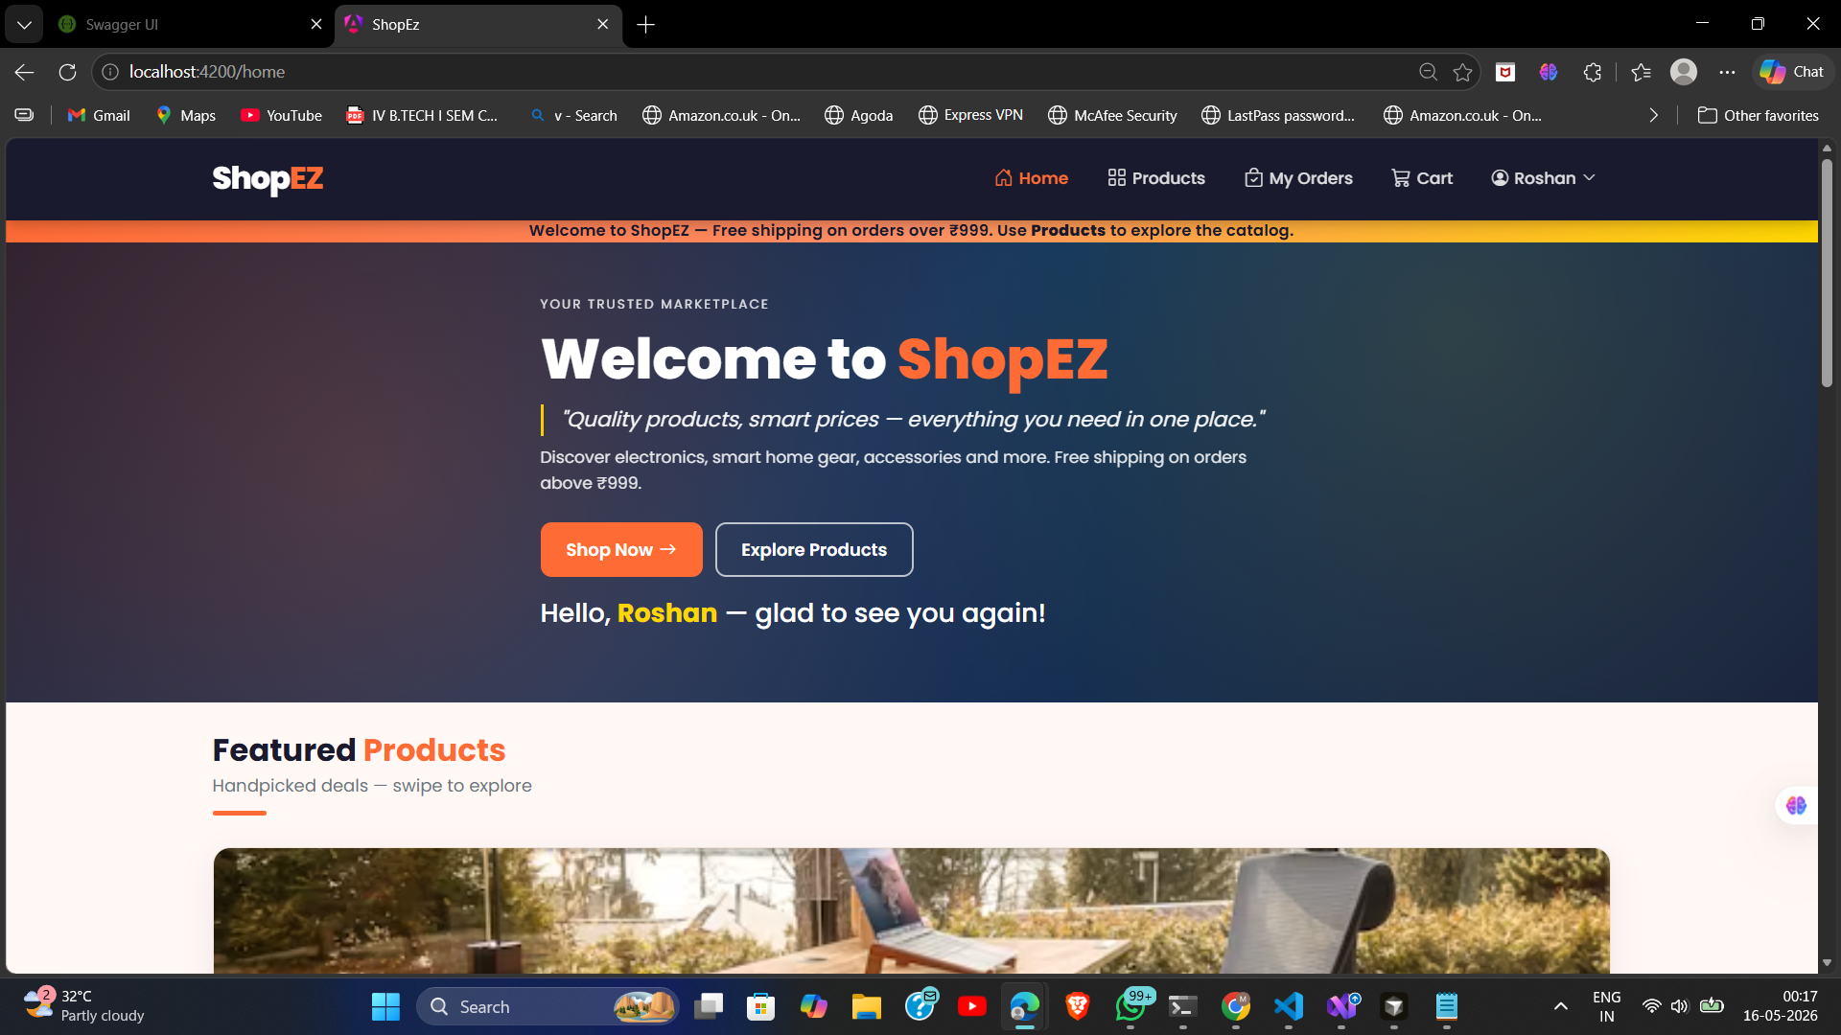
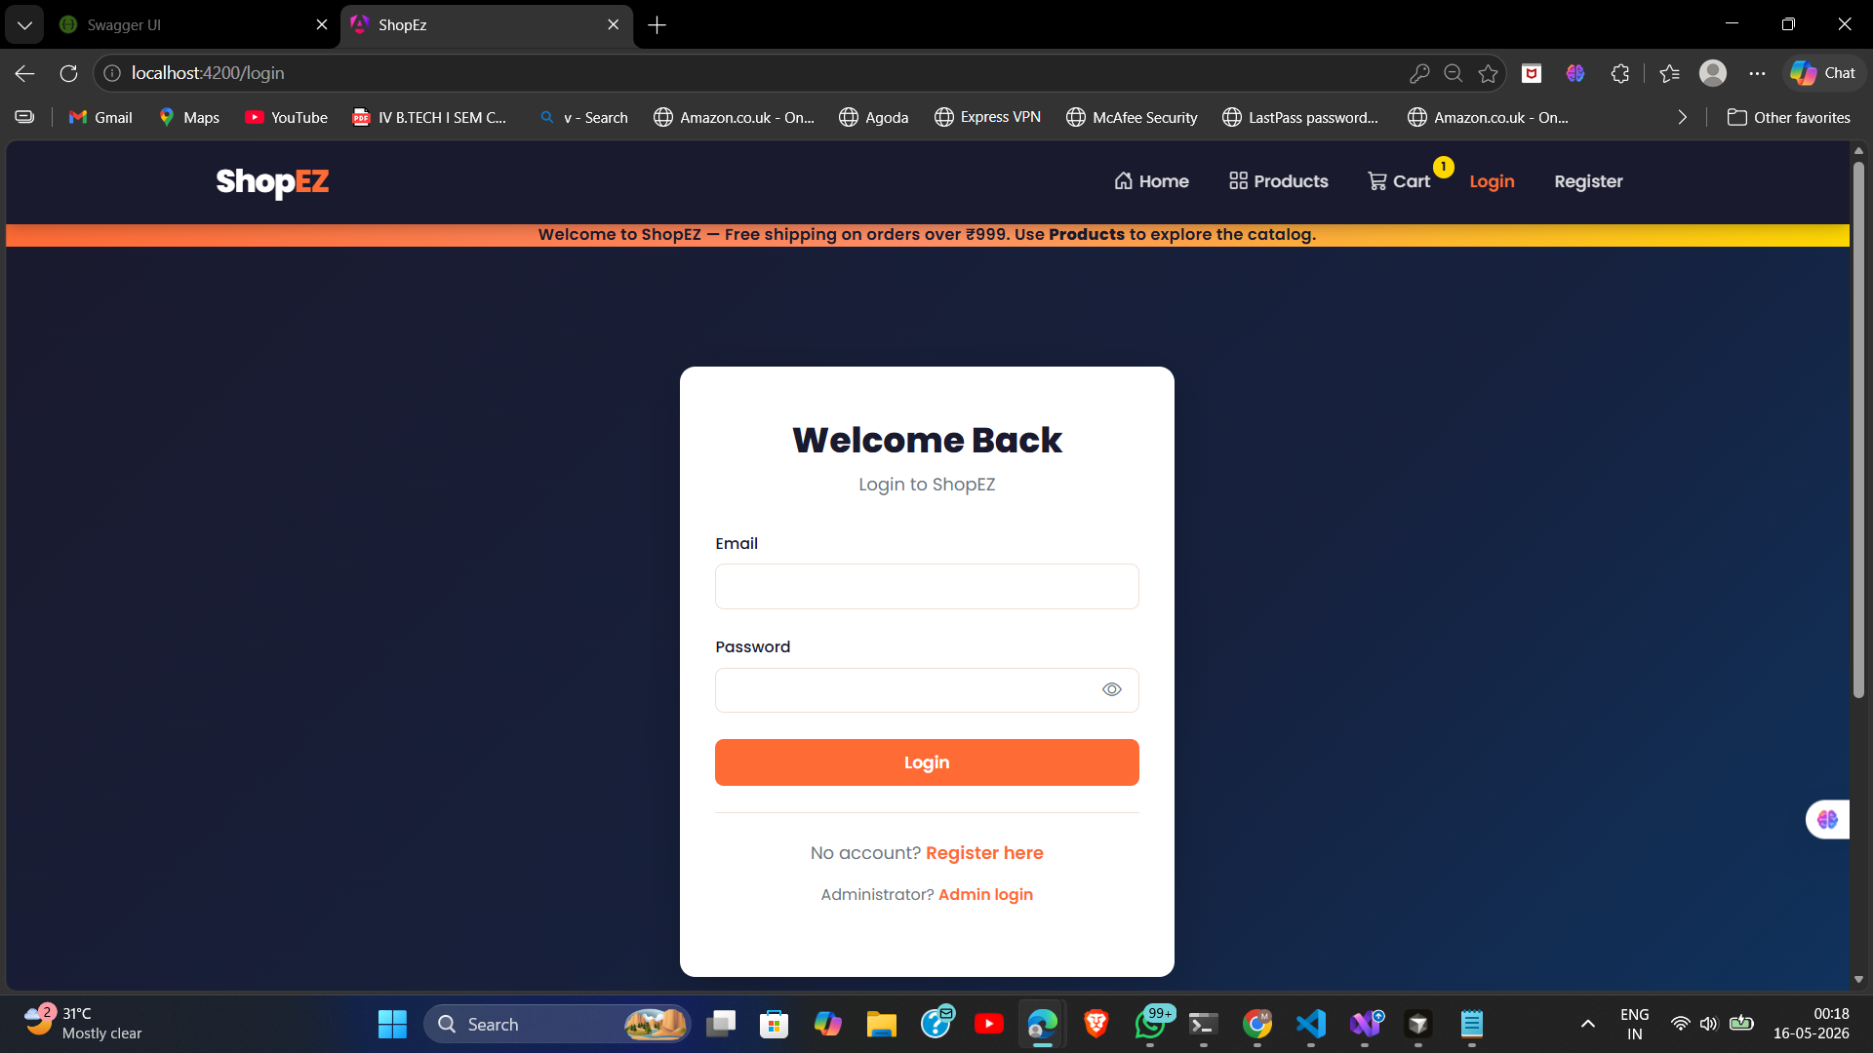
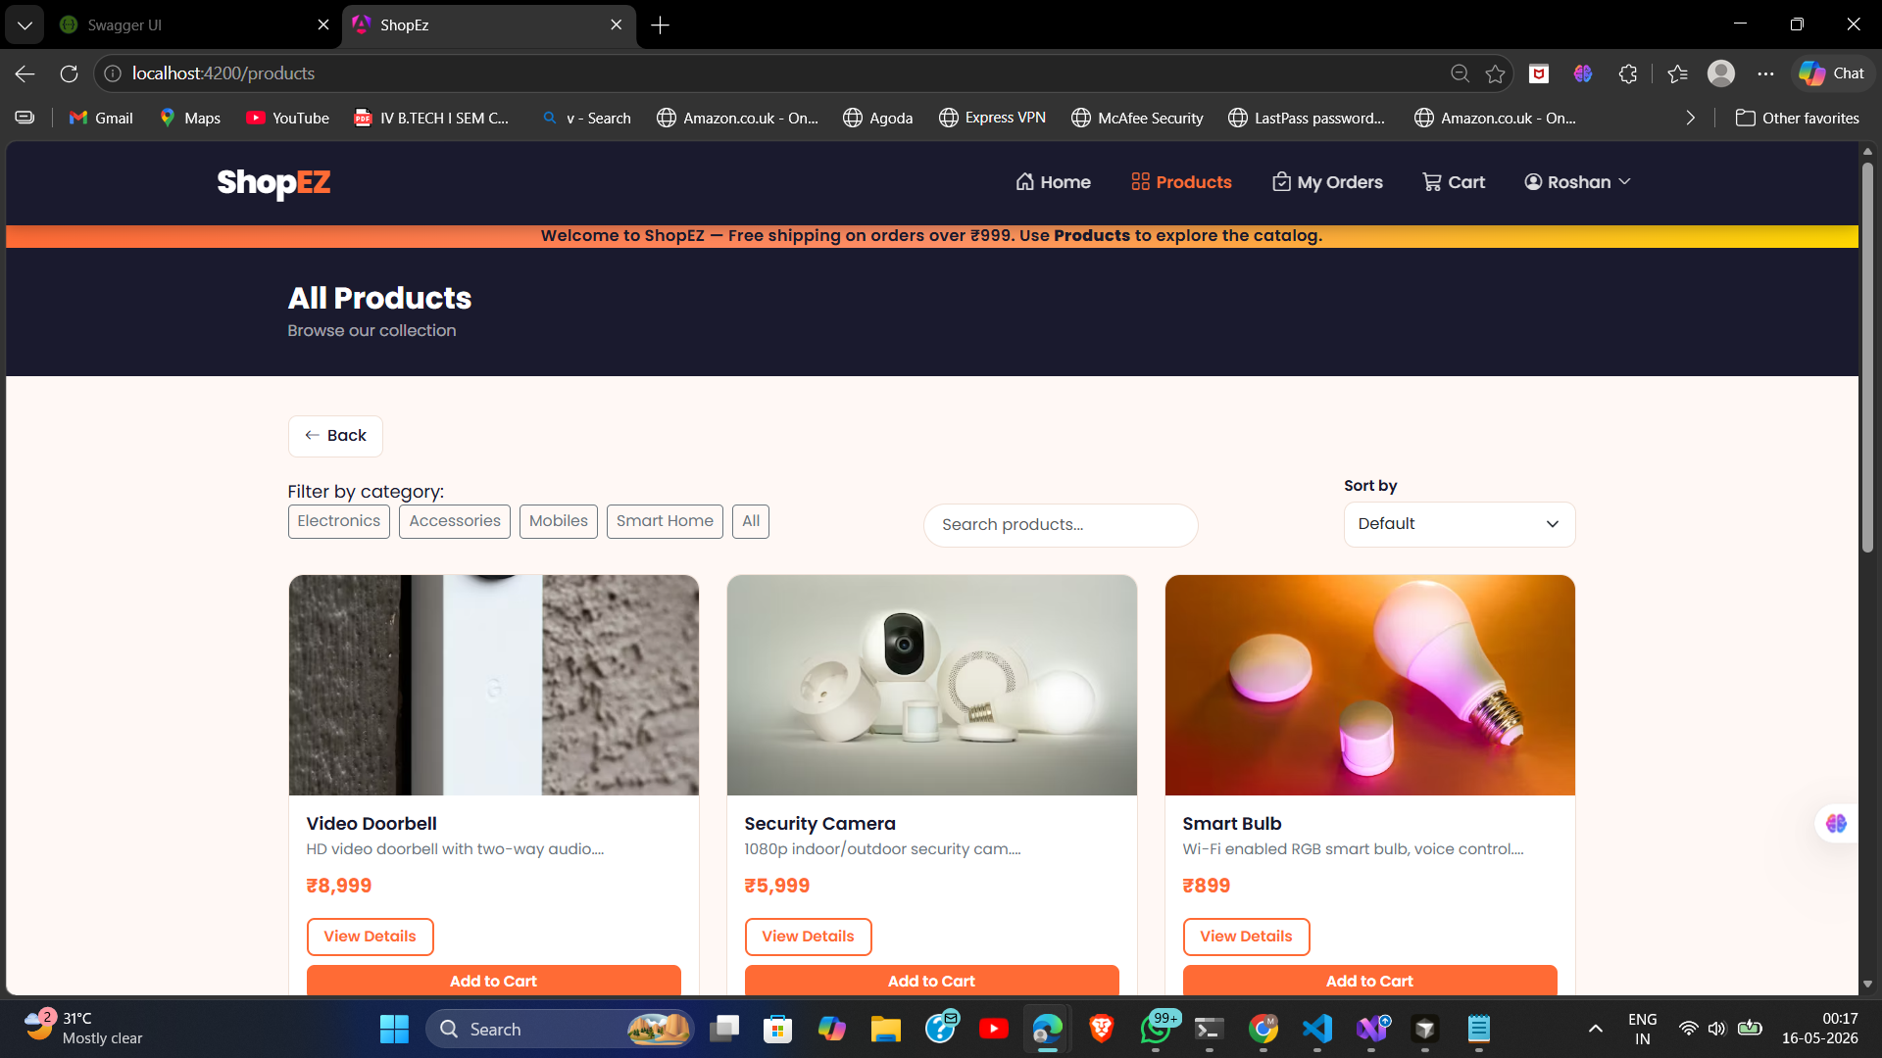
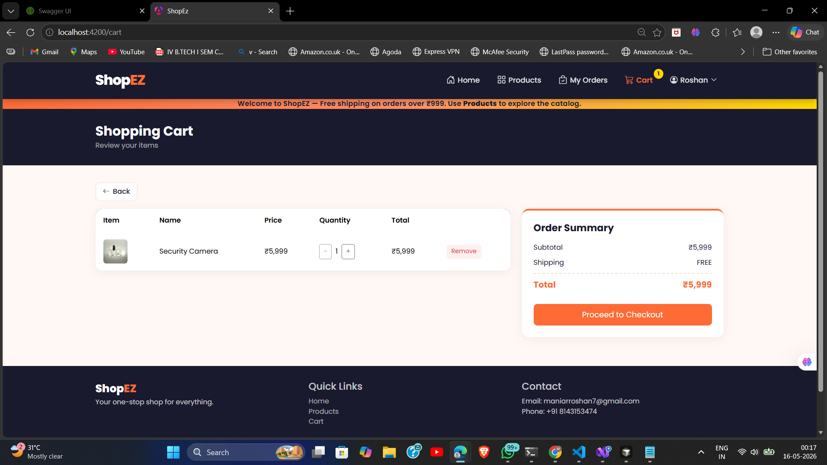
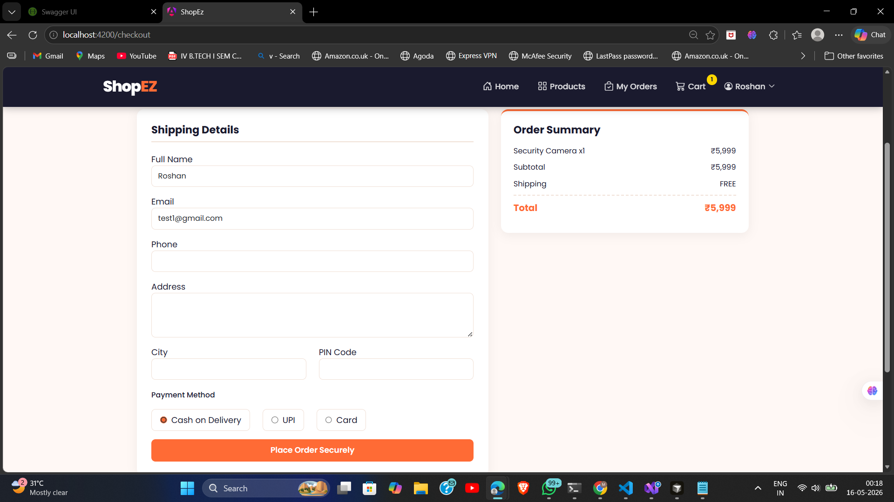
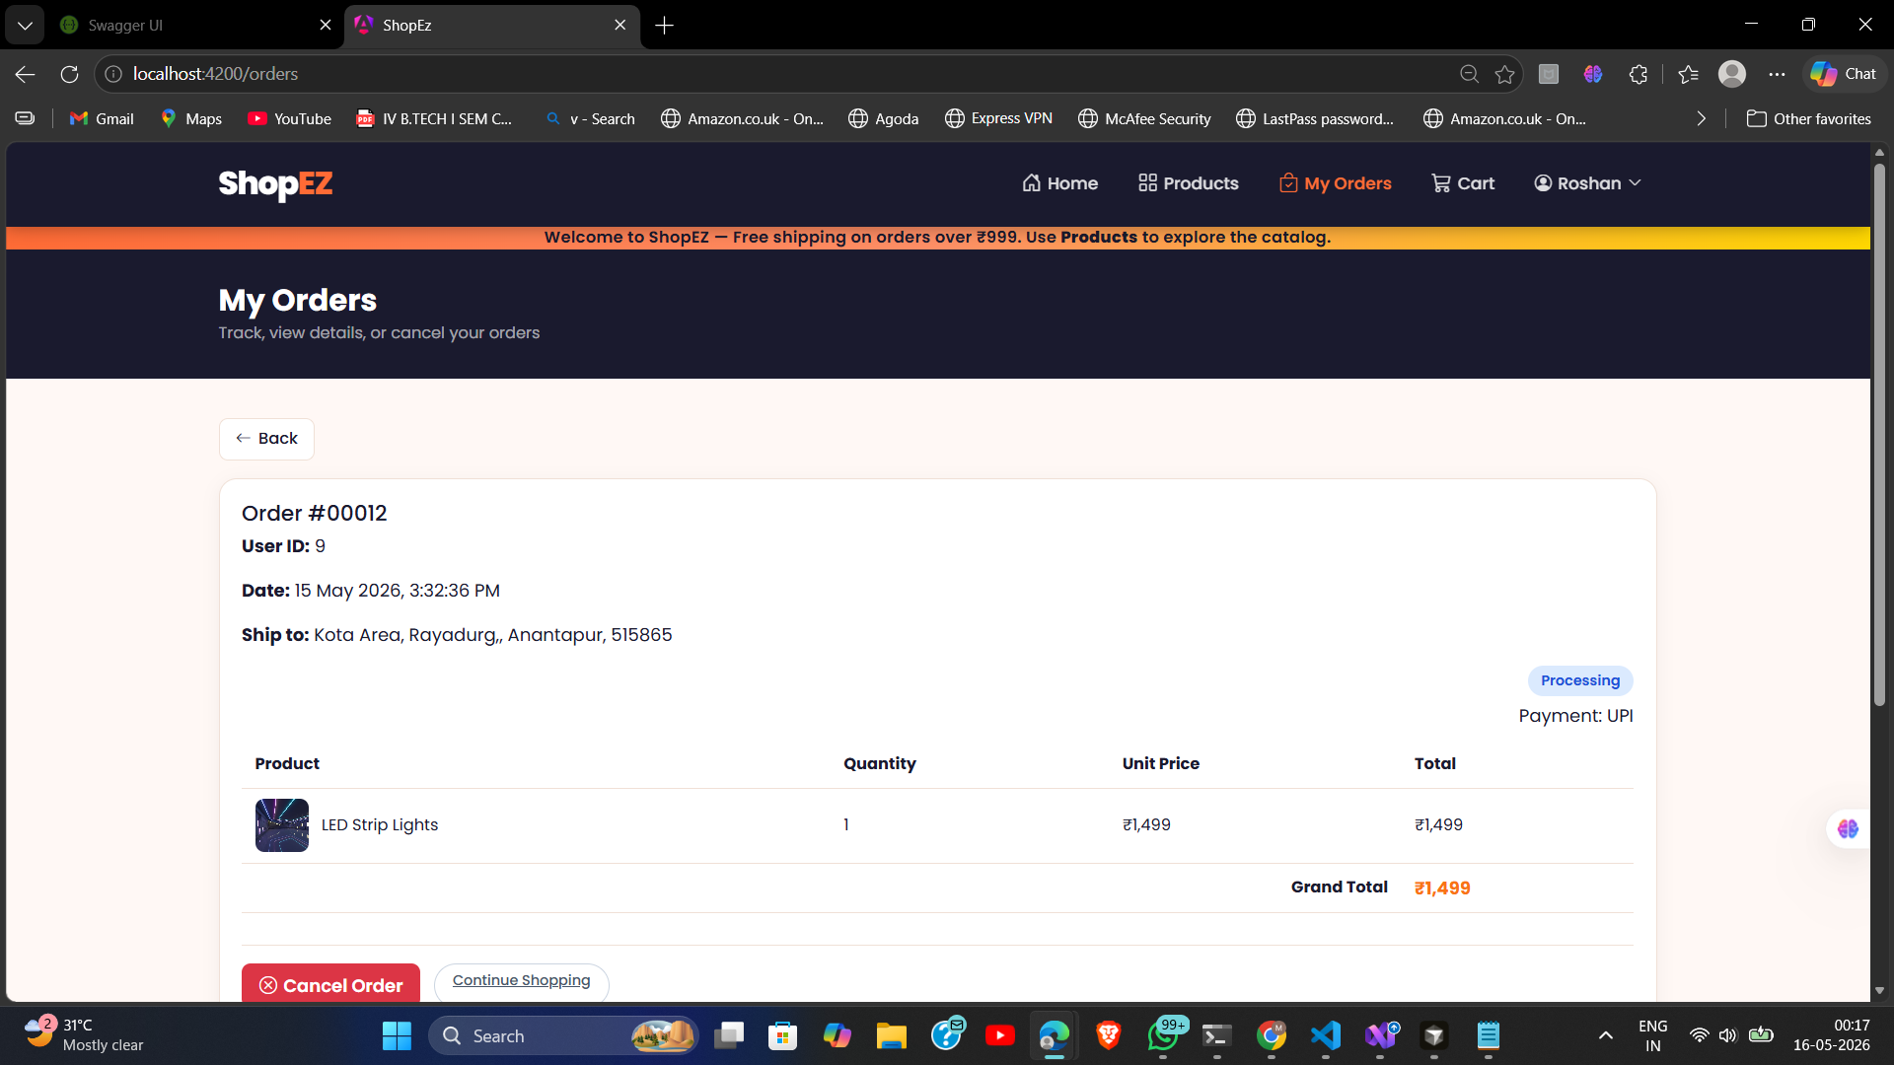
USER INTERFACE
Customer Module — UI Screens
Home Page
Login
Products Catalogue
Shopping Cart
Checkout
Order History
Notes:
Customer journey: Home → Login → Browse → Cart → Checkout → Order History.

Slide 20

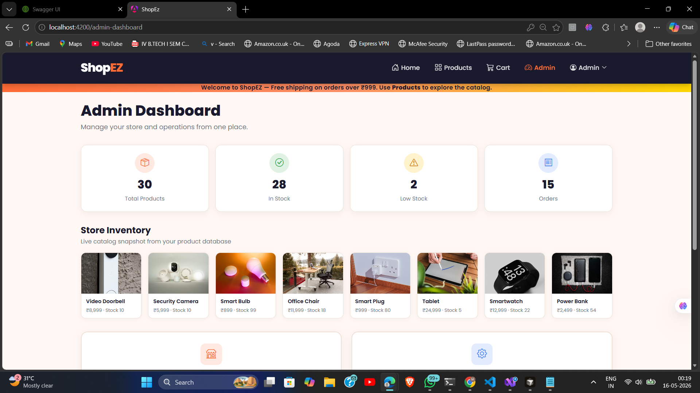
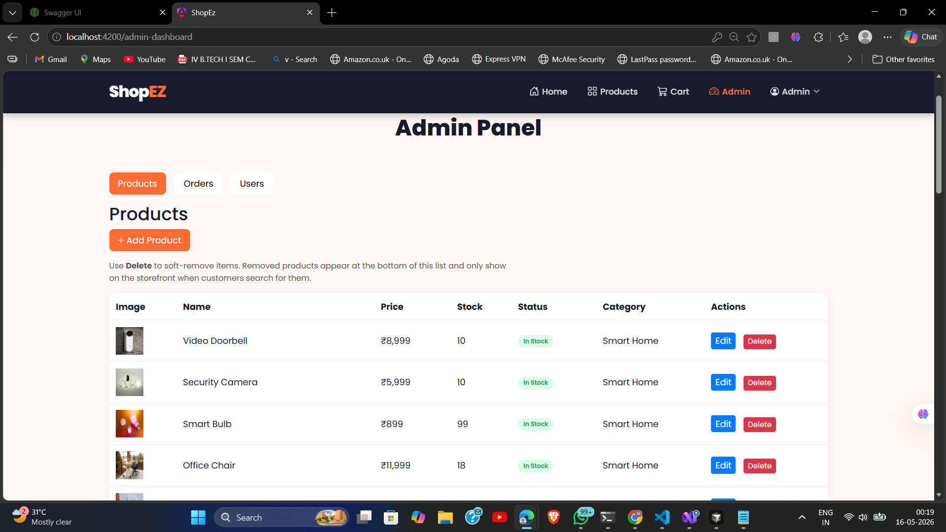
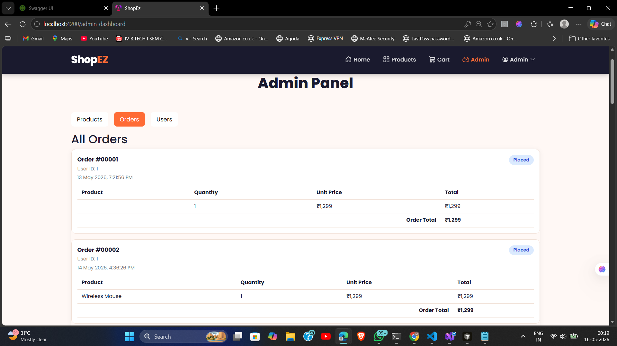
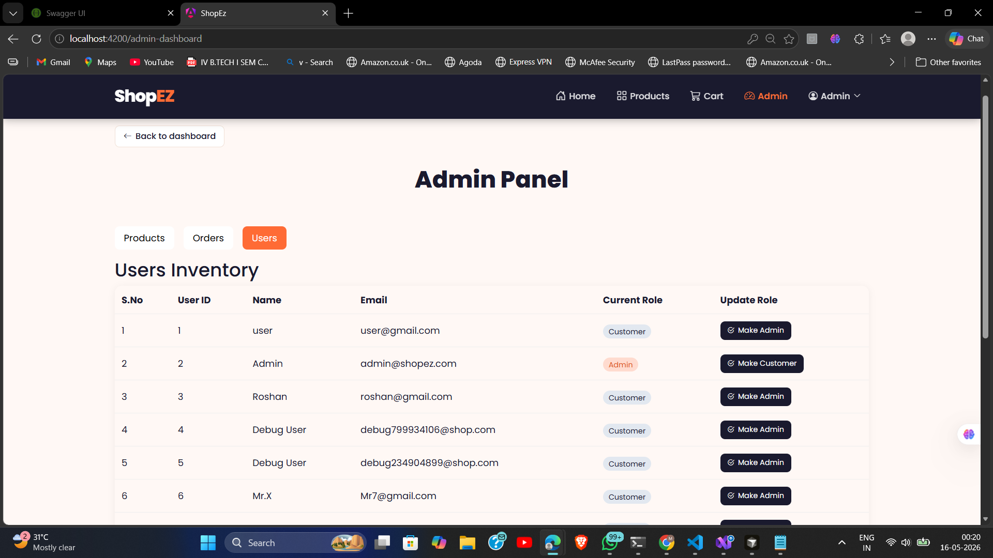
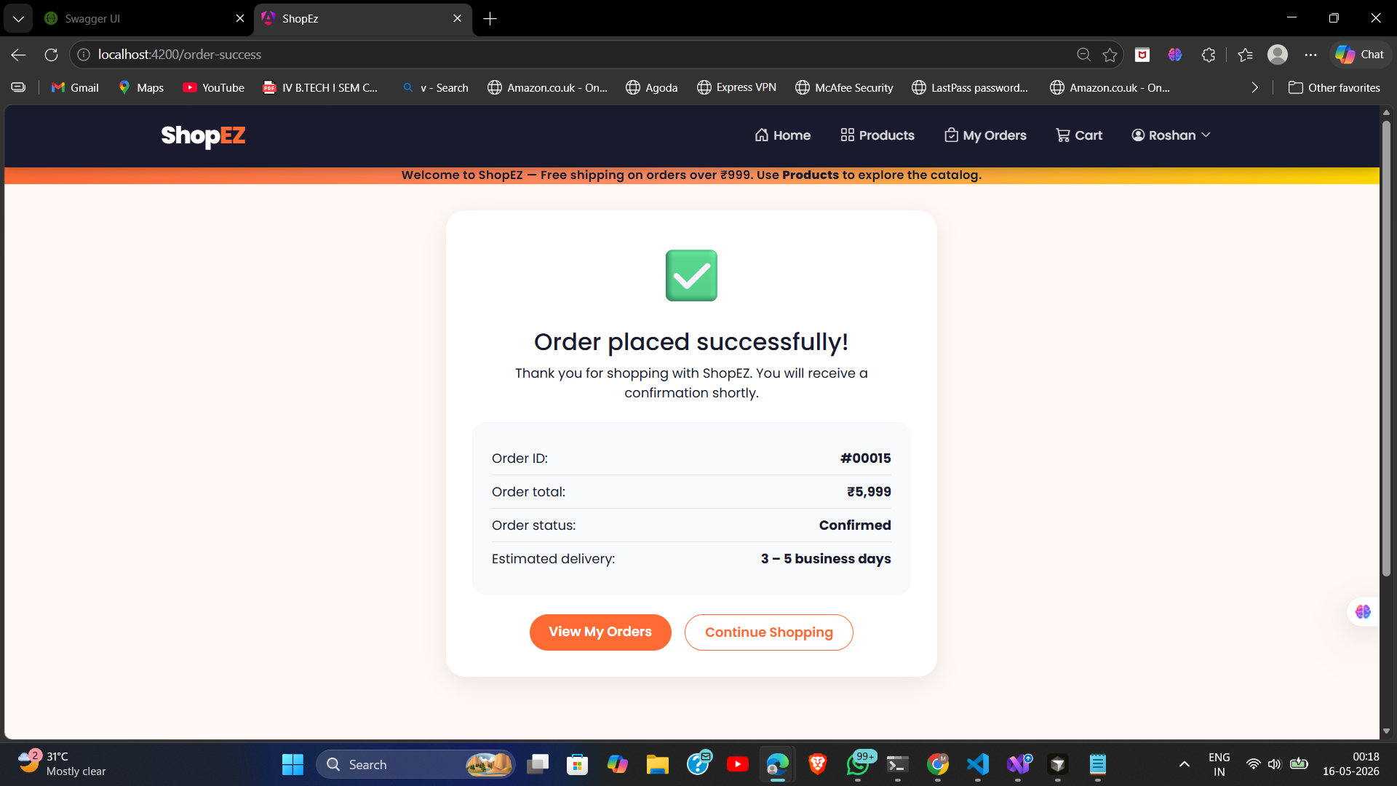
USER INTERFACE — ADMIN
Admin Module — UI Screens
Admin Login
Dashboard Stats
Product Management
All Customer Orders
User Role Toggle
Order Confirmation
Notes:
Admin has separate login. Dashboard shows live stats. Product management has CRUD + image upload. User management allows role toggles.

Slide 21
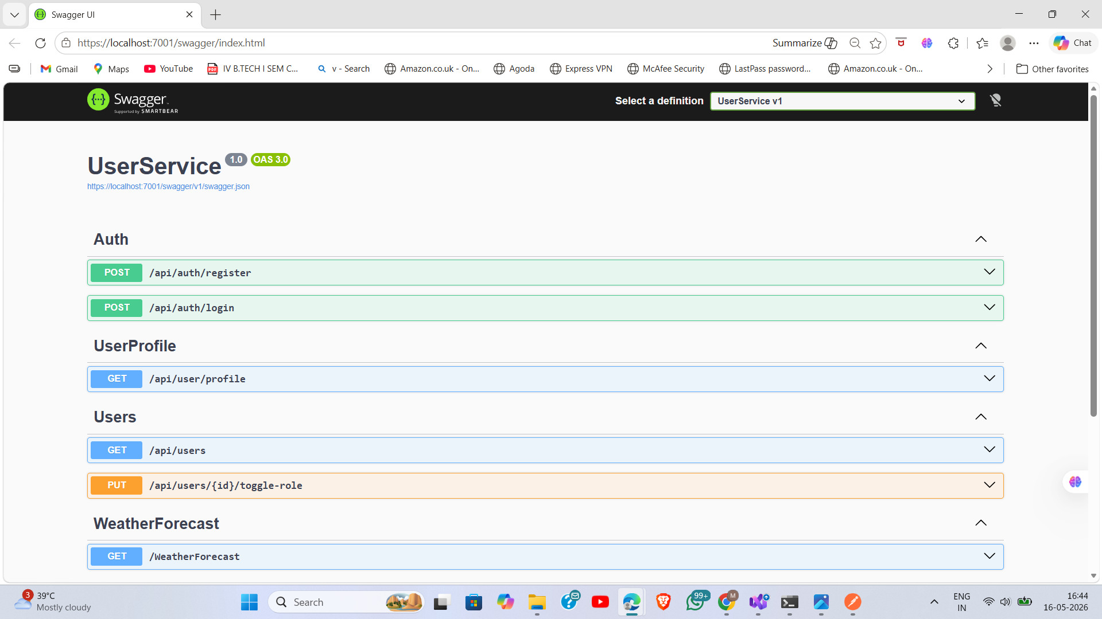
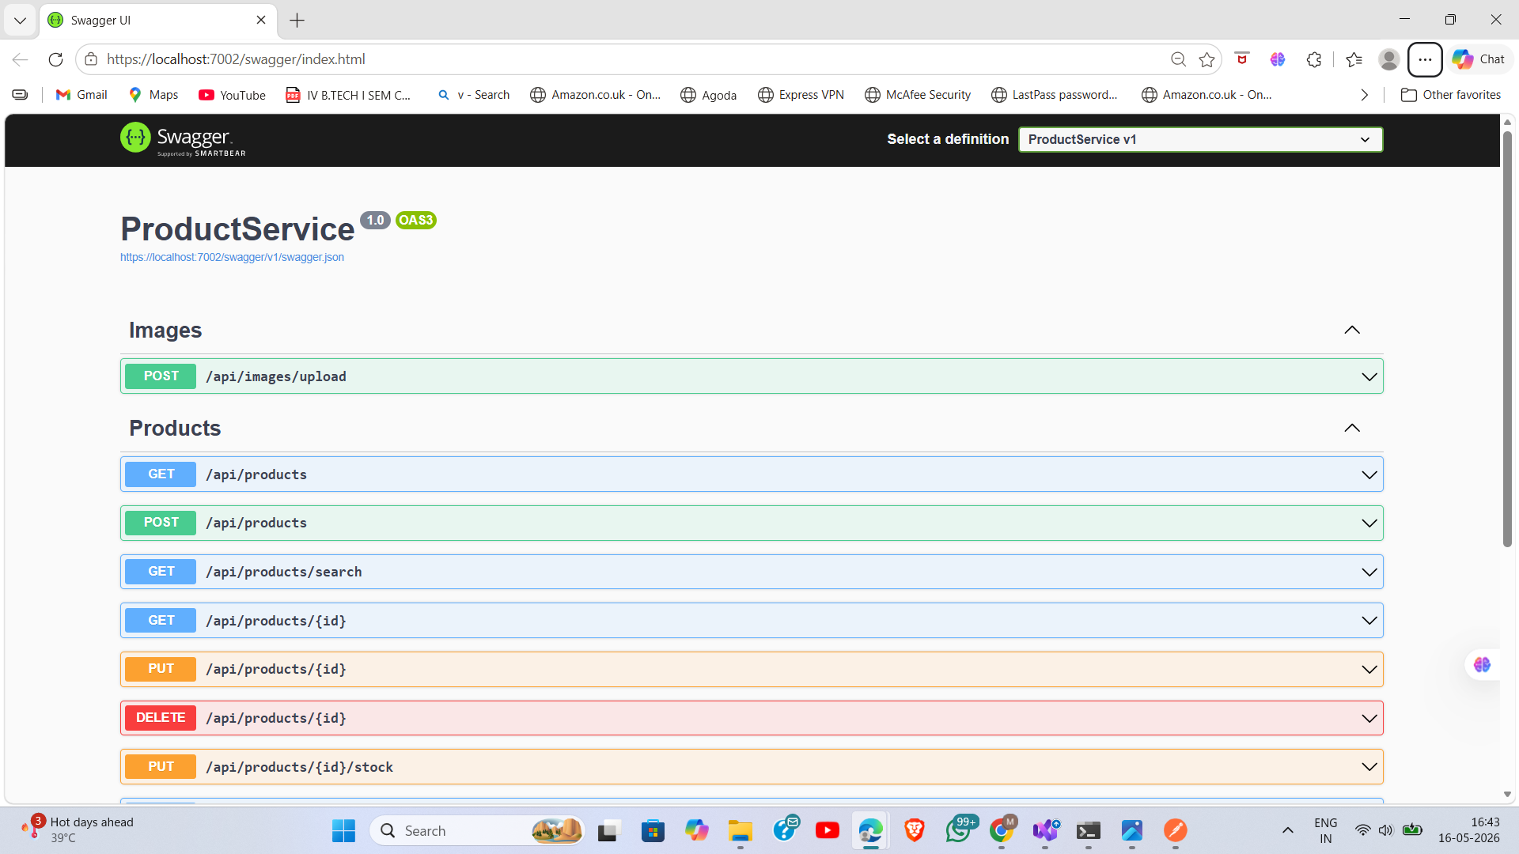
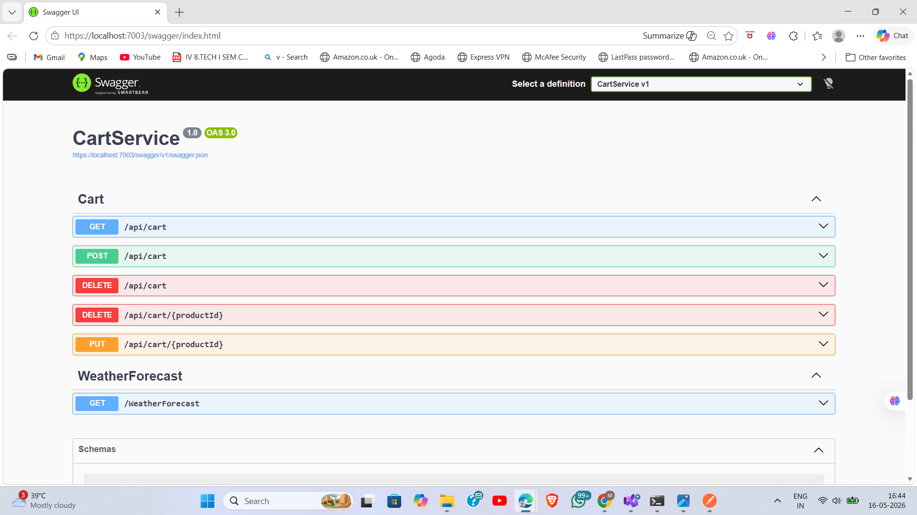
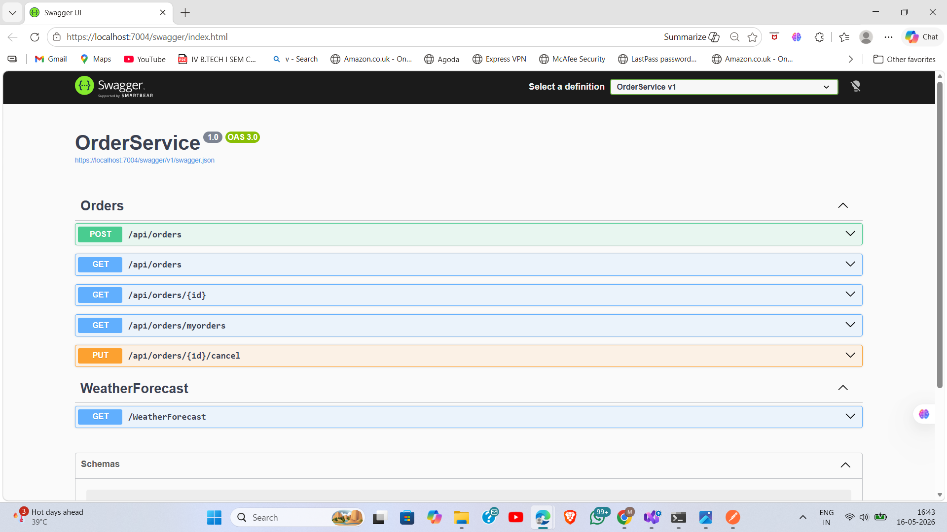
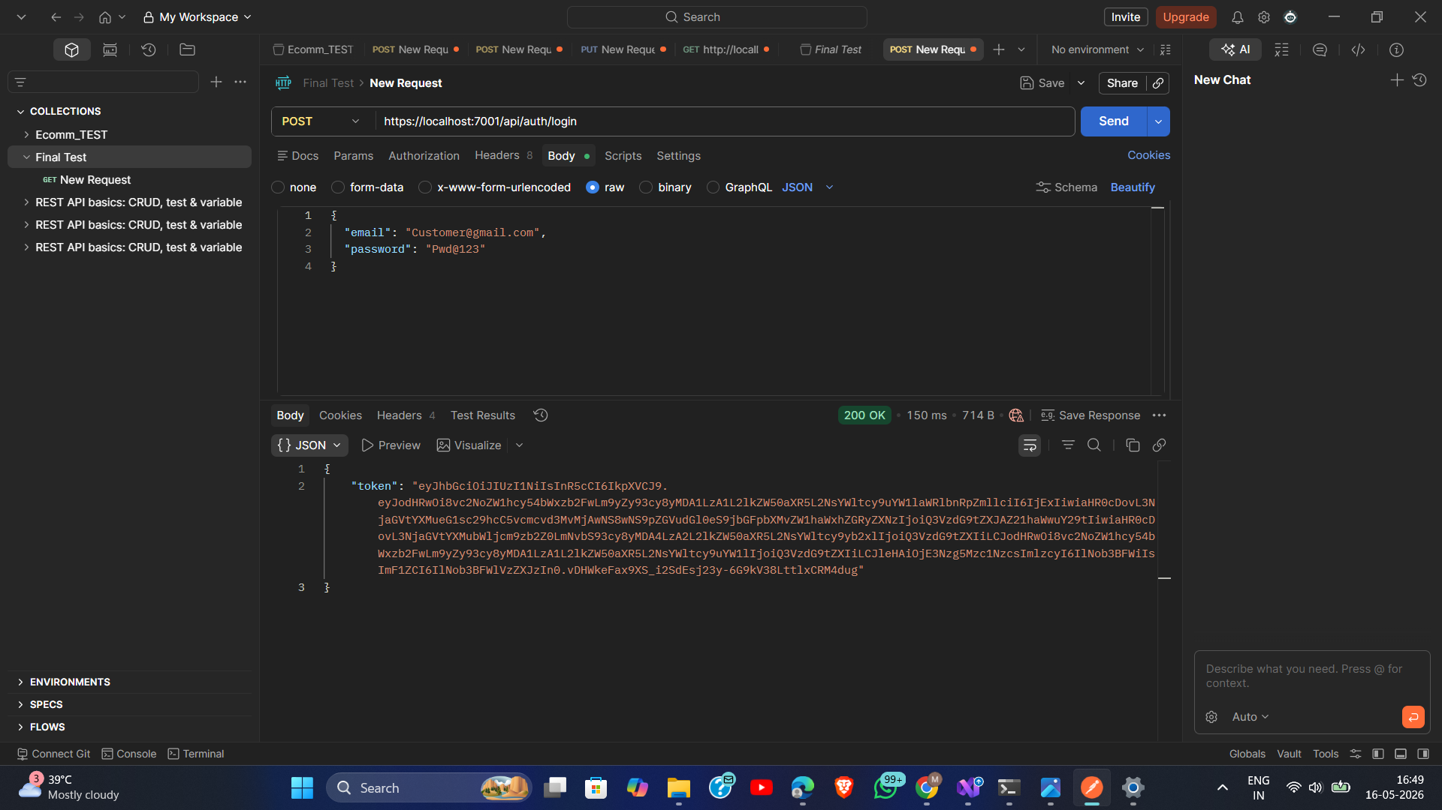
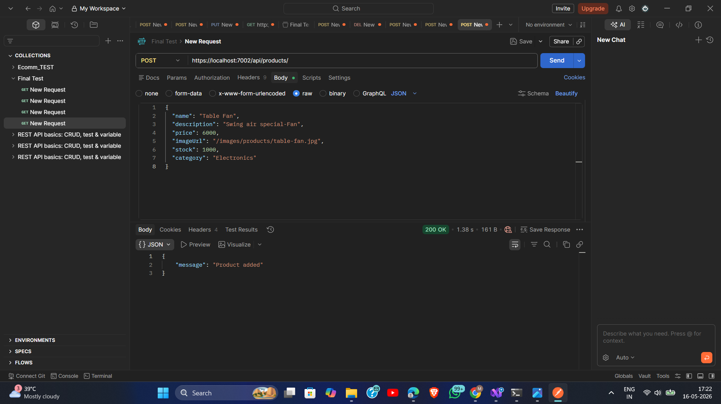
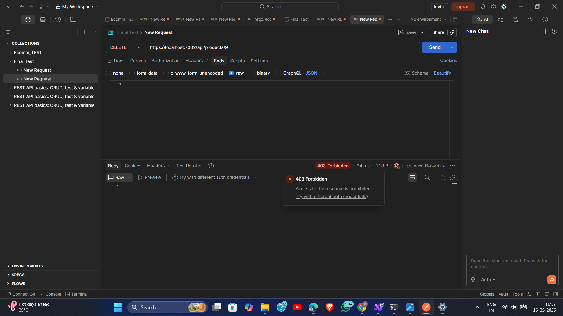
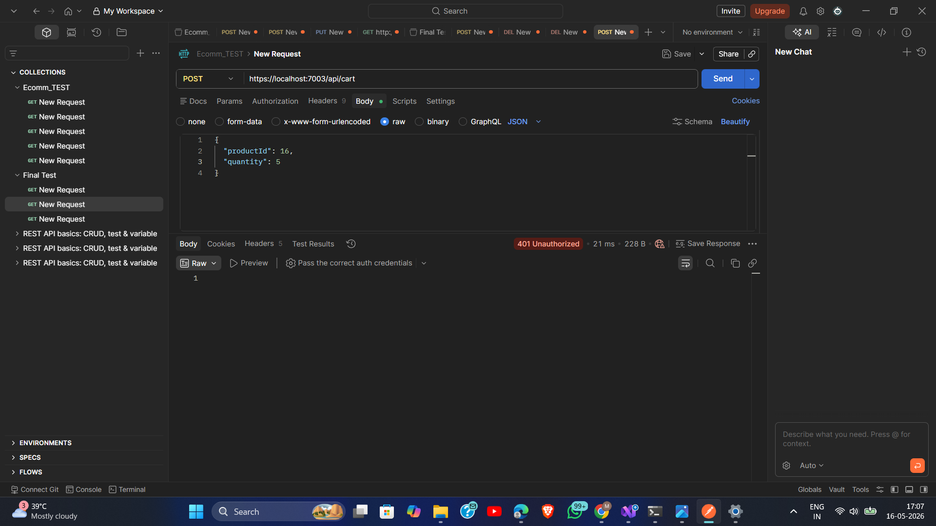
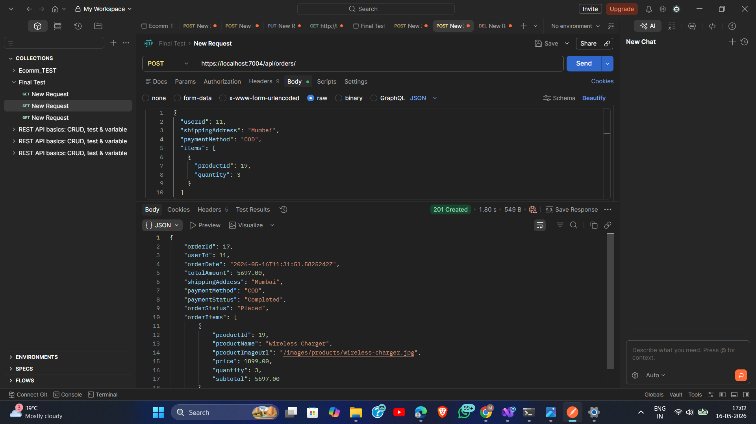
API DOCUMENTATION & TESTING
Swagger & Postman Test Evidence
Swagger — Auto-Generated API Documentation (per service)
UserService :5001
ProductService :5002
CartService :5003
OrderService :5004
Postman — Key API Test Cases
200 OK
200 OK
BLOCKED
BLOCKED
200 OK
Login → JWT (200 OK)
Add Product Admin (200)
No Admin Role → 403
No Token → 401
Create Order (201)
Notes:
Swagger provides interactive docs per service. Most important Postman tests: 403 Forbidden on admin endpoint without admin role, 401 on cart without token. Prove security works.

Slide 22
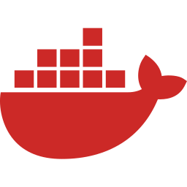


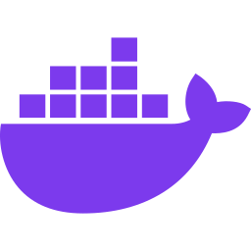


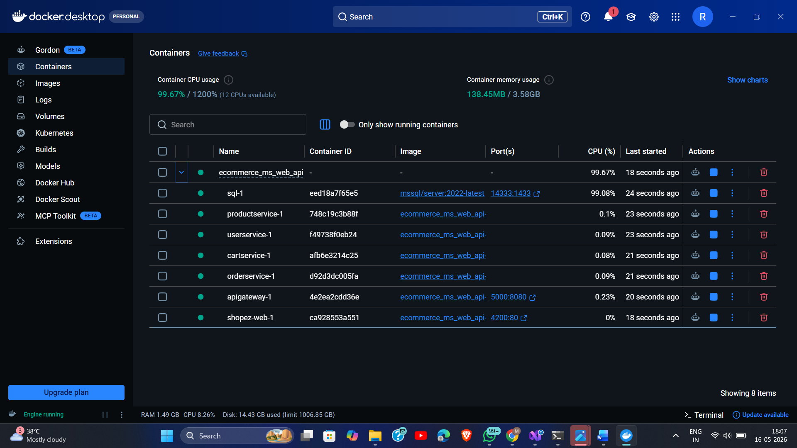
Docker & Deployment Architecture
sql
userservice
productservice
cartservice
orderservice
apigateway
shopez-web
SQL Server
:14333→1433
UserService
:8080 int
ProductService
+img vol
CartService
:8080 int
OrderService
:8080 int
Ocelot Gateway
:5000
Angular Nginx
:4200→80
Docker Desktop — All 7 Containers Running
$ docker compose up --build → Starts all 7 containers in correct dependency order
Notes:
One command starts everything. Dependency order: SQL → services → gateway → frontend. ProductService has volume mount for image persistence.

Slide 23
ORM ARCHITECTURE DECISION
Dapper + EF Core — Hybrid ORM in ProductService
ProductService uses BOTH ORMs deliberately — choosing the right tool for each type of operation:
⚡ Dapper — Read Operations
🏗 EF Core — Writes & Schema
Direct SqlConnection — zero EF translation overhead
EF Core change tracking — knows what changed
GET /products → raw SQL SELECT WHERE IsActive=1
POST /products → _context.Products.Add(entity)
GET /products/search → parameterized queries
PUT /products/:id → Update with change tracking
GET /products/:id → single row, instant response
DELETE → IsActive=false via EF (soft delete)
High-frequency catalogue reads — ~3-10× faster
dotnet ef migrations add → schema versioning
Ideal for read-heavy public-facing endpoints
__EFMigrationsHistory tracks applied migrations
💡 Result: Dapper raw SQL for fast catalogue reads + EF Core change tracking for safe writes = Best performance AND best maintainability
Notes:
This hybrid ORM decision is the most impressive technical choice. Explain: reads are high-frequency so Dapper is right. Writes are low-frequency admin actions so EF Core safety is right.

Slide 24
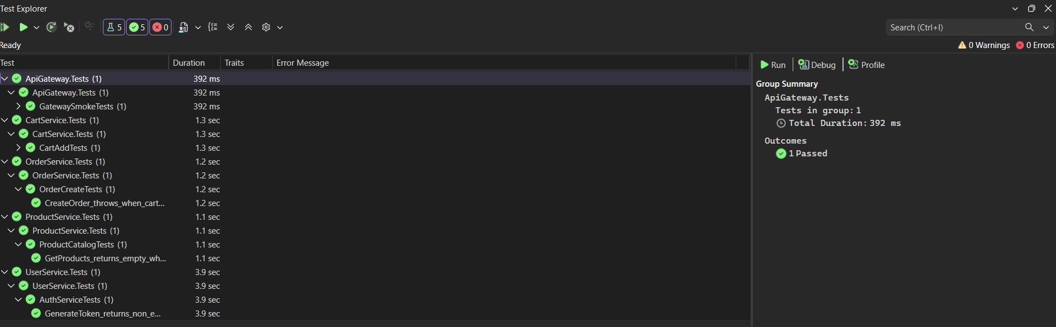
QUALITY ASSURANCE
Unit Testing & Validation
Backend — xUnit + Moq
Frontend — Karma + Jasmine
Test Project | Test Cases Covered
CartService.Tests | CartAddTests — add item, qty increment, auth check
OrderService.Tests | OrderCreateTests — order creation, stock update, invalid product
ApiGateway.Tests | GatewaySmokeTests — Ocelot config load + route resolution
Spec File | What Is Tested
auth.spec.ts | login, isLoggedIn, isAdmin, logout
cart-service.spec.ts | getCart, addToCart
order-service.spec.ts | createOrder, getMyOrders
checkout-component.spec.ts | form validation
object-url-pipe.spec.ts | Blob → object URL
✅ Moq mocks all repositories — zero live database dependency during tests
Test Run Evidence — All Tests Passing
Notes:
Testing is a professional differentiator. Backend tests need no database — Moq mocks everything. All 3 test projects and 13 Angular spec files pass.

Slide 25






Future Enhancements
Payment Gateway
AI Recommendations
Kubernetes (K8s)
Razorpay / Stripe in OrderService for live payment processing.
ML-based product suggestions using purchase + browsing history.
Replace Docker Compose with K8s for auto-scaling, self-healing.
Redis Caching
RabbitMQ Messaging
SignalR Real-Time
Cache product listings for sub-millisecond response on reads.
Async inter-service comms — decouple OrderService from ProductSvc.
WebSocket live order status updates to customers.
Notes:
Most impressive to mention: Kubernetes (production scale), RabbitMQ (distributed systems), Redis (performance). Shows thinking beyond student project.

Slide 26
SUMMARY
Learning Outcomes & Conclusion
✓
Microservices Architecture
✓
Angular 19 Modern Patterns
4 ASP.NET Core 8 services — domain-driven, isolated, independently deployable, each containerized.
Standalone components, functional guards/interceptor, BehaviorSubject state — no NgModules.
✓
Defense-in-Depth Security
✓
Hybrid ORM Decision
JWT validated at Ocelot Gateway AND microservice middleware — two independent authentication layers.
Dapper for performance-critical reads, EF Core for safe schema-managed writes — choosing the right tool.
✓
Docker Compose Deployment
✓
Comprehensive Testing
7-container one-command startup — SQL, 4 services, Gateway, Angular Nginx with multi-stage build.
xUnit+Moq backend (no live DB), Karma+Jasmine Angular — 3 test projects, 13 spec files, all passing.
Notes:
ShopEZ demonstrates production-quality engineering patterns directly applicable to Cognizant enterprise projects.

Slide 27



Thank You
Questions & Discussion Welcome
maniarroshan7@gmail.com
github.com/ManiarRoshan
Cognizant uGE_DotNet FSD | May 2026
ShopEZ — E-Commerce Application | Developed by Maniar Roshan
Notes:
End: 'Thank you. Happy to answer questions about the architecture, design decisions, or specific code choices in ShopEZ.'

