Slide 1

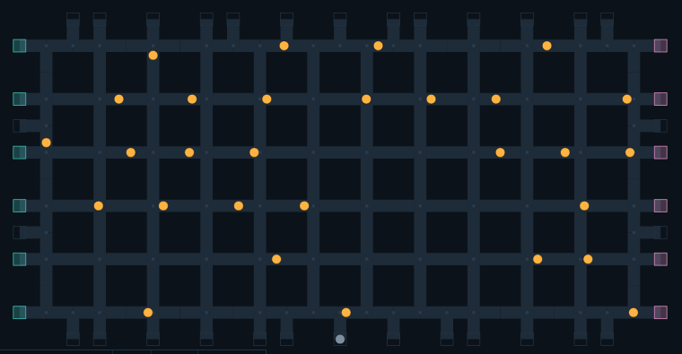
MINISTRY LOGO
SMART INDIA
HACKATHON 2026
SIH 2026 LOGO
Problem Statement ID - 26123
Problem Statement Title -
  Edge-AI Based Distributed Fleet Coordination for Autonomous Mobile Robots (AMRs) in Smart Warehouses
Theme - Smart Automation
PS Category - Software
Team ID - [ your team ID ]
Team Name - Team Roboton
30 AMRs coordinating on a warehouse floor. No central planner.

Slide 2
TEAM NAME / LOGO
ROBOTON FLEET SYSTEM
MINISTRY + SIH 2026 LOGOS
THE PROBLEM
PROPOSED SOLUTION
INNOVATION
Single point of failure: one central server plans every route and assigns every task. If it goes down, the whole fleet stops.
Latency grows with fleet size: every decision is a round trip to the server, so more robots means slower decisions.
Wi-Fi dead zones: a robot that loses coverage cannot get its next instruction and stands still.
Stop-and-wait jams: simple "halt when close" rules break down at density: 47 collisions and unfinished work at 30 AMRs in our baseline test.
Robots decide for themselves: each AMR plans its own route and bids for its own work, on board.
Distributed auction: a new order is broadcast; every robot prices it and the lowest bid wins. No dispatcher.
Whole-route reservation: the winner books its route as time windows on junctions and aisles, and shares that plan with its peers.
Peer-to-peer mesh: robots talk directly over ESP-NOW radio, with no access point or server in between.
Deterministic right of way: robots move in booking order, never by the clock, so two robots can never both claim one junction.
Safe by floor design: one-way single-lane aisles and dead-end station spurs make head-on meetings impossible.
Self-healing: lost messages, duplicate claims and dropped robots are repaired from the 5-per-second heartbeat.
Server is optional: the order gateway and dashboard hold no fleet state; the fleet finishes its held work with both switched off.

Slide 3











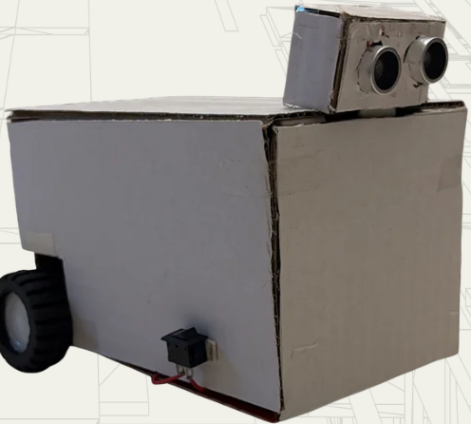
TEAM NAME / LOGO
TECHNICAL APPROACH
MINISTRY + SIH 2026 LOGOS
OPERATOR
WINNER
TECH STACK
TASK
ALLOCATION
TASK
ANNOUNCEMENT
TASK
BIDDING
ROBOT (EDGE)
WAREHOUSE
ORDERS
Python
ESP32 · ESP-NOW
BACKEND & DASHBOARD
FLEET DASHBOARD
ROBOT
POSITION
BATTERY
LEVEL
ON EVERY ROBOT · NO CENTRAL PLANNER
FastAPI
WebSockets
JavaScript
SIMULATION & TESTING
TASK
STATUS
ALERTS
SENSE
SHARE (P2P)
PLAN ROUTE
Position · Obstacles
Battery · Map
Status · Route · ETA
ESP-NOW, 5× a second
Time-window A*
around peers' bookings
Webots 3D
pytest
MY TURN?
TASK
COMPLETE
DRIVE &
DELIVER
YES
BOOK ROUTE
(time windows)
Hardware
prototype
(booking order)
Tested: 0 collisions · 120 / 120 tasks at 30 AMRs
NO
Software Link:
Hardware Link:
wait for turn / replan

Slide 4
TEAM NAME / LOGO
MINISTRY + SIH 2026 LOGOS
FEASIBILITY
CONSTRAINTS
WORKAROUNDS
Low-cost hardware: every message fits one 250-byte ESP-NOW frame, sized for ESP32-class boards.
One codebase: the same decision code runs headless, in Webots 3D and on hardware.
Proven at scale: tested with 3, 6, 30 and 100 simulated robots.
Reproducible: every run replays exactly from its seed, so any result can be re-checked.
Verified: 600+ automated tests, including rules that keep the design decentralized.
No licence cost: built entirely on open-source tools: Python, FastAPI, Webots.
Radio loss: ESP-NOW frames can drop and are never retransmitted.
Small frames: 250 bytes limits how much of a route one message can carry.
Small-fleet speed: waiting for booked turns makes 3-6 robot fleets slower than stop-and-wait.
Traffic at scale: at 100 robots, auction messages could flood the mesh.
Uniform fleet: all robots are assumed to share one size and speed.
Hardware untested: radio range has not yet been measured on real robots.
Heartbeat healing: each robot re-broadcasts its state 5 times a second. At 30% message loss: 0 duplicate deliveries.
Compact binary codec: routes are capped at 57 nodes so one plan always fits one frame.
Turn-time tuning: a tighter auction window and a bid filter already cut replanning by 11%.
Zoned auctions: the 100-robot floor is split into 24 zones so bidding stays local.
Staging bays: idle robots park in dedicated bays, never on an aisle.
Staged rollout: a 2-robot ESP32 demonstrator and range test come before any fleet deployment.

Slide 5
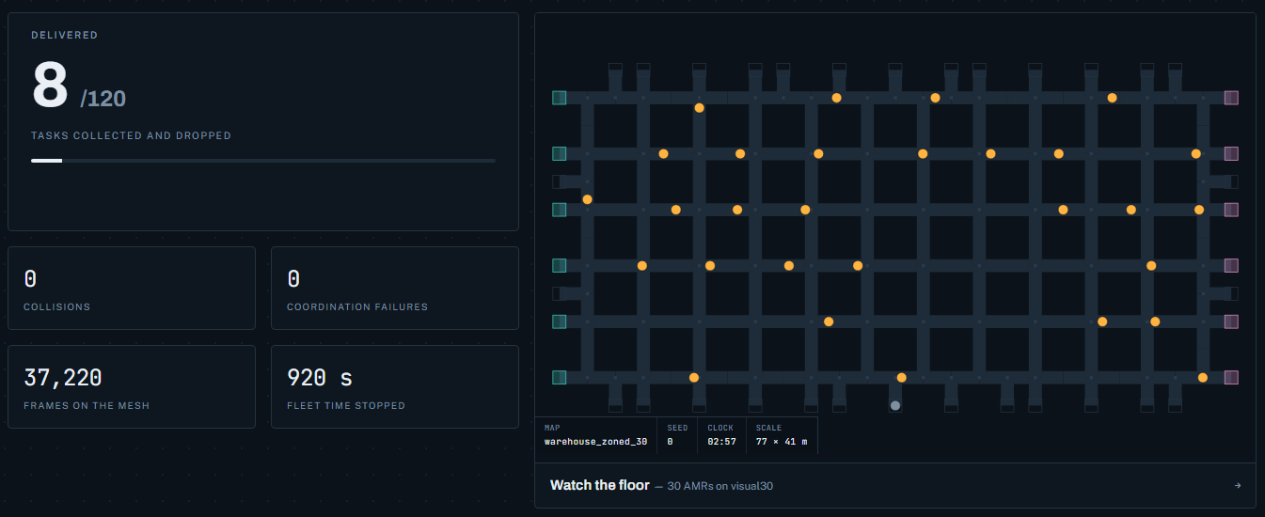
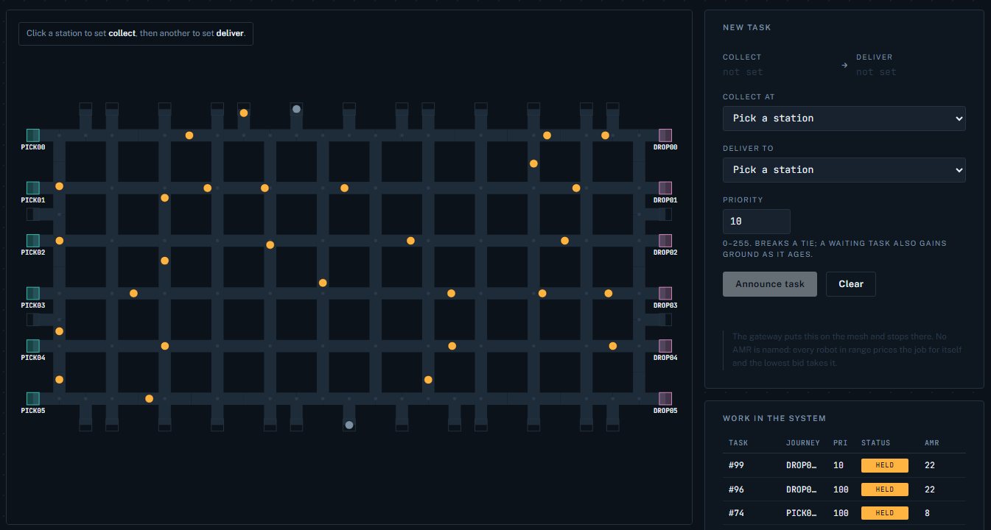
TEAM NAME / LOGO
MINISTRY + SIH 2026 LOGOS
BENEFITS
No single point of failure: the fleet keeps working if the server or Wi-Fi drops.
Zero collisions: 0 in 30 seeded test runs, and 0 with 30 robots on one floor.
Works where stop-and-wait jams: 120/120 tasks done at 30 AMRs; the baseline stalled.
4.2x less idle time: than stop-and-wait with a 30-robot fleet.
Fair allocation: waiting tasks gain priority over time; low-battery robots bid higher.
Simple to operate: post an order in a browser; watch every robot's state and battery live.
PROOF OF CONCEPT
Live dashboard: 30 AMRs, 0 collisions
Baseline: 47 collisions, 118/120 tasks. ROBOTON: 0 collisions, 120/120.
Order entry: the gateway names no robot

Slide 6
TEAM NAME / LOGO
MINISTRY + SIH 2026 LOGOS
RESEARCH AND REFERENCES
Wurman, P. R., D'Andrea, R., and Mountz, M. 2008. "Coordinating Hundreds of Cooperative, Autonomous Vehicles in Warehouses." AI Magazine 29, no. 1.
Ma, H., Li, J., Kumar, T. K. S., and Koenig, S. 2017. "Lifelong Multi-Agent Path Finding for Online Pickup and Delivery Tasks." Proc. AAMAS 2017.
ter Mors, A. W., Witteveen, C., Zutt, J., and Kuipers, F. A. 2010. "Context-Aware Route Planning." Multiagent System Technologies (MATES 2010), LNCS 6251.
Hönig, W., Kiesel, S., Tinka, A., Durham, J. W., and Ayanian, N. 2019. "Persistent and Robust Execution of MAPF Schedules in Warehouses." IEEE Robotics and Automation Letters 4, no. 2.
Silver, D. 2005. "Cooperative Pathfinding." Proc. AAAI Conference on Artificial Intelligence and Interactive Digital Entertainment (AIIDE).
Dias, M. B., Zlot, R., Kalra, N., and Stentz, A. 2006. "Market-Based Multirobot Coordination: A Survey and Analysis." Proceedings of the IEEE 94, no. 7.
Koenig, S., and Likhachev, M. 2002. "D* Lite." Proc. AAAI Conference on Artificial Intelligence.
Espressif Systems. "ESP-NOW User Guide." Espressif documentation.

