Slide 1
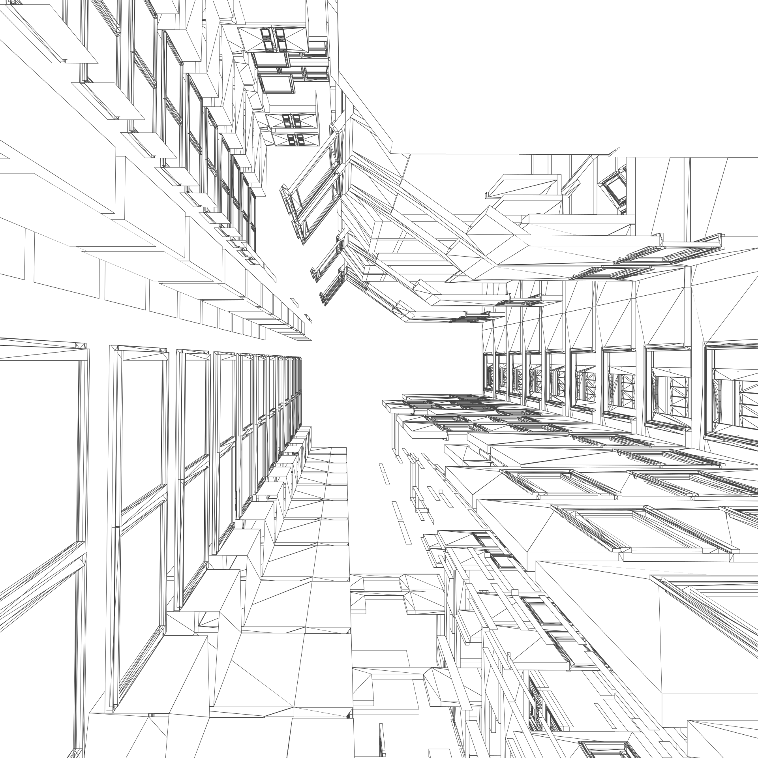













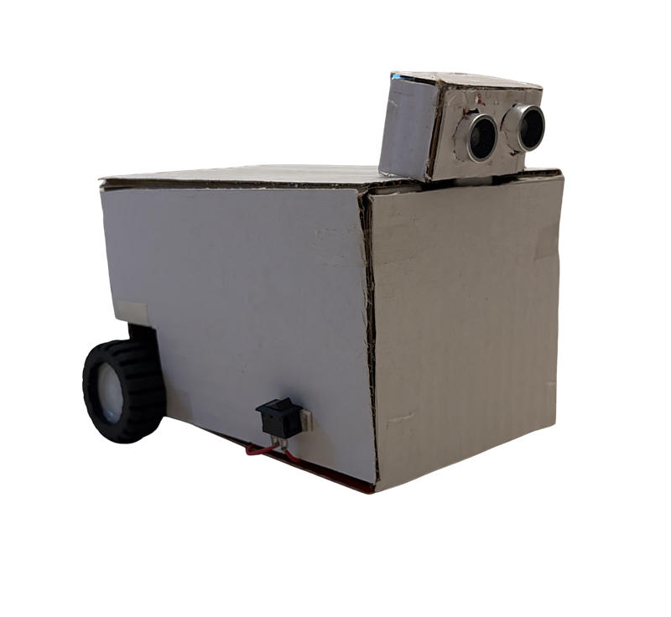
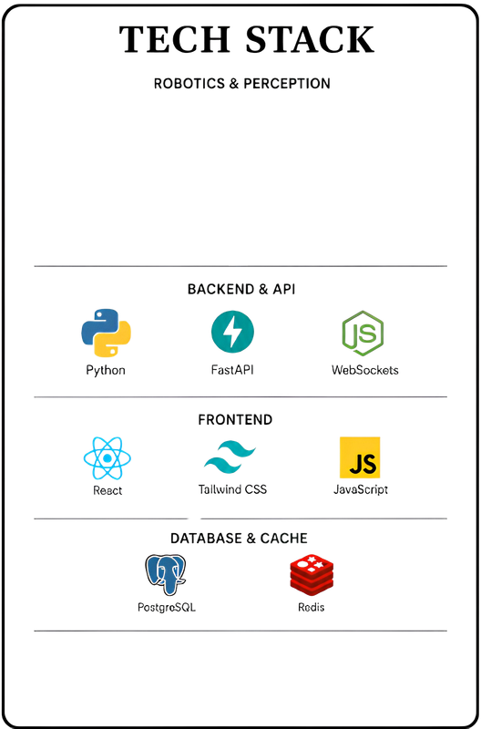

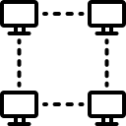





TECHNICAL APPROACH
AMR SENSORS
Pose · Proximity
ON-BOARD EVERY AMR · NO CENTRAL PLANNER
TECH STACK
TASK
ANNOUNCE RECEIVER
DISTRIBUTED
AUCTION
TIME-WINDOW
A* PLANNER
EDGE ROBOT LOGIC
OPERATOR ORDER
Order Gateway
PEER-TO-PEER MESH
ESP-NOW · 250 B
Python 3.11
ESP32 · ESP-NOW
GATEWAY & DASHBOARD
SELF-HEALING
loss · dropouts
PRECEDENCE
EXECUTOR
ROUTE RESERVATION
PATH broadcast
WAREHOUSE MAP
Graph JSON
FastAPI
WebSockets
JavaScript
HTML5
PEER STATE
INTENT @ 5 Hz
Right of way goes by booking order, never by the clock, so two robots can never both believe they have it.
SIMULATION & VERIFICATION
Webots 3D
pytest
Git
CORE ALGORITHMS
TASK
DELIVERED
TELEMETRY
WebSocket
UPDATE
DASHBOARD
Sealed-bid reverse auction
Free-time-window A*
Precedence execution (ADG)
OPERATOR VIEWS (read-only)
Well-formed Kiva-style maps
WAREHOUSE
MAPS
PEER PLAN
TABLE
EVENT &
METRICS LOG
LIVE FLEET
FLOOR
BENCHMARK
PANEL (A/B)
Software Link:
Hardware Link:
Hardware prototype
ORDER ENTRY
PAGE
WEBOTS 3D
VIEW

