Slide 1
Dynamic Weather Dashboard
CAPSTONE PROJECT
Presented By:
1. NATUKULA MANICHARAN-Sathyabama University-BE-CSE

Slide 2
OUTLINE
Problem Statement (Should not include solution)
System Development Approach (Technology Used)
Algorithm & Deployment (Step by Step Procedure)
Result
Conclusion
Future Scope(Optional)
References

Slide 3
Problem Statement
The need for an intuitive and accessible weather information system is growing due to increasing reliance
on real-time climate data.
Existing weather applications often lack user-friendly interfaces, seamless login functionality, or engaging
visual elements.
Challenges include automatic page transitions, inconsistent login processes, and limited interactivity for
users seeking detailed weather forecasts.
There is no integrated solution that combines real-time data, customizable features, and an immersive user
experience in a single web-based dashboard.

Slide 4
System Approach
Frontend Technologies:
HTML5 – Structure of the webpage
CSS3 – Styling and responsive layouts
JavaScript – Dynamic interactivity (weather updates, search functionality, theme toggling)
Design Approach:
Clean and user-friendly interface
Mobile-responsive design
Modular separation of HTML, CSS, and JS files

Slide 5
Algorithm & Deployment
Weather Data Retrieval: Fetch real-time weather data using OpenWeatherMap API (latitude, longitude, units).
Frontend Design
Layout using HTML and CSS (cards for forecasts, navbar for navigation).
Interactive Features
City search with autocomplete in JavaScript.
Login/logout functionality and theme toggling.
Real-time weather updates and favorite cities management.
Testing
Cross-browser compatibility
Mobile responsiveness
Deployment
Host using GitHub Pages / Netlify for free and easy access.

Slide 6
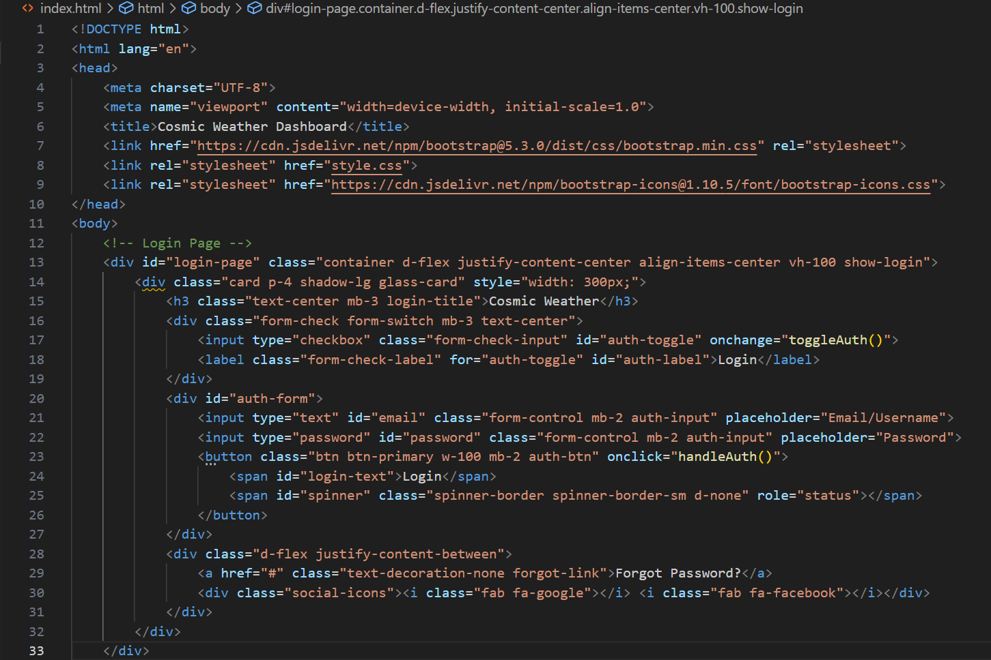
Result

Slide 7
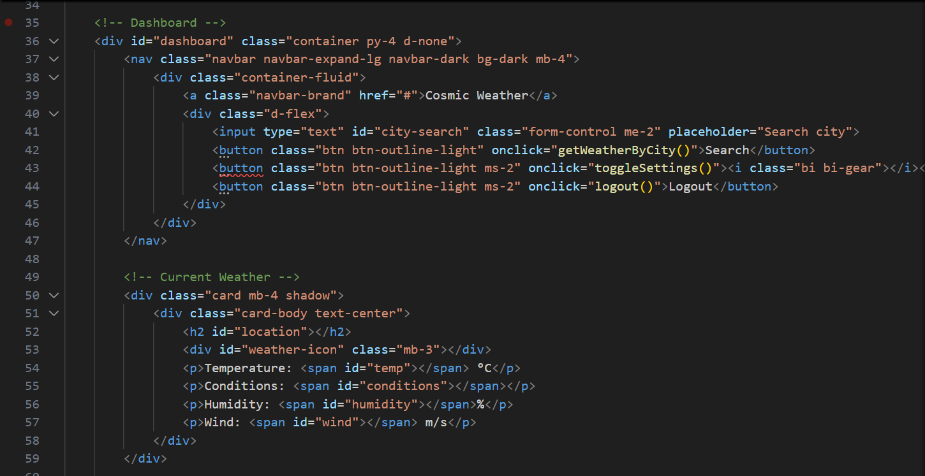
RESULT

Slide 8
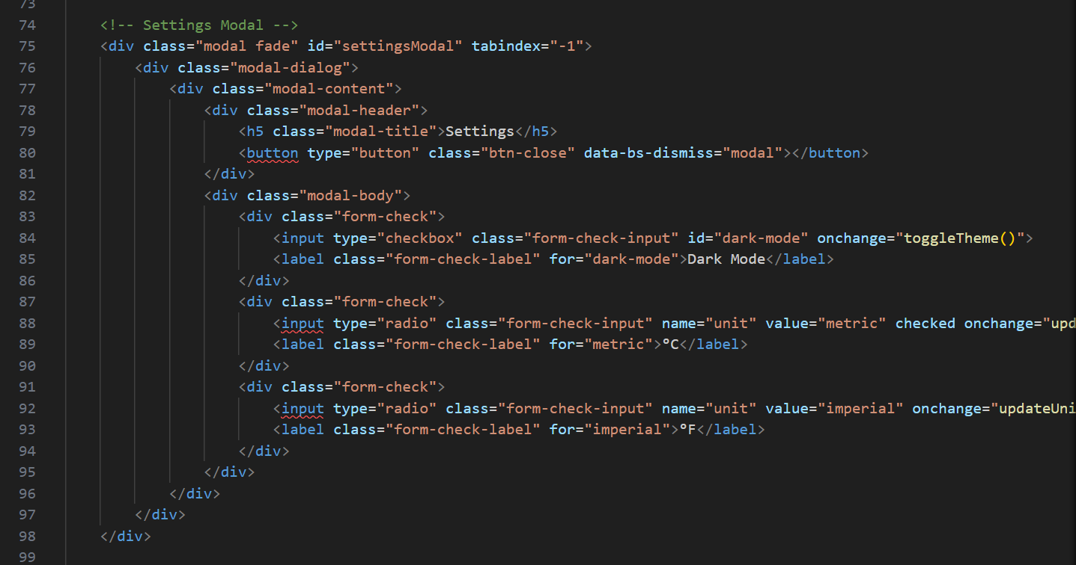
RESULT

Slide 9
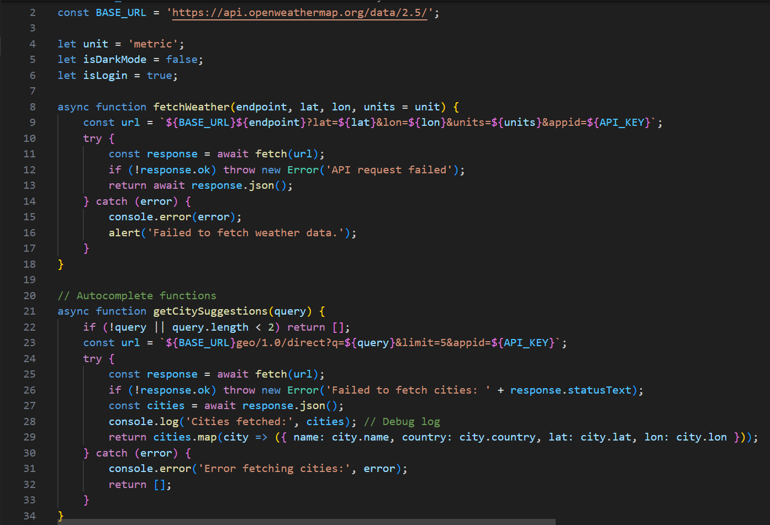
RESULT

Slide 10
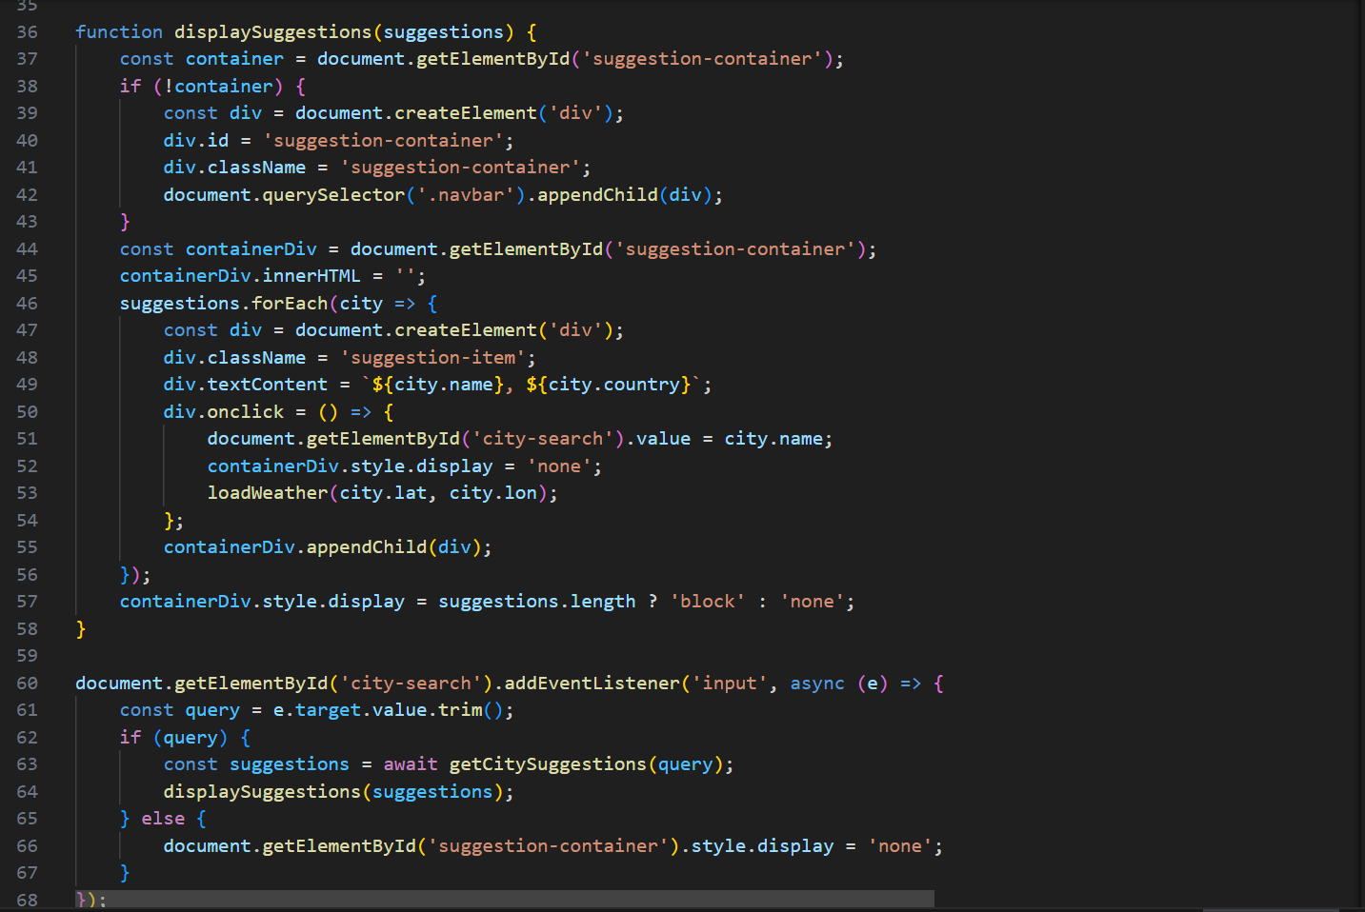
RESULT

Slide 11
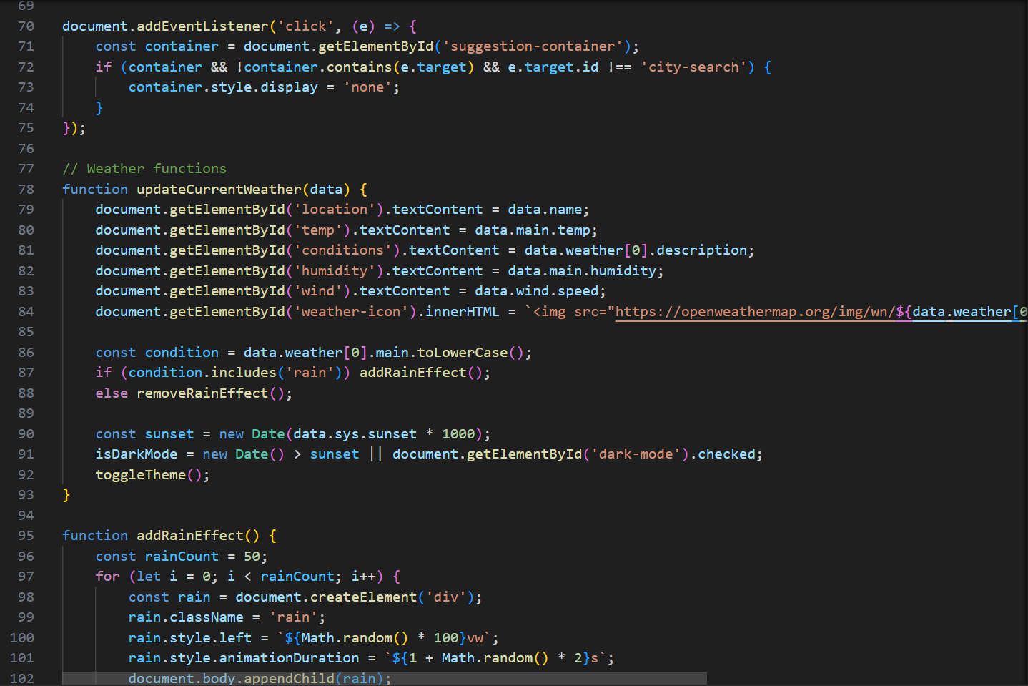
RESULT

Slide 12
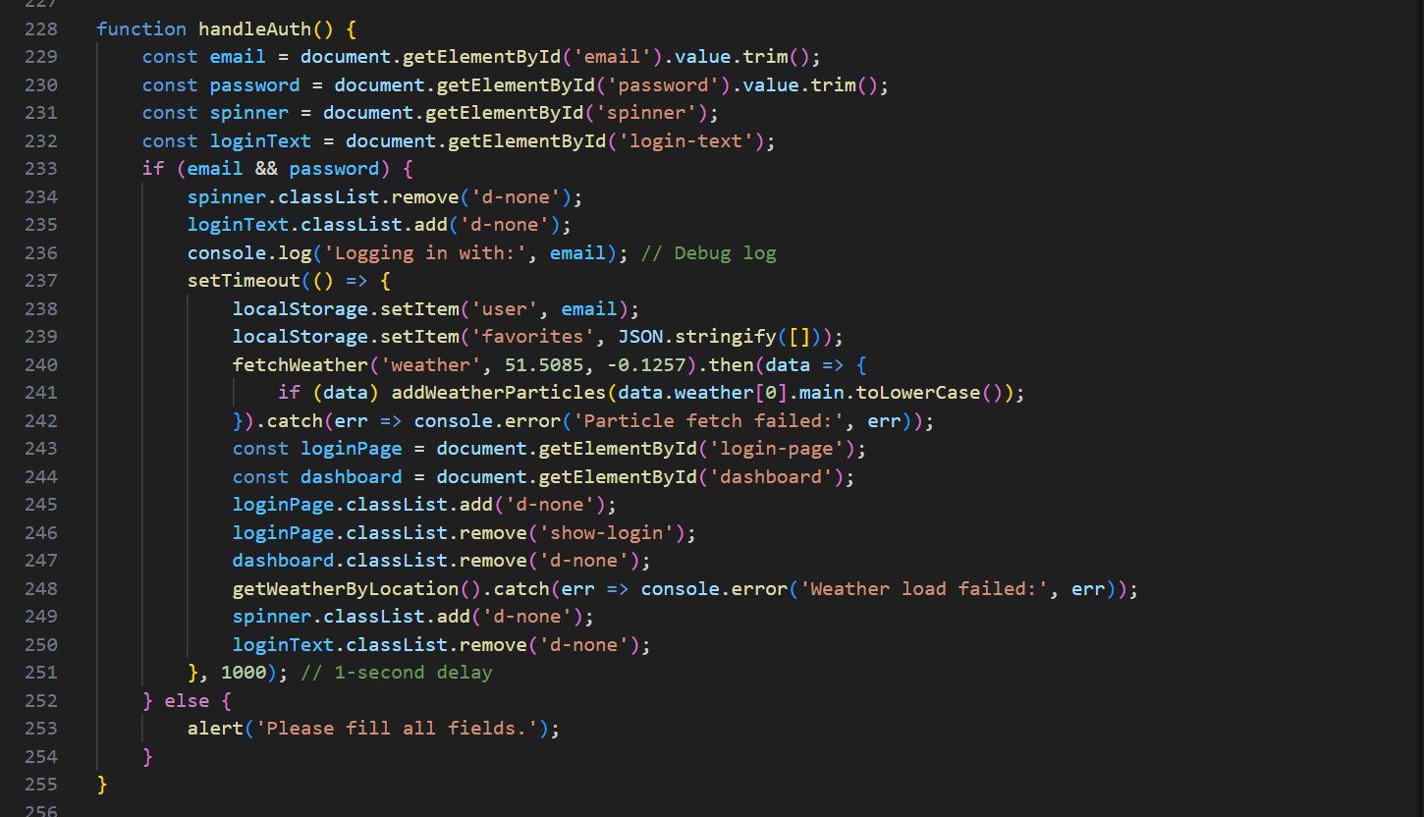
RESULT

Slide 13
GITHUB AND DEPLOYMNET LINK
Github Link : https://github.com/Manicharan16/cosmic-weather-dashboard
Deployment link: cosmic-weather-dashboard.netlify.app

Slide 14
Conclusion
Provides a cost-effective online presence for weather enthusiasts and casual users.
Eliminates dependency on dedicated weather applications or paid services.
Offers an engaging and interactive weather experience for all users.

Slide 15
Future scope(Optional)
Add backend integration (Node.js) for user authentication and weather data caching.
Secure API authentication integration for enhanced data security.
Admin dashboard for weather service management and user analytics.
AI-based weather predictions and personalized forecast recommendations.

Slide 16
References
INTERACTIVE WEATHER FORECASTING SYSTEM USING OPENWEATHER API AND WEB TECHNOLOGIES (Research Paper 2024)
Build A Weather App in HTML CSS & JavaScript (Article)
Get Started with Bootstrap v5.3 (Official Documentation)
OpenWeatherMap API Guide

Slide 17
THANK YOU

